Slide 1

It’s Time for a Dad Joke!

Slide 2
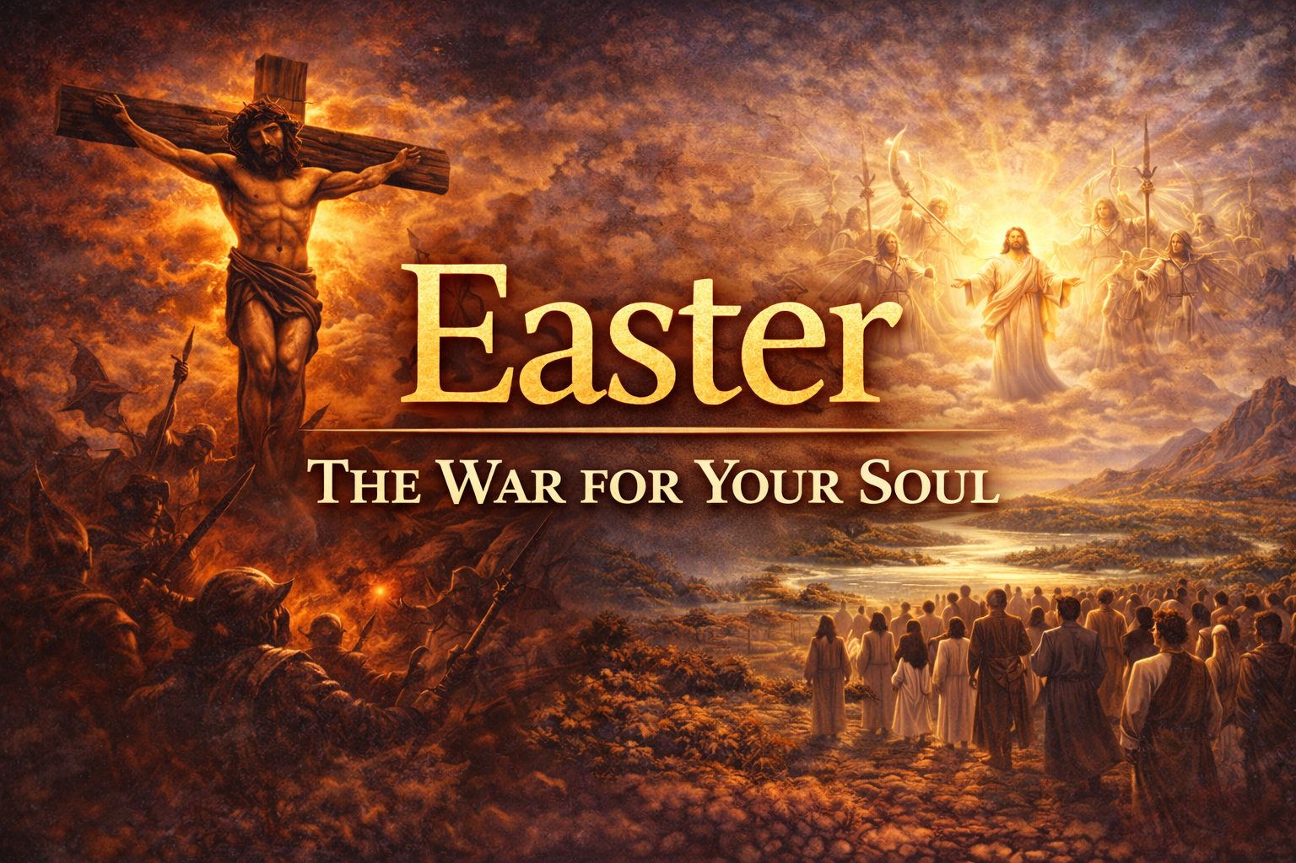

Slide 3
Act 1- The Condition Act 2- The Consideration Act 3- The Cross Act 4- The Command Act 5- The Conclusion

Slide 4
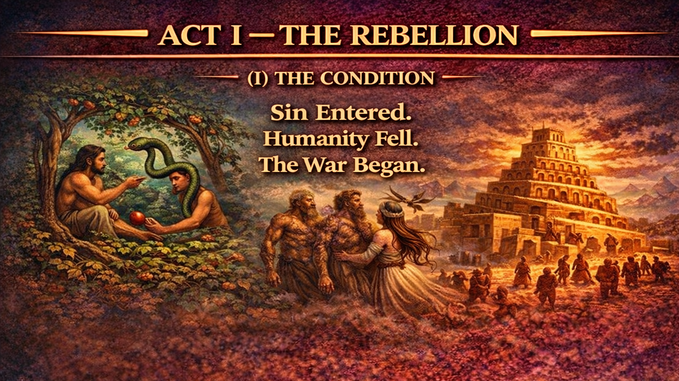

Slide 5
ACT 1 – THE CONDITION
Genesis 3 – The Fall of Man (sin)
Genesis 4 – Cain/Abel (murder)
Genesis 6:1-8 – Everyone evil (Noah, Flood)
Genesis 11 – Tower of Babel
Genesis 12, 15 – Abraham (Father of Faith)
Isaac, Jacob (Israel) and Esau (Muslims)

Slide 6
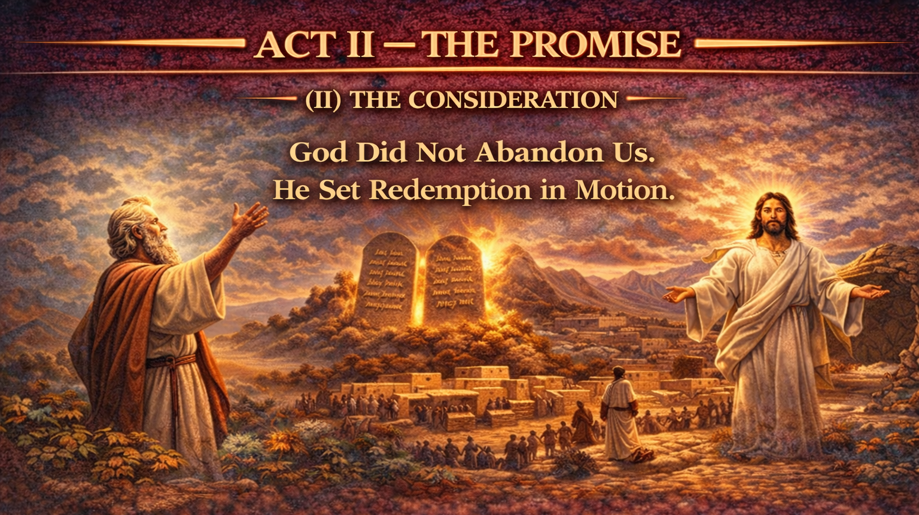

Slide 7
Act 2 – THE CONSIDERATION
Throughout the OT, set apart, make God known, failure.
If you obey (bless). Disobey? (curse)
Kings and Prophets who did not honor Him
Priests who did not point to Him
A nation who would not follow Him
Now they will not hear from Him (400 years of silence)

Slide 8
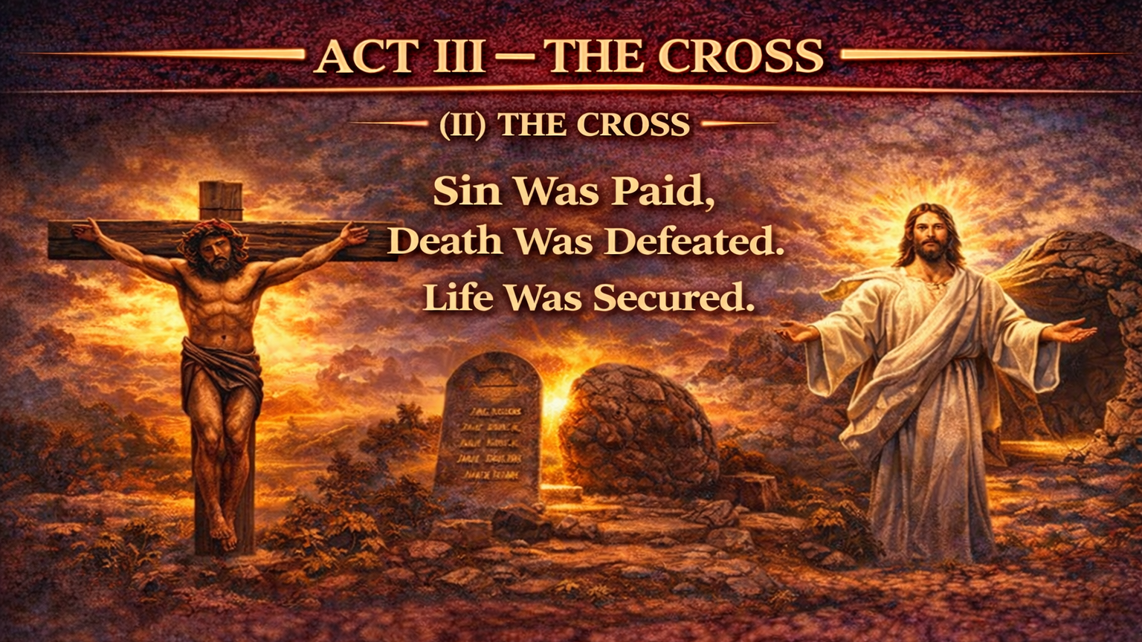

Slide 9
Act 3 – THE CROSS
The 400 years of silence is broken.
John the Baptist – the forerunner and “final OT prophet.”
God entered humanity to do for us what we could never do for ourselves.
Emmanuel – God with us.
The Promised Messiah – Christ our Savior
King of kings, Lord of Lords
The sacrificial Lamb who was slain (Jesus Barabbas)

Slide 10
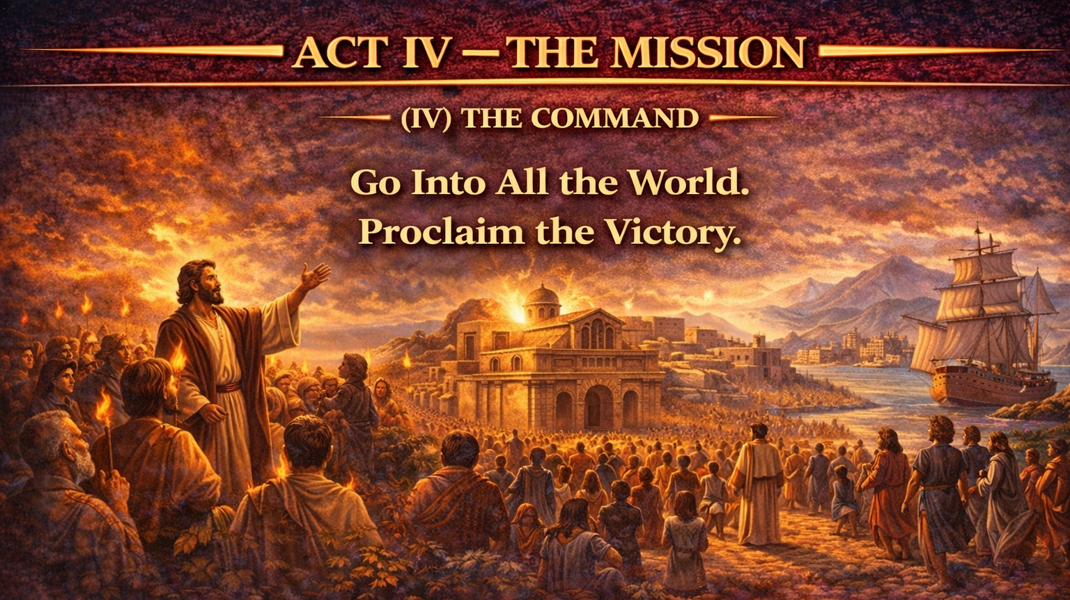

Slide 11
Act 4 – THE COMMAND
Salvation is offered in only One (John 14:7)
The Church is born (Acts 2:38, 42-47)
The Message is clear (Gospel)
The Great Commission (Matthew 28:18-20)
YOU ARE EITHER IN OR YOU ARE OUT.
Man cannot save himself. Otherwise, why Jesus?

Slide 12
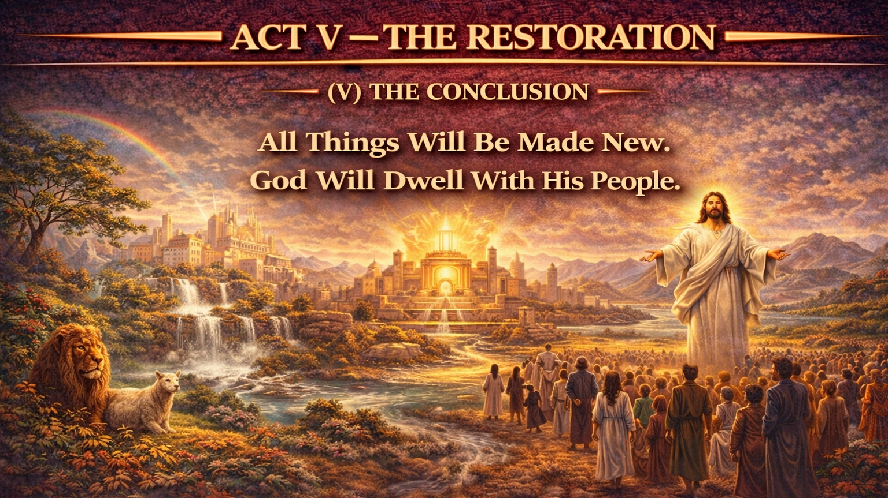

Slide 13
Act 5 – THE CONCLUSION
WHY do we celebrate Easter?
The Greatest Man… The Greatest Message…
The Single Event that CHANGED THE WORLD.
Why Easter? The cross is empty. The grave clothes are empty. The tomb? Empty.
Don’t let your heart be empty (Ephesians 1; 3:17; 2 Cor 5:17)

Slide 14
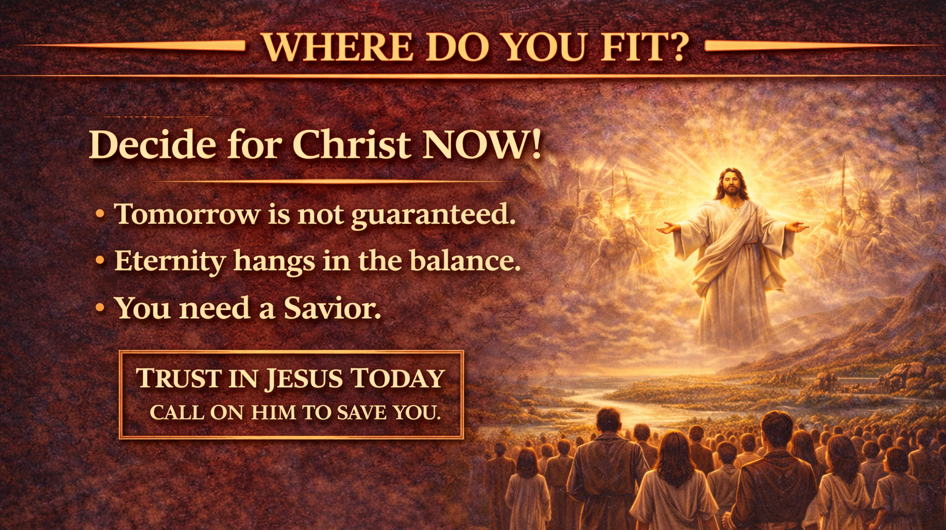

Slide 15
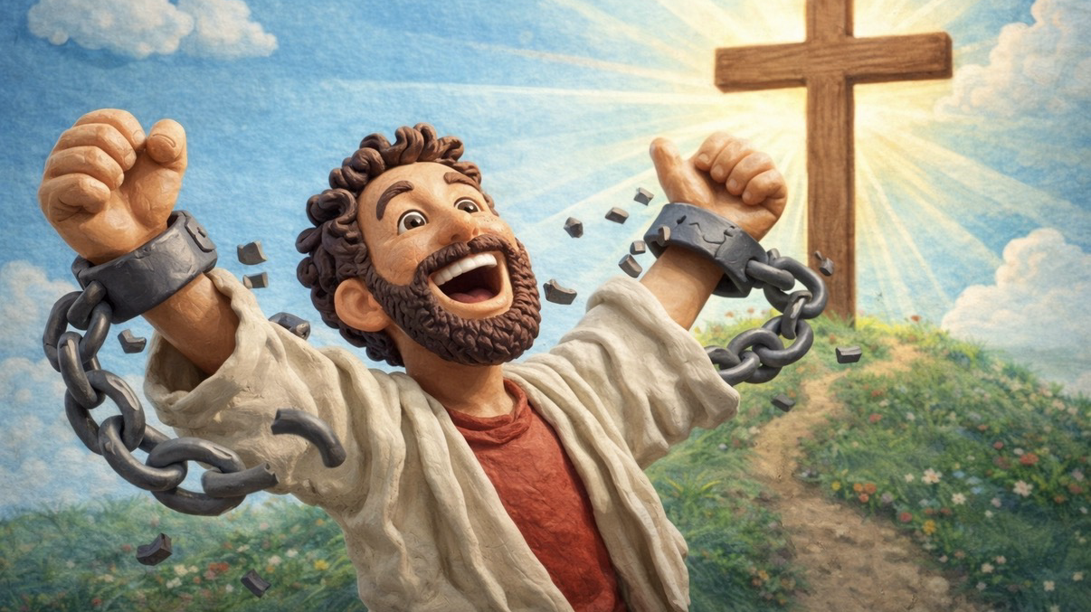
Next week - Galatians 6:1-5 (ESV)

