Slide 1
Vices or Virtues?
“The War for Your Will”
Galatians 5:16-21 (ESV)

Slide 2
1. THE COMMAND -
Walk by the Spirit (16)

Slide 3
16 But I say, walk (live) by the Spirit, and you will not gratify (carry out) the desires (lust) of the flesh.
Walk… gratify… desires… flesh

Slide 4

Walk

Slide 5

Gratify

Slide 6
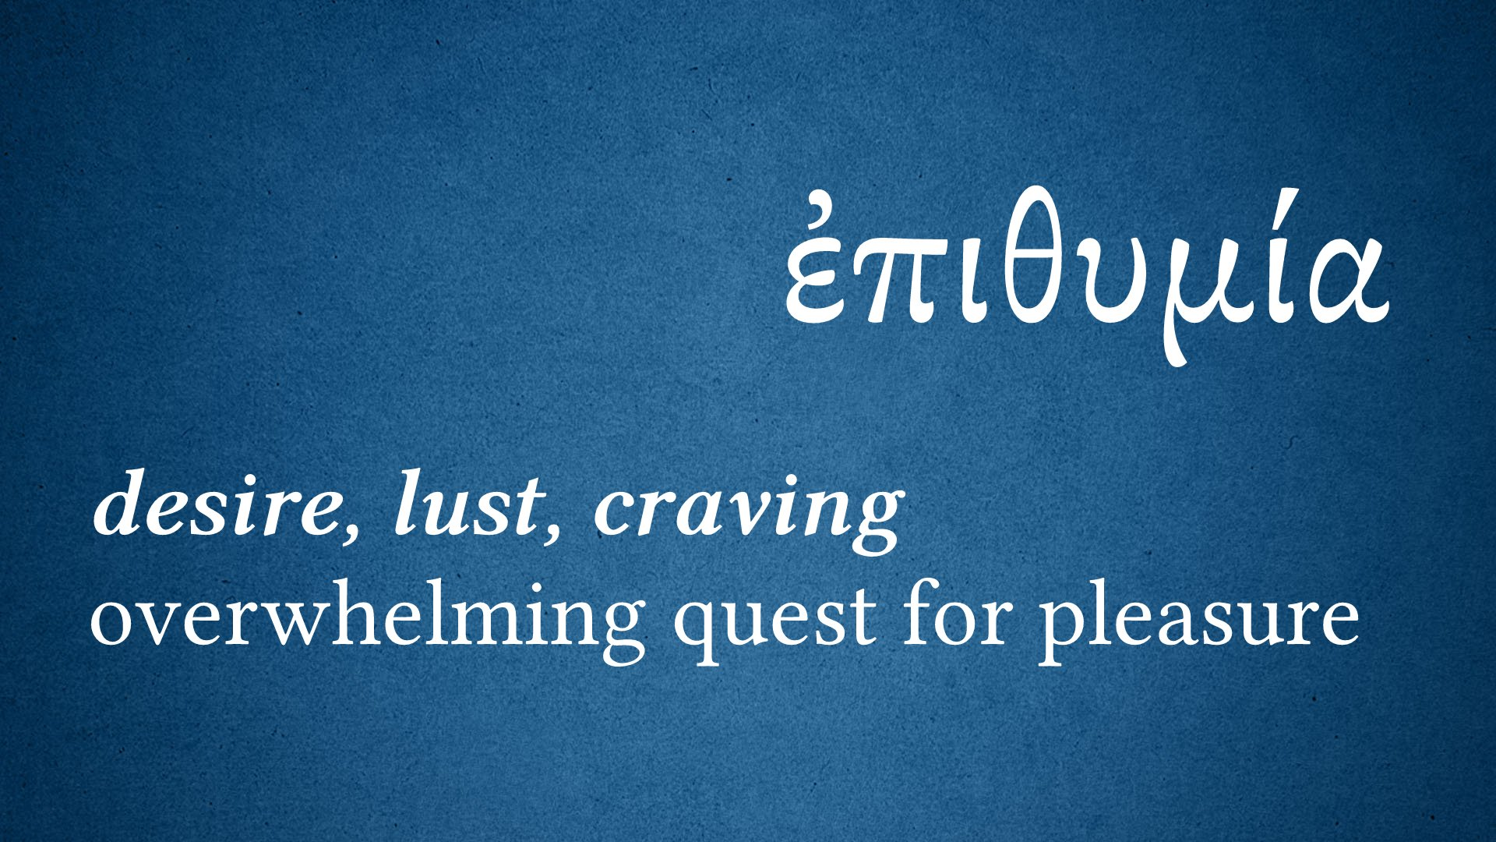
Desires

Slide 7
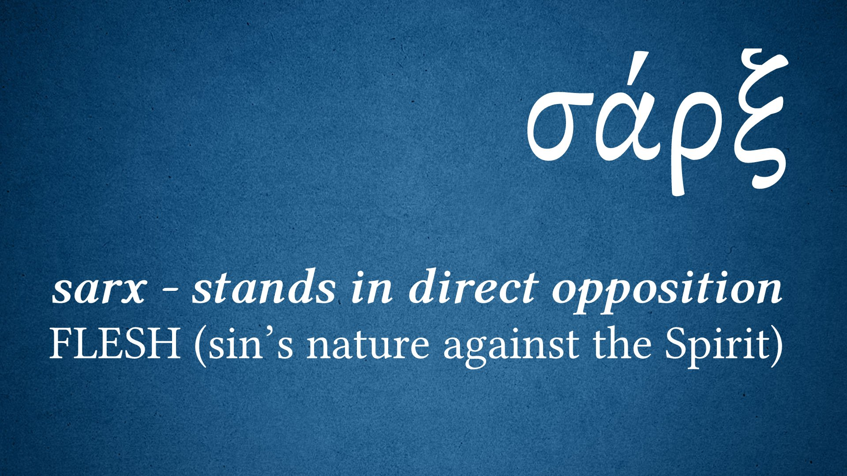
Flesh

Slide 8
2. THE CONFLICT -
Waging war against the Spirit
(17-18)

Slide 9
17 For the desires of the flesh are against the Spirit, and the desires of the Spirit are against the flesh, for these are opposed to each other, to keep you from doing the things you want to do.
18 But if you are led by the Spirit, you are not under the law.

Slide 10
3. THE CORRUPTION -
Works of the Flesh
(19-21)

Slide 11
19 Now the works of the flesh are evident: sexual immorality, impurity, sensuality,
20 idolatry, sorcery, enmity, strife, jealousy, fits of anger, rivalries, dissensions, divisions,
21 envy, drunkenness, orgies, and things like these. I warn you, as I warned you before, that those who do such things will not inherit the kingdom of God.

Slide 12
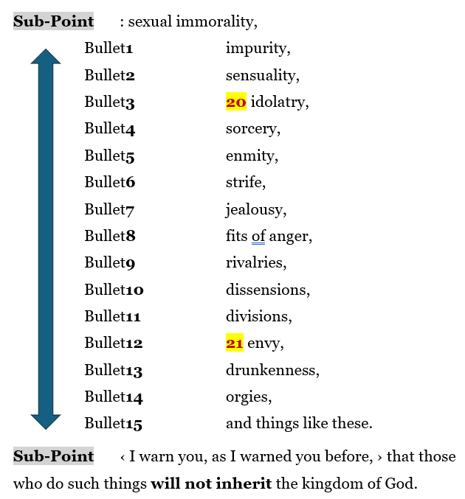

Slide 13
THE WEEK AFTER EASTER:
The Fruit of the Spirit…
It’s more than you think!

