Slide 1
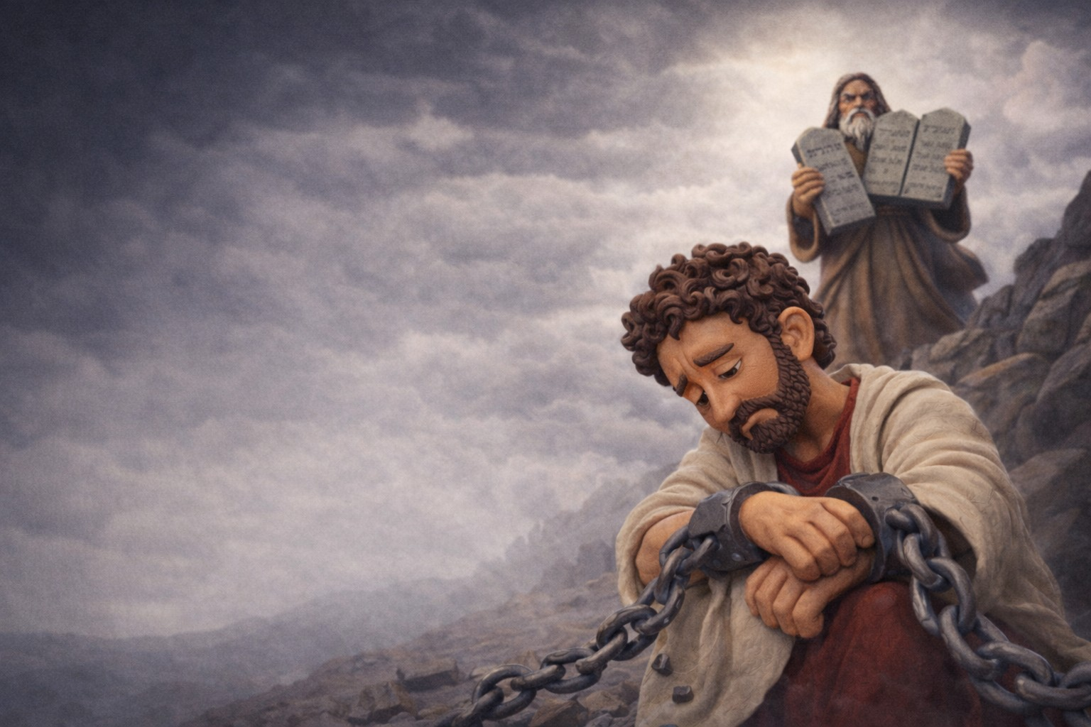
A Freedom that Serves
Galatians 5:13-15
(ESV)

Slide 2
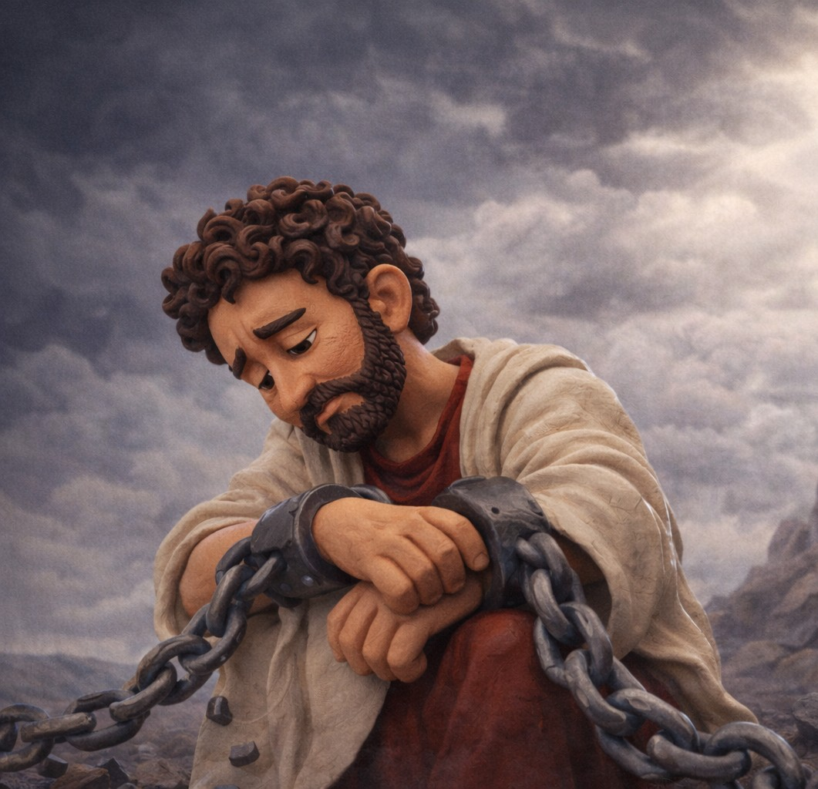
CIT:
Christian freedom must be governed by love, or it will turn destructive.

Slide 3
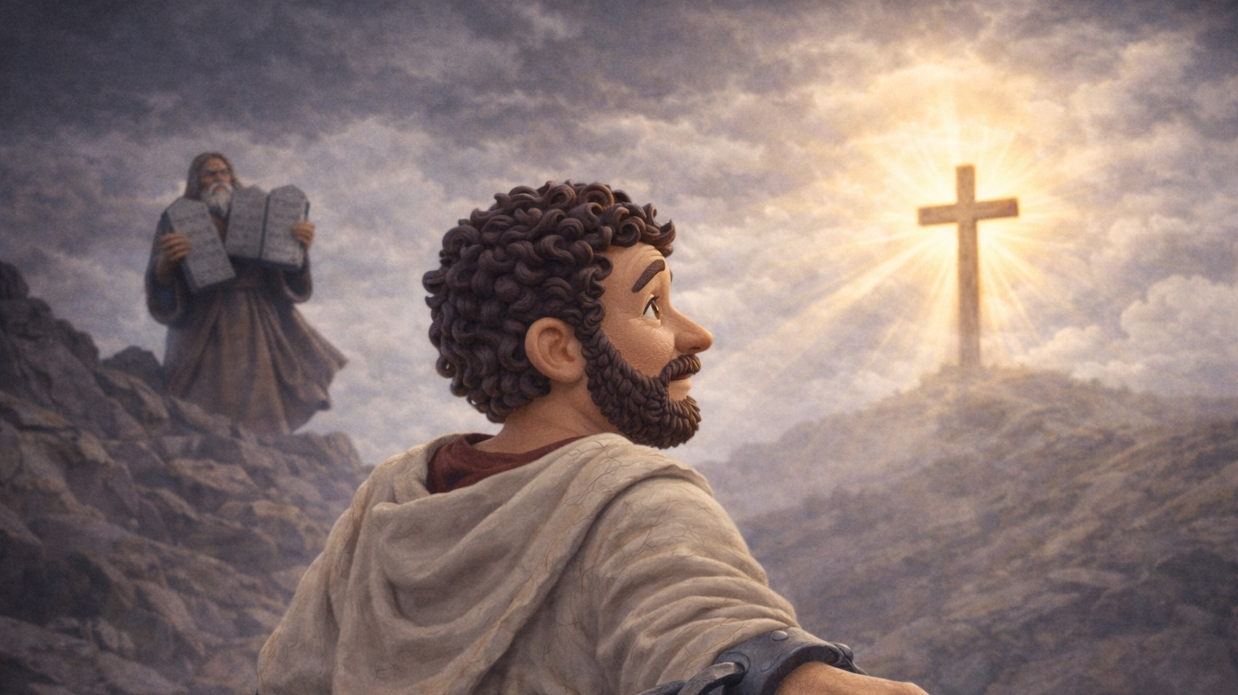
1. FREEDOM - OUR CALLING (v. 13a)

Slide 4

For you were called to freedom, brothers …
Galatians 5:13a

Slide 5
1. Sola Gratia – Salvation by grace alone
2. Sola Fide – through faith alone
3. Solus Christus – in Christ alone
4. Soli Deo Gloria – to the glory of God alone
5. Sola Scriptura – according to Scripture alone

Slide 6
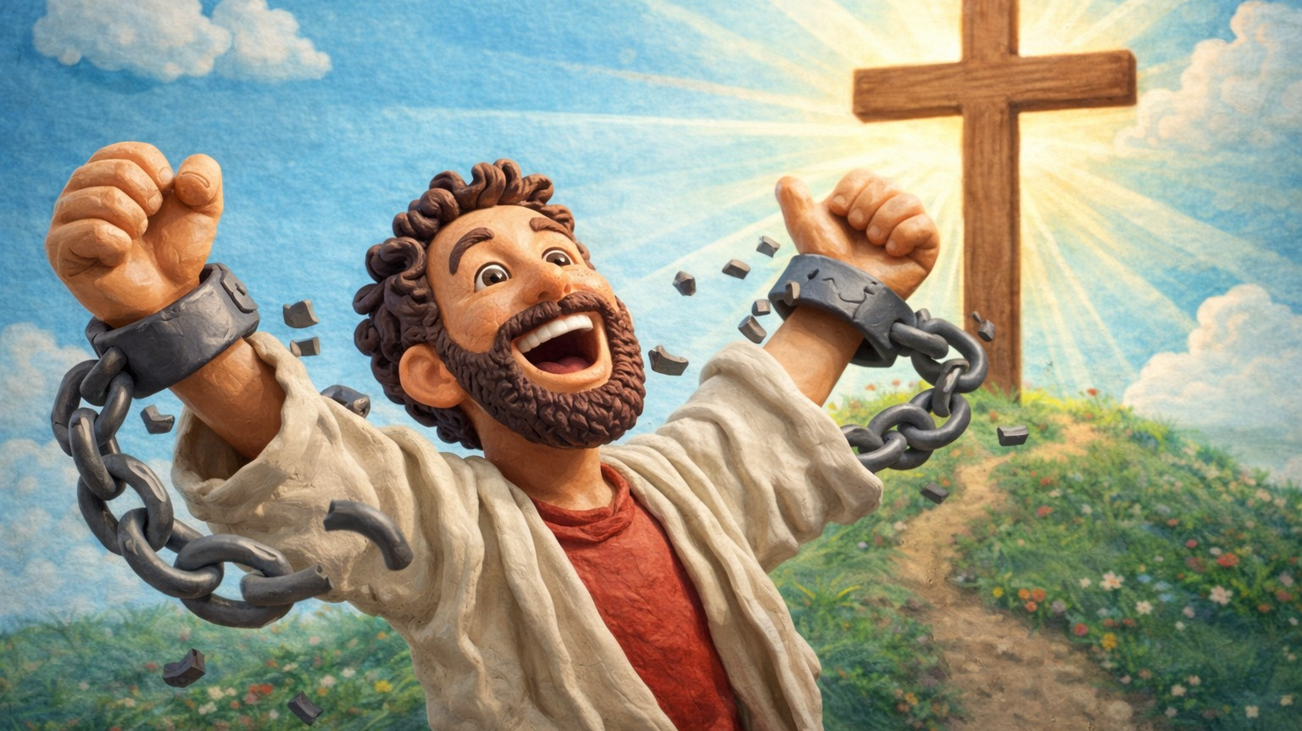

Slide 7
Freedom comes in three packages:
a.) Spiritual freedom
b.) Emotional/mental …
c.) Freedom from oppression
… Eph 6:12

Slide 8
For you were called to freedom, brothers …
Galatians 5:13a

Slide 9
Because of the grace found in Christ alone
(and for God’s glory) you all were summoned (invited) to be included to have freedom placed upon/over you, and as fellow believers, you are now bros/sis in Christ.
Gal 5:13a - loose translation (in context)

Slide 10

Freedom is not absence of authority. It is living your life following the right authority.
- Romans 6:6, 7, 11, 14

Slide 11
The Law and Sin are joined together…
Christ fulfilled the righteous requirements of the Law and broke sin’s dominion, thus giving us the opportunity to live under GRACE.

Slide 12
2. FREEDOM - Governed by Love (vv. 13b-14)

Slide 13
Only do not use your freedom as an opportunity for the flesh, but through love serve one another.
Galatians 5:13b

Slide 14
For the whole law is fulfilled
in one word:
“You shall love your neighbor
as yourself.”
Galatians 5:14

Slide 15
3. FREEDOM - When Abused, Destroys (v. 15)

Slide 16
But if you bite and devour one another, watch out that you are not consumed by one another.
Galatians 5:15

Slide 17
Conclusion - The Model of True Freedom

Slide 19
Our next time together we’ll be in Galatians 5:16-26.
We’ll address the question:
Who is in control of your life?
                The Conflict
                The Corruption
                The Character
                The Call

