Slide 1

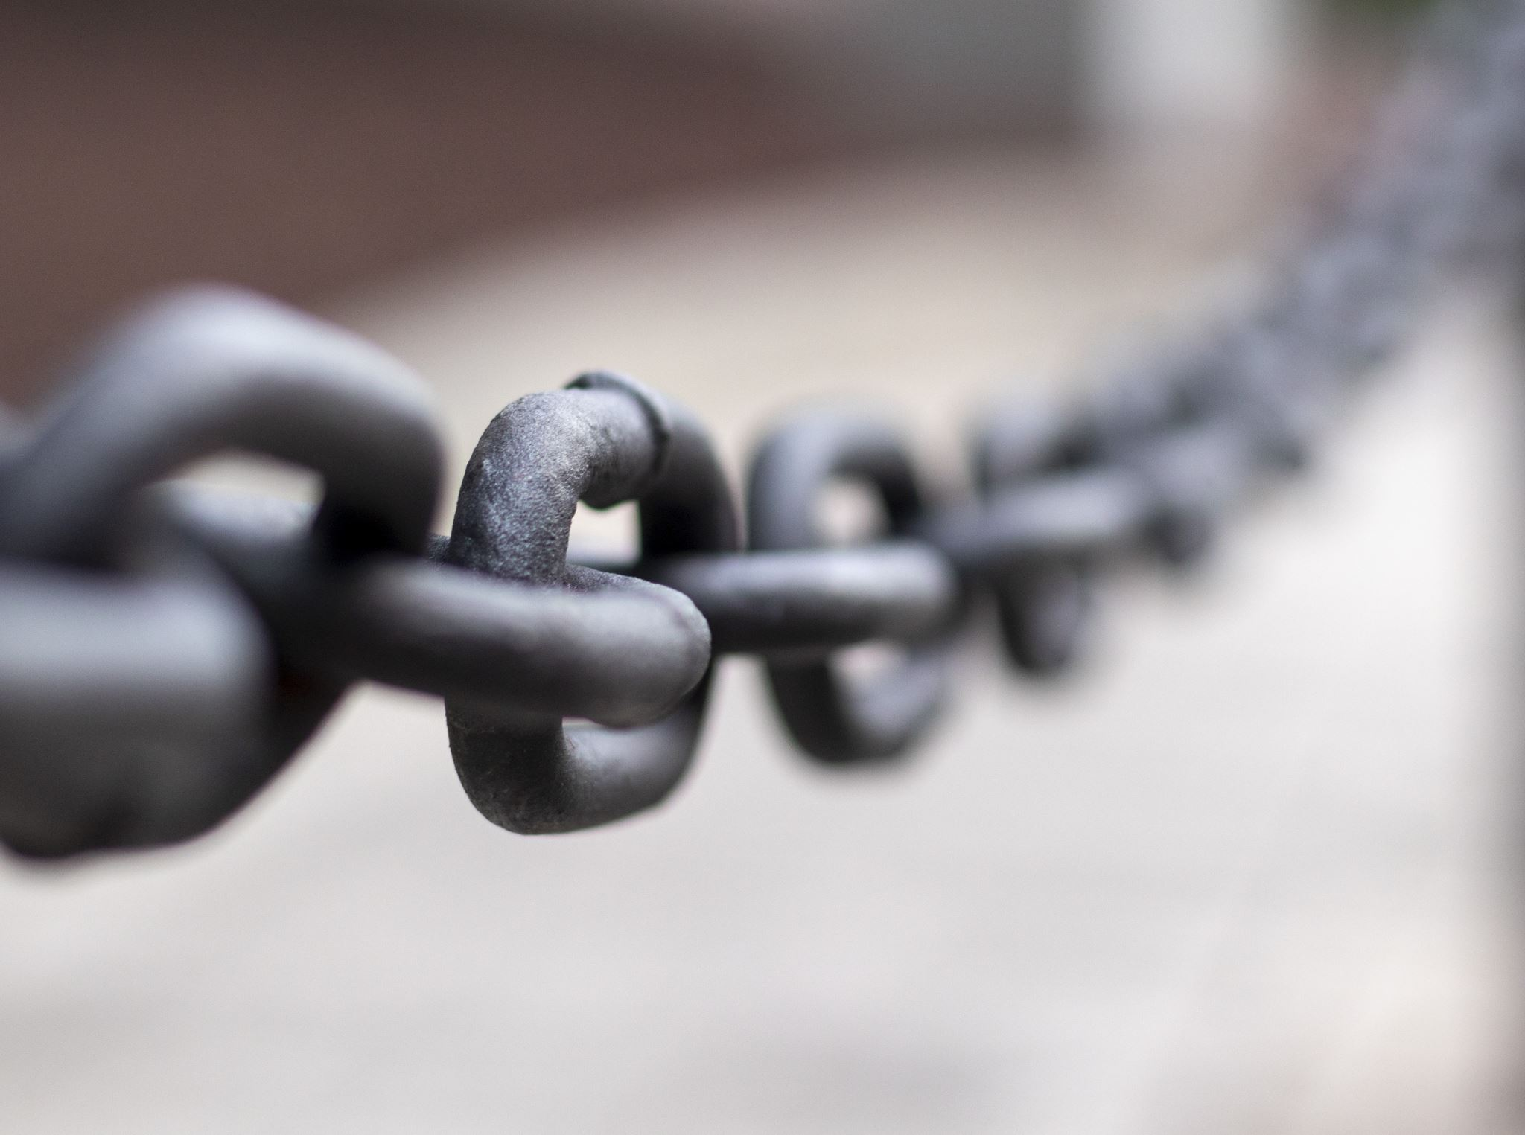
Are You Changed or Are You Chained ?

Slide 2
Galatians 5:1-12 (ESV)

Slide 3

Central Idea of the Text:
Because Christ has set us free by grace alone, we must stand firm against the drift towards societal norms and spiritual bondage.

Slide 4
INTRODUCTION

Slide 5

Because Christ has set me free - I will stand firm in His grace!
Key Take-Away Thought

Slide 6
Galatians 5:1 - Everything Else Hinges
For freedom Christ has set us free; stand firm (fast) therefore, and do not submit again (to be burdened by, to be oppressed by, or to be subject to) to a yoke of slavery.

Slide 7
A Call to Stand: Freedom Must Be Immovable (v. 1)

Slide 8
Because Christ has set me free - I will stand firm in His grace!
Key Take-Away Thought

Slide 9
John Stott:
“Christian freedom is not freedom to sin but freedom from sin, not freedom to ignore God but freedom to serve Him willingly.”

Slide 10
2. A Compromise to Avoid: Grace Must Remain Pure (vv. 2–6)

Slide 11

Like legalistic drifting, mold starts off small, and if left unaddressed …

Slide 12
Because Christ has set me free - I will stand firm in His grace!
Key Take-Away Thought

Slide 13
3. A Commitment to Protect: False Voices Always Distract (vv. 7–10)

Slide 14
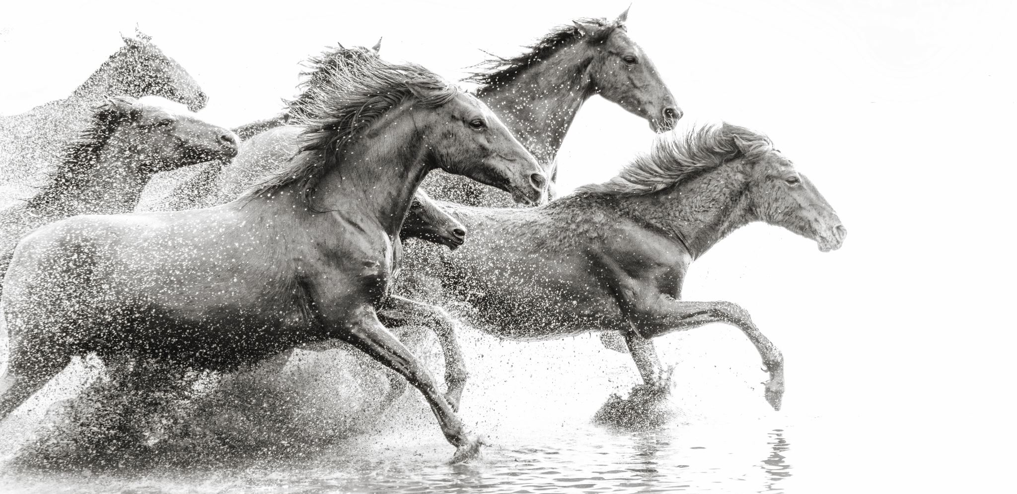
Like a Horse Race …

Slide 15
3. A Commitment to Protect: False Voices Always Distract (vv. 7–10)

Slide 16
Because Christ has set me free - I will stand firm in His grace!
Key Take-Away Thought

Slide 17
4. A Cost to Remember:
The Cross Cuts Deep (vv. 11–12)

Slide 18
Because Christ has set me free - I will stand firm in His grace!
Key Take-Away Thought

Slide 19
APPLICATION

Slide 20
CONCLUSION

Slide 21
Because Christ has set me free - I will stand firm in His grace!
Key Take-Away Thought

Slide 22
Are You Changed or Are You Chained ?

