Slide 1

Galatians 4:12-20 (ESV)

Slide 2

Galatians and the Hermeneutical Bridge

Slide 3

“We must guard our hearts from cultural drift by anchoring our souls in Christ’s grace and truth.”
CIT

Slide 4
A.) A Past WARMTH to Remember (12-15)

Slide 5
Galatians 4:12
Brothers, I entreat you, become as I am, for I also have become as you are. You did me no wrong.

Slide 6
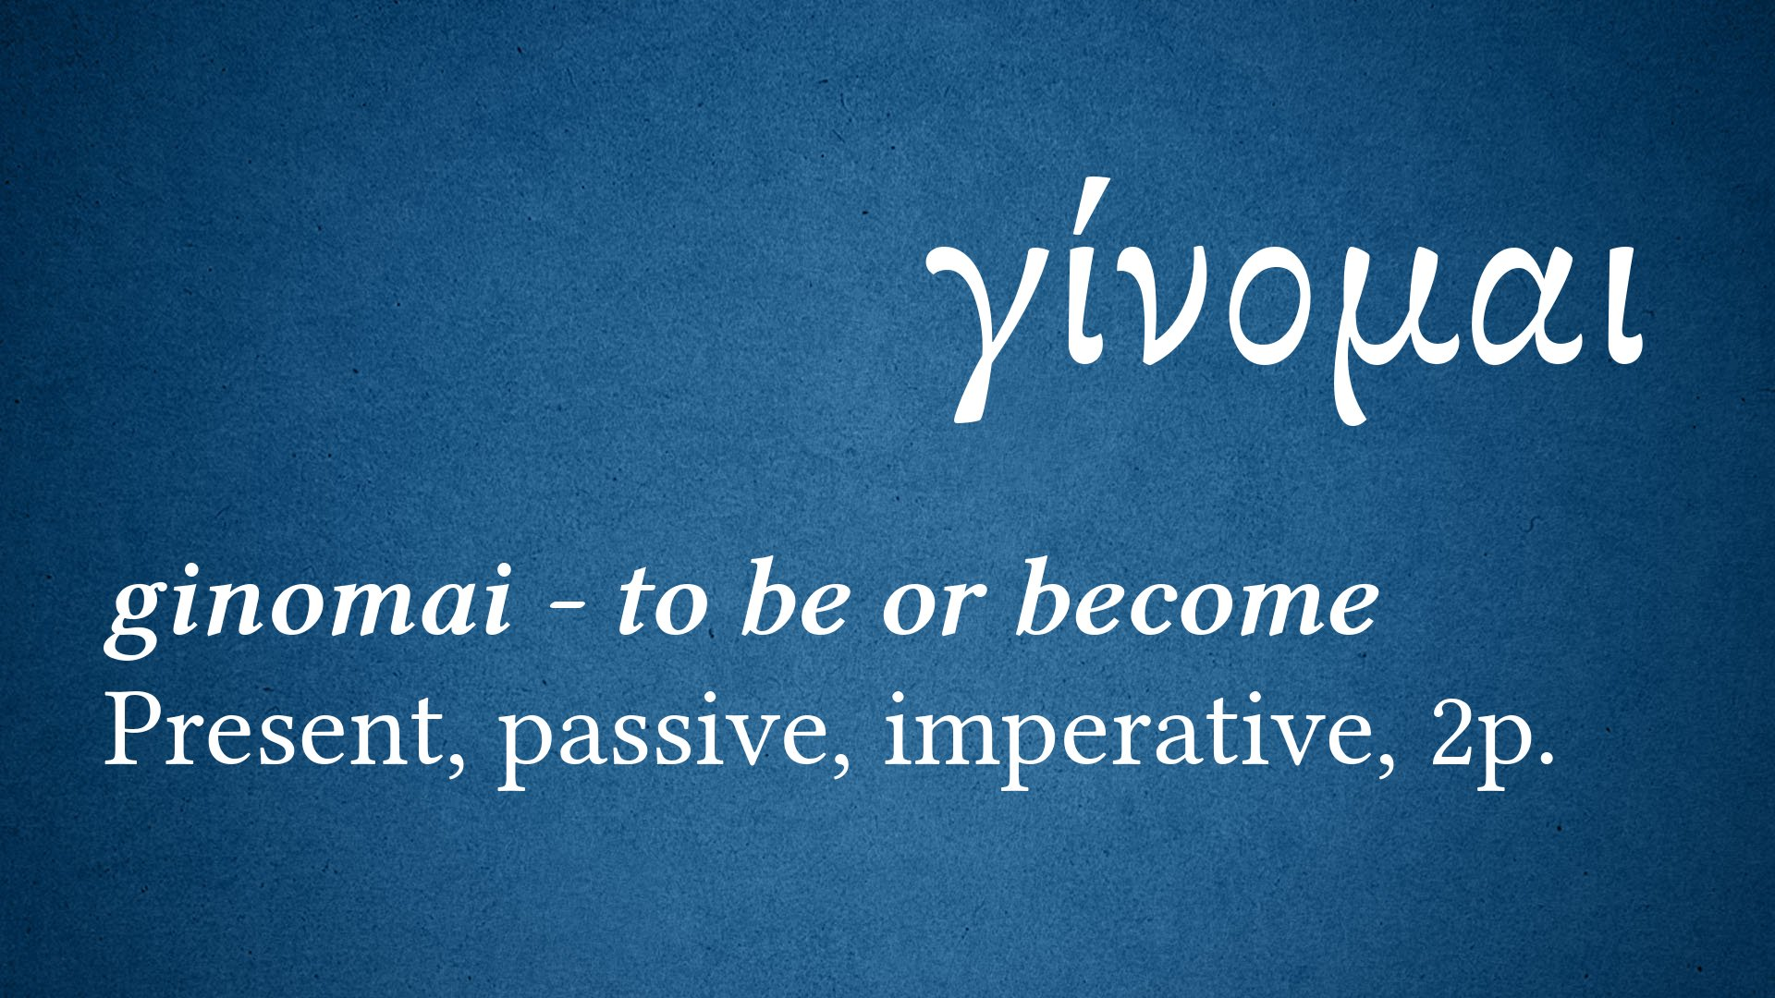

Slide 7
Galatians 4:13
You know it was because of a bodily ailment that I preached the gospel to you at first,

Slide 8
Galatians 4:14 and though my condition was a trial to you, you did not scorn or despise me, but received me as an angel of God, as Christ Jesus.

Slide 9
Galatians 4:15
What then has become of your blessedness? For I testify to you that, if possible, you would have gouged out your eyes and given them to me.

Slide 10
A.) A Past WARMTH to Remember (12-15)
B.) A Present WOUND to Refute (16)

Slide 11
Galatians 4:16
Have I then become your enemy by telling you the truth?

Slide 12
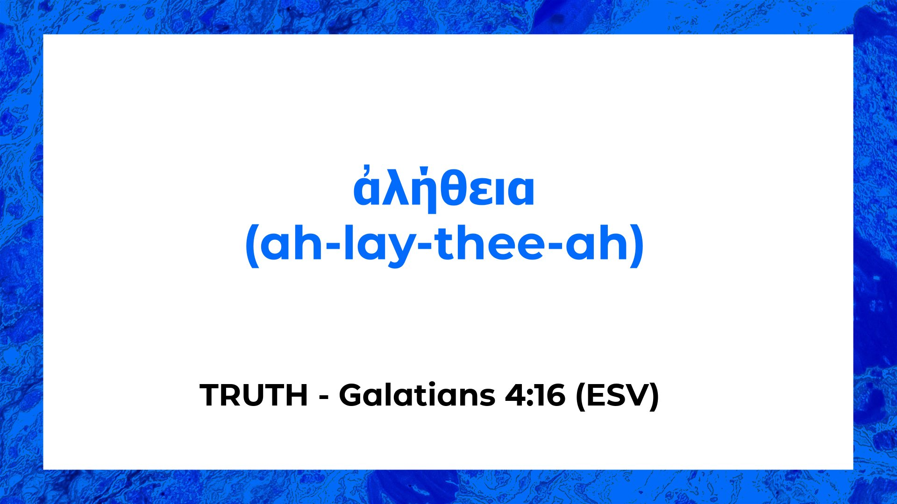

Slide 13
A.) A Past WARMTH to Remember (12-15)
B.) A Present WOUND to Refute (16)
C.) A Persistent WOLF to Reject (17-18)

Slide 14
Galatians 4:17
They make much of you, but for no good purpose. They want to shut you out, that you may make much of them.

Slide 15
Galatians 4:18
It is always good to be made much of for a good purpose, and not only when I am present with you,

Slide 16
A.) A Past WARMTH to Remember (12-15)
B.) A Present WOUND to Refute (16)
C.) A Persistent WOLF to Reject (17-18)
D.) A Painful WORK to Relive (19-20)

Slide 17
Galatians 4:19 my little children, for whom I am again in the anguish of childbirth until Christ is formed in you!

Slide 18
Galatians 4:20
I wish I could be present with you now and change my tone, for I am perplexed about you.

Slide 19
The
Problems
Jesus: Yes, He is the Messiah, but you need more (salvific equation was distorted - 2:16).
Customs: The Old Testament Law needed to be obeyed, including circumcision (5:2) and dietary restrictions (2:12).
Days, Months, Seasons, and Years: Jewish customs and observances were forced upon the Galatians.
Add-ons: To be a REAL Christian, you must become a Jew first (3:3). The LAW = perfection

Slide 20
Paul’s Response?
Starting in 4:12, Paul’s persona changes from being an evangelistic church planter to being a caring and concerned shepherd.
You are justified by FAITH ALONE
You are adopted by GRACE ALONE
You are made free in CHRIST ALONE

Slide 21
Galatians 4:12-20 (ESV)

