Slide 1
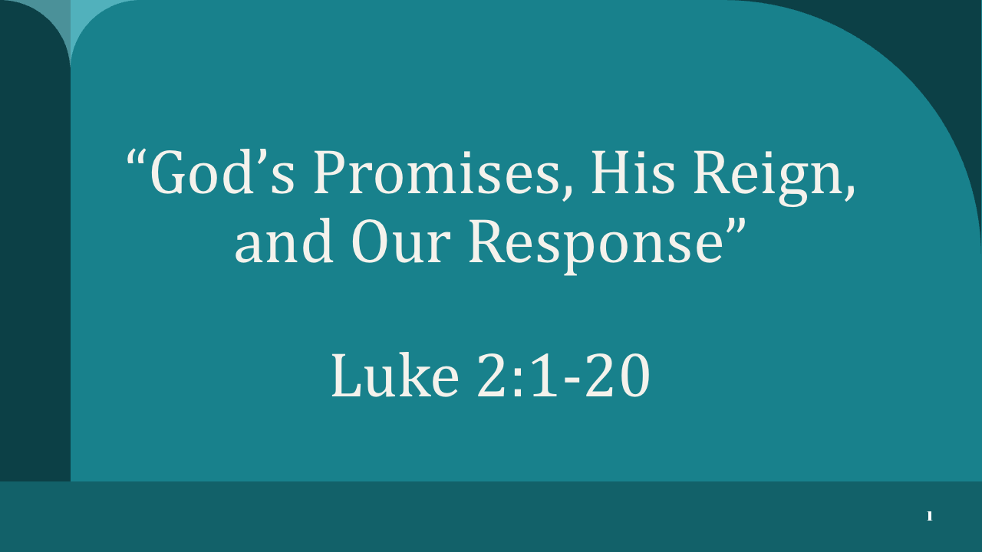

Slide 2

INTRODUCTION - “The Grand Narrative of the Greatest Entrance in History”

Slide 3
Flow of today’s sermon:
01 | Read Luke 2:1-20
02 | A Journey Through the Old Testament
03 | Six (6) Prophesies in Zechariah
04 | Outline: Rejoice, Reign, Respond
05 | Key Takeaway, TEST

Slide 4
The Birth Narrative of Our Lord
Luke 2:1-20 (ESV)

Slide 5
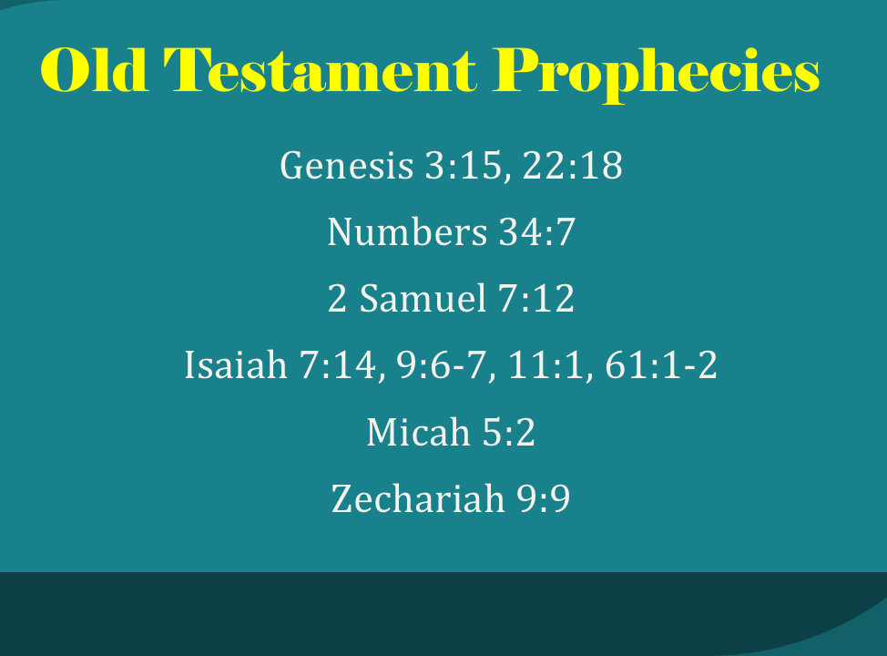
This will be posted to the FBC website.
www.fbcnorway.com/sermons

Slide 6
Wonderful Counselor

Slide 7
Wonderful Counselor
Mighty God

Slide 8
Wonderful Counselor
Mighty God
Everlasting Father

Slide 9
Wonderful Counselor
Mighty God
Everlasting Father
Prince of Peace

Slide 10
This will be posted to the FBC website.
www.fbcnorway.com/sermons

Slide 11
⭐ OT ZECHARIAH CONNECTIONS
Zechariah Prophecy | Fulfillment in Luke 2
Zech 9:9 – Humble King comes | Luke 2:7 – Humble birth, manger
Zech 2:10–12 – God dwells among His people | Luke 2:11 – “Christ the Lord” (God with us)
Zech 6:12–13 – Priest-King to come | Luke 2:14 – Peace through Christ
Zech 14:9 – The Lord will be King over all the earth | Luke 2:10 – Good news for all people
Zech 8:20–23 – Nations drawn to God | Luke 2:17–18 – Shepherds spread the word
Zech 12:10 – Salvation that moves hearts | Luke 2:19 – Mary treasures, ponders

Slide 12
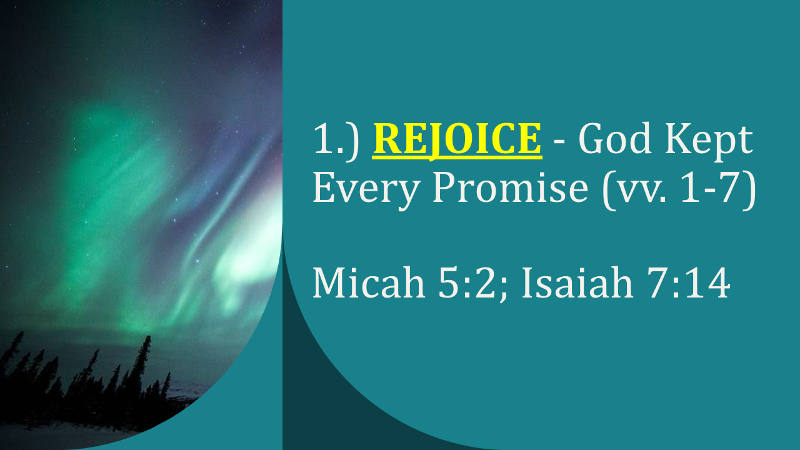

Slide 13
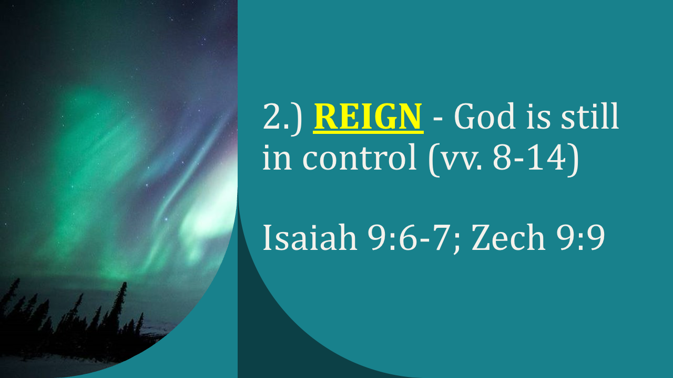

Slide 14
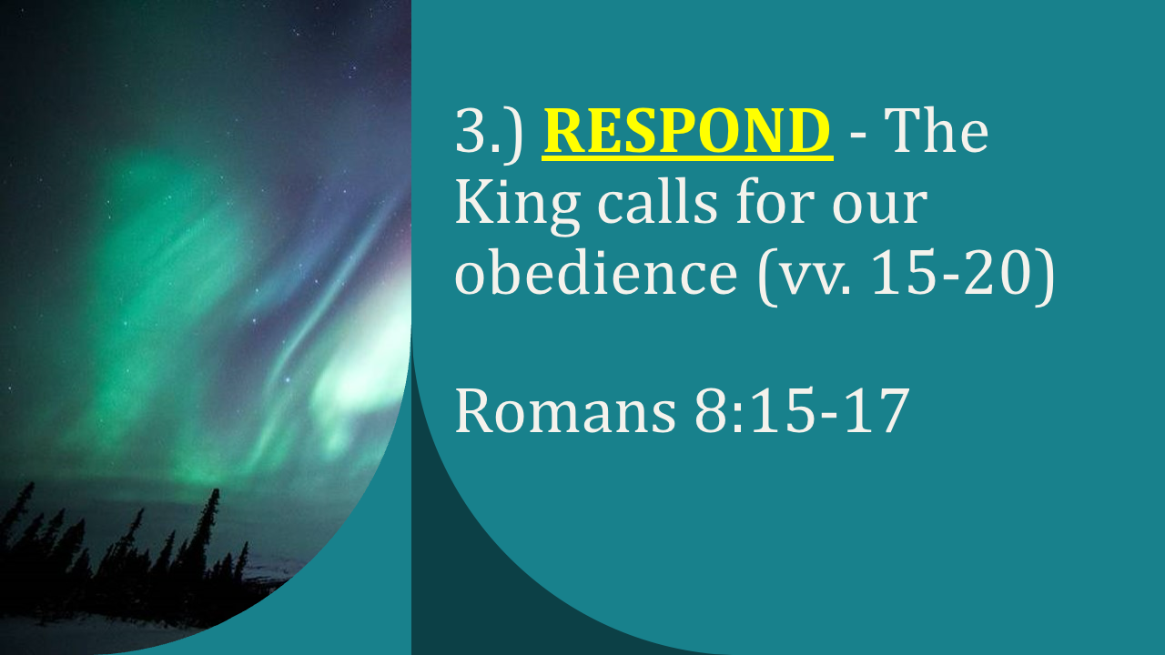

Slide 15
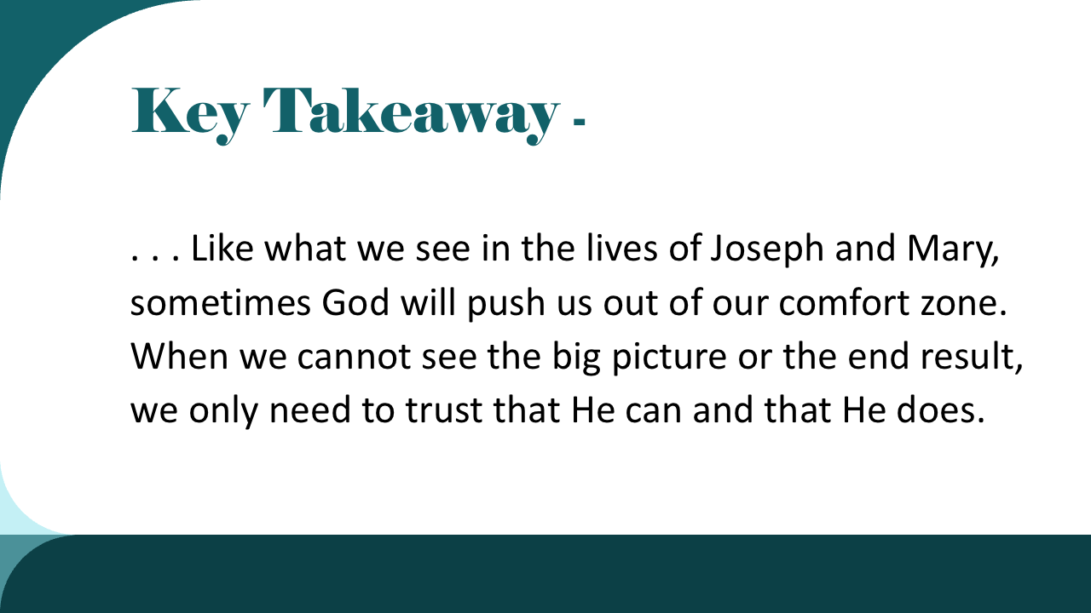

Slide 16
