Slide 1


Slide 2
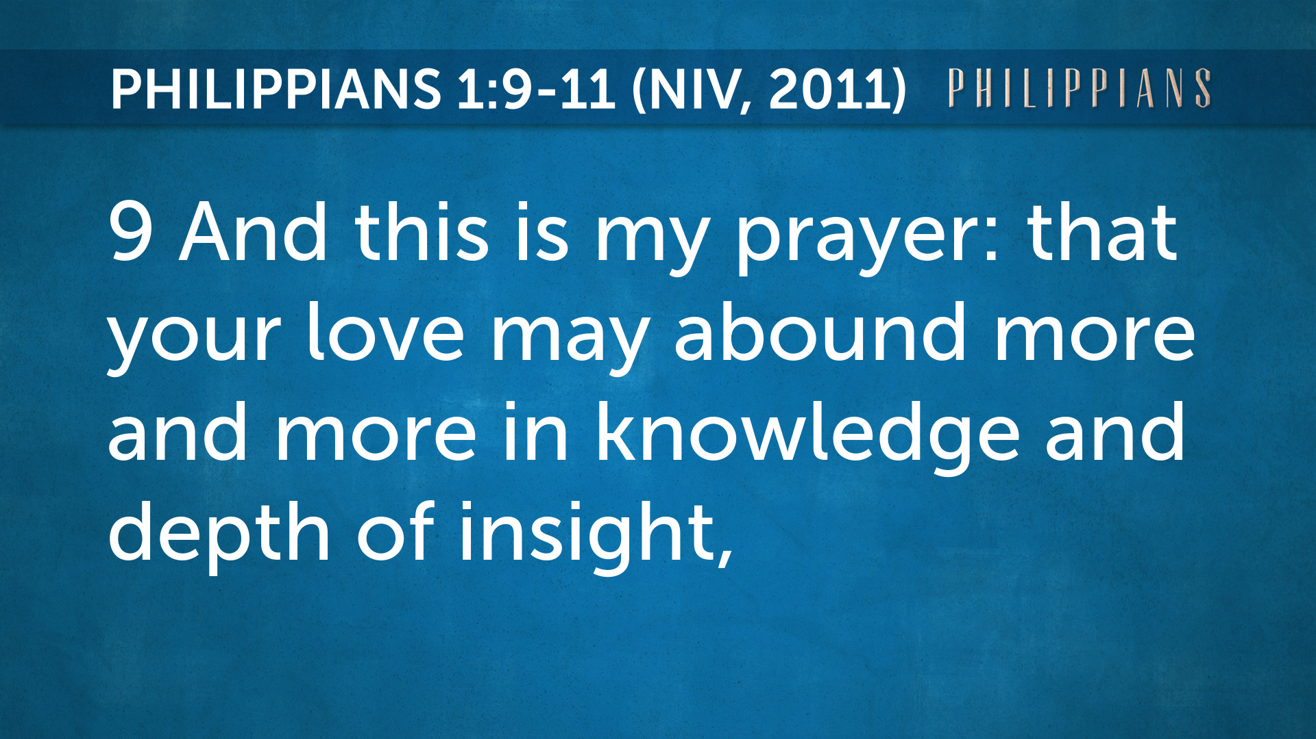

Slide 3
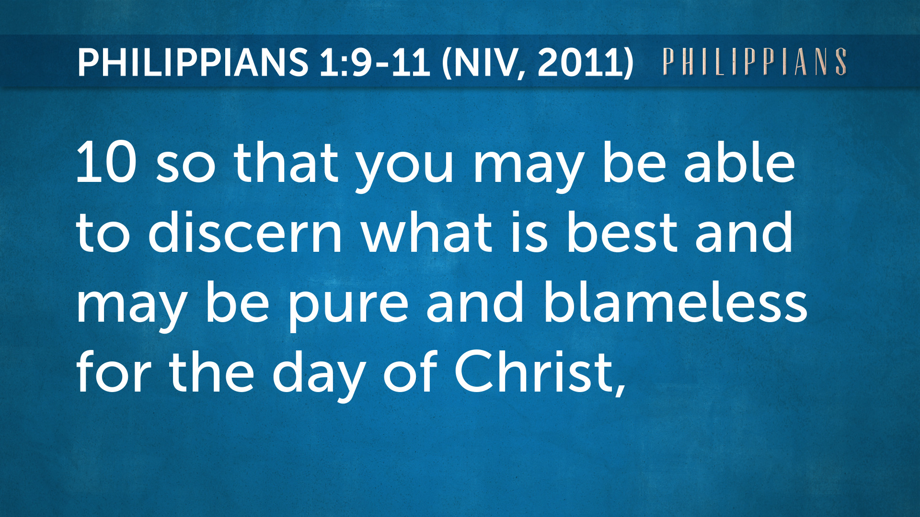
ESV - approve what is excellent

Slide 4
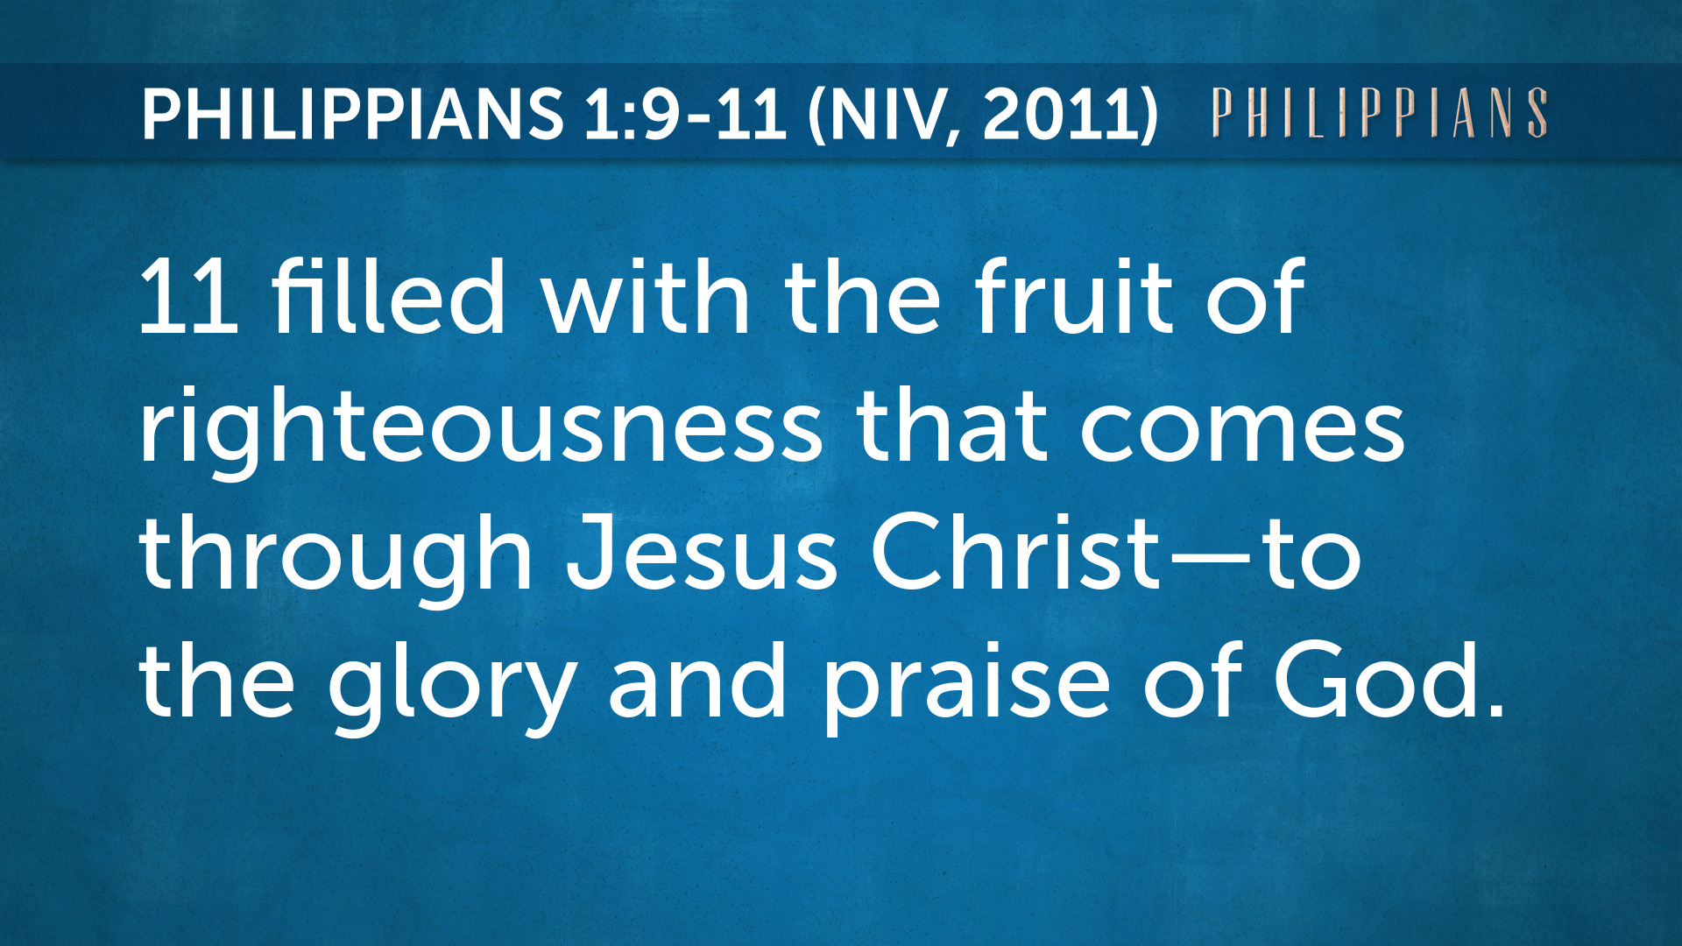

Slide 5

If you could ask God just one question, what would that be?

Slide 6


Slide 7
Philippians 1:6 - being confident of this, that He who began a good work in you will carry it on to completion until the day of Christ Jesus.
Philippians 2:13 - for it is God who works in you to will and to act in order to fulfill His good purpose.
Philippians 2:12 - Therefore, my dear friends, as you have always obeyed - not only in my presence, but now much more in my absence - continue to work out your salvation with fear and trembling.

Slide 8
My JOURNEY
with the Lord

Slide 9

1

Slide 10
4- Love is patient, love is kind. It does not envy, it does not boast, it is not proud.
5- It does not dishonor others, it is not self-seeking, it is not easily angered, it keeps no records of wrongs.

Slide 11
6- Love does not delight in evil but rejoices with the truth.
7- It always protects, always trusts, always hopes, always perseveres.
8 - Love never fails.

Slide 12

2

Slide 13
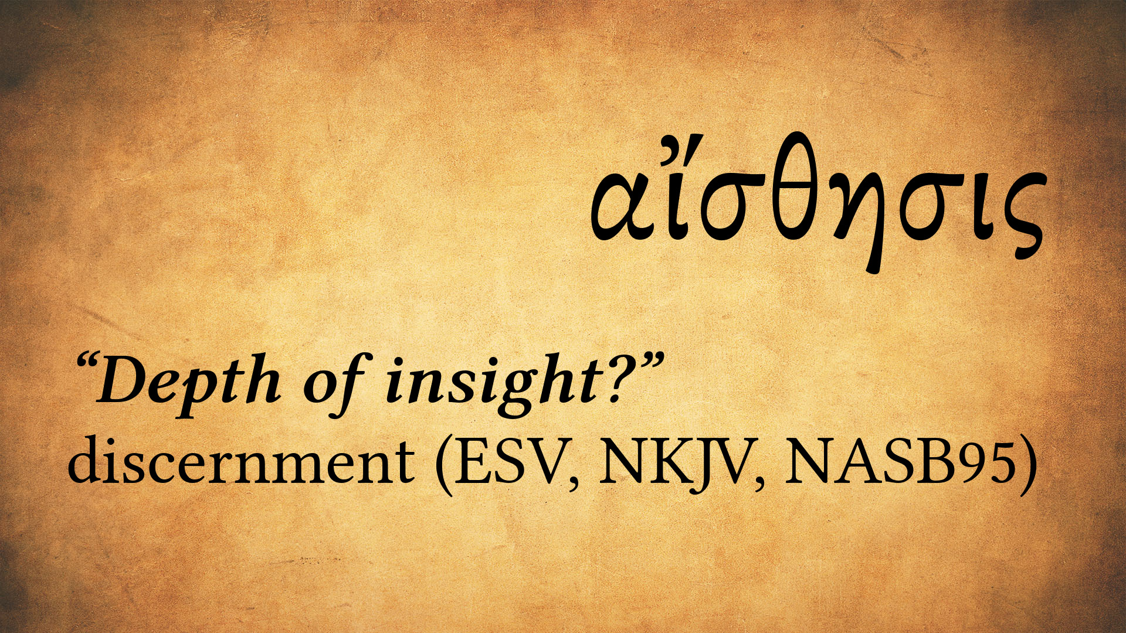

Slide 14
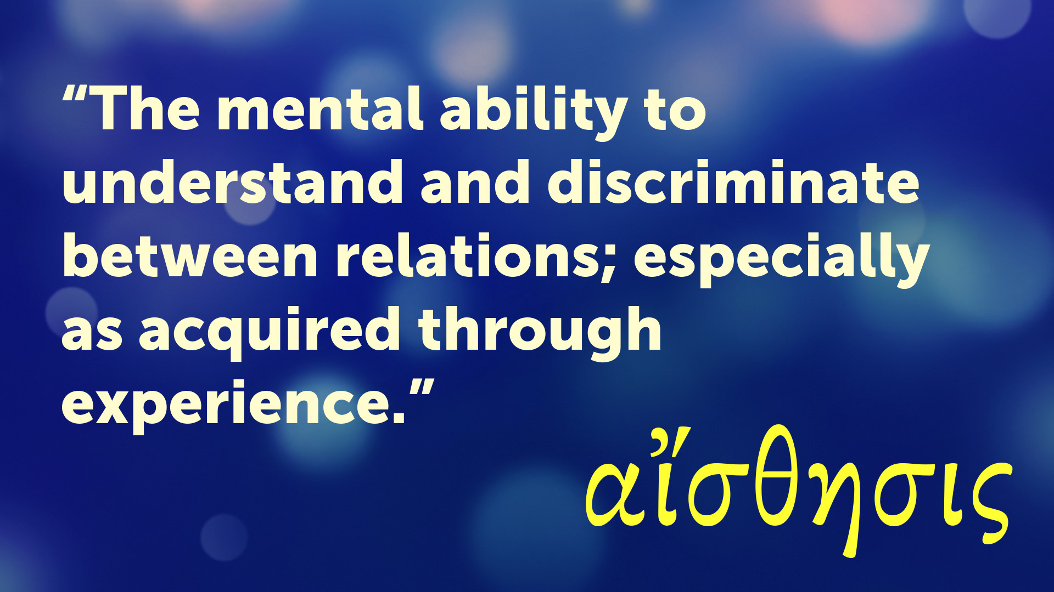

Slide 15
Romans 12:2 - Do not be conformed any longer to the pattern of this world but be transformed by the renewing of your mind. Then you can test and approve what God’s will is: His good, pleasing, and perfect will.
Philippians 4:8 - Whatever is T…N…R…P…L…A, if anything be E... or P… think on these things.

Slide 16
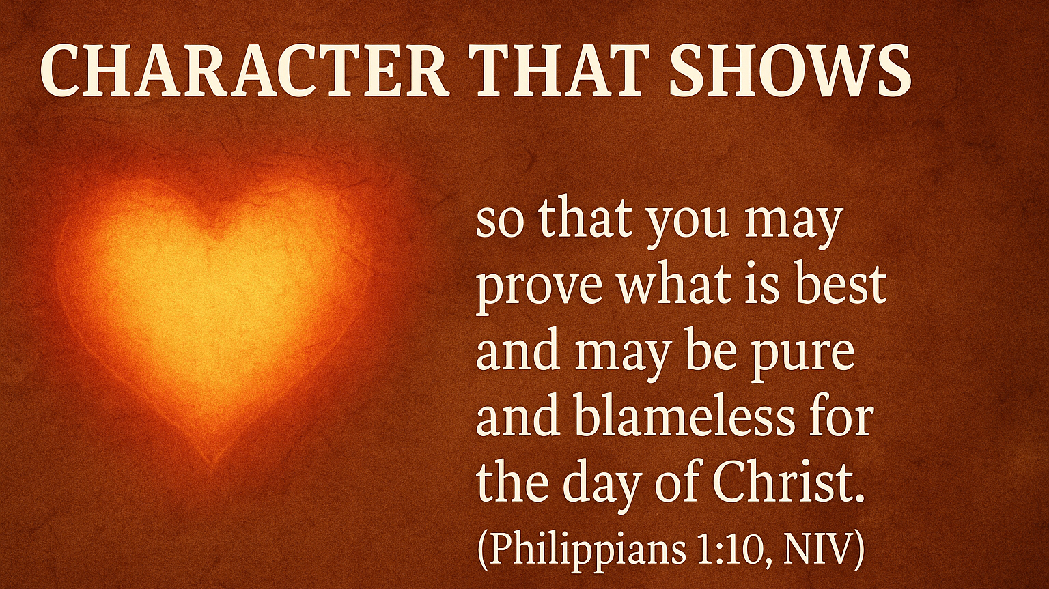
3

Slide 17

4

Slide 18


