Slide 1
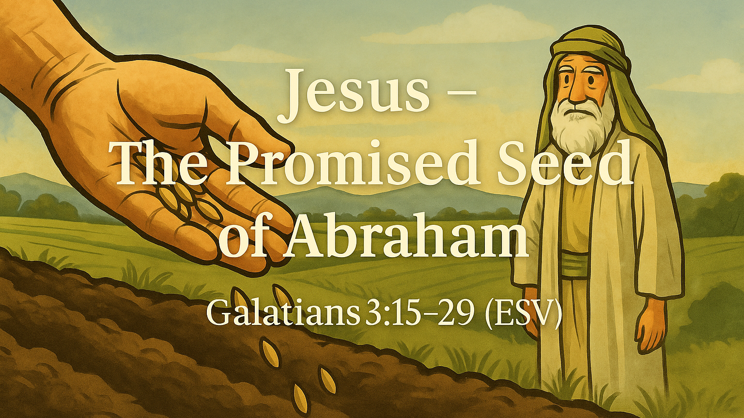

Slide 2
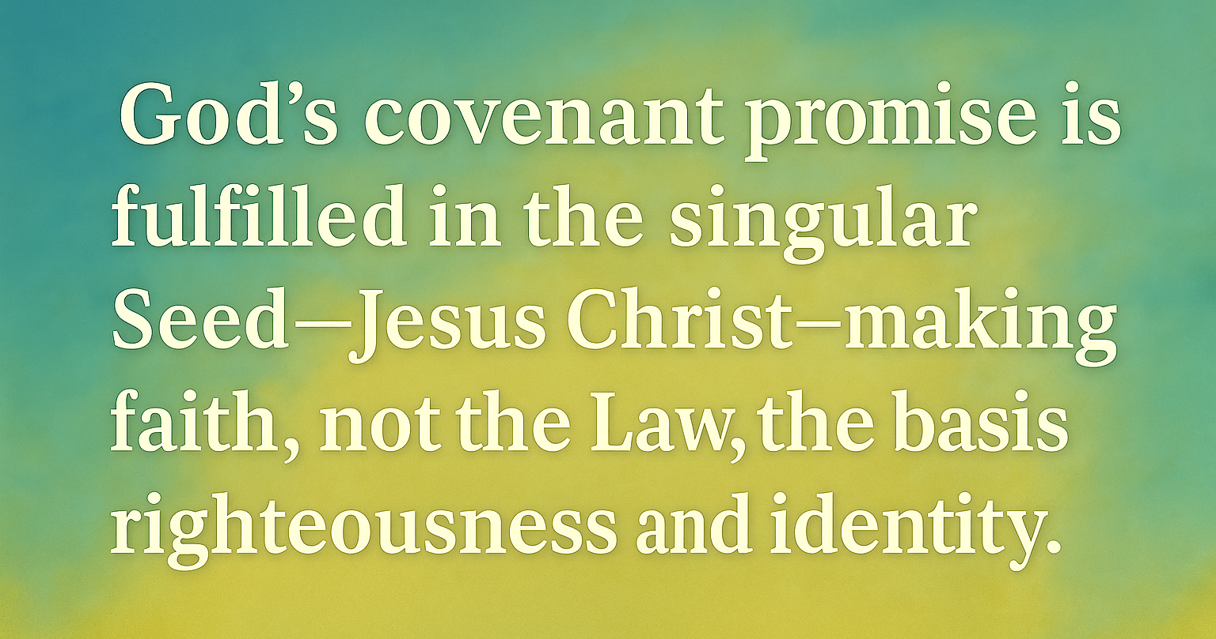

Slide 3
…If you are able
Please stand for the reading of God’s Word -
Galatians
3:15-29 (ESV)

Slide 4

1.)
The Promise that Cannot Be Broken
vv. 15–18

Slide 5

To give a human example, brothers: even with a man-made covenant, no one annuls it or adds to it once it has been ratified.
Galatians 3:15 (ESV)

Slide 6
Now the promises were made to Abraham and to his offspring. It does not say, 'And to offsprings,' referring to many, but referring to one, 'And to your offspring,' who is Christ.
Galatians 3:16 (ESV)

Slide 7
6 Major Covenants in the Bible
1. The Covenant with creation through Adam (Gen 1-3)
2. The Covenant with Creation through Noah (Gen 6-9)
3. The Covenant with Abraham (Gen 12, 15, 17)
4. The Covenant with Israel through Moses at Mt. Sinai (Ex 19-24)
5. The Covenant with King David (2 Sam 7; Ps 89)
6. The New Covenant in Christ’s Blood (Jer 31:31-34; Mt 26:26-29)

Slide 8
This is what I mean: the law, which came 430 years afterward, does not annul a covenant previously ratified by God, so as to make the promise void.
Galatians 3:17 (ESV)

Slide 9
For if the inheritance comes by the law, it no longer comes by promise; but God gave it to Abraham by a promise.
Galatians 3:18 (ESV)

Slide 10
2.)
The Promise that Clarifies the Law
vv. 19–22

Slide 11
Why then the law? It was added because of transgressions, until the offspring should come to whom the promise had been made, and it was put in place through angels by an intermediary.
Galatians 3:19 (ESV)

Slide 12

Sin
Iniquity
Transgression
“He roped me into that one.”

Slide 13
Now an intermediary implies more than one, but God is one.
Galatians 3:20 (ESV)

Slide 14

The Shema
“Hear, listen”
Deuteronomy 6:4-9

Slide 15
Is the law then contrary to the promises of God? Certainly not! For if a law had been given that could give life, then righteousness would indeed be by the law.
Galatians 3:21 (ESV)

Slide 16
But the Scripture imprisoned everything under sin, so that the promise by faith in Jesus Christ might be given to those who believe.
Galatians 3:22 (ESV)

Slide 17
3.)
The Promise that Captivates Us in Christ
vv. 23–25

Slide 18
Now before faith came, we were held captive under the law, imprisoned until the coming faith would be revealed.
Galatians 3:23 (ESV)

Slide 19
So then, the law was our guardian until Christ came, in order that we might be justified by faith.
Galatians 3:24 (ESV)

Slide 20
But now that faith has come, we are no longer under a guardian.
Galatians 3:25 (ESV)

Slide 21
4.)
The Promise that Confirms God's People
vv. 26–29

Slide 22
For in Christ Jesus you are all sons of God, through faith.
Galatians 3:26 (ESV)

Slide 23
For as many of you as were baptized into Christ have put on Christ.
Galatians 3:27 (ESV)

Slide 24
There is neither Jew nor Greek, there is neither slave nor free, there is no male and female, for you are all one in Christ Jesus.
Galatians 3:28 (ESV)

Slide 25
And if you are Christ's, then you are Abraham's offspring, heirs according to promise.
Galatians 3:29 (ESV)

Slide 27
Lord’s Supper
“Open Table.”
If you are a born-again believer in Jesus Christ for your salvation, you are welcome to participate with us.

