Slide 1


Slide 2
Galatians 2:11-14

Slide 3
Last week (2:1-10) we saw Paul waging war against the Judaizers: 1. The Gospel DEFENDED 2. The Gospel DECLARED 3. The Gospel DEMONSTRATED

Slide 4
There was tension in the air.
Peter danced with the danger of hypocrisy.
The Church’s doctrinal future and heavenly witness weighed in the balance.

Slide 5


Slide 6
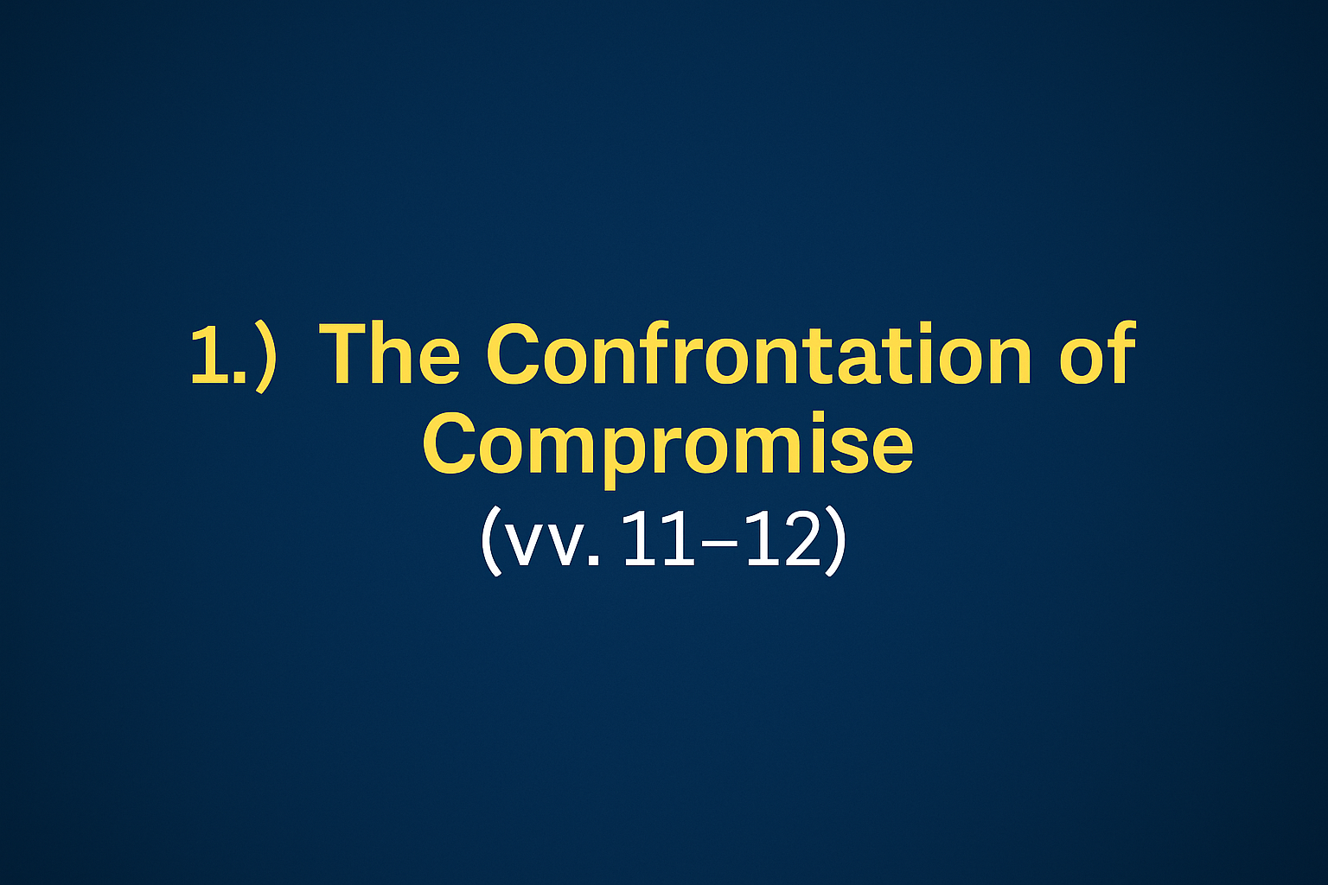

Slide 7
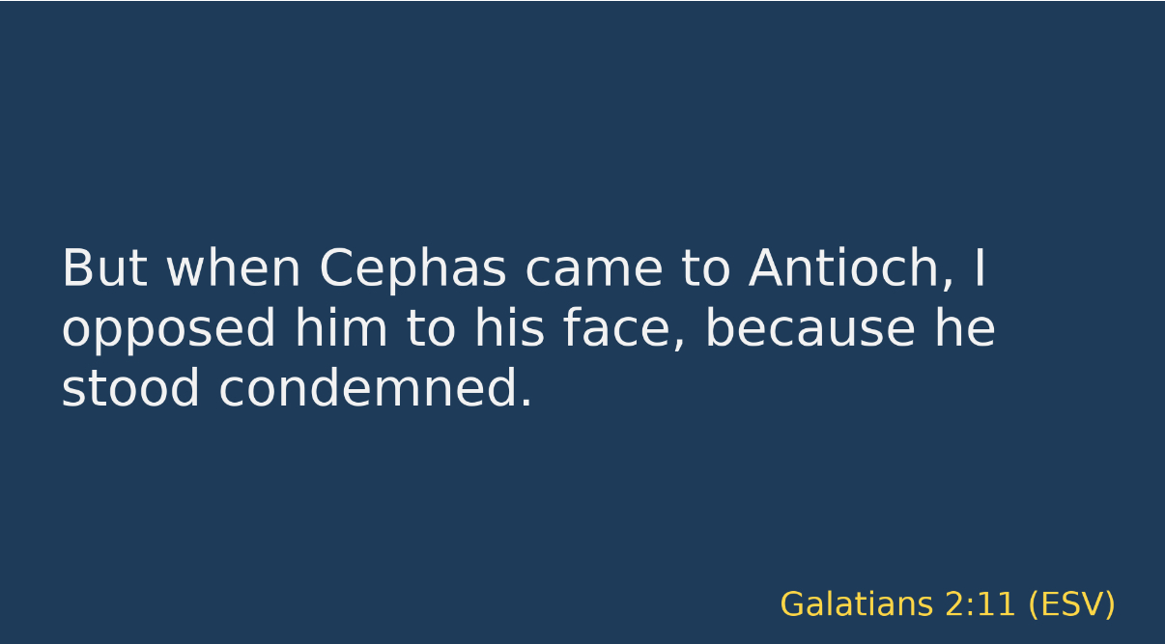

Slide 8
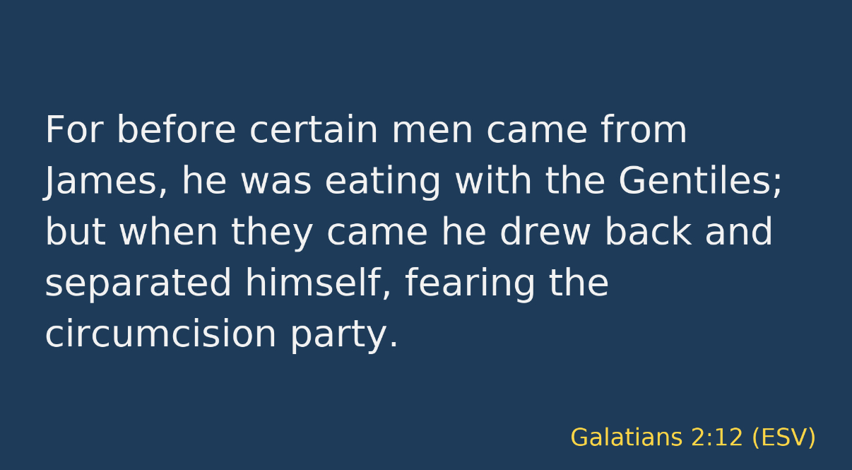

Slide 9
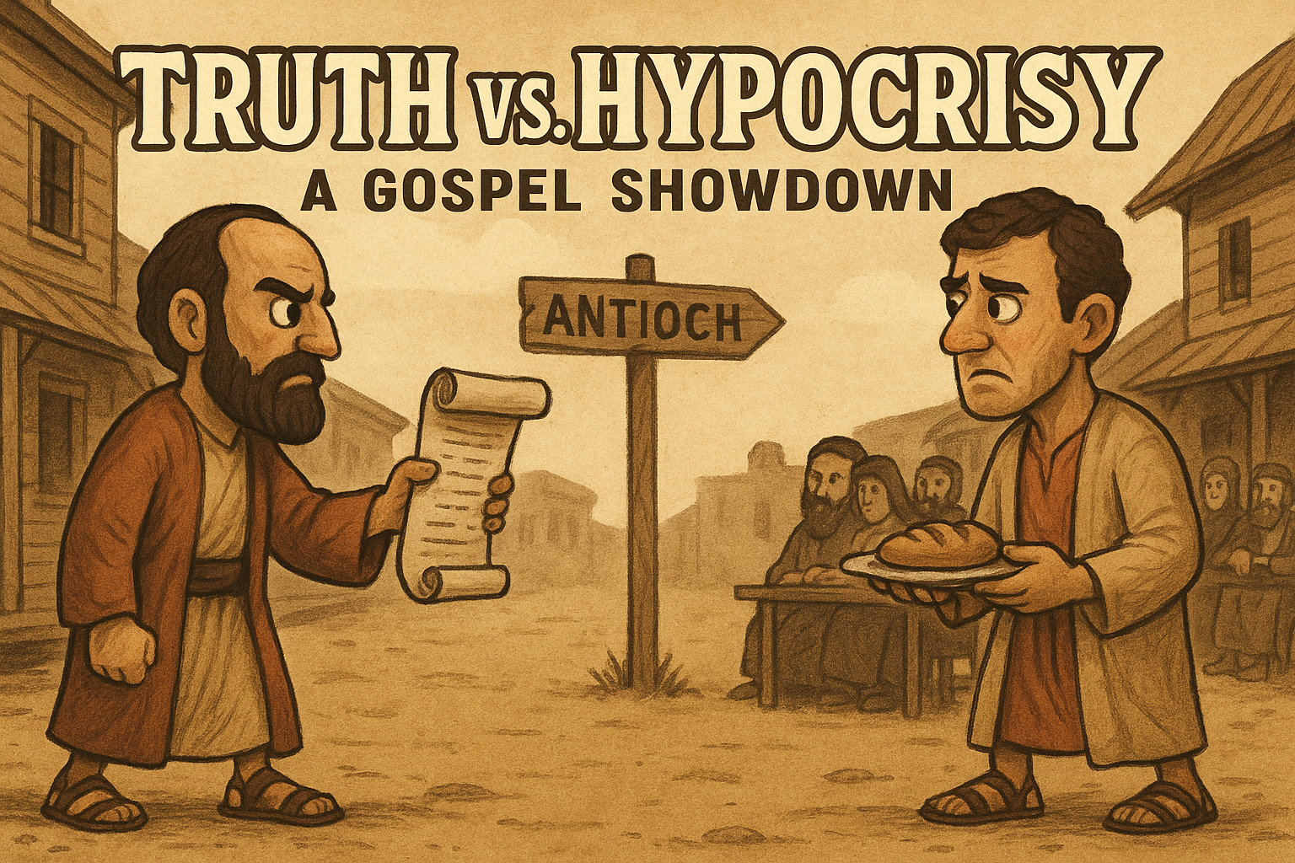

Slide 10


Slide 11
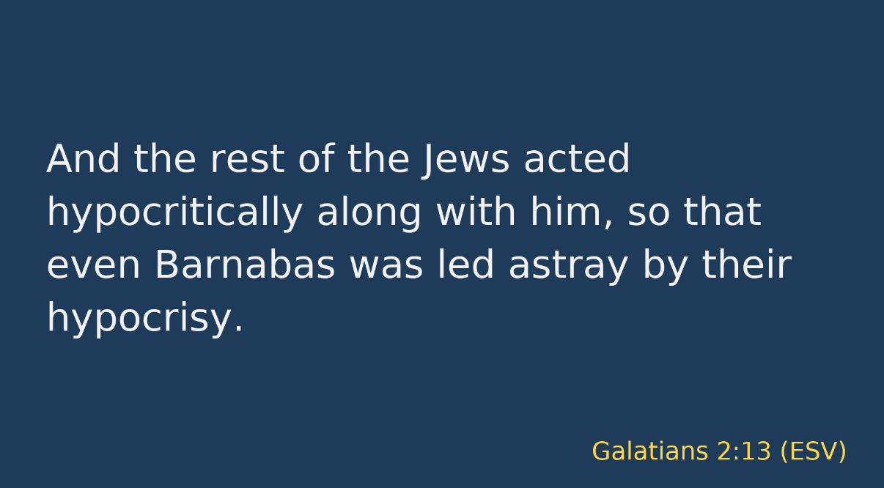

Slide 12
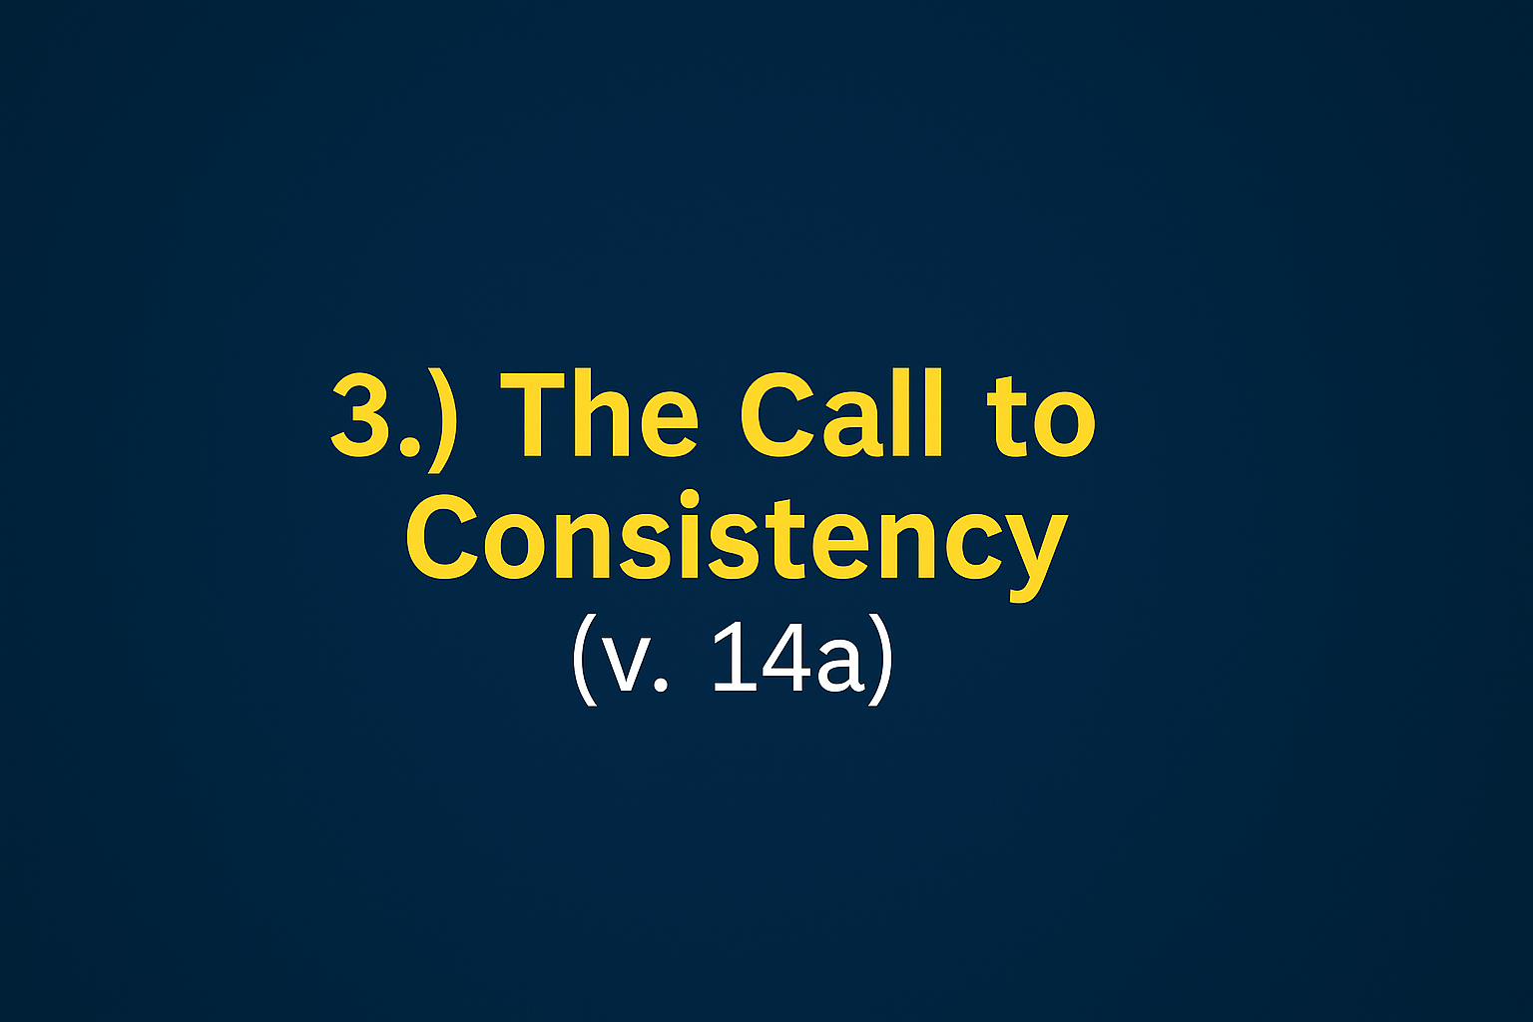

Slide 13
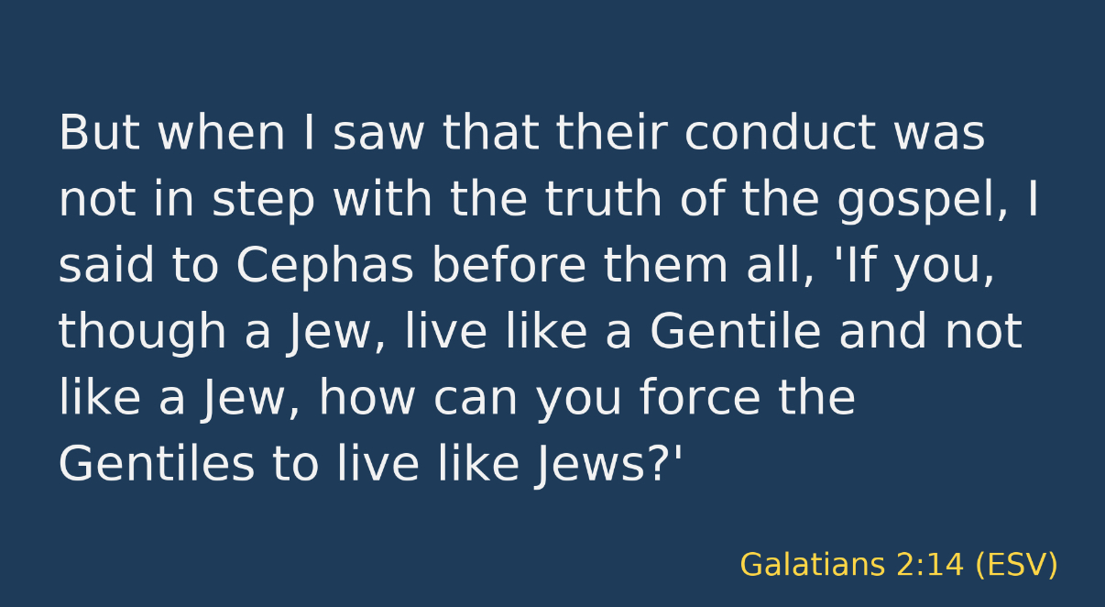

Slide 14
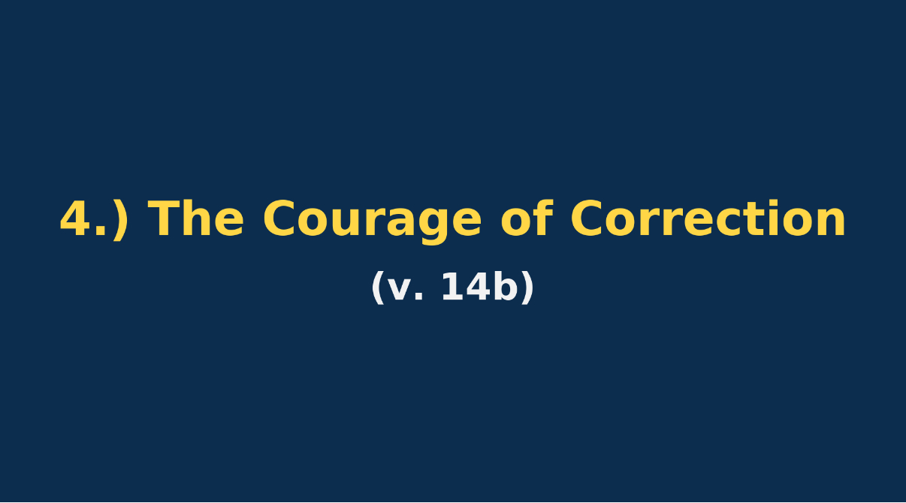

Slide 16

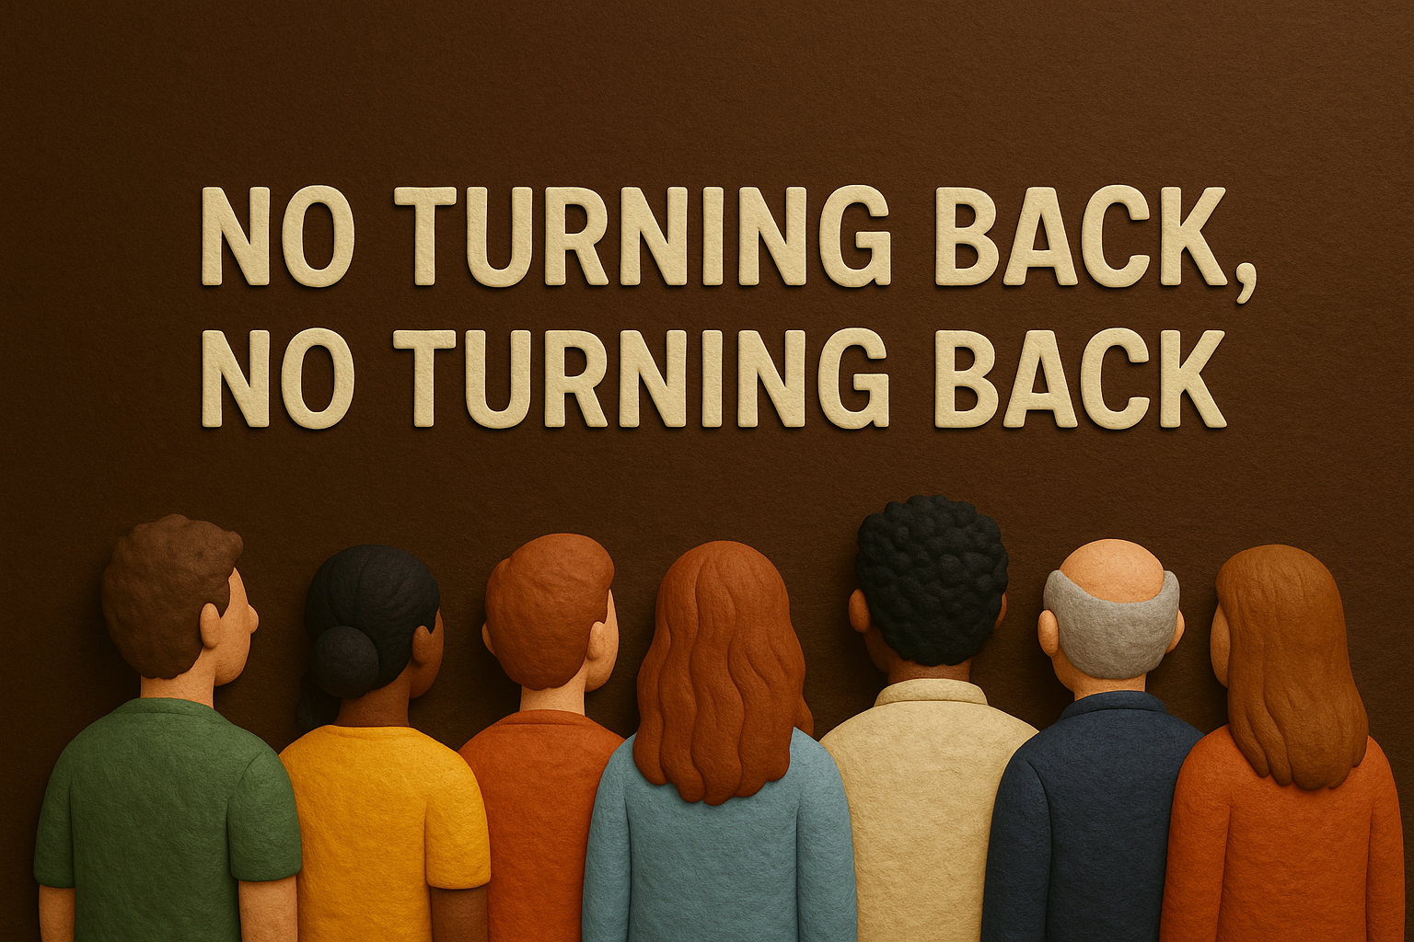

Slide 17

CONCLUSION
When we drift away, the Gospel (Good News) calls us back. Our failures do not define us. God’s grace does!

Slide 18
