Slide 1
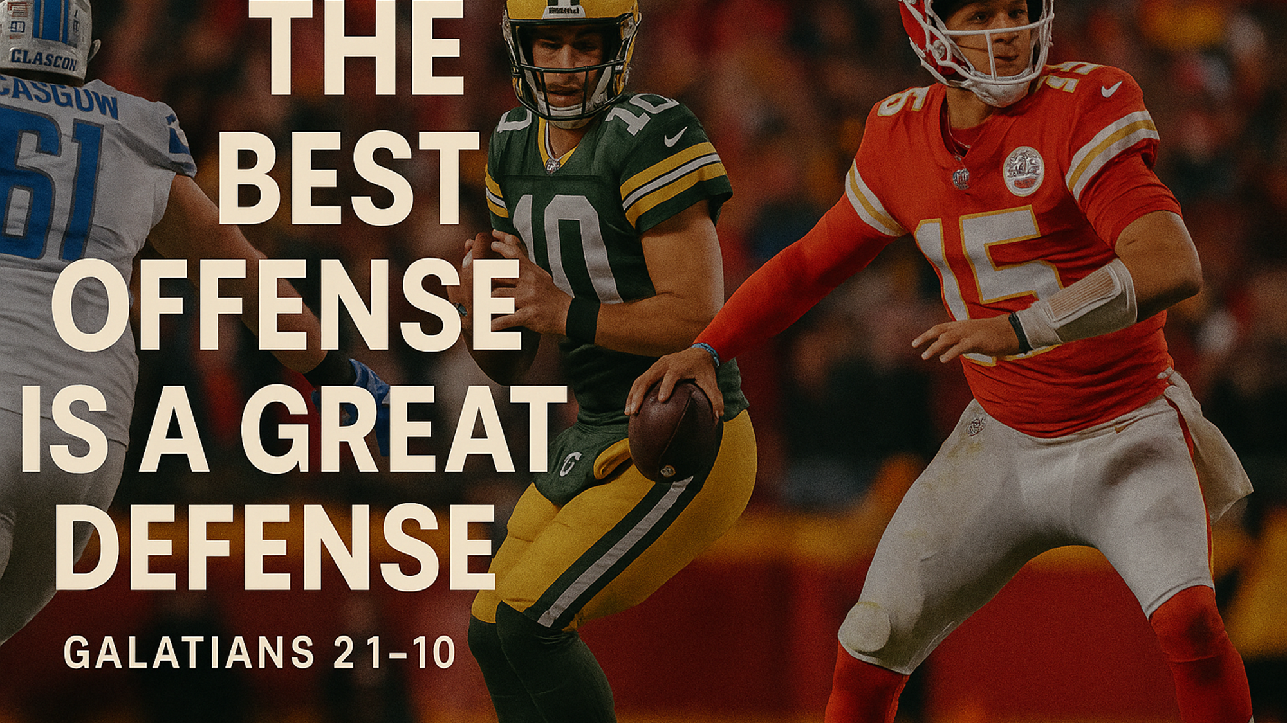
:

Slide 2

Like the early apostles, we are called to defend the gospel, declare the gospel, and demonstrate the gospel.
CIT: The Heart of Salvation

Slide 3
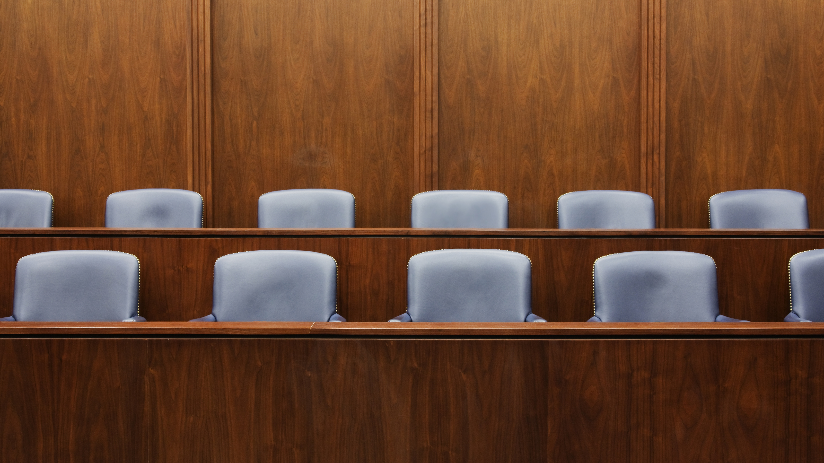
I. The Gospel DEFENDED (1-6)

Slide 4
Galatians 2:1
Then after fourteen years, I went up again to Jerusalem with Barnabas, taking Titus along with me.

Slide 5
Galatians 2:2
I went up because of a revelation and set before them (though privately before those who seemed influential) the gospel that I proclaim among the Gentiles, in order to make sure I was not running or had not run in vain.

Slide 6
Galatians 2:3
But even Titus, who was with me, was not forced to be circumcised, though he was a Greek.

Slide 7
Galatians 2:4
Yet because of false brothers secretly brought in ⁠— who slipped in to spy out our freedom that we have in Christ Jesus, so that they might bring us into slavery⁠

Slide 8
Galatians 2:5
to them we did not yield in submission even for a moment, so that the truth of the gospel might be preserved for you.

Slide 9
Galatians 2:6
And from those who seemed to be influential (what they were makes no difference to me; God shows no partiality)⁠—those, I say, who seemed influential (v. 2) added nothing to me.

Slide 10
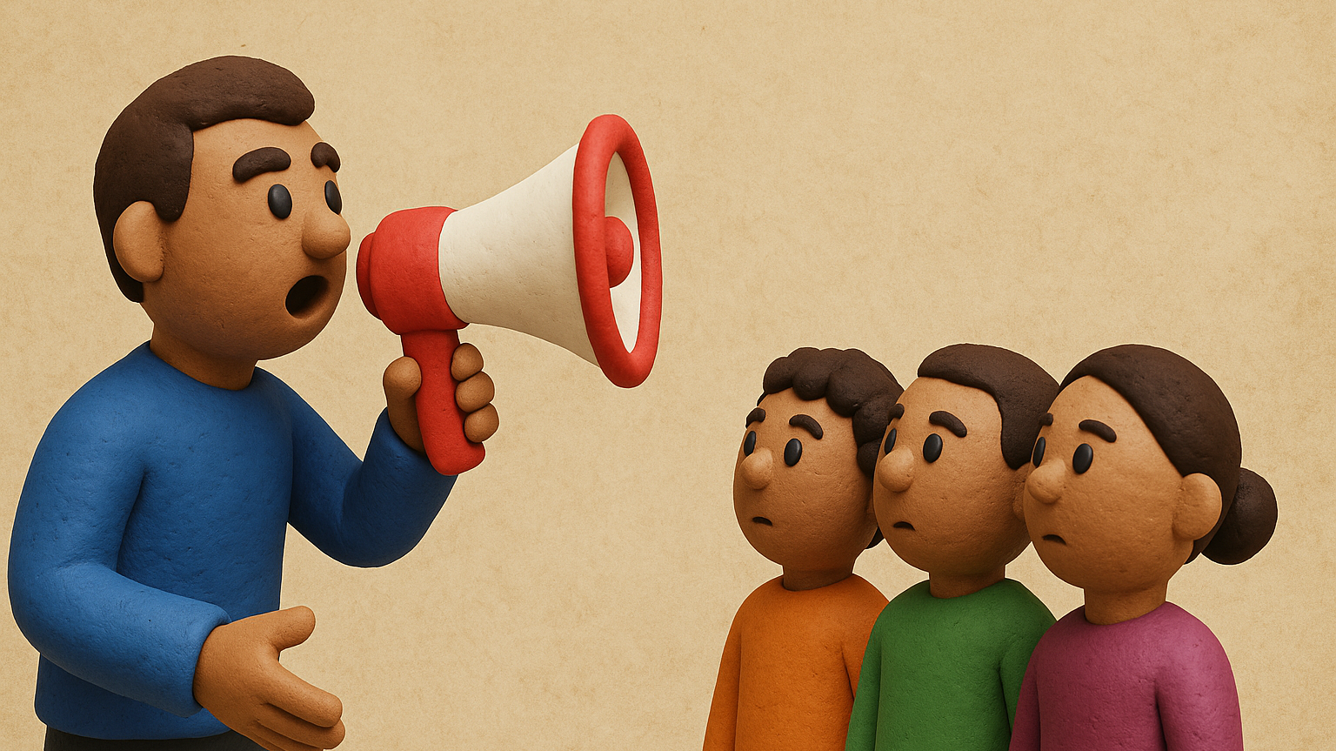
II. The Gospel DECLARED (7-8)

Slide 11
Galatians 2:7
On the contrary, when they saw that I had been entrusted with the gospel to the uncircumcised, just as Peter had been entrusted with the gospel to the circumcised

Slide 12
Galatians 2:8
(for he who worked through Peter for his apostolic ministry to the circumcised worked also through me for mine to the Gentiles),

Slide 13

III. The Gospel DEMONSTRATED (9-10)
“I press on toward…”
Phil 3:13-14

Slide 14
Galatians 2:9
and when James and Cephas and John, who seemed to be pillars, perceived the grace that was given to me, they gave the right hand of fellowship to Barnabas and me, that we should go to the Gentiles and they to the circumcised.

Slide 15
Galatians 2:10
Only, they asked us to remember the poor, the very thing I was eager to do.
“The very least…cold water”
Matthew 10:42

Slide 16
Ch 1 - Paul defended his apostleship Ch 2 - the shift SKOPOS to defending “his” gospel. 1. The Gospel Defended (1-6) 2. The Gospel Declared (7-8) 3. The Gospel Demonstrated (9-10)

Slide 17
Like the early apostles, we are called to defend the gospel, declare the gospel, and demonstrate the gospel.
CIT: The Heart of Salvation

Slide 18
:

