Slide 1
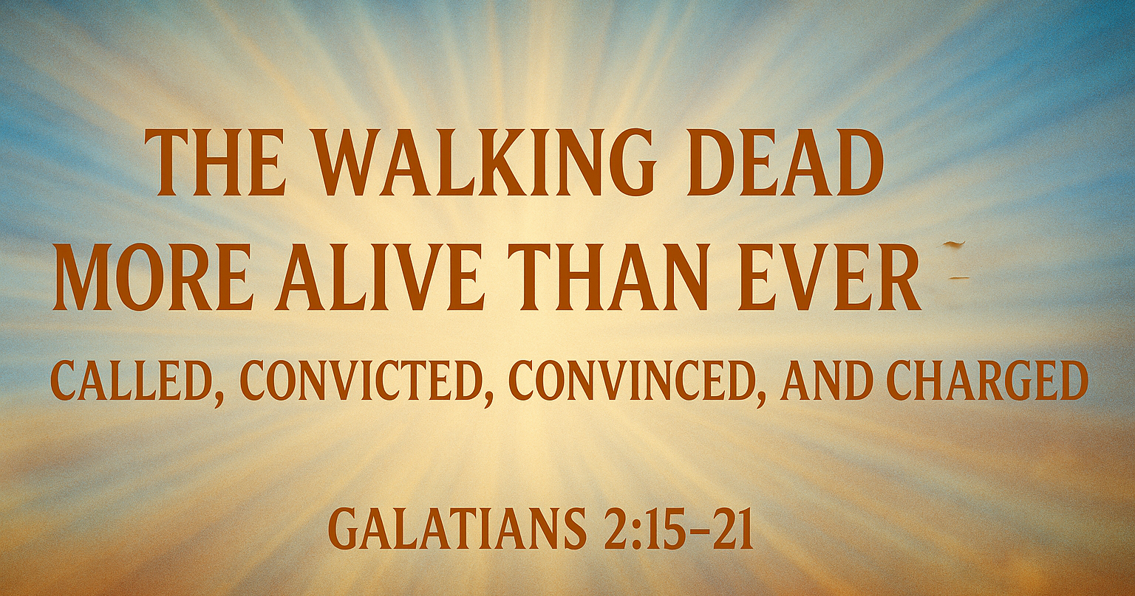

Slide 2
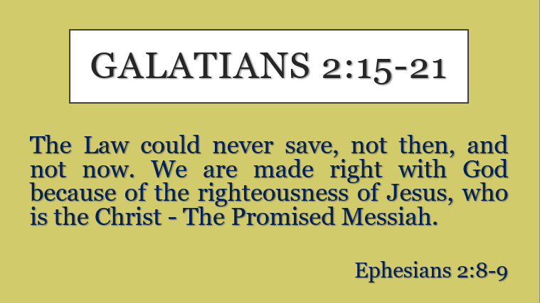

Slide 3

INTRODUCTION
* We are CALLED
* We are CONVICTED
* We are CONVINCED
* We are CHARGED

Slide 4
To Know …
To Grow …
To Show …

Slide 5
The Good News is really the
Greatest News Ever!
The Progressive Nature of Salvation is seen in removing sin’s penalty, its power, and its presence.

Slide 6
1.) You were CALLED by God.
Ephesians 2:8-10 * Romans 8:30 * John 6:44

Slide 7
Because the Law cannot save, we must trust the Lord completely.
(vv. 15–16)

Slide 8
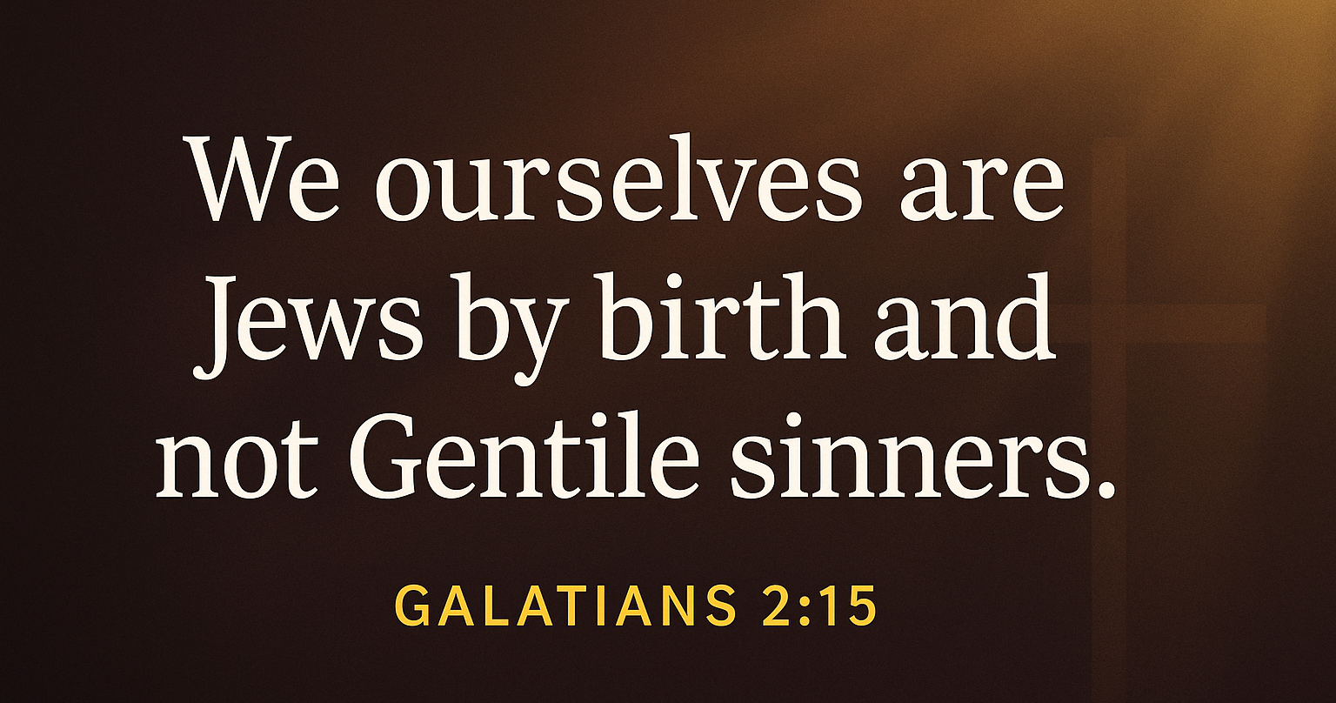

Slide 9
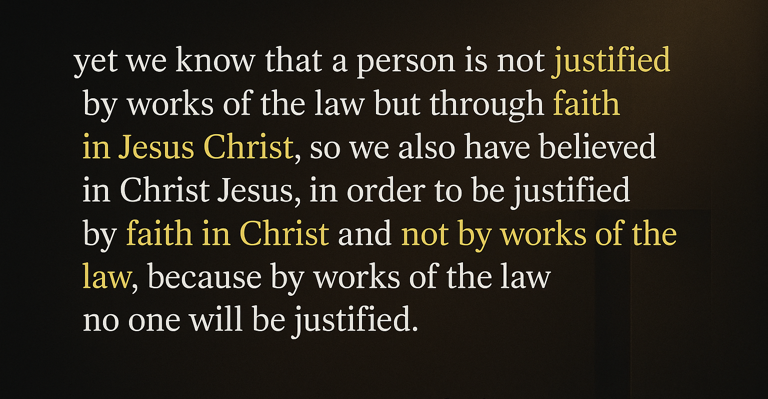
Galatians 2:16 (ESV)

Slide 10
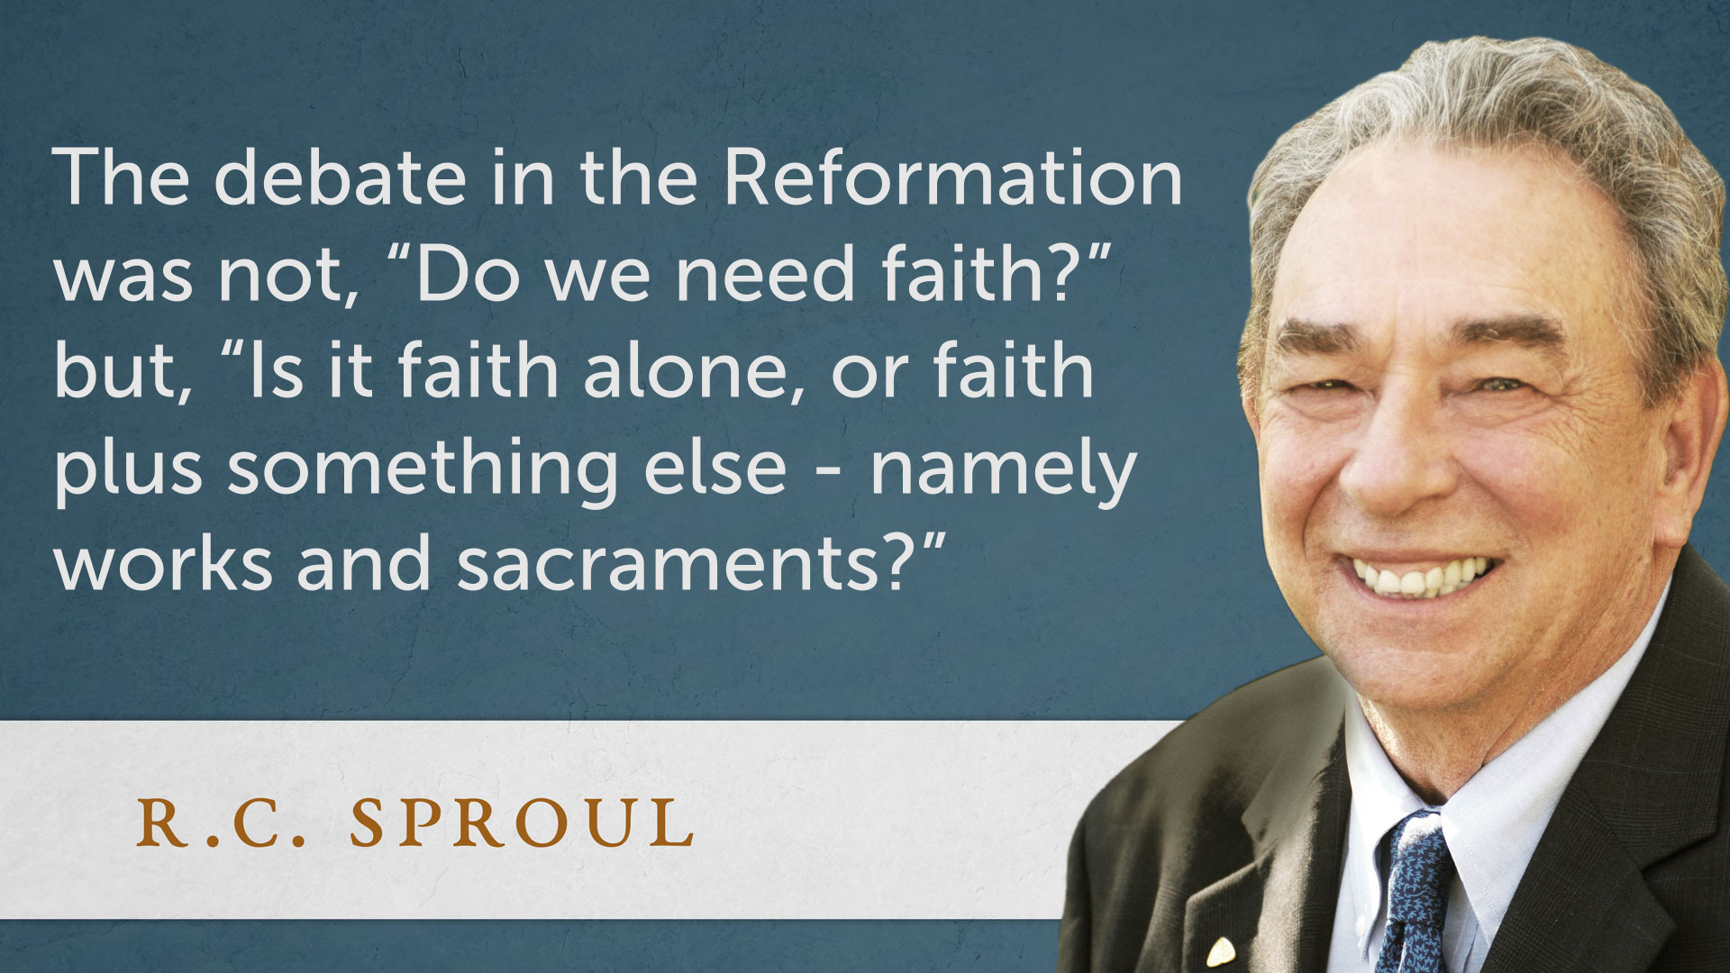

Slide 11
2.) You were CONVICTED by God.
John 16:8-11 * Galatians 2:19-20 * Acts 2:37-38

Slide 12
Because legalism cannot sanctify, we must rest in Christ constantly.
(vv. 17–19)

Slide 13
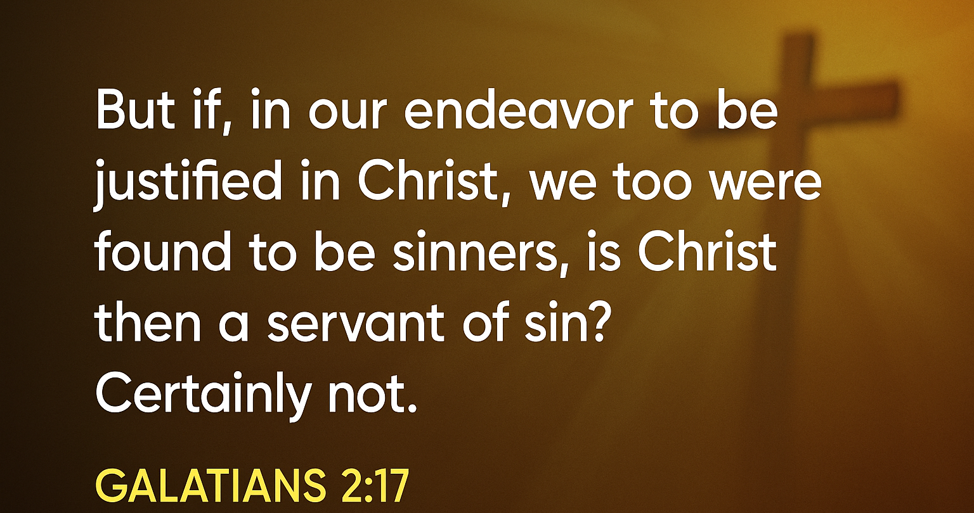

Slide 14
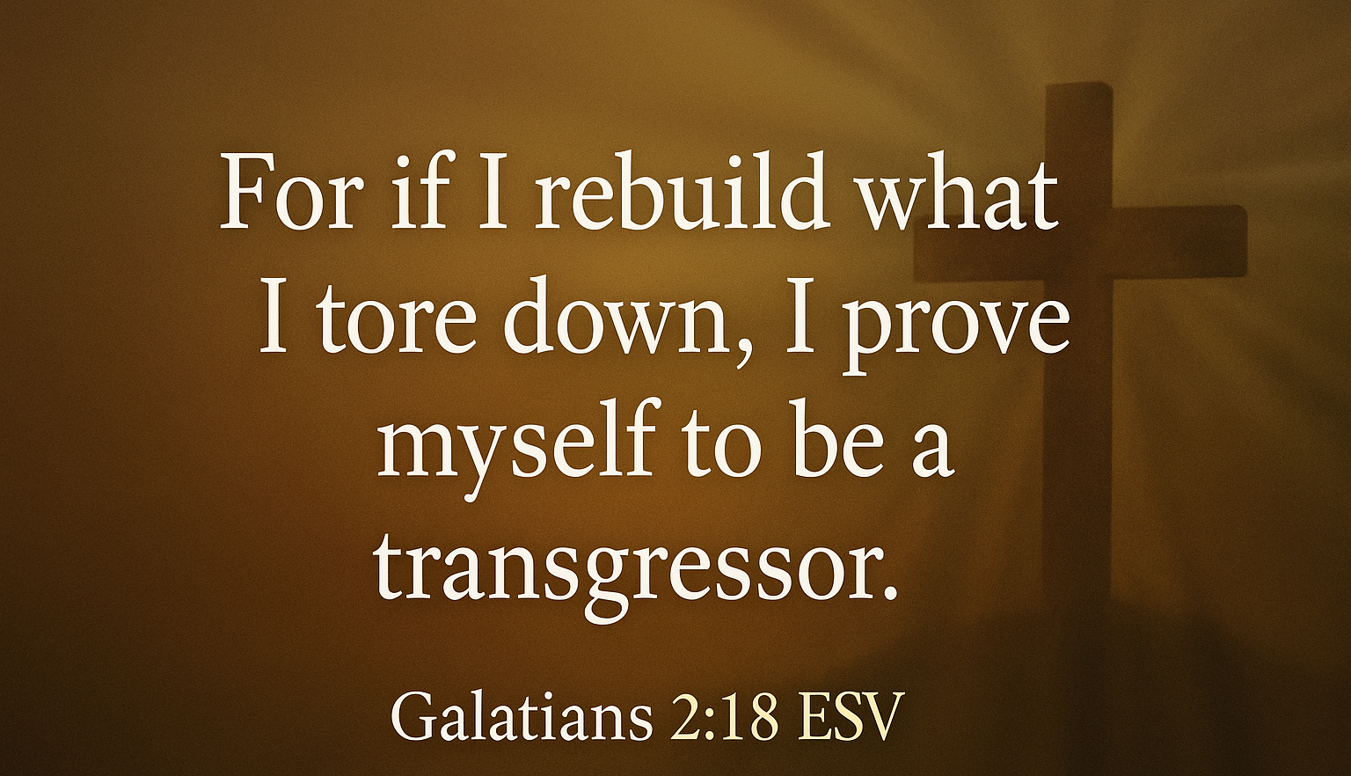

Slide 15
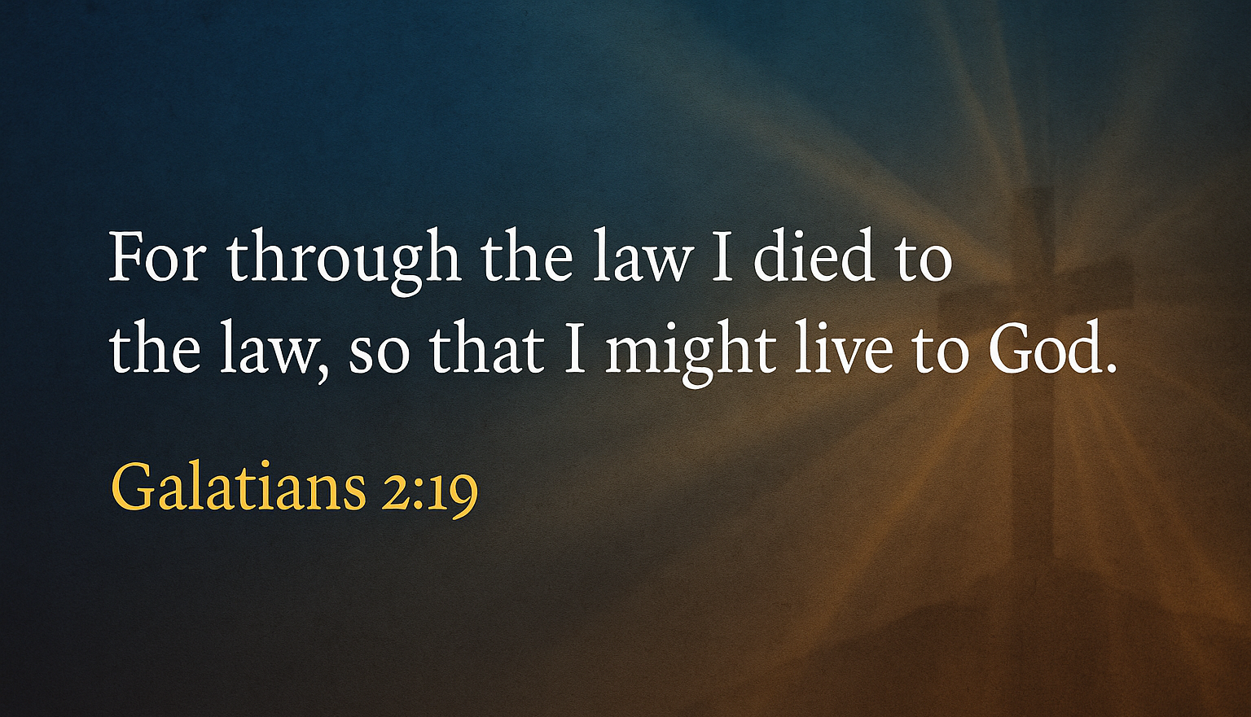

Slide 16
3.) You were CONVINCED by God.
Galatians 5:6 * James 2:17-19 * Hebrews 11:1, 6

Slide 17
Because love now lives within us, we must live by faith continually.
(v. 20)

Slide 18
I have been crucified with Christ. It is no longer I who live, but Christ who lives in me. And the life I now live in the flesh I live by faith in the Son of God, who loved me and gave Himself for me.
Galatians 2:20 (ESV)

Slide 20
4.) You were CHARGED by God.
James - Faith without works is dead.
Paul - work out your salvation with fear and trembling.

Slide 21
Because legalism cannot sanctify, we must rest in Christ constantly.
(v. 21)

Slide 22
I do not nullify the grace of God, for if righteousness were through the law, then Christ died for no purpose.
Galatians 2:21 (ESV)

Slide 23
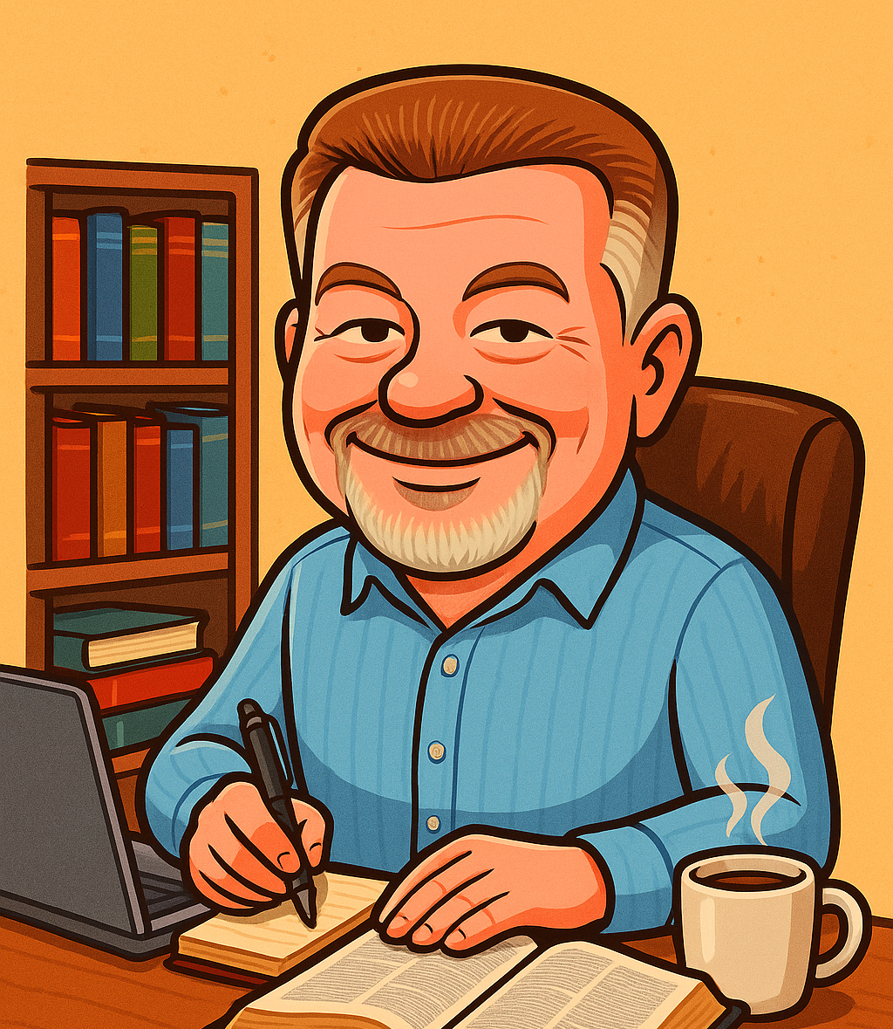
“Justification by faith alone frees us from the burdens of a works-based religion.
Instead, as we grow in spiritual maturity, we learn what it means to pursue a life of works that glorify God.”
From the Desk of:

