Slide 1
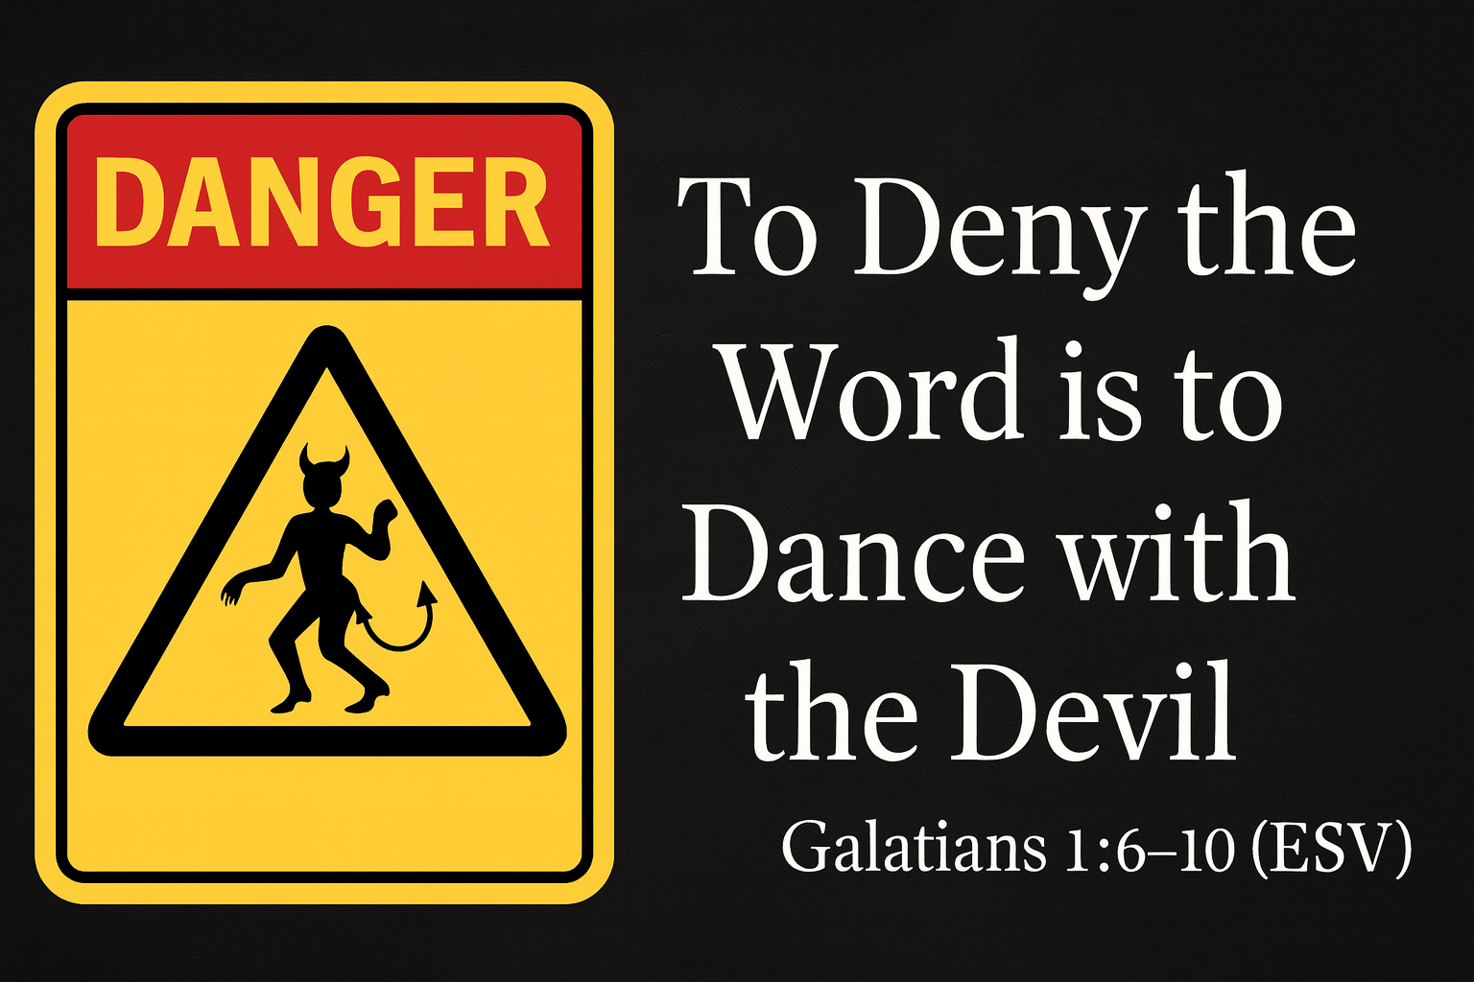
“
”

Slide 2
Galatians 1:6-10 (ESV)
6 - I am astonished that you are so quickly deserting Him who called you in the grace of Christ and are turning to a different gospel -
7 - not that there is another one, but there are some who trouble you and want to distort the gospel of Christ.

Slide 3
Galatians 1:6-10 (ESV)
8 - But even if we or an angel from heaven should preach to you a gospel contrary to the one we preached to you, let him be accursed.
9 - As we have said before, so now I say again: If anyone is preaching to you a gospel contrary to the one you received, let him be accursed.

Slide 4
Galatians 1:6-10 (ESV)
10 - For am I now seeking the approval of man, or of God? Or am I trying to please man? If I were still trying to please man,
I would not be a servant of Christ.

Slide 5

1. The Danger of Desertion
6 - I am astonished that you are so quickly deserting Him who called you in the grace of Christ and are turning to a different gospel -
7 - not that there is another one, but there are some who trouble you and want to distort the gospel of Christ.

Slide 6
In a nation falling apart at the seams, “church” as we once knew it is being corrupted by sin. Stay true to the Gospel of Grace.
Galatians 1:6-10

Slide 7
ANATHEMA
ἀνάθεμα
Accursed
While ἀνάθεμα can mean “that which is laid up or consecrated,” Paul uses it in the negative sense - and with great force.

Slide 8
2. The Curse of Corruption
8 - But even if we or an angel from heaven should preach to you a gospel contrary to the one we preached to you, let him be accursed.
9 - As we have said before, so now I say again: If anyone is preaching to you a gospel contrary to the one you received, let him be accursed.

Slide 9
Any diversion or distortion of the absolute truth will cause division. Stay true to the Gospel of Grace.
Galatians 1:6-10

Slide 10
Mormons … Jehovah’s Witnesses … Muslim/Islam … Hinduism … Buddhism…Taoism…
ROMAN CATHOLICISM
These are all guilty of ADDING.

Slide 11
Sacraments
Baptism
Confirmation
Eucharist/Communion
Reconciliation (confession)
Anointing the Sick (including last rites)
Holy Orders
Matrimony

Slide 12
3. The Test of a True Servant
10 - For am I now seeking the approval of man, or of God? Or am I trying to please man? If I were still trying to please man, I would not be a servant of Christ.

Slide 13
God’s grace should compel us to deny ourselves and live for the glory of God alone. Stay true to the Gospel of Grace.
Galatians 1:6-10

Slide 14
1. The Danger of Desertion
6 - I am astonished that you are so quickly deserting Him who called you in the grace of Christ and are turning to a different gospel -
7 - not that there is another one, but there are some who trouble you and want to distort the gospel of Christ.

Slide 15
2. The Curse of Corruption
8 - But even if we or an angel from heaven should preach to you a gospel contrary to the one we preached to you, let him be accursed.
9 - As we have said before, so now I say again: If anyone is preaching to you a gospel contrary to the one you received, let him be accursed.

Slide 16
3. The Test of a True Servant
10 - For am I now seeking the approval of man, or of God? Or am I trying to please man? If I were still trying to please man, I would not be a servant of Christ.

