Slide 1
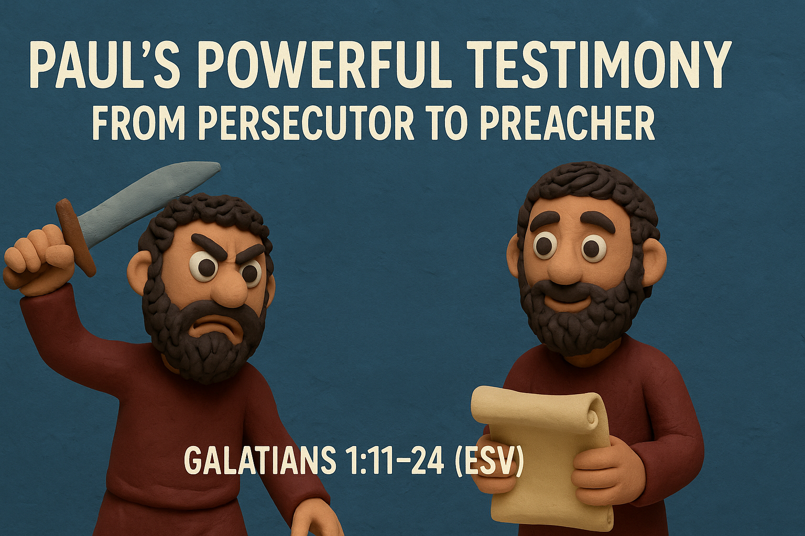
-

Slide 2
God calls us out of our past and into His future.
Central Idea of the Text:
How you live your life matters to God!

Slide 3
1. A Godly Gospel (11-12)
(11) For I would have you know, brothers, that the gospel that was preached by me is not man’s gospel.
(12) For I did not receive it from any man, nor was I taught it, but I received it through a revelation of Jesus Christ.

Slide 4

2. A zealous persecutor (13-14)
(13) For you have heard of my former life in Judaism, how I persecuted the church of God violently and tried to destroy it.
(14) And I was advancing in Judaism beyond many of my own age among my people, so extremely zealous was I for the traditions of my fathers.

Slide 5
3. A man set apart by grace (15-17)
(15) But when He who had set me apart before I was born, and who called me by His grace, (16) was pleased to reveal His Son to me, in order that I might preach Him among the Gentiles, I did not immediately consult with anyone; (17) nor did I go up to Jerusalem to those who were apostles before me, but I went away into Arabia, and returned again to Damascus.

Slide 6
4. well-versed in the faith (18-21)
(18) Then after three years I went up to Jerusalem to visit Cephas and remained with him fifteen days.
(19) But I saw none of the other apostles except James the Lord’s brother.
(20) In what I am writing to you, before God, I do not lie!
(21) Then I went into the regions of Syria and Cilicia.

Slide 7
5. An unbelievable testimony (22-23)
(22) And I was still unknown in person to the churches of Judea that are in Christ.
(23) They only were hearing it said, “He who used to persecute us is now preaching the faith he once tried to destroy.”

Slide 8

6. To god be the glory! (24)
(24) And they glorified God because of me.

Slide 9

Key takeaway from today’s message:

Slide 10
1.) A godly gospel (vv. 11-12) 2.) A zealous persecutor (vv. 13-14) 3.) A man set apart by grace (vv. 15-17) 4.) Well-versed in the faith (vv. 18-21) 5.) An unbelievable testimony (vv. 22-23) 6.) To God be the glory! (v. 24)

Slide 11
God calls us out of our past and into His future.
Central Idea of the Text:
How you live your life matters to God!

Slide 12
-

