Slide 1

The Word Works!

Slide 2
In chapter 1
He addresses the problem of false teachers, sin

Slide 3
In chapter 2
He announces the protection - elders, households

Slide 4
In chapter 3
He applies the provision - grace is a gift for the glory of God.

Slide 5
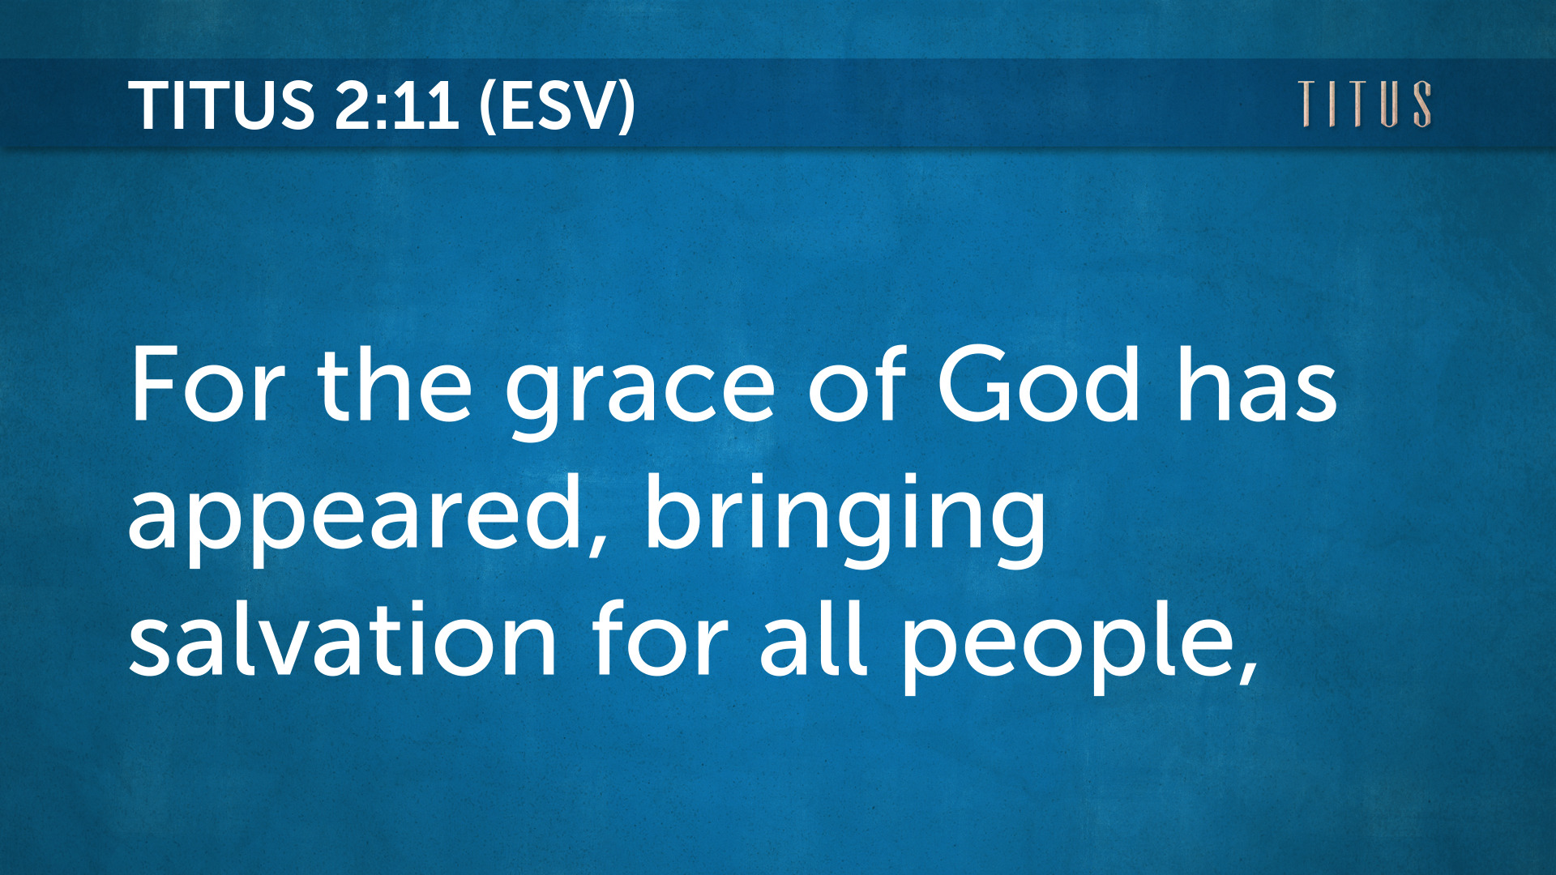

Slide 6
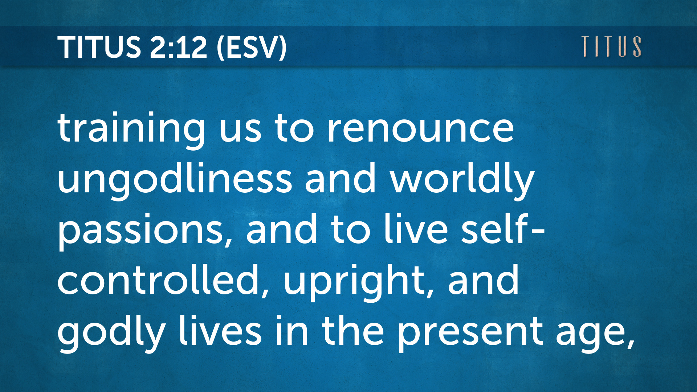

Slide 7
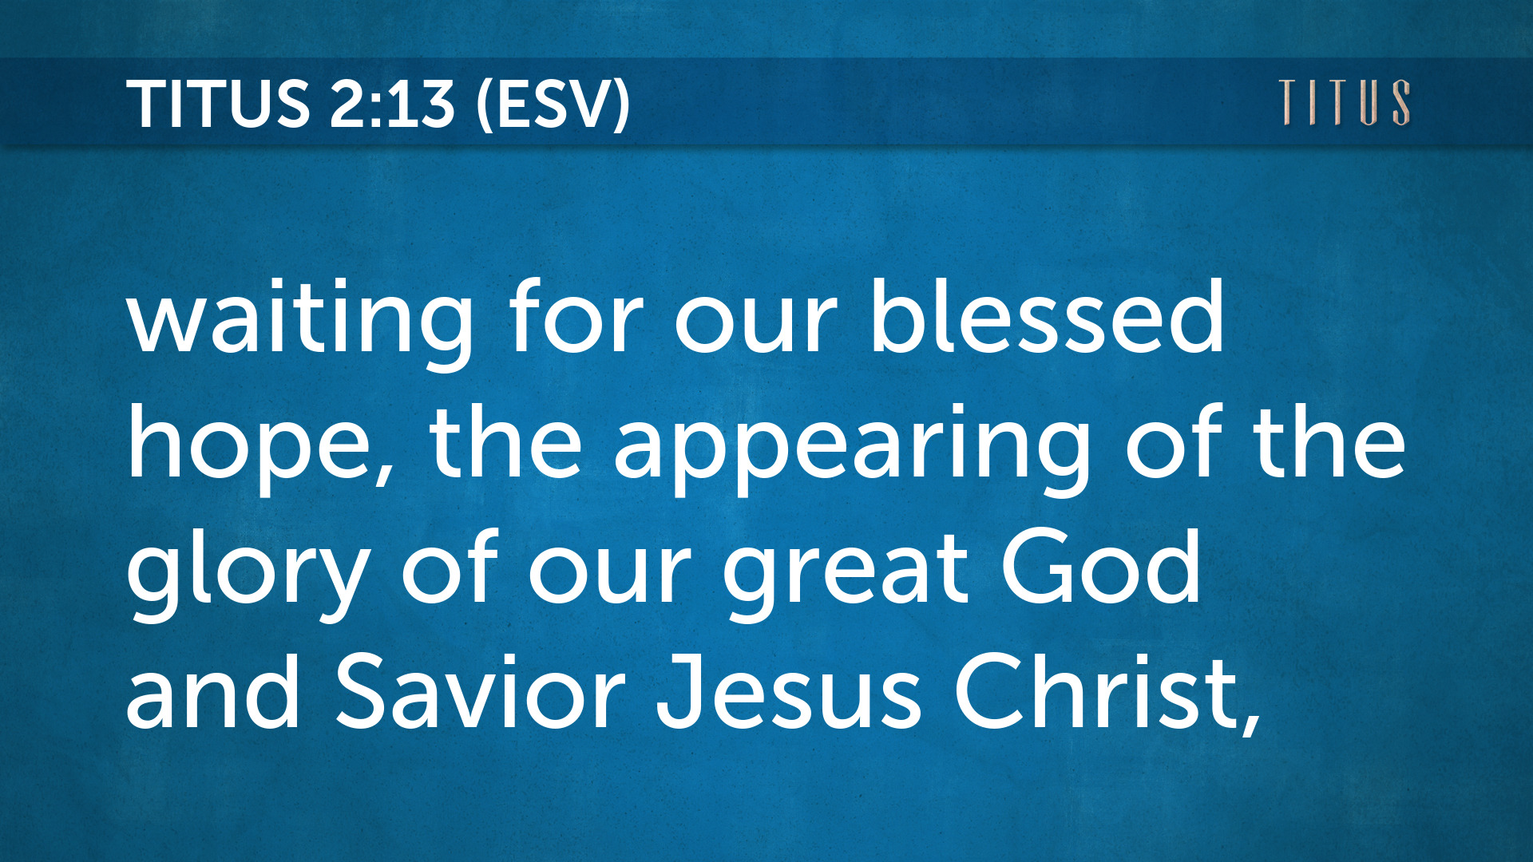

Slide 8
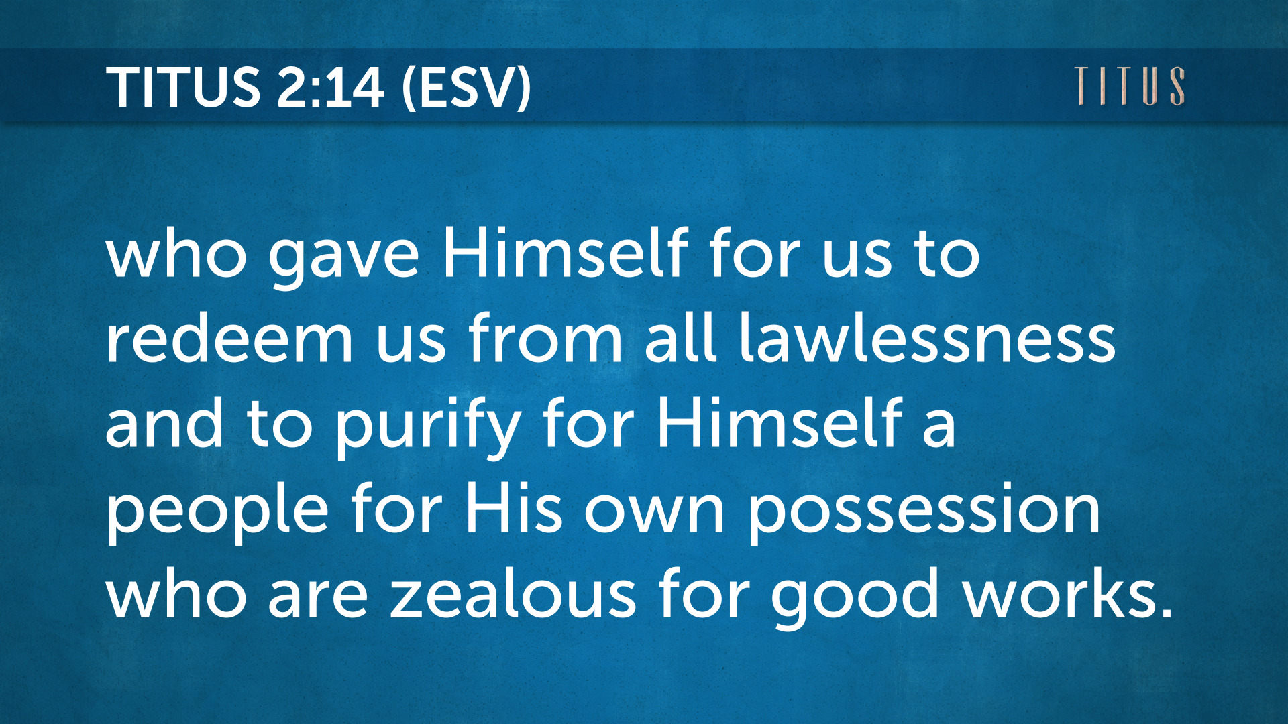

Slide 9
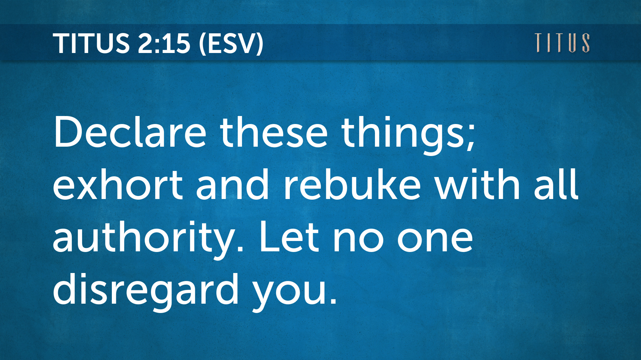

Slide 10

If Jesus wrote a letter
To FBC Norway …
“You are the church that works through
the grace that trains.”

Slide 11
1.) He adorned us with His doctrine (10b)
2.) He appeared to us by His grace (11a)
3.) He accepted us by way of His salvation (11b)
4.) He acclimated us with His training (12)
5.) We anticipate His return (13)
6.) We are a purified and possessed people (14)
7.) We are to announce these truths with authority (15)

Slide 12
God’s Riches At Christ’s Expenses
χάρις
Grace
Favor
Good will
Esteem
Beauty
Charm
kindness
The beneficent intention of God …
a gift given to undeserved people.

Slide 13
1. The Word is given to humanity (10b)
2. The Word is introduced in Christ (11a)
3. The Word is to be applied as directed (11b)
4. The Word is ingrained within us for change (12)
5. The Word is anticipated with hope (13)
6. The Word is at work within us toward purity (14)
7. The Word has absolute authority (15)

Slide 14
1.) He adorned us with His doctrine (10b) …so that in everything they may adorn the doctrine of God our Savior.

Slide 15
2.) He appeared to us by His grace (11a) For the grace of God has appeared…

Slide 16
3.) He accepted us by way of His salvation (11b) …bringing salvation for all people,

Slide 17
4.) He acclimated us with His training (12) …training us to renounce ungodliness and worldly passions, and to live self-controlled, upright, and godly lives in the present age,

Slide 18
5.) We anticipate His return (13) …waiting for our blessed hope, the appearing of the glory of our great God and Savior Jesus Christ,

Slide 19
6.) We are a purified and possessed people (14) …who gave Himself for us to redeem us from all lawlessness and to purify for Himself a people for His own possession who are zealous for good works.

Slide 20
7.) We are to announce these truths with authority (15) Declare these things; exhort and rebuke with all authority. Let no one disregard you.

Slide 21
Grace is not soft, it is strong. Receiving God’s grace is not a one-time event.

Slide 22
The Word Works!

Slide 23
Reminder:
Quarterly Business Meeting
will start 10 minutes after church.

