Slide 1


Slide 2
Titus 1:1 (ESV)
Paul, a servant of God and an apostle of Jesus Christ, for the sake of the faith of God's elect and their knowledge of the truth, which accords with godliness,

Slide 3
Titus 1:2 (ESV)
in hope of eternal life, which God, who never lies, promised before the ages began

Slide 4
Titus 1:3 (ESV)
and at the proper time manifested in His word through the preaching with which I have been entrusted by the command of God our Savior;

Slide 5
Titus 1:4 (ESV)
To Titus, my true child in a common faith:
Grace and peace from God the Father and Christ Jesus our Savior.

Slide 6
A Quick Overview of Titus 1:1-4 “It’s the GOSPEL TRUTH!”
Gospel Truth comes from God, not man.
Gospel Truth anchors us in eternal hope
Gospel Truth is proclaimed so lives are changed.
Gospel Truth builds family, not just followers.

Slide 7
CIT & Purpose
CIT: Grounded in truth. Growing in godliness. Reflecting Christ, not the world.
Purpose (of Titus): A contagious church is one transformed by grace.
For FBC, church revitalization Stage 2 - orthodoxy and orthopraxy.

Slide 8
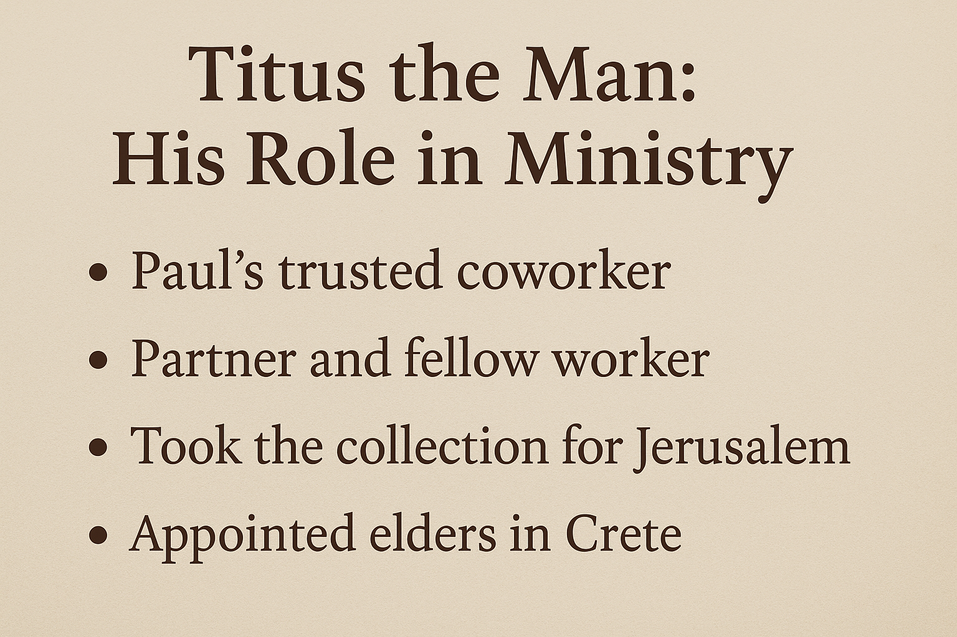

Slide 9
Background to Titus
Crete: Corrupt, deceitful culture (Titus 1:12)
Zeus worship & moral chaos
Paul left Titus to 'set in order’ the house churches infiltrated by Judaizers

Slide 10


Slide 11
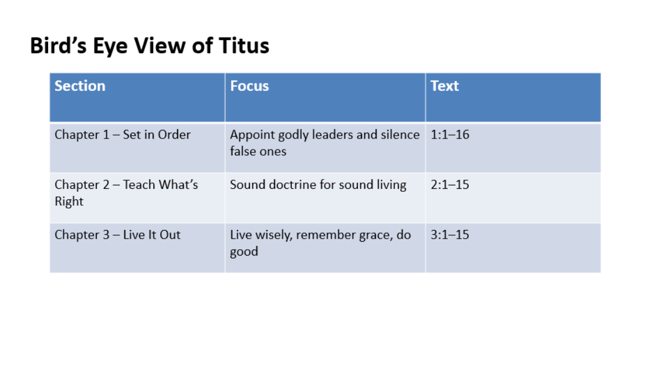

Slide 12
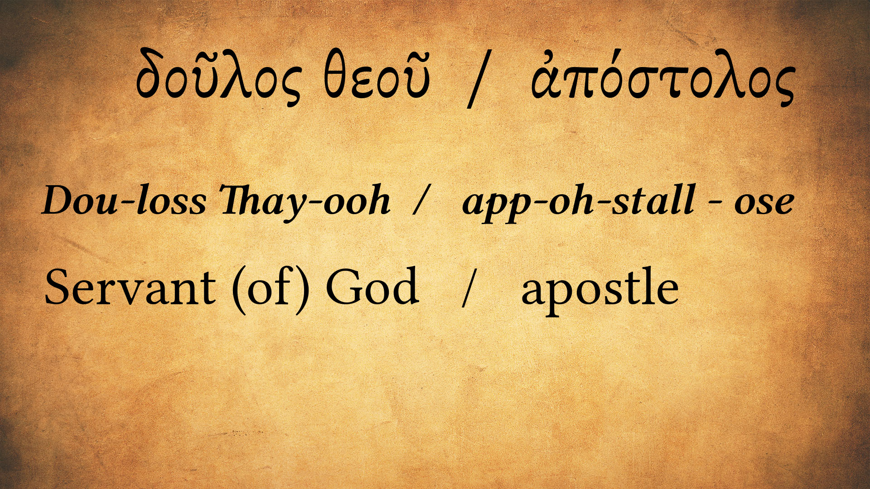

Slide 13
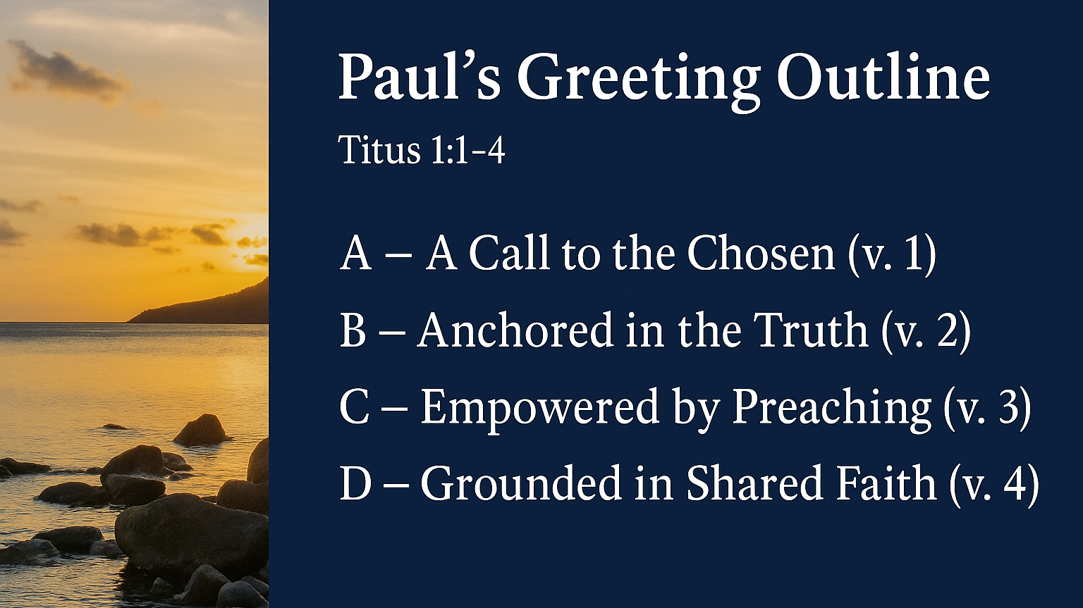

Slide 14
Modern Parallels
False gospels: Prosperity, NAR, Progressive theology
Compromise: LGBTQ theology, gender confusion
Like Crete: 'They profess to know God...' (Titus 1:16)

Slide 15
We are chosen to reflect Christ
Be contagious with gospel hope
Revitalization is not the finish line—it’s the launchpad

Slide 16
Application for FBC Norway
Warmer through Fellowship
Deeper through Discipleship
Stronger through Ministry
Larger through Evangelism

Slide 17


