Slide 1
“Standing strong in A stormy society”
Titus 1:5-14 [ESV]

Slide 2
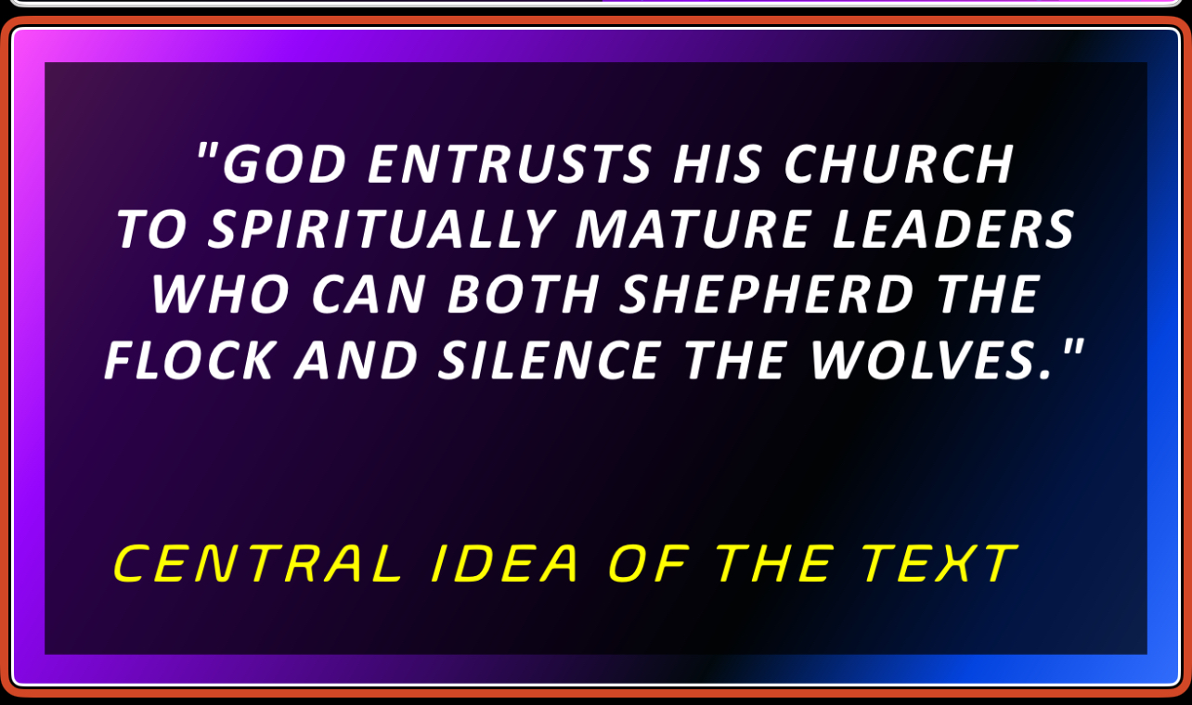

Slide 3
Point #1 - The Call is serious (vv. 5-6)

Slide 4
This is why I left you in Crete, so that you might put what remained in order, and appoint elders in every town as I directed you -
Titus 1:5 (ESV)

Slide 5
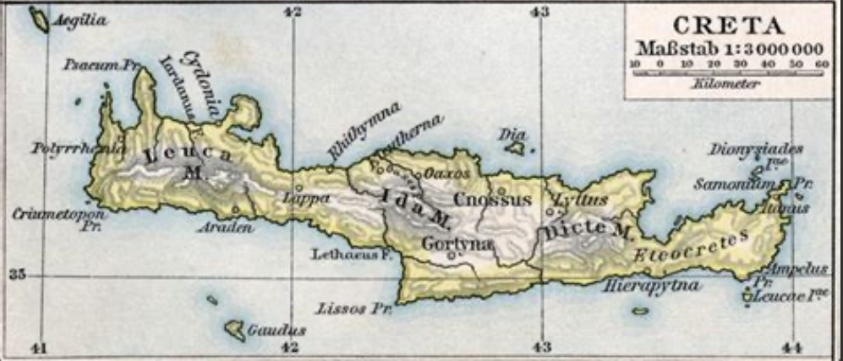

Slide 6
if anyone is above reproach, the husband of one wife, and his children are believers and not open to the charge of debauchery or insubordination.
Titus 1:6 (ESV)

Slide 7
Point #2 - The Character is steadfast (vv. 7-8)

Slide 8
For an overseer, as God’s steward, must be above reproach. He must not be arrogant or quick-tempered or a drunkard or violent or greedy for gain,
Titus 1:7 (ESV)

Slide 9
but hospitable, a lover of good, self-controlled, upright, holy, and disciplined.
Titus 1:8 (ESV)

Slide 10
Point #3 - The Conviction is sound (vv. 9-10)

Slide 11
He must hold firm to the trustworthy word as taught, so that he may be able to give instruction in sound doctrine and also to rebuke those who contradict it.
Titus 1:9 (ESV)

Slide 12
For there are many who are insubordinate, empty talkers and deceivers, especially those of the circumcision party.
Titus 1:10 (ESV)

Slide 13
Point #4 - The Compromise is shameful (vv. 11-12)

Slide 14
They must be silenced, since they are upsetting whole families by teaching for shameful gain what they ought not to teach.
Titus 1:11 (ESV)

Slide 15
One of the Cretans, a prophet of their own, said, “Cretans are always liars, evil beasts, lazy gluttons.”
Titus 1:12 (ESV)

Slide 16
Point #5 - The Command is to silence (vv. 13-14)

Slide 17
The testimony is true. Therefore rebuke them sharply, that they may be found in the faith,
Titus 1:13 (ESV)

Slide 18
not devoting themselves to Jewish myths and the commands of people who turn away from the truth.
Titus 1:14 (ESV)

Slide 19
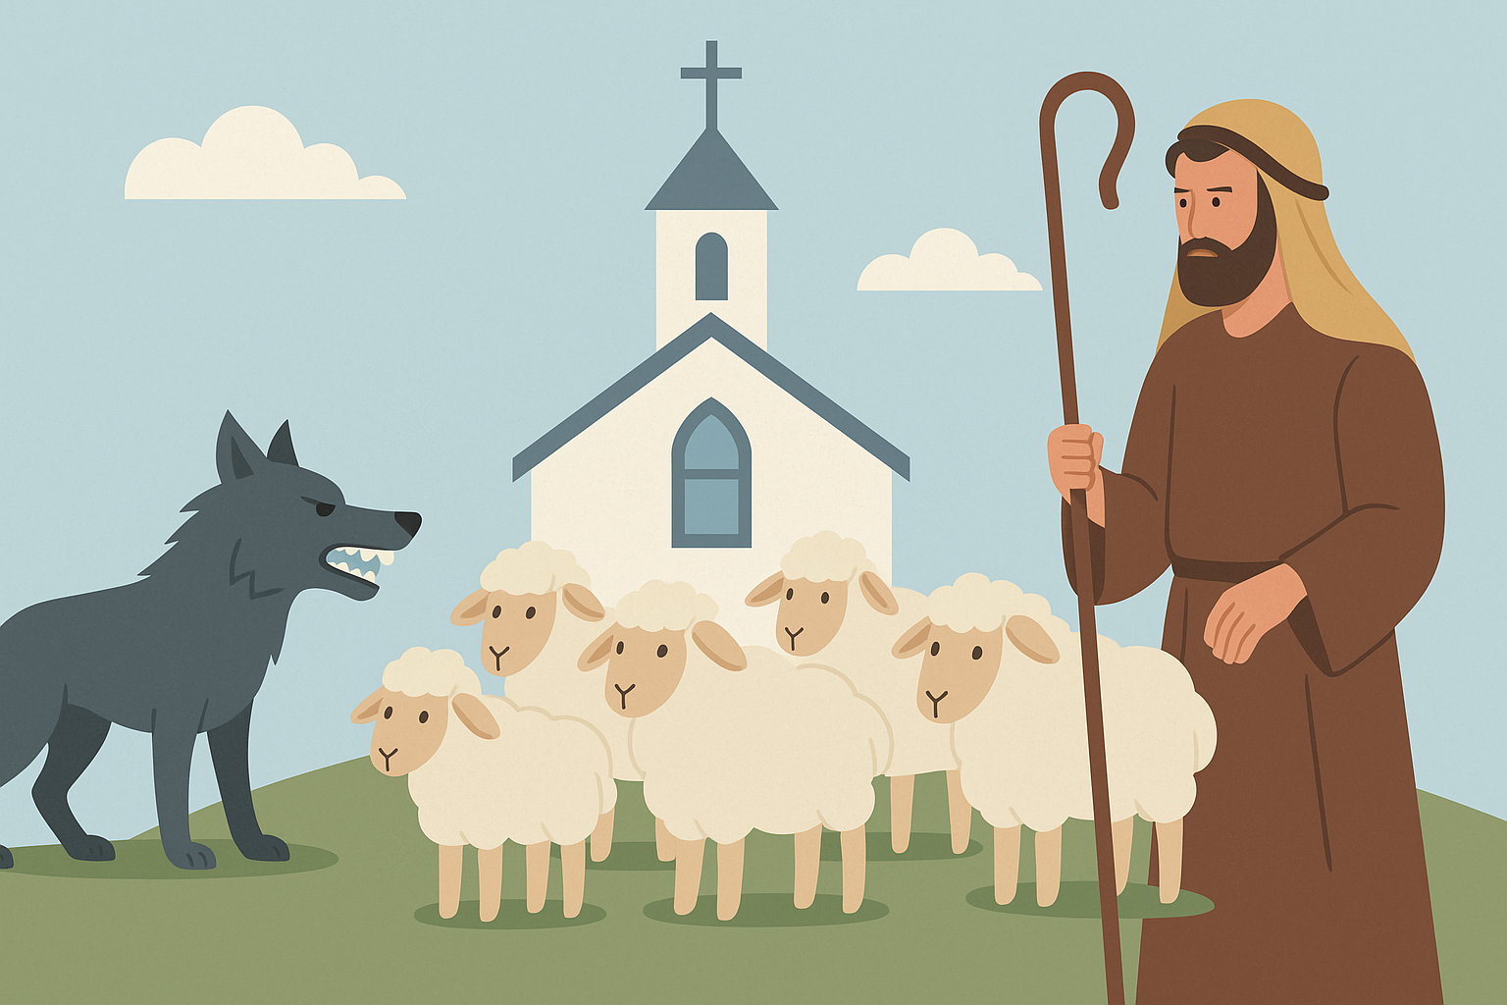
An Elder’s #1 responsibility
Shepherd
the flock
and silence
the wolves

Slide 20
Bad theology wolves may slip into the flock universalism prosperity gospel progressive theology works-based righteousness hyper-charismatic errors

Slide 21
How these wolves sneak in through: sentimentality relationships resource sharing

Slide 22
How to stop the infiltration without breaking the spirit teaching - prevention doctrinal gatekeepers address errors gently but firmly model humility and correction re-center on Christ’s sufficiency

Slide 23
“Standing strong in A stormy society”
Titus 1:5-14 [ESV]

