Slide 1


Slide 2
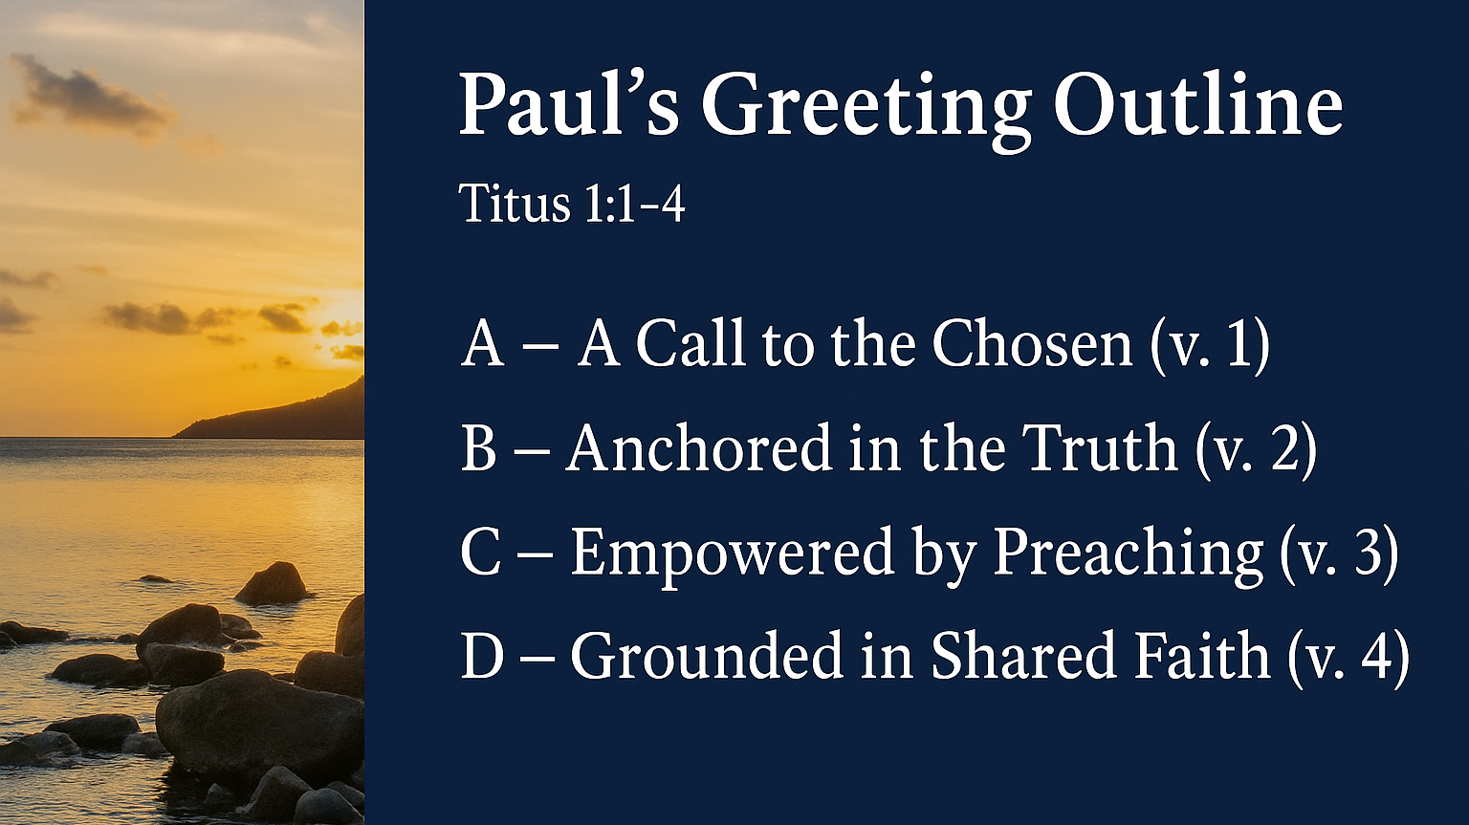

Slide 3
Titus 1:1 (ESV)
Paul, a servant of God and an apostle of Jesus Christ, for the sake of the faith of God's elect and their knowledge of the truth, which accords with godliness,

Slide 4
Titus 1:2 (ESV)
in hope of eternal life, which God, who never lies, promised before the ages began

Slide 5
Titus 1:3 (ESV)
and at the proper time manifested in His Word through the preaching with which I have been entrusted by the command of God our Savior;

Slide 6
Titus 1:4 (ESV)
To Titus, my true child in a common faith: Grace and peace from God the Father and Christ Jesus our Savior.

Slide 7
Outline in the bulletin:
1. For the sake of __THE FAITH__ (v. 1)
2. In the hope of __ETERNAL LIFE__(v. 2)
3. At the proper time of _HIS WORD_(v. 3)
4. For the purpose of _DISCIPLESHIP_(v. 4)

Slide 8
A Church Entrusted, Because You Matter to God
Discovering Your Call to Serve the King
You are needed, wanted, valued, appreciated, and loved by God and
your family here at FBC Norway!

Slide 9


BEFORE THE WORLD BEGAN … Before the Stars were given their name …
YOU matter to God!

Slide 10

The Letter to Titus - The Song of Paul’s Heart

Slide 11

1.) God chose you before time began (1-2a)

Slide 12
2.) God grows you through truth that transforms (1b)

Slide 13
3.) God secured your eternity with a promise (2)

Slide 14
4.) God sent His word through preachers - with a purpose (v. 3)

Slide 15
5.) God pours out His grace through gospel relationships (v. 4)

Slide 16
A Church Entrusted, Because You Matter to God
Discovering Your Call to Serve the King
You are needed, wanted, valued, appreciated, and loved by God and
your family here at FBC Norway!

Slide 17
What ? so what ? now what ?

