Slide 1


Slide 2

(18) Wives, submit to your husbands, as is fitting in the Lord. (19) Husbands, love your wives, and do not be harsh with them. (20)
Children, obey your parents in everything, for this pleases the Lord. (21) Fathers, do not provoke your children, lest they become discouraged
Colossians 3:18-21
Notes:
Men, your wife will submit ONLY once she knows that you have her best interest in mind.

Slide 3
(22) Slaves, obey in everything those who are your earthly masters, not by way of eye-service, as people-pleasers, but with sincerity of heart, fearing the Lord.
(23) Whatever you do, work heartily, as for the Lord and not for men,
Colossians 3:22 - 23
Notes:
Men, your wife will submit ONLY once she knows that you have her best interest in mind.

Slide 4
(24) Knowing that from the Lord you will receive the inheritance as your reward. You are serving the Lord Christ.
(25) For the wrongdoer will be paid back for the wrong he has done, and there is no partiality.
(4:1) Masters, treat your slaves justly and fairly, knowing that you also have a Master in heaven.
Colossians 3:24 - 4:1
Notes:
Men, your wife will submit ONLY once she knows that you have her best interest in mind.

Slide 5
1. Wives submit (v. 18)

Slide 6
Wives, submit to your husbands, as is fitting in the Lord.
Colossians 3:18
Notes:
Men, your wife will submit ONLY once she knows that you have her best interest in mind.

Slide 7

That which is
FITTING

Slide 8
Some of the same problems they had then still exist today!
(Shamanism, astrology, horoscope, submit/lead)

Slide 9
2. Husbands love (v. 19)

Slide 11
Husbands, love your wives, and do not be harsh with them.
Colossians 3:19
Notes:
Husbands do not need to be told that we are supposed to love their wife. We just need to know two things: (1) The language in which she would respond positively, and (2) which kind of love is most important to her heart (agape, eros, phileo…)

Slide 12
Notes:
Consider the dance and the embrace to represent God’s passionate love for us. He courts us. He asks us to the dance. He leads us by the hand, and into a unison of movement as we learn to follow His lead, His music, and His embrace.

Slide 13

1 Peter 3:8
Live in harmony with one another; be sympathetic…compassionate and humble. Do not repay evil with evil or insult with insult.

Slide 14
3. Children obey (v. 20)

Slide 15
Children, obey your parents in everything, for this pleases the Lord.
Colossians 3:20

Slide 16
4. Fathers encourage (v. 21)

Slide 17
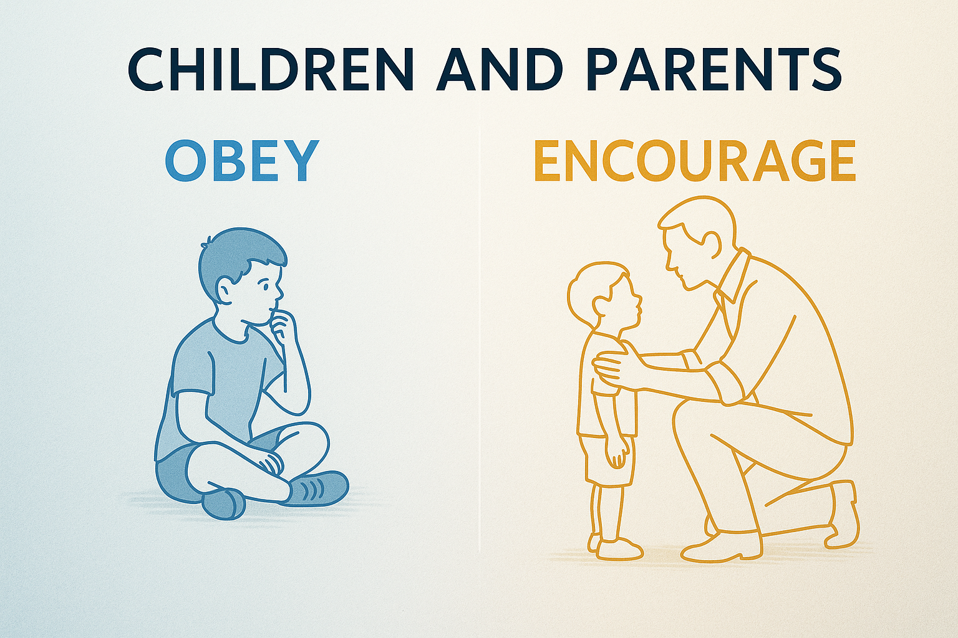

Slide 18
Paul wrote these
same commands in
Ephesians 5:22-6:9

Slide 19
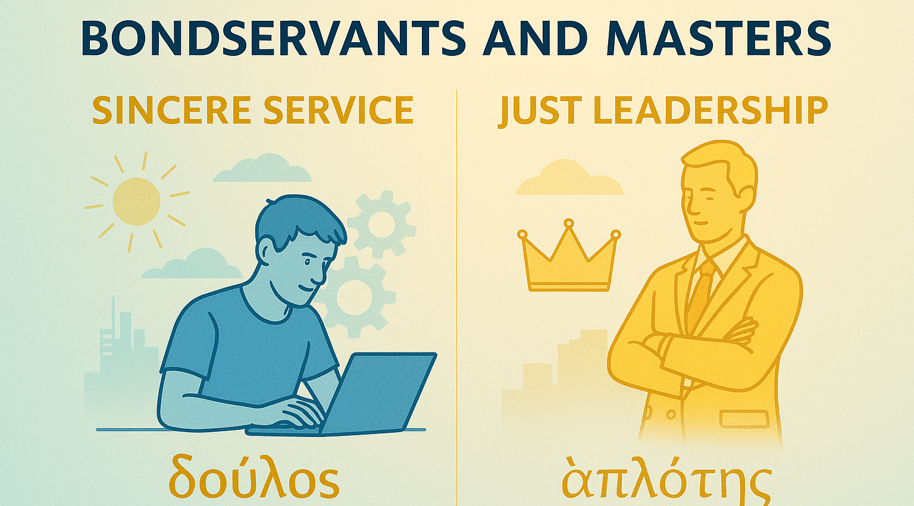

Slide 20
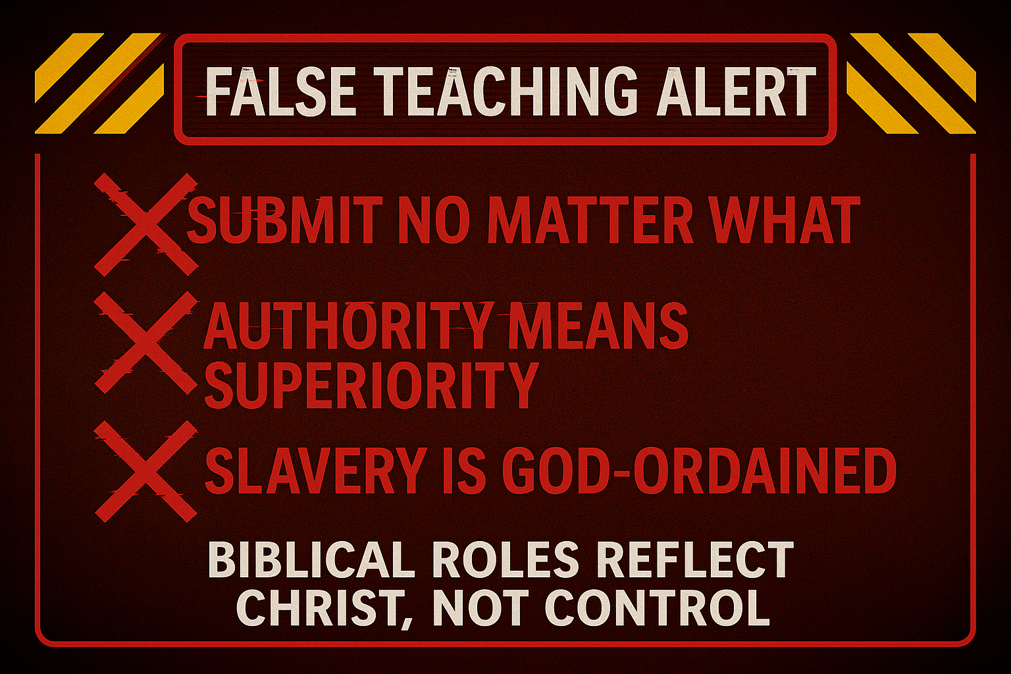

Slide 21
Bondservants, ____ as unto the Lord:
5a. obey (v. 22)
5b. work (v. 23)
5c. serve (v. 24)

Slide 22
6. Masters treat fairly (3:25-4:1)

Slide 23
Paul is picking up momentum re: the Heavenly Home with nine (9) imperatives

Slide 24
Can this be said of
your family life?
“Your Home is
Absolutely Heavenly!”

