Slide 1
The Spiritually Mature Prayer Warrior
Colossians 4:2-6 (ESV)
Rev. Dr. David T. Williamson, Senior Pastor

Slide 2
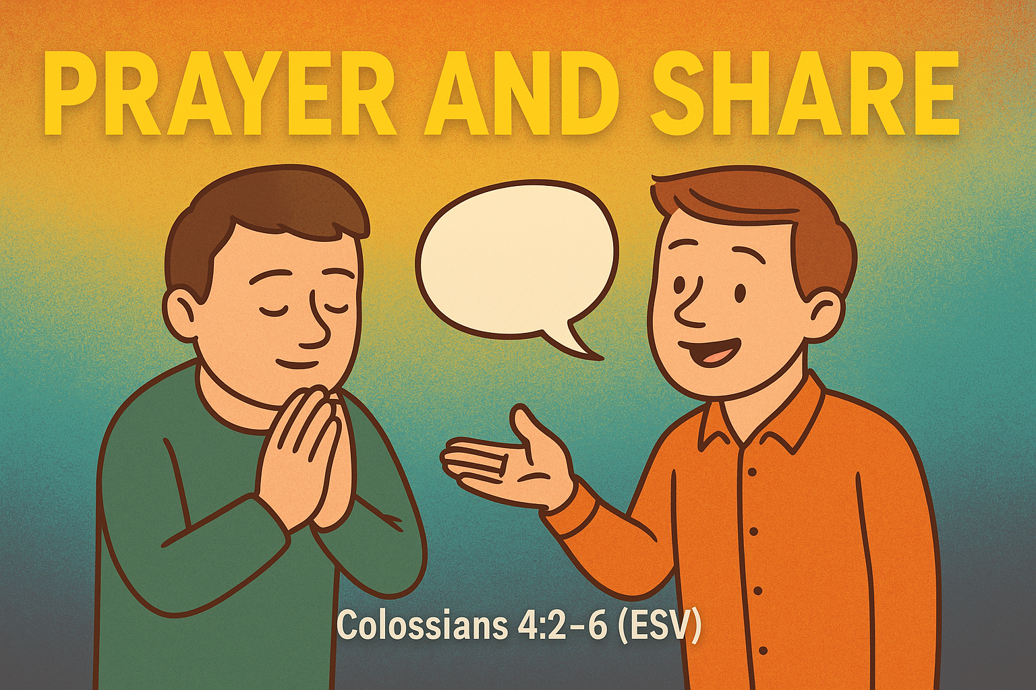
Prayer and Share: The Gospel Life in Action

Slide 3

Colossians 4:2a
“Continue steadfastly in prayer being watchful in it with thanksgiving.”

Slide 4

The Spiritually Mature Prayer Warrior Should Be:
4:2a – Consistent in Prayer

Slide 5
Colossians 4:2b
“Continue steadfastly in prayer being watchful in it with thanksgiving.”

Slide 6
The Spiritually Mature Prayer Warrior Should Be:
4:2b – Watchful in Praise

Slide 7
Colossians 4:3
“At the same time pray also for us that God may open to us a door for the Word to declare the mystery of Christ on account of which I am in prison.”

Slide 8
The Spiritually Mature Prayer Warrior Should Be:
4:3 – Dashing through Doors
What do DQ and Mormons have in common?

Slide 9
Colossians 4:4
…that I may make it clear which is how I ought to speak.

Slide 10
The Spiritually Mature Prayer Warrior Should Be:
4:4 – Simple in Speech
Notes:
Did you know that EVERY Word you speak matters?
And by that I do not mean what you will hear TV preachers say, “What you say today will manifest itself tomorrow.”
Christianity should NEVER be reduced to a name it and claim it manifest destiny “Live Your Best Life Now” formula for earthly gain.
When I say that EVERY WORD WE SPEAK MATTERS I am tying that to the words of Scripture.
The prophet Isaiah (55:11) said - God speaking… “So is My word that goes out from My mouth: It will not return to Me empty but will accomplish what I desire and achieve the purpose for which I sent it.”
Ezekiel quotes God saying it like this: (12:28), “Therefore say to them, Thus says the Lord GOD: None of My words will be delayed any longer, but the word that I speak will be performed, declares the Lord GOD.”
And the author of Hebrews describes the Word of God in 4:12 as being ALIVE and FILLED WITH POWER - “For the Word of God is living and active, sharper than any two-edged sword, piercing to the division of soul and of spirit, of joints and of marrow, and penetrating to the heart of what is thought.”
Matthew 24:35 (Jesus speaking), “Heaven and earth will pass away, but My words will not pass away.”
1 Peter 1:25 - “But the word of the Lord endures forever.”
IOW, GOD’S WORD IS POWERFUL… IT IS RELIABLE… AND IT WILL ALWAYS BE FULFILLED IN GOD’S TIME, FOR HIS PURPOSE, AND TO HIS GLORY!
Just think of it… YOU and I get to participate in God’s greater plan to fulfill His unyielding Word … in many circumstances, just by being a prayer warrior, growing in spiritual maturity, and being simple in our speech.
How are we simple in our speech? BY PROCLAIMING THE GOOD NEWS WHICH IS JESUS CHRIST.
… EXAMPLE - If I really wanted to, I COULD bring my Greek Bible to the pulpit and preach a sermon from the Greek text. I could bring you through a confusing series of morphology, dissecting every word, its prefixes and suffixes, case stems and augmentations, talk about rough breathing marks and why the Vocative Mood is seldom taught in seminary level Greek classes.
I could recite to you Scripture verses memorized in Koine Greek, such as the Lord’s Prayer or perhaps even the Jude 24-25 benediction … and NONE OF IT WOULD MEAN A THING TO YOU. As a matter of fact, it would only make ME look bad. And it’s not that I am trying to look good or to impress anyone here … because if I SAID or DONE anything, including a gospel illusion for a sermon illustration, to make me look good, or clever, or WHATEVER… it would be for all the wrong reasons.
And I think everyone of you could from your heart say a hearty AMEN TO THAT!
Paul could have spoken circles around those who heard his sermons, his declarations that Jesus is the Promised Messiah come to save the world. He was well trained, extremely intelligent, and could craft well-written speeches with the best of them.
But HIS PRAYER - HIS DESIRE - and I would add - GOD’S DESIRE FOR YOU AND FOR ME - to meet people where they are at… to speak with truths of Scripture simply, directly, and without reservation or hesitation.
WE HAVE THE WORDS OF LIFE… WE HAVE BEEN GIVEN THE WORDS OF ETERNAL LIFE TO SHARE WITH THOSE WHOM GOD HAS PLACED IN YOUR PATH.
John 6:63 - 68 … It is the Spirit who gives life; the flesh is no help at all. The words that I have spoken to you are spirit and life. But there are some of you who do not believe.” ((For Jesus knew from the beginning who those were who did not believe, and who it was who would betray Him.) And He said, “This is why I told you that no one can come to Me unless it is granted him by the Father.” After this many of His disciples turned back and no longer walked with Him. So Jesus said to the 12, “Do you want to go away as well?” Simon Peter answered Him, “Lord, to whom shall we go? You have the worlds of eternal life, and we have believed, and have come to know, that You are the Holy One of God.”

Slide 11
Colossians 4:5
Walk in wisdom toward outsiders making the best use of time.

Slide 12
The Spiritually Mature Prayer Warrior Should Be:
4:5 – Walking in Wisdom

Slide 13
Colossians 4:6
Let your speech always be gracious seasoned with salt so that you may know how you ought to answer each person.

Slide 14
The Spiritually Mature Prayer Warrior Should Be:
4:6 – Gracious in Replies

Slide 15

The Spiritually Mature Prayer Warrior Should Be:
4:2a – Consistent in Prayer
4:2b – Watchful in Praise
4:3 – Dashing through Doors
4:4 – Simple in Speech
4:5 – Walking in Wisdom
4:6 – Gracious in Replies

Slide 16
The Spiritually Mature Prayer Warrior
Colossians 4:2-6 (ESV)
Rev. Dr. David T. Williamson, Senior Pastor

