Slide 1
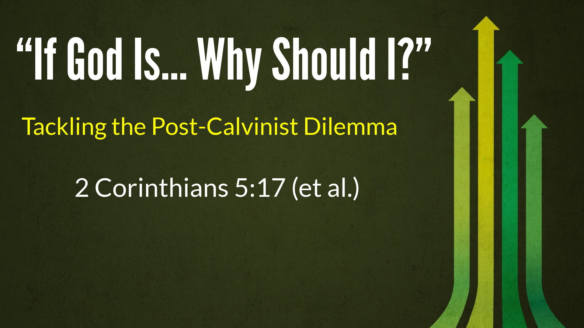

Slide 2

The Five Solas of the Great Reformation
Sola Gratia (Grace)
Sola Fide (Faith)
Solus Christus (Christ)
Sola Scriptura (Scripture)
Soli Deo Gloria (Glory of God)

Slide 3
The Five Points of Calvinism:
T - Total Depravity
U - Unconditional Election
L - Limited Atonement
I - Irresistible Grace
P - Perseverance of the Saints

Slide 4
The Five “Responses” of Arminianism:
F - Free Will (it is up to us)
A - Atonement for All (Christ died for all, not just the elect)
C - Conditional Election (God knew beforehand whosoever would)
T - Total Depravity (man can still seek God even if he is not drawn to Him)
S - Security in Christ (not assured)

Slide 5
Because God is Sovereign, and because we are IN CHRIST ALONE We get to Pray Specifically and Evangelize Confidently

Slide 6
Because God is Sovereign, we have a: 1. NEW IDENTITY IN CHRIST 2. NEW PERSPECTIVE FOR LIFE 3. NEW STRENGTH TO SERVE

Slide 7
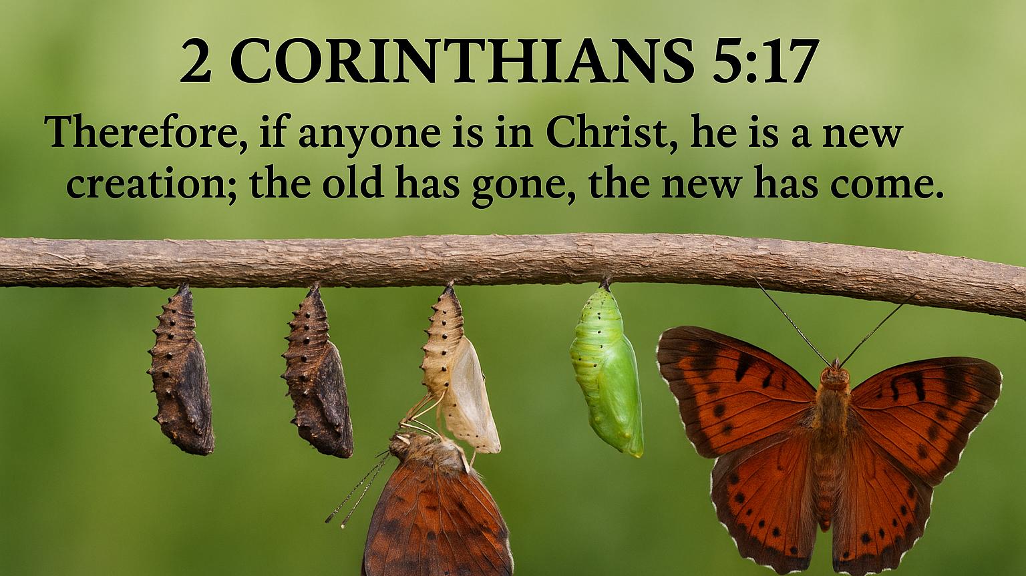

Slide 8
Because God is Sovereign, we have a: 1. NEW IDENTITY IN CHRIST 2 CORINTHIANS 5:11, 14-21

Slide 9
We have been TRANSFORMED μεταμορφόω
be changed, transformed, transfigured
Rom 12:2; 2 Cor 5:17

Slide 10
We are to REFLECT Christ’s image: εἰκών
Image, likeness, portrait, representation… mimic
Romans 8:28-30

Slide 11
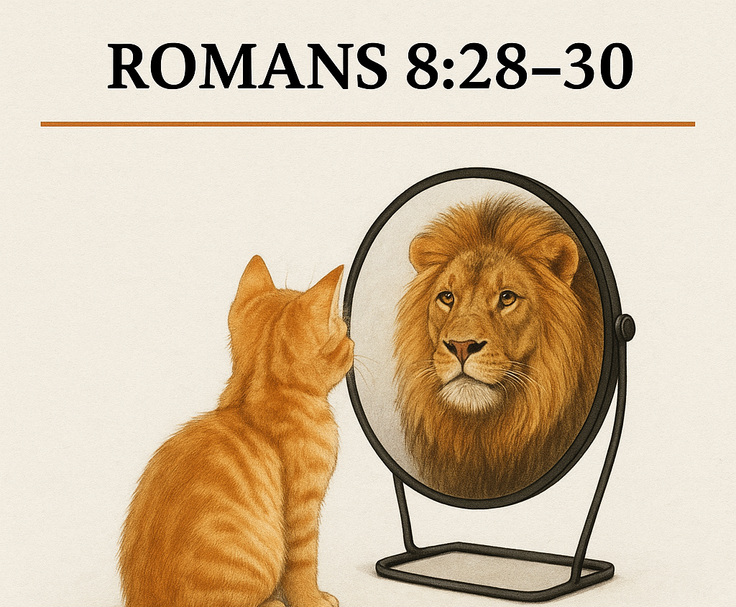

We have a new identity in Christ:
b.) We are to reflect Christ’s image.

Slide 12
We now SERVE our brothers/sisters, for HIS glory: διακονέω
Wait upon, be at one’s service, render assistance, to help/aid - DEACON
1 Peter 4:10-11

Slide 13

Because God is Sovereign, We Have a New Identity in Christ - a.) We are TRANSFORMED b.) We REFLECT Christ’s image c.) We SERVE for His glory.

Slide 14
Because God is Sovereign, we have a: 2. NEW PERSPECTIVE FOR LIFE
“Seeing the world through the eyes of God.”

Slide 15
2. New Perspective in Christ: a.) We can think differently about our struggles. (Rom 12:1-2; Phil 4:6-9)

Slide 16
2. New Perspective in Christ: b.) We can view trials as opportunities (James 1:2-4)

Slide 17


Slide 18
2. New Perspective in Christ: c.) Our outlook is hopeful because we have assurance of victory (Testing - δοκίμιον) …proof of genuineness, judge, evaluate, asserting authenticity (1 John 5:1-5)

Slide 19
Because God is Sovereign, We have a: 1. NEW IDENTITY IN CHRIST 2. NEW PERSPECTIVE FOR LIFE 3. NEW STRENGTH TO SERVE

Slide 20
3. Because of a new strength to serve in Christ: a.) We are empowered by the Holy Spirit. (Acts 1:8; 2 Cor 12:9-10; Eph 3:14-21)

Slide 21


Slide 22
3. Because of a new strength to serve in Christ: b.) We are gifted with and by the Holy Spirit. (Acts 1:8; 2 Cor 12:9-10; Eph 3:14-21)

Slide 23


Slide 24
3. Because of a new strength to serve in Christ: c.) We are no longer restricted by human limitations because we are filled with the Holy Spirit. (1Cor 6:19-20; Eph 5:18)

Slide 25
Because God is Sovereign, and because we are IN CHRIST ALONE We get to Pray Specifically and Evangelize Confidently

