Slide 1
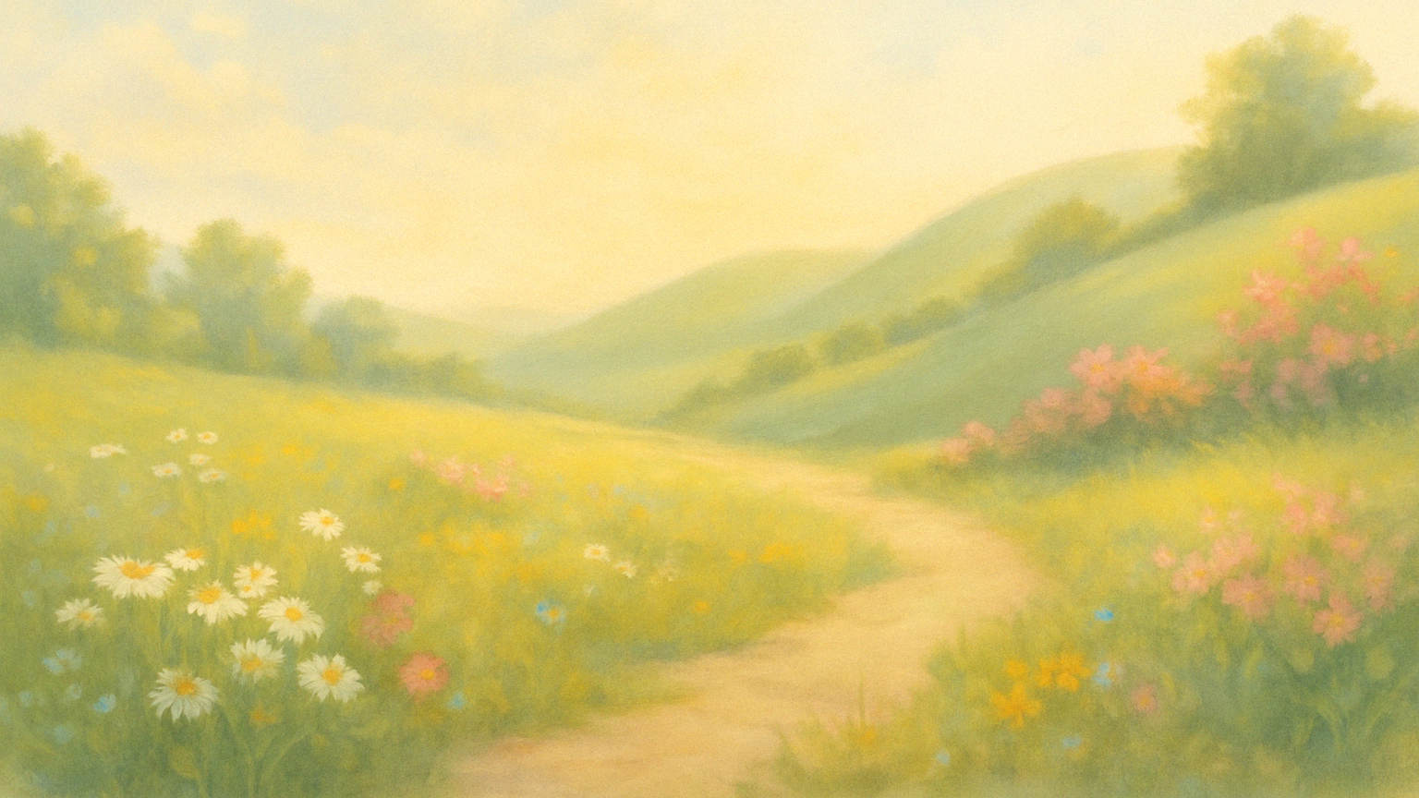
Risen to Reign:
“His Greatest Miracle,
Our Greatest Mercy”
John 20:1-18

Slide 2
(CIT) Because Jesus conquered death and rose in victory, we can receive the mercy of salvation and walk in the freedom of grace, not the burden of works.

Slide 3
1. The Empty Tomb - death could not hold Him, nor will it hold those who believe. 2. The Empty Grave Clothes - peace can rule in your heart (not panic). 3. The Empty Heart - despair is replaced by a heart filled with joy and hope for a new life.

Slide 4

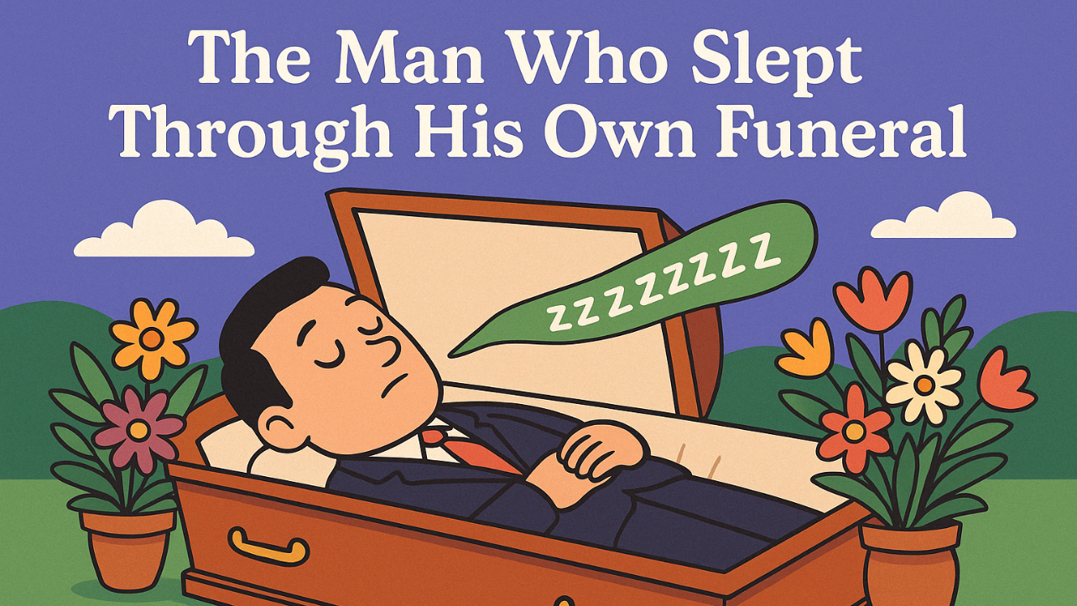

Slide 5
John 20:1-5
1. The Death-Defeating Miracle
“The Empty Tomb -
Death Could Not Hold Him”

Slide 6




20:1 Now on the first day of the week (Sunday) Mary Magdalene came to the tomb early, while it was still dark, and saw that the stone had been taken away from the tomb.
But WHY?

Slide 7
20:2 So she ran and went to Simon Peter and the other disciple, the one whom Jesus loved, and said to them, “They have taken the Lord out of the tomb, and we do not know where they have laid Him.”
?
v. 1 highlights only Mary

Slide 8

20:3 So Peter went out with the other disciple, and they were going toward the tomb.
20:4 Both of them were running together, but the other disciple outran Peter and reached the tomb first.

Slide 9
20:5 And stooping to look in, he saw the linen cloths lying there, but he did not go in.
The Death-Defeating Miracle…

Slide 10
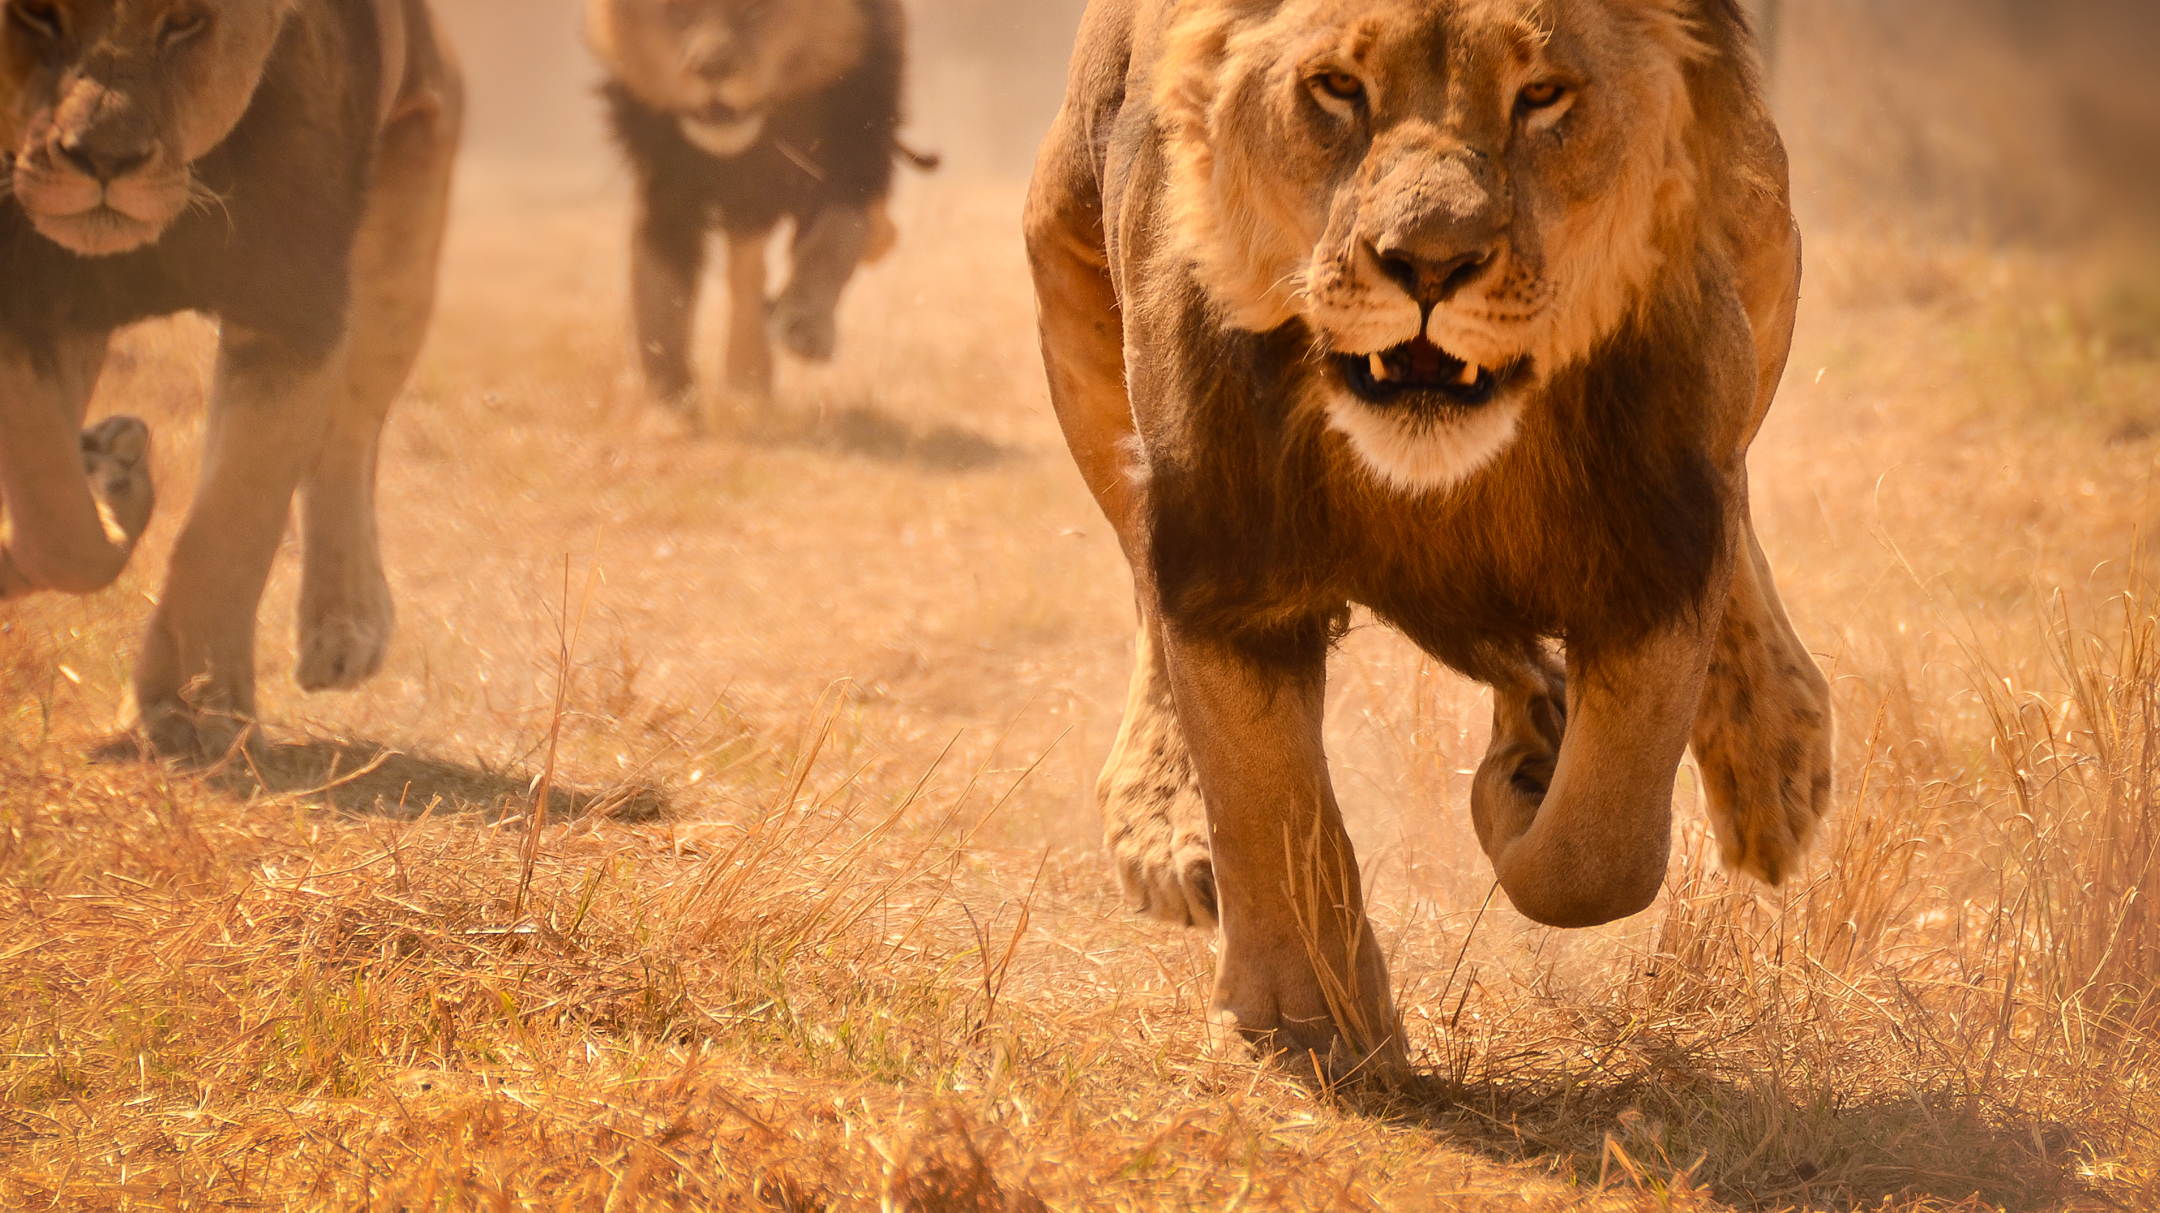
The Spiritual Significance of the Foot Race Between John and Peter.

Slide 11
John 20:6-7
2. The Rule-Writing Religion
The Empty Grave Clothes - represents peace, not panic.
(See v. 2)

Slide 12
20:6 Then Simon Peter came, following him, and went into the tomb. He saw the linen cloths lying there…
Fitted sheet?

Slide 13
20:7 … and the face cloth, which had been on Jesus' head, not lying with the linen cloths but folded up in a place by itself.
Fitted sheet?

Slide 14
3. The Gift-Seated Messiah
John 20:11-18

Slide 15
