Slide 1
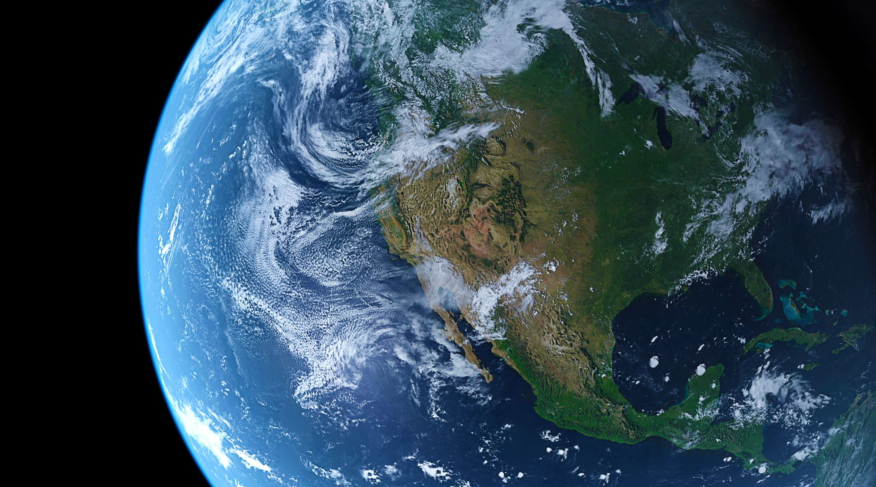
Dead to the World -
Made Alive in Christ
Colossians 3:5-11

Slide 2
BACKGROUND and
INTRODUCTION
Colossians 3:1-4, 5-11

Slide 3


Colossians 3:1-4
1 - If then you have been raised with Christ, seek the things that are above, where Christ is, seated at the right hand of God.
2 - Set your minds on things that are above, not on things that are on earth.
3 - For you have died, and your life is hidden with Christ in God.
4 - When Christ who is your life appears, then you also will appear with Him in glory.

Slide 4
Glory - δόξα
ADJECTIVE - the condition of being bright or shining; having brightness, splendor, radiance.
NOUN - Glory is both the PLACE where God the Father dwells in perfect holiness and the CONDITION we will share when Christ returns.

Slide 5
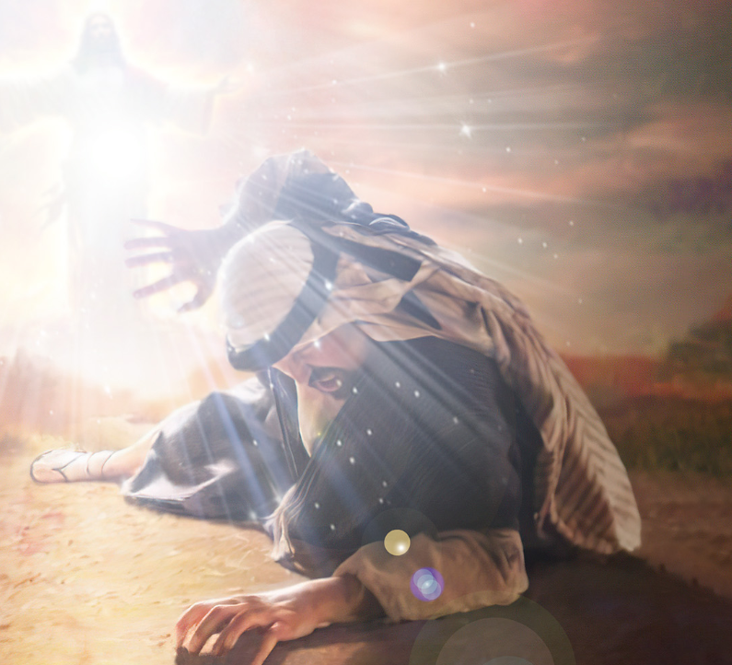
Saul -
Blinded by the Glory of Christ
Acts 9:3-8, 22:11

Slide 6

Surnames - England 11th Century
Patronymic - “son of”
Occupation
Location
Description of Character or Body

Slide 7

Jesus, who is the Christ!
Acts 4:12 (NLT)
“There is no way to be saved from the punishment of sin through anyone else. For there is no other name under heaven given to men by which we can be saved.”

Slide 8
Colossians 3:5-6
1.
“Do not let sin reign
In your mortal bodies.”
Put Sin to Death.

Slide 9
Colossians 3:5-6
5 Put to death therefore what is earthly in you: sexual immorality, impurity, passion, evil desire, and covetousness, which is idolatry.
6 On account of these the wrath of God is coming.
(Some manuscripts- … upon the sons of disobedience).

Slide 10
Νεκρώσατε
(neck-row-sat-ay)
Verse 5 Put to death
Slay, destroy the strength of, deprive of power.
Thrown off, tossed aside, never again…

Slide 11
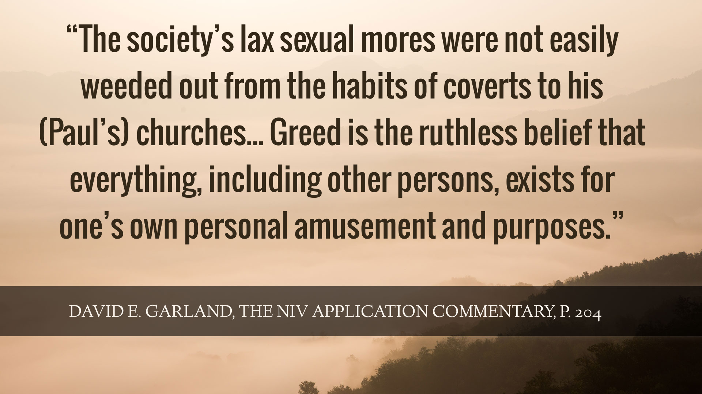

Slide 12
Colossians 3:7-9
2.
Take off the
grave clothes -
“Burn that which binds.”

Slide 13
Colossians 3:7-9
7- In these you once walked, when you were living in them.
8- But now you must put them all away: anger, wrath, malice, slander, and obscene talk from your mouth.
9- Do not lie to one another, seeing that you have put off the old self with its practices.

Slide 14
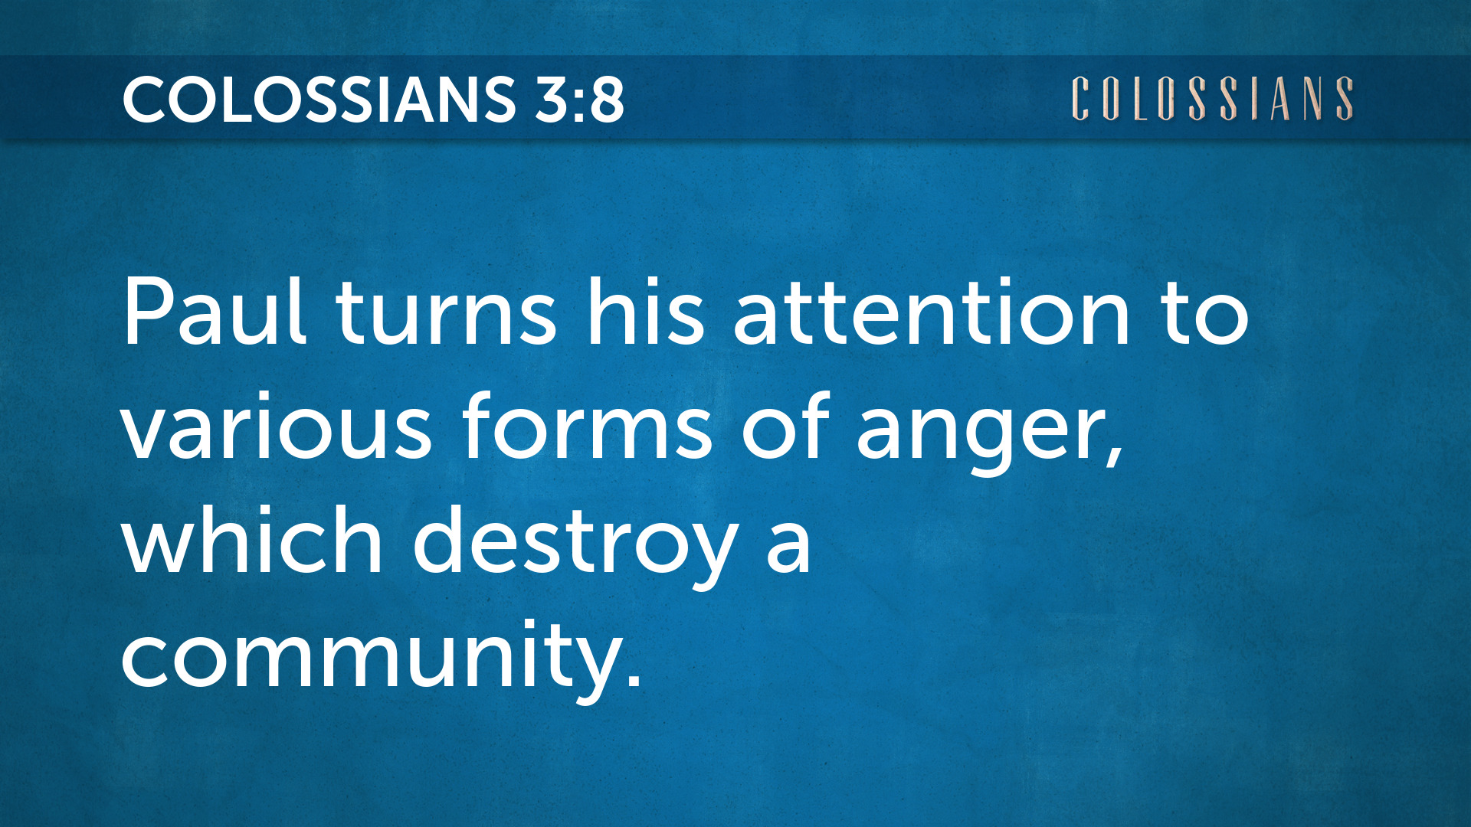

Slide 15
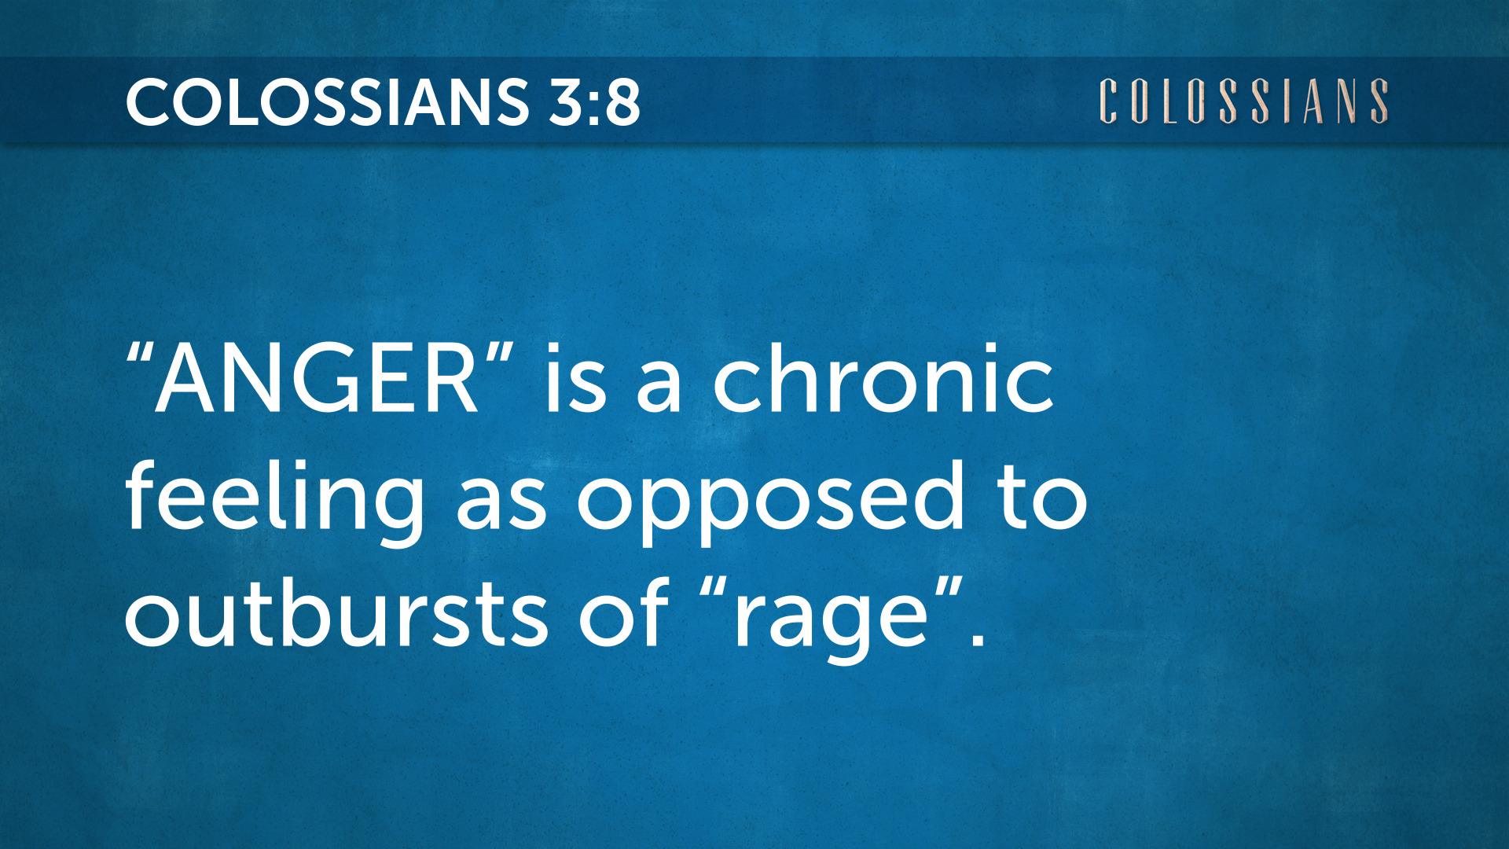

Slide 16
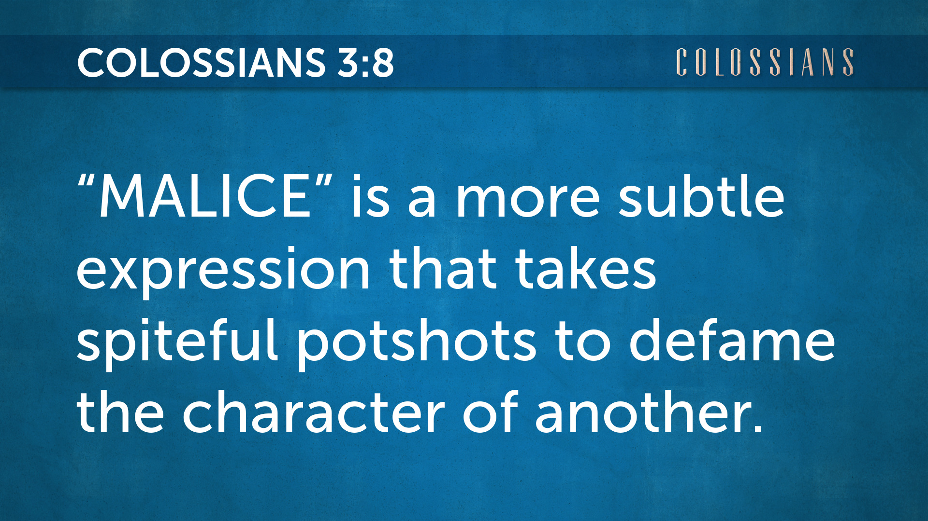

Slide 17
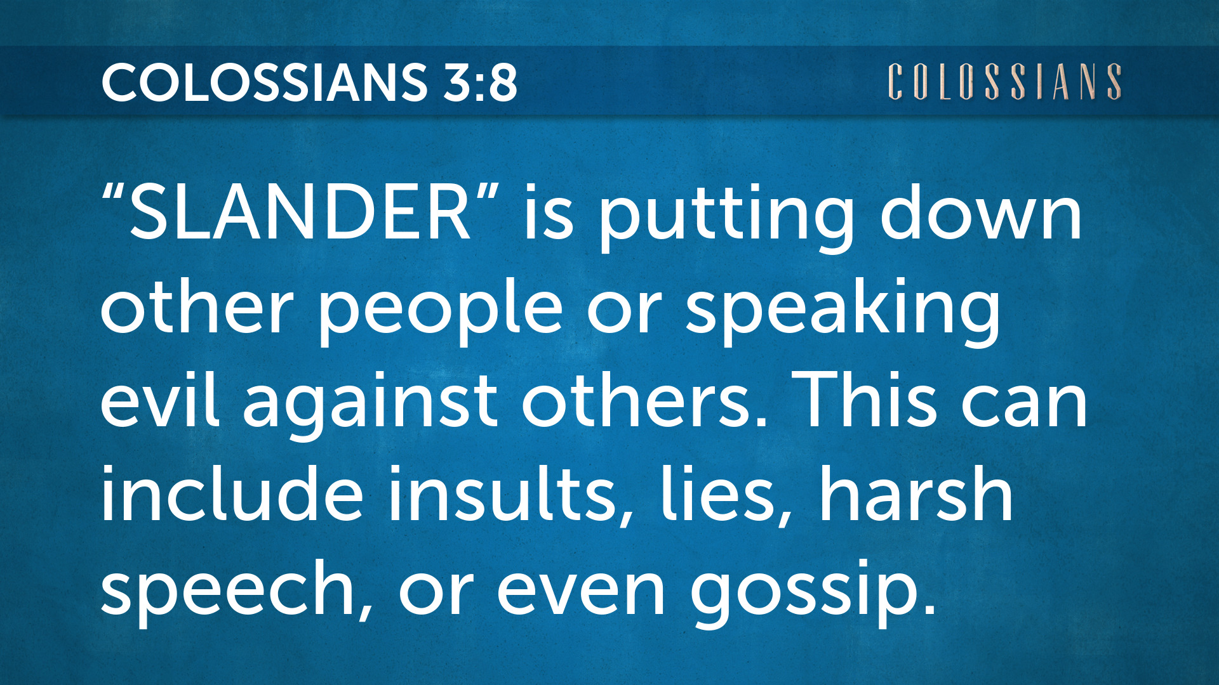

Slide 18
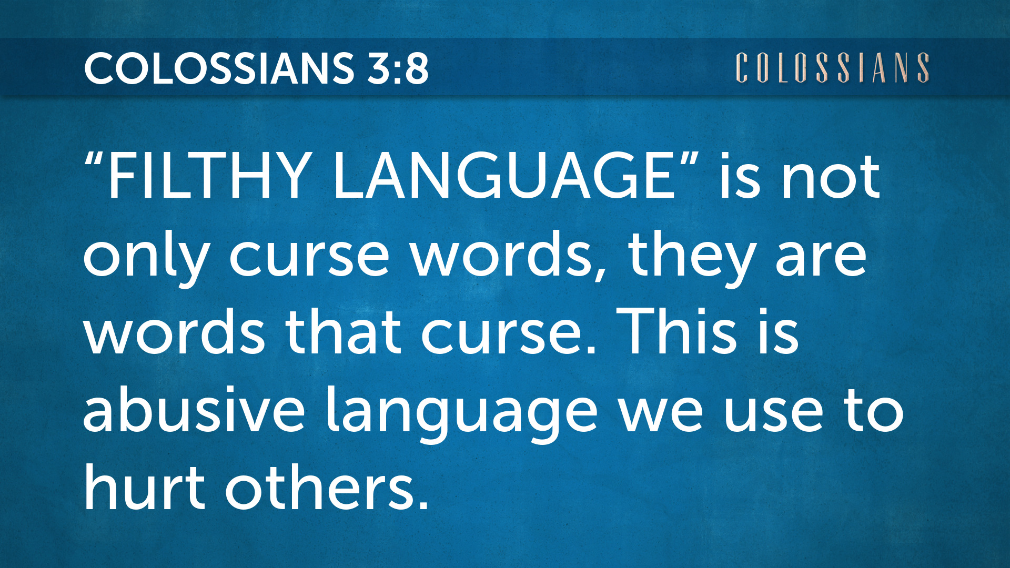

Slide 19
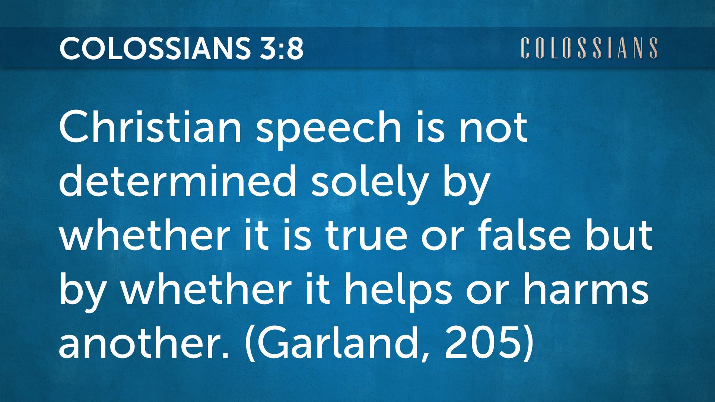

Slide 20

“Christian speech in general is not determined solely by whether it is true or false but by whether it helps or harms another.”
(Garland, NIV Application Commentary, p. 205)

Slide 21
Colossians 3:10-11
3.
Put on the new self -
“Who do you see when
you look in the mirror?”

Slide 22
Colossians 3:10-11
3.
10 - and have put on the new self, which is being renewed in knowledge after the image of its Creator.
11 - Here there is not Greek and Jew, circumcised and uncircumcised, barbarian, Scythian, slave, free; but Christ is all, and in all.

Slide 23


Slide 24

For those who participated in my doctoral project - the confidential one-on-one interviews and the discipleship training course

Slide 25
Dead to the World -
Made Alive in Christ
Colossians 3:5-11

