Slide 1
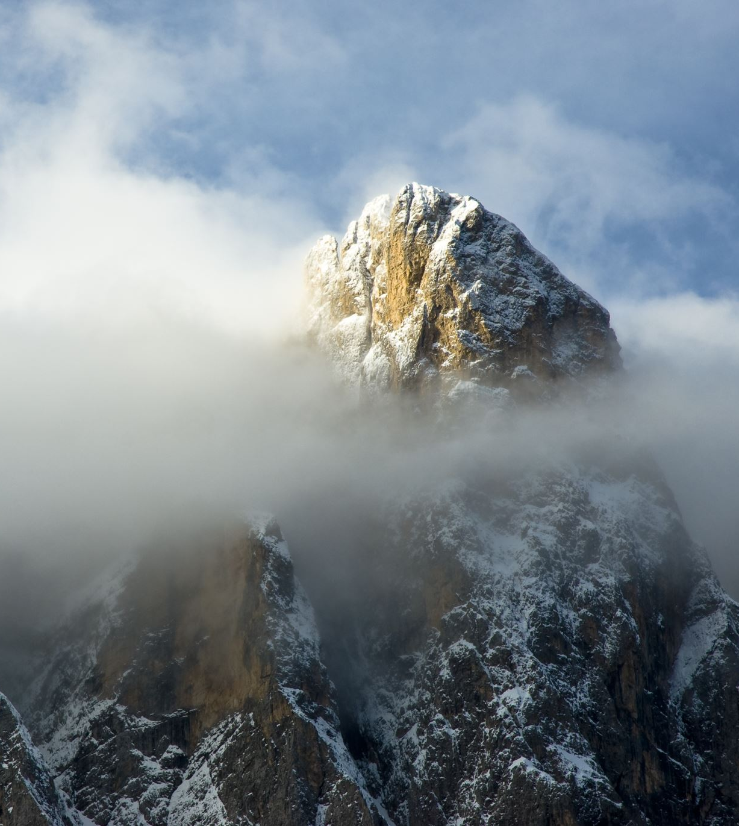
“Living the High Life” Colossians 3:1-4 (ESV)

Slide 2
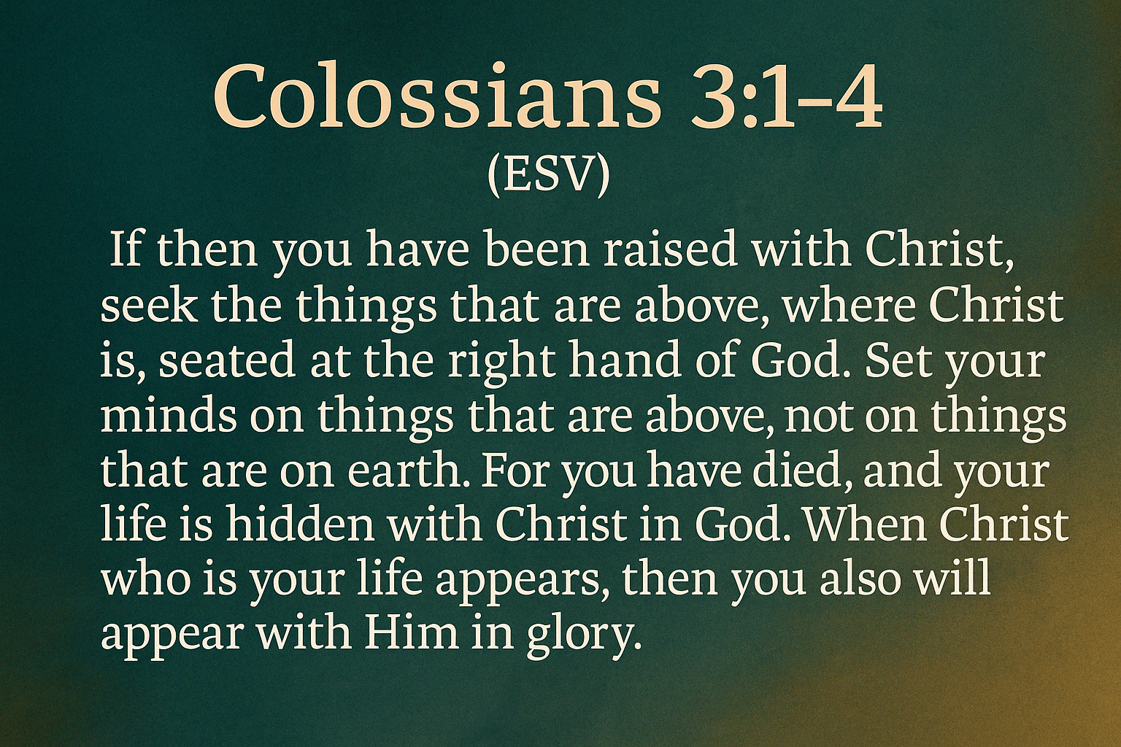

Slide 3
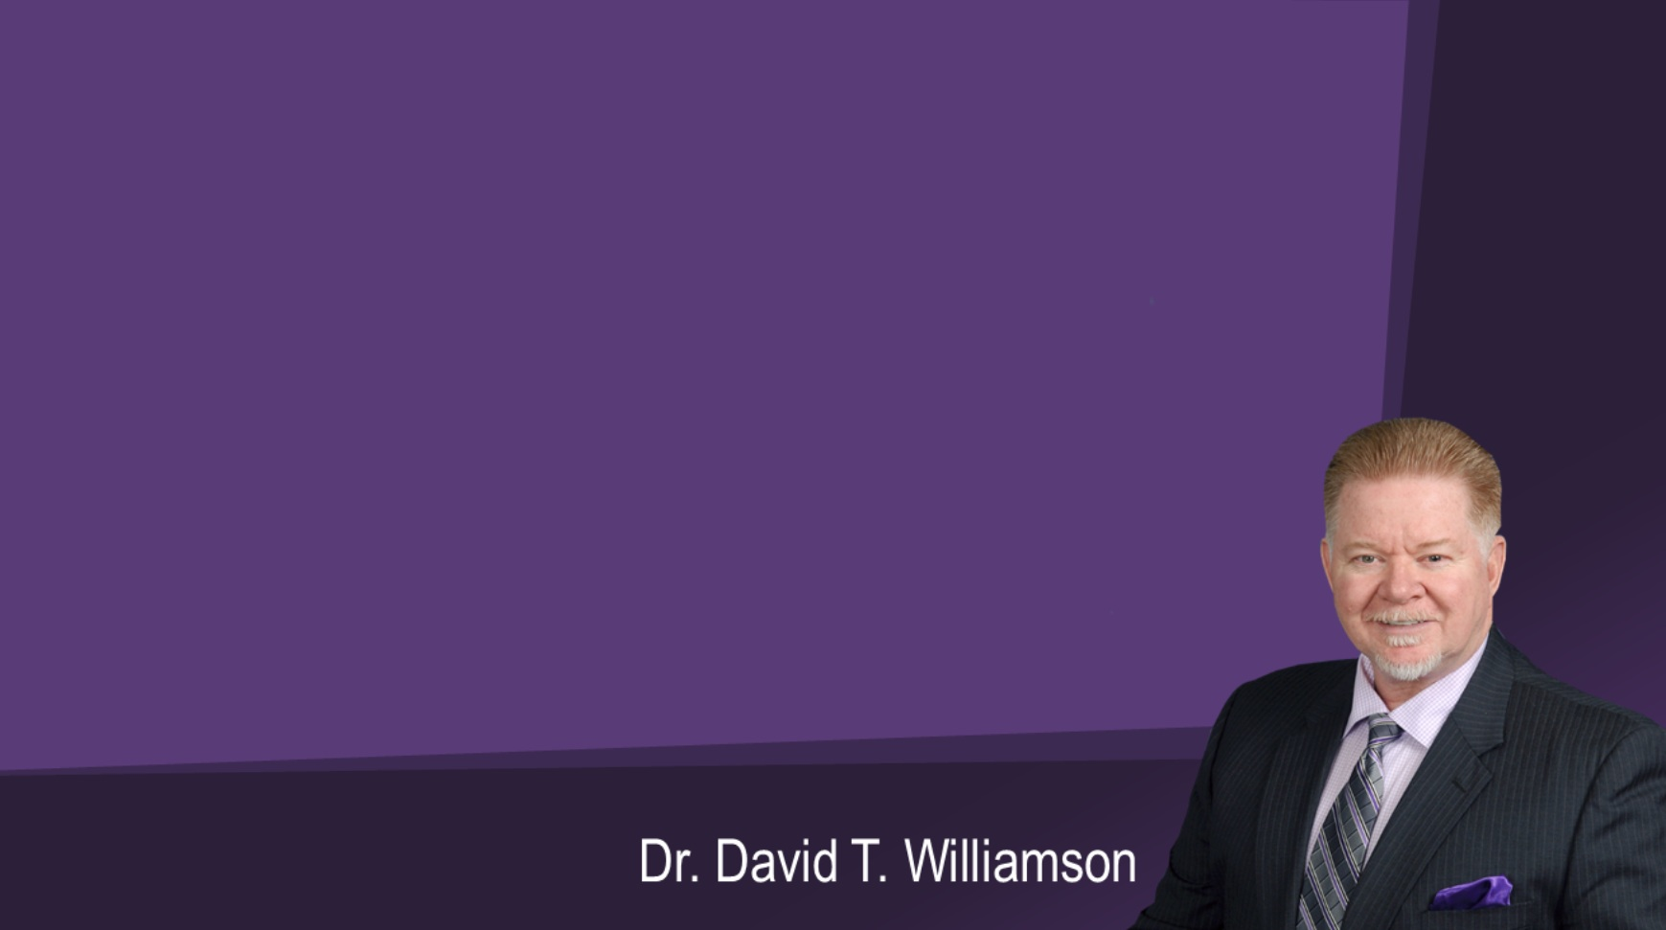
Central Idea of the Text (CIT):
“If you belong to Jesus, your life is no longer tied to this world; but instead, it is hidden with Christ in heaven. When Christ returns, you will appear with Him in glory. This is the new life.”

Slide 4
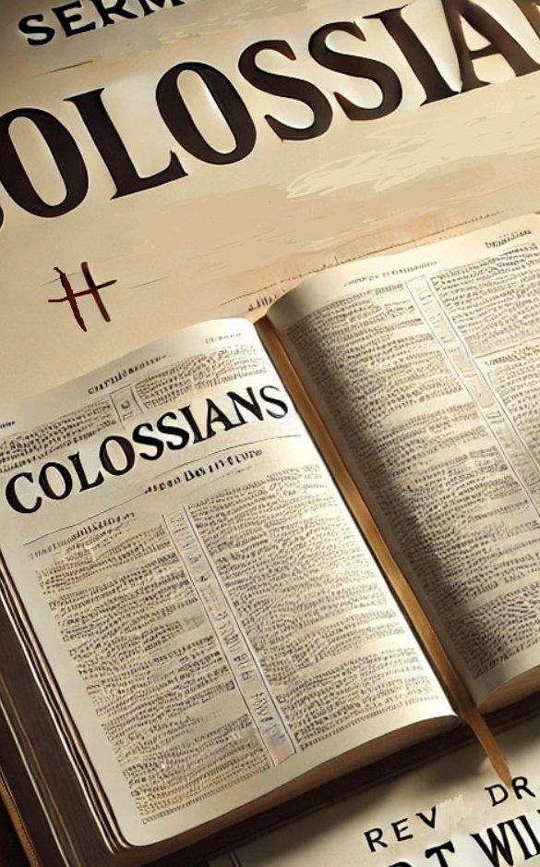
Christ above - He reigns
Colossians 3:1
Christ within - He rewires
Colossians 3:2
Christ ahead - He raises
Colossians 3:3-4

Slide 5
1. We have been buried with Christ in heaven.
Past tense
Verse 3

Slide 6
For you have died, and your life is hidden with Christ in God. Colossians 3:3

Slide 7
2. We are raised with Christ in life.
Present tense
Verse 1

Slide 8
If then you have been raised with Christ, seek the things that are above, where Christ is, seated at the right hand of God. Colossians 3:1

Slide 9
3. We will appear with Christ in glory.
Future tense
Verse 4

Slide 10
When Christ who is your life appears, then you also will appear with Him in glory. Colossians 3:4

Slide 11
4. Therefore, focus on the eternal benefits of walking close to Christ.
Past tense
Verse 2

Slide 12
Set your minds on things that are above, not on things that are on earth. Colossians 3:2

Slide 13
Romans 6:1-8 (NIV) Dead to sin, Alive in Christ. Buried with Christ in baptism. Raised by God to His glory and for our new life.

Slide 14
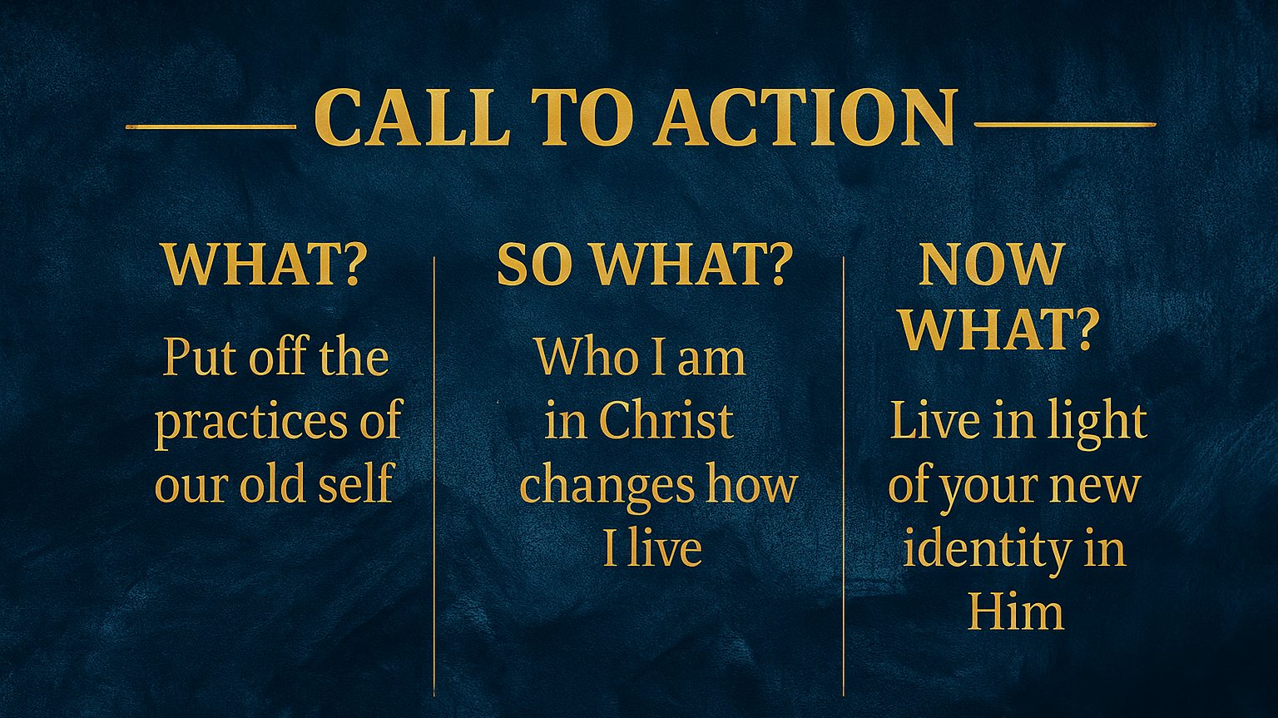

Slide 15
NEXT WEEK:
We will go on a deep dive into Colossians 3:5-11 to see
“How to Put Your
Past Hurts Behind You!”
Invite a Friend!

