Slide 1
“You’re Putting Me On!” (God‘s Great Exchange) COLOSSIANS 3:11-14 (ESV)

Slide 2
1. Who/Whose we are (12a) 2. What we have (12b) 3. How we should behave (12c) 4. Where we may fall short (13) 5. We rediscover what love is (14)

Slide 3
1. Our identity determines our outfit (12a) 2. Start with the undergarments of grace (12b) 3. Layer on with patience and gentleness (12c) 4. Bear and forgive with Gospel grace (13) 5. Fasten it all with love (14)

Slide 4
Central Idea of the Text (CIT)
God directs us to
take off the old and put on the new.
What does that mean?
Today’s message reinforces our need to:
Wear Christ on our sleeves.
Fellowship with Him in our hearts.
Focus on Him in our thoughts.

Slide 5
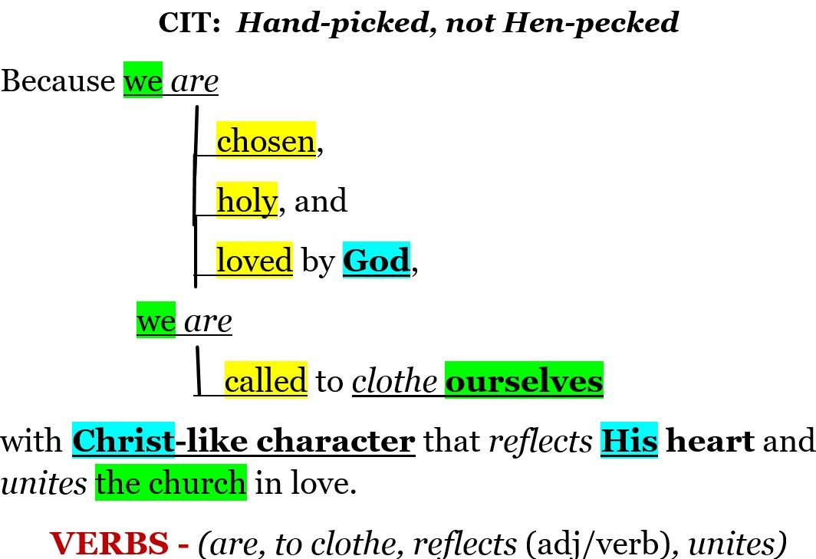

Slide 6
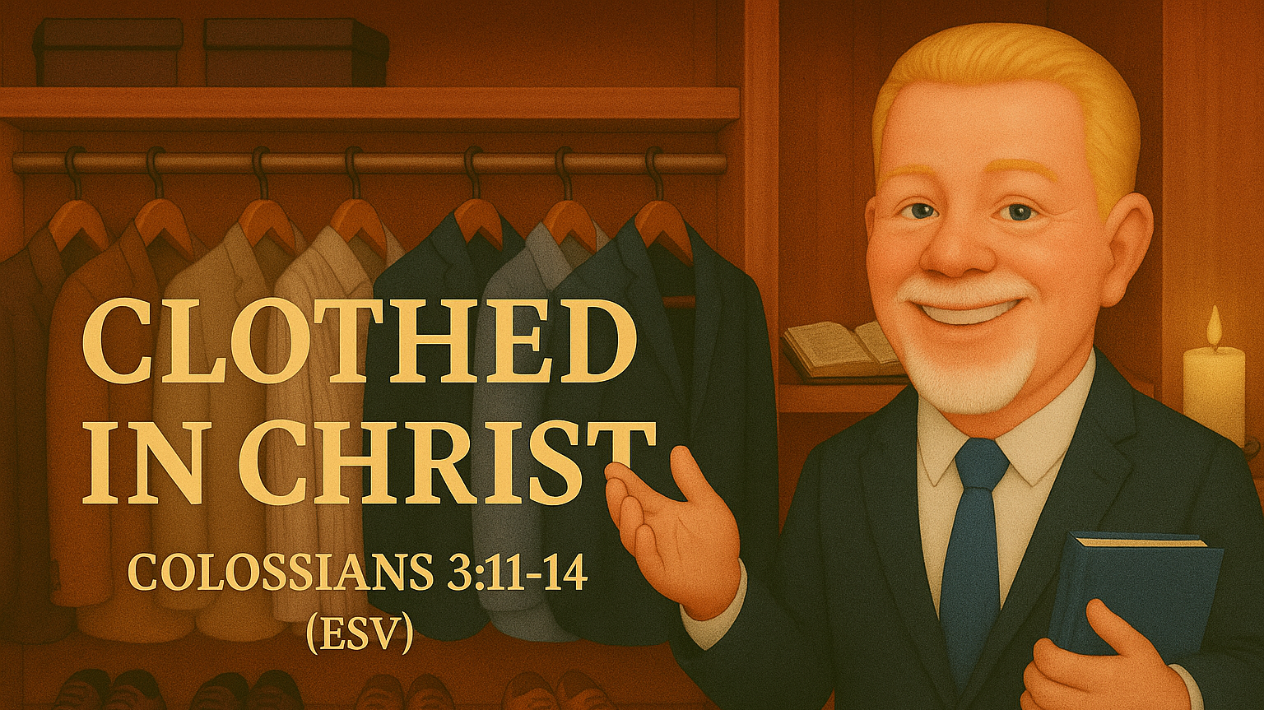

Slide 7


Put on then, as God’s chosen ones, holy and beloved…
Colossians 3:12a

Slide 8
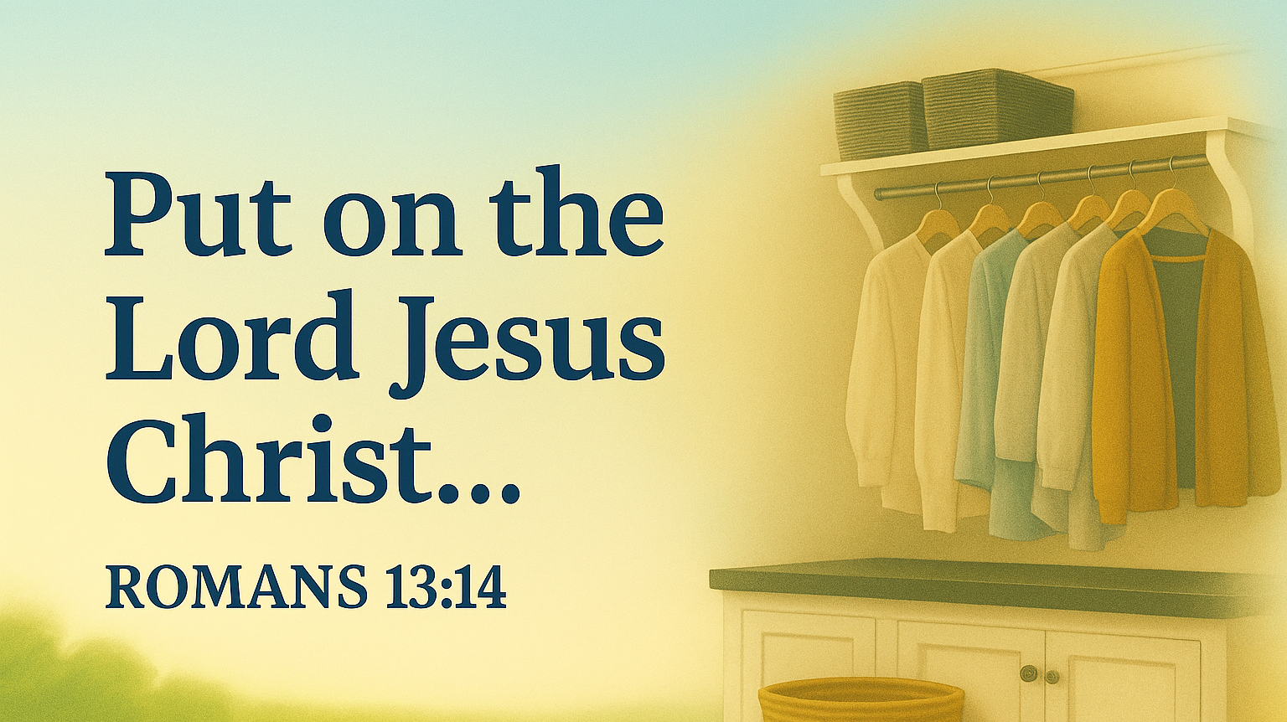

Slide 9

1. Who/Whose we are (12a)
We are CHOSEN
We are HOLY
We are BELOVED

Slide 10
CHOSEN
Chosen, elect, selected,
of the best choice,
favorite, excellent,
distinguished from others, hand picked,
utmost and excellent
ἐκλεκτός
(eklektos)

Slide 11
HOLY
ἅγιος
(hagios)
Dedicated to God, sacred, pure, morally clean and blameless, consecrated, devoted to the Divine, that which is set apart in the Temple - the Holy of Holies.

Slide 12
BELOVED
ἀγαπάω
Agga-pow
Cherished, loved, highly esteemed, take pleasure in, strong affection, treat with affection, regardly highly, valued beyond others.

Slide 13
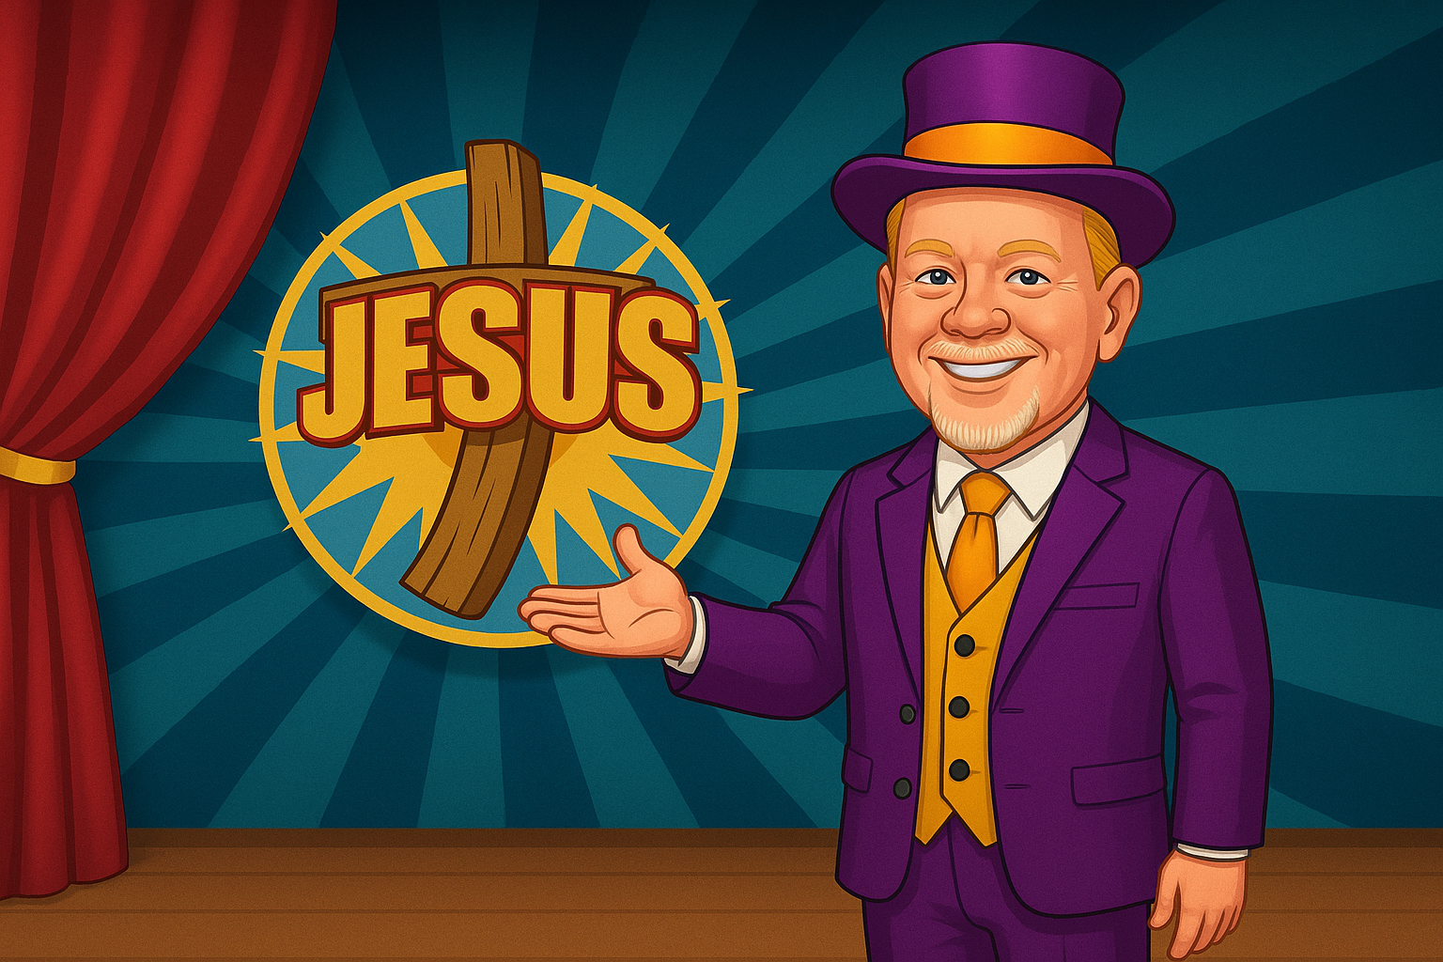
#1 - Our Identity Determines Our Outfit (12a)

Slide 14
#2 - Start with the Undergarments of Grace (v. 12b)
Ummmm, no photo for this one!

Slide 15
1. What we have (12b)
Compassionate hearts
Οἰκτιρμός σπλάγχνον
Kindness
χρηστότης

Slide 16
Compassionate Hearts
Love, affection, feelings, desires, emotions, pity.
Can also mean guts, entrails, bowels…
Pity, mercy, care, concern, sympathy, to offer tenderness

Slide 17
Kindness -
Uprightness
goodness
generosity
gentleness
excellence
usefulness
“Actions that show up in quiet offerings of benevolence. Living by the Golden Rule. Doing what is right with honesty and sincerity.

Slide 18
#3 - Layer Up with Patience and Gentleness (v. 12c)

Slide 19
(put on)… humility, meekness, and patience,
Colossians 3:12c

Slide 20
- Modesty
- Lowliness of mind
- Without arrogance
Opposite:
- Pride
- Mean-spiritedness
Humility
Also: “Asceticism”
- “The religious doctrine that one can reach a higher spiritual state by rigorous self-discipline and self-denial.” (SEE NEXT)

Slide 21

“A religious doctrine promoting…self-discipline and self-denial… “particularly in Catholicism and Taoism, emphasizing the balance between indulgence and extreme self-denial.”
A false humility based on elevating oneself to a lower status.
“The A to Z of Taoism” -Julan F. Pas

Slide 22
Gentleness
Kind
Mild
Modest
Courtesy
Considerate
Meekness
While it CAN mean any of those words, the 11x it is seen in the NT, it is only “gentleness, meekness, or courtesy.”
G-6, C-1, M-4

Slide 23
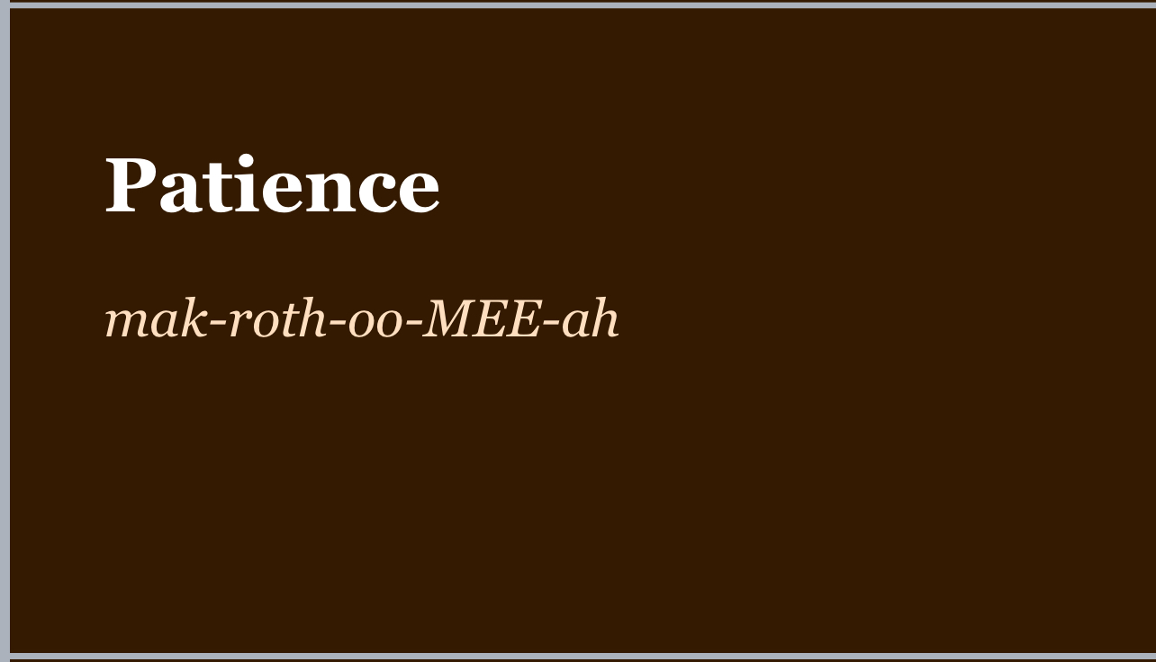
Hold your pack off.
Hold your horses.
μακροθυμία

Slide 24









The Bamboo Tree
God’s example to us of PATIENCE
Original bamboo tree file became corrupt. Have you ever seen red bamboo before? Now you have. ;-)

Slide 25
#4 - Bear and Forgive with Gospel Grace (v. 13)

Slide 26
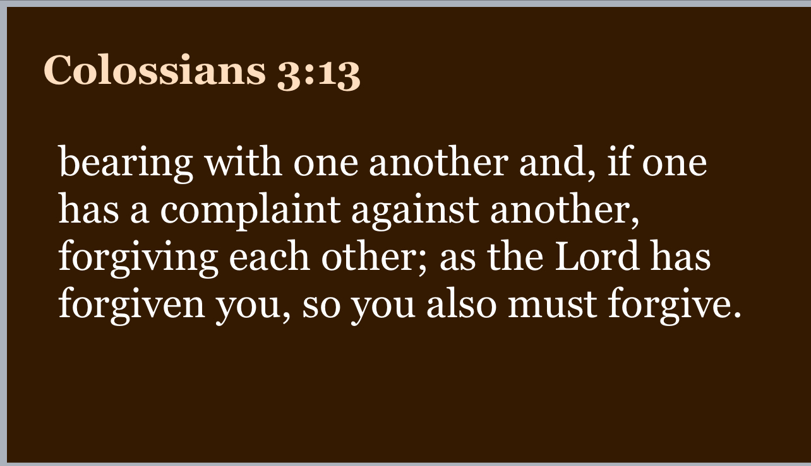

Slide 27
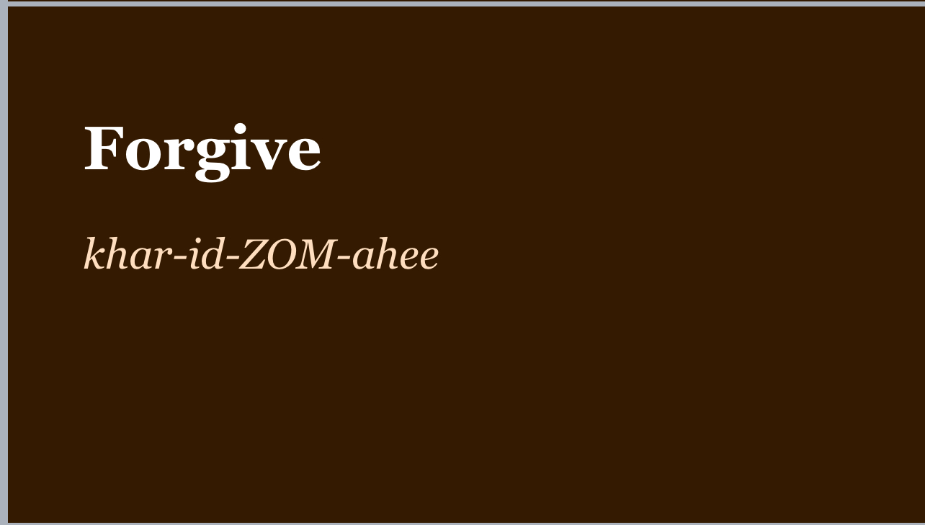
Cancel/remove,
pardon,
show favor, gratify,
give graciously,
zero out a debt
χαρίζομαι

Slide 28
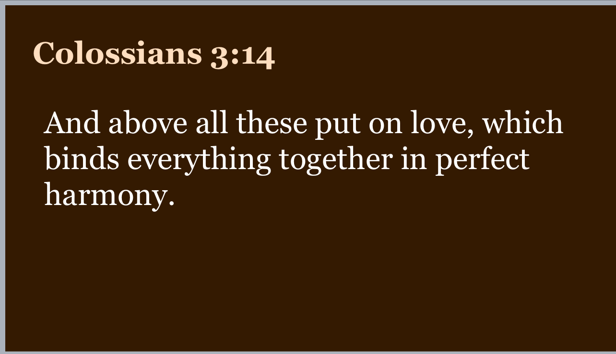

Slide 29
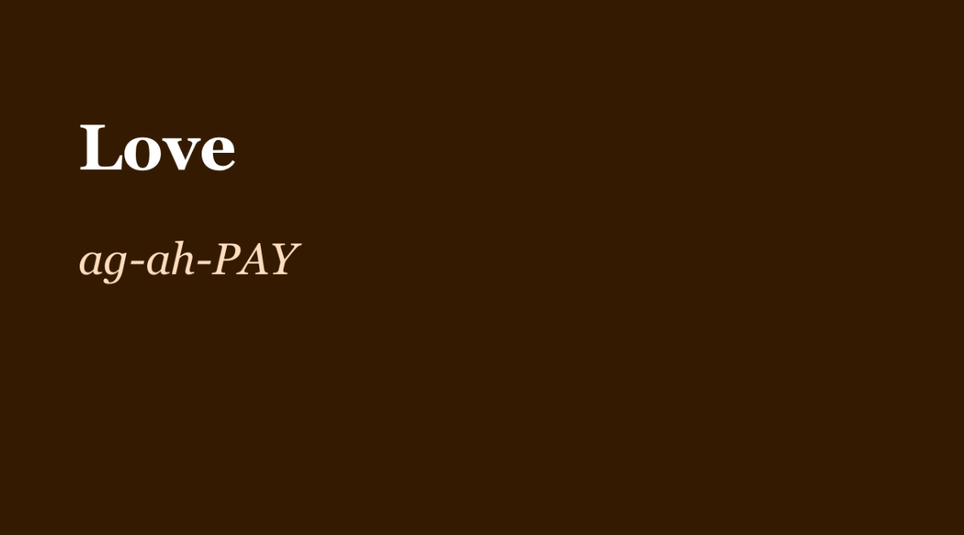

Slide 30
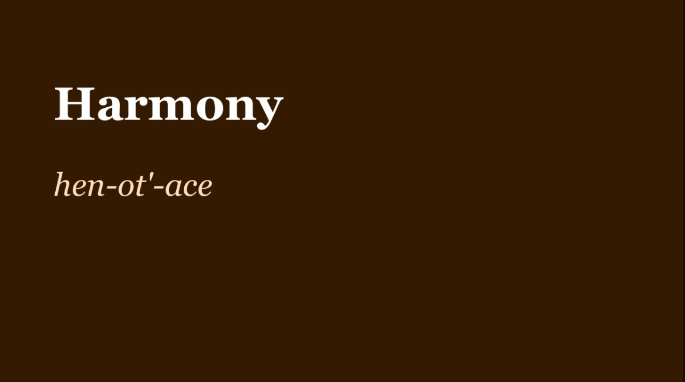
?
There are no words
in Koine Greek

Slide 31
1- Τελειότης - perfect, mature, complete. 2- συμφωνέω - agree on opinion, feeling,or purpose.
Verb - to agree, noun - a harmonious state

Slide 32


Slide 33
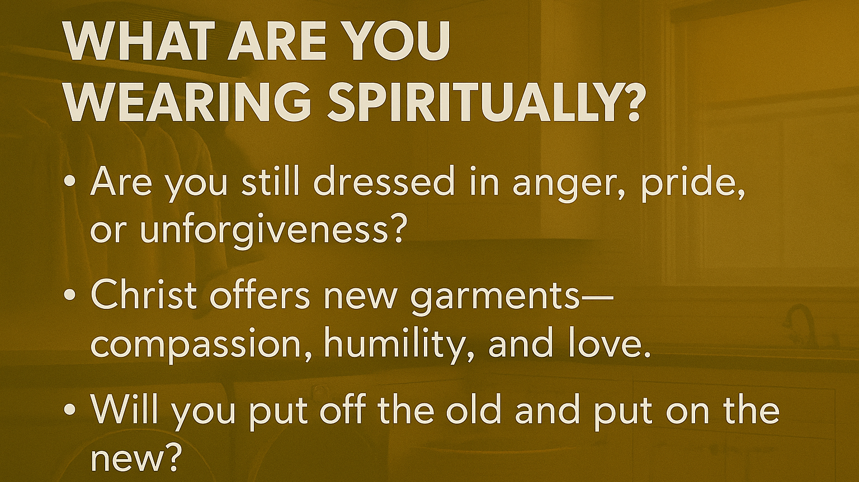

Slide 35
Prepare your hearts now as we observe the Lord’s Supper “The Communion Table is open to all who are born again in Jesus Christ.”

Slide 36

Qrtly Business Mtg Starts in 10 Minutes

