Slide 1

“From Cheers to the Cross: When Worship Misses the Mark”
Luke 19:28-44 (NIV)
Palm Sunday 2025

Slide 2
INTRODUCTION
The Grand Crescendo
The Culmination
The Donkey
The Prophecy

Slide 3

The predominant prophecy is seen in Zechariah 9:9
Rejoice greatly, O Daughter of Zion! See,
your king comes to you, gentle and riding
on a donkey, on a colt, the foal of a donkey.

Slide 4

Modern-Day Troubles
Philosophy
Money
Liberalism

Slide 5

The Silent Years
430 BC - 4 BC
No word from God
No leadership in Israel
No enforcement of Law
Wanting to Rule

Slide 6
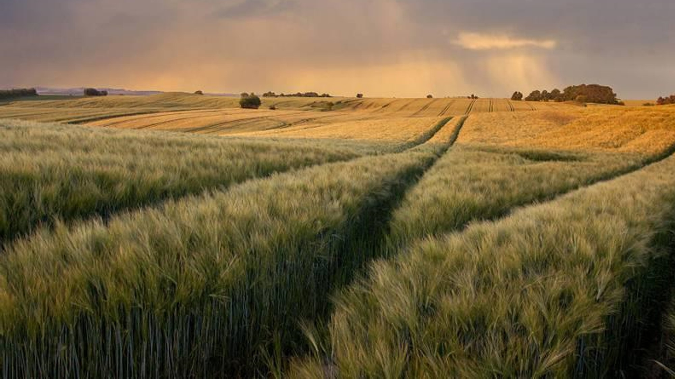
1. The Flesh-fueled fanfare
(vv. 37-38)

Slide 7
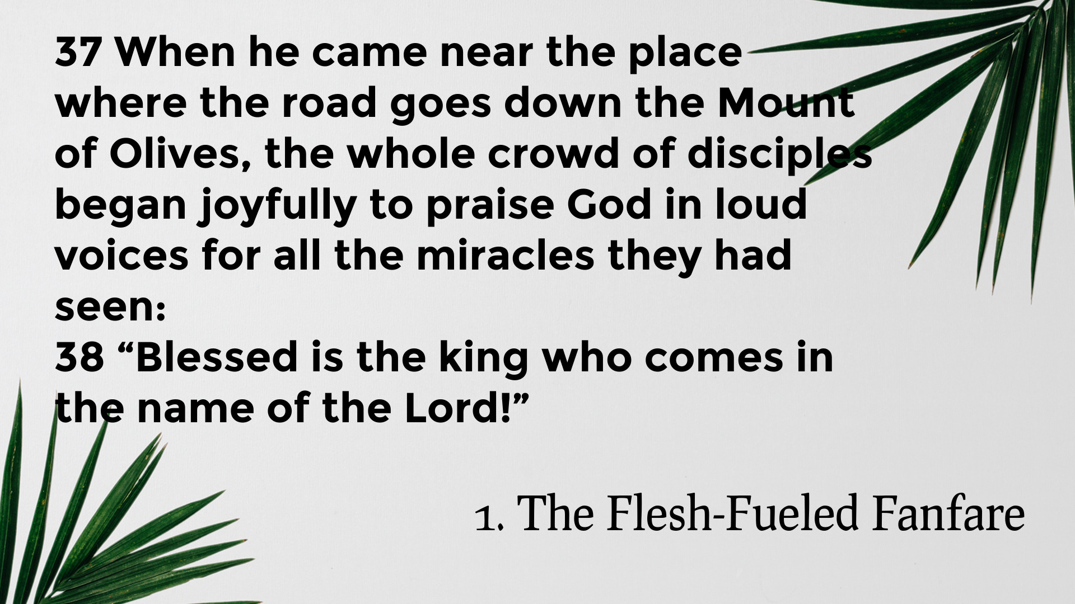

Slide 8
2. The Compassionate Cry
(vv. 39-40)

Slide 9
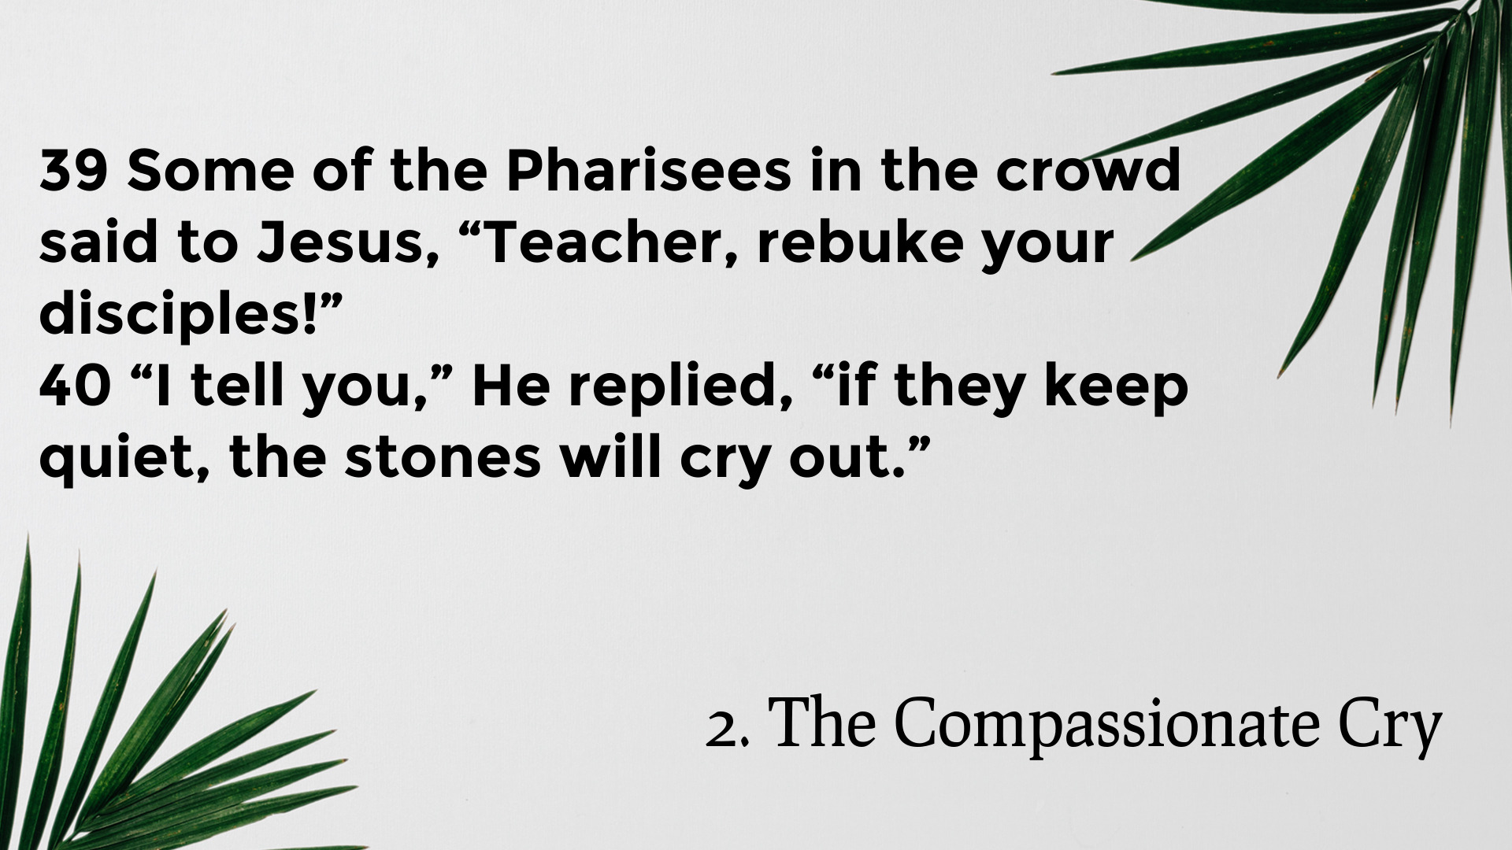

Slide 10
3. The Cross-Bound Commitment (vv. 41-44)

Slide 11


Slide 12
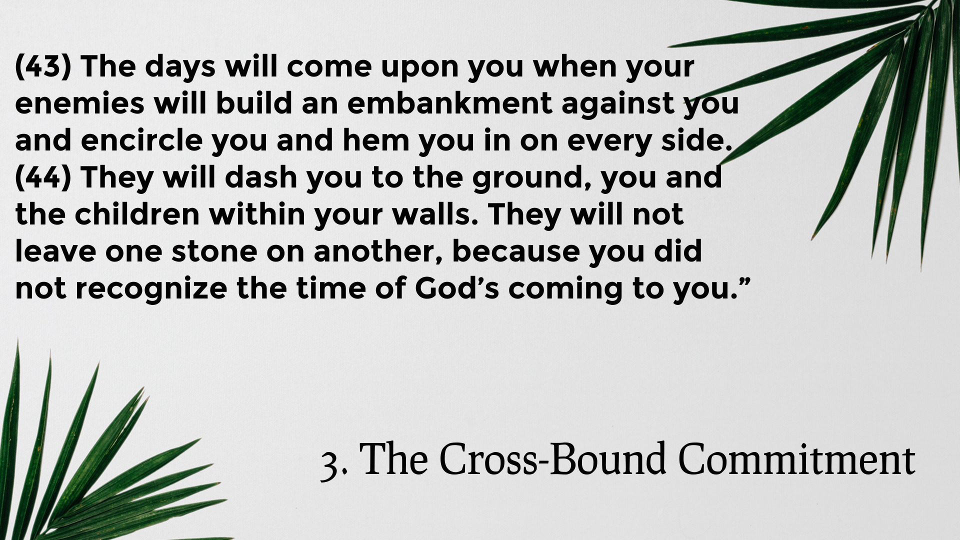

Slide 13

CONCLUSION

Slide 14
“From Cheers to the Cross: When Worship Misses the Mark”
Luke 19:28-44 (NIV)

Slide 15
Without Jesus Christ,
Nothing Else Matters!
Lord’s Supper
Open table
Take the elements together

