Slide 1
“The Crucifixion” Luke 23:26-49 (ESV)

Slide 2

Good Friday Service FBC Norway, MI April 18, 2025, Rev. Dr. David T. Williamson, Senior Pastor

Slide 3
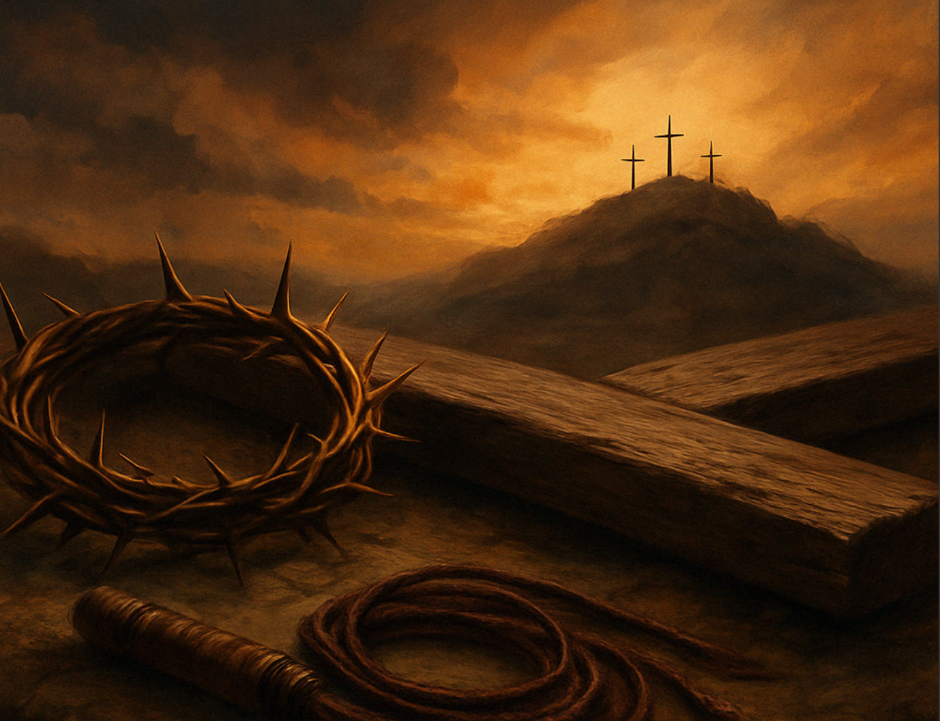
Introduction:
“Don’t Carry the
Weight of the
World”
…Give it to God!

Slide 4
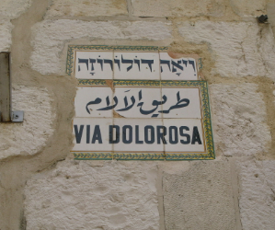
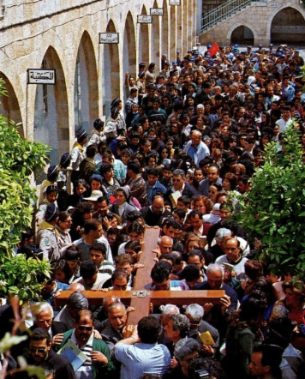
14 Stations along the ½ mile journey

Slide 5
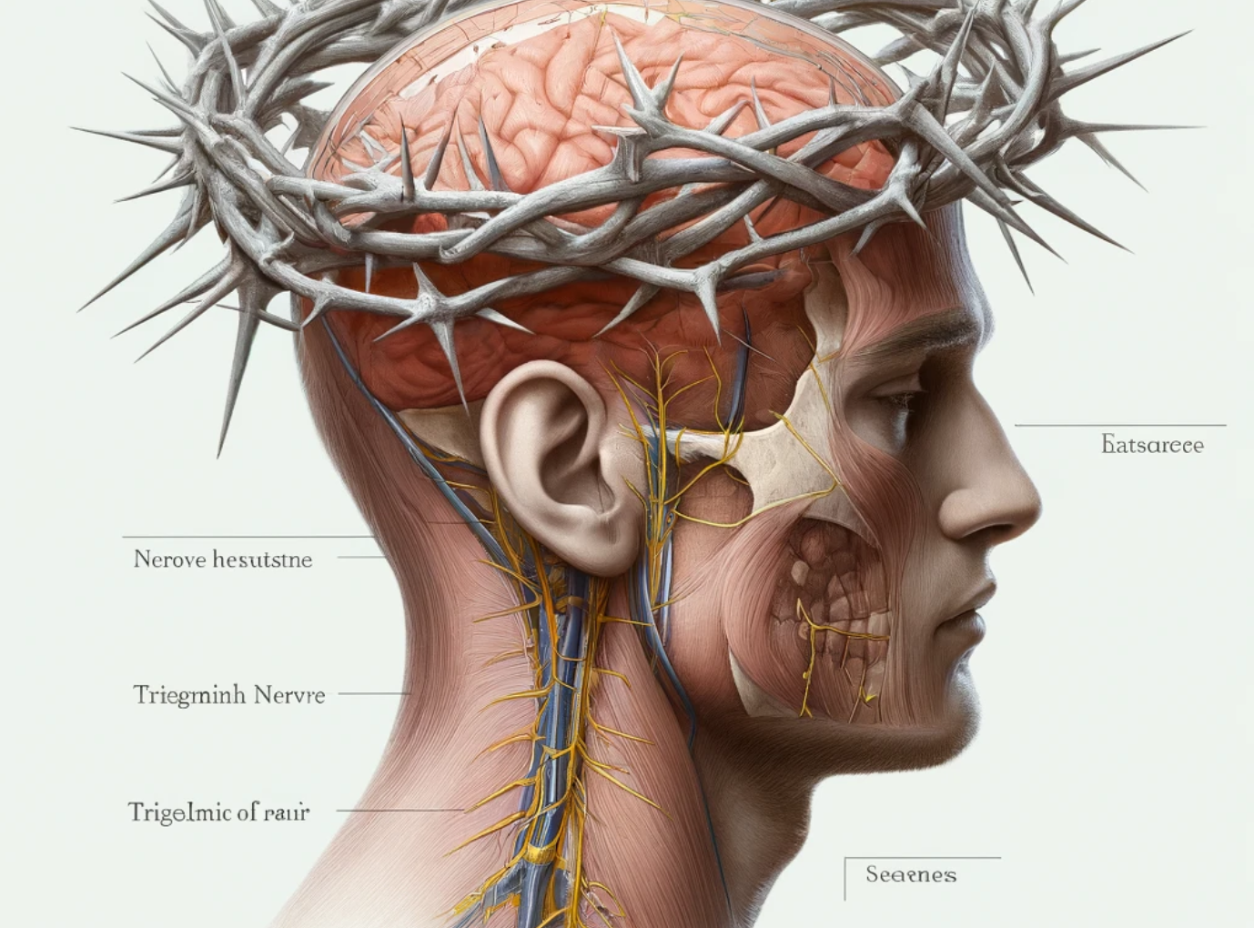
1. The Crown of Cruelty
Luke 23:11
John 19:2
Matthew 27:29
Mark 15:27-20

Slide 6
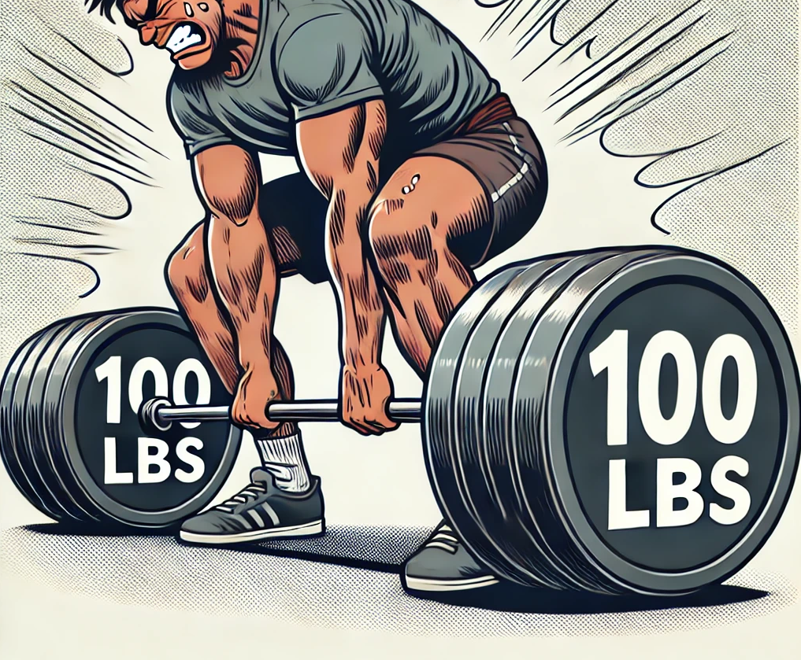

Slide 7
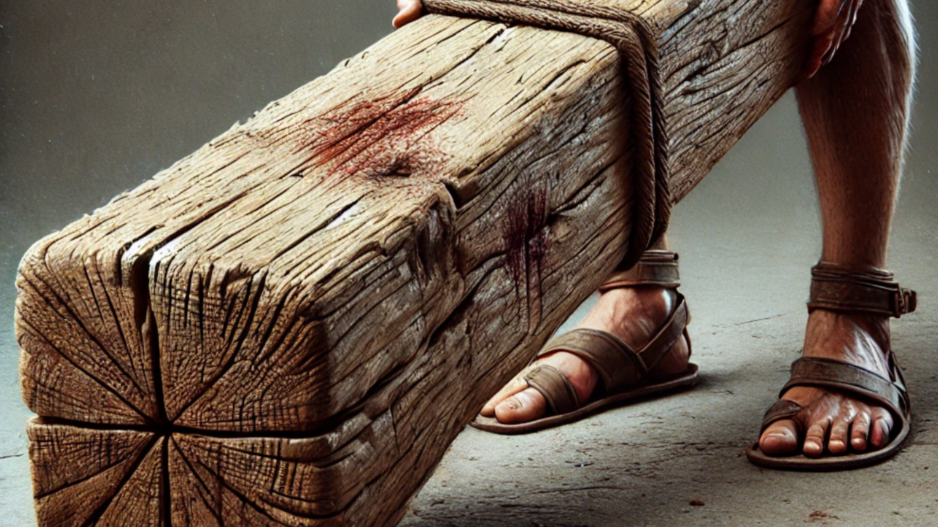
2. The Cross of Condemnation

Slide 8

3. The Choice
of Conversion

Slide 9
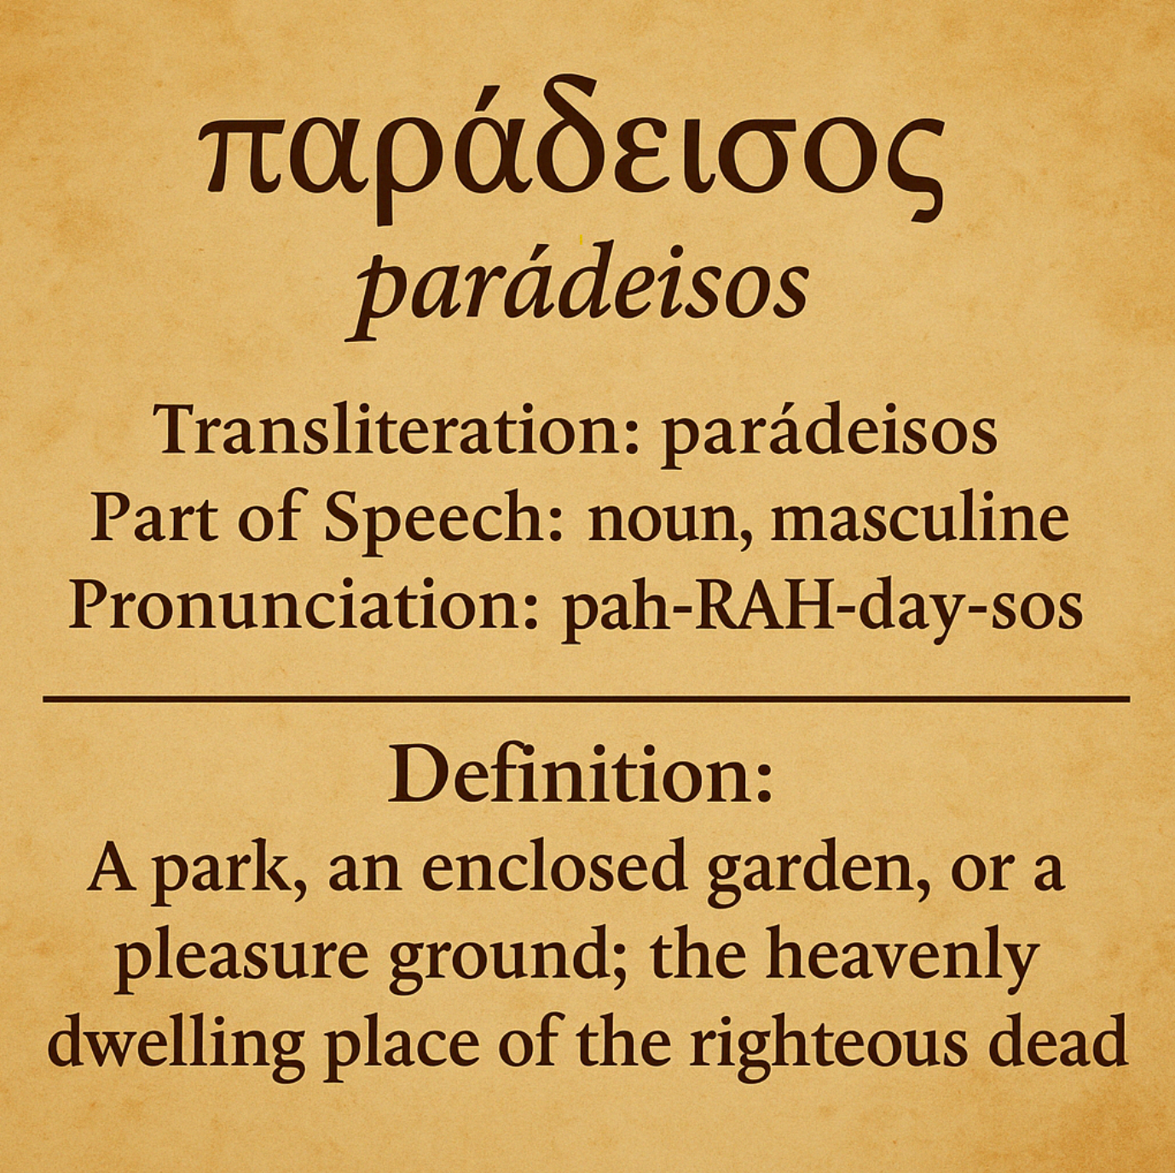
“The heavenly dwelling place of the righteous dead.” (Not purgatory) (Not soul sleep)

Slide 10

The Choice is for you to make today - now - before you leave.

Slide 11

Quiet Reflection
“It is Finished!”

Slide 12
Good Friday Service FBC Norway, MI April 18, 2025, Rev. Dr. David T. Williamson, Senior Pastor

