Slide 1
“Rooted, Rescued, and Responding to Christ”
Colossians 2:8-15 (ESV)

Slide 2


Slide 3
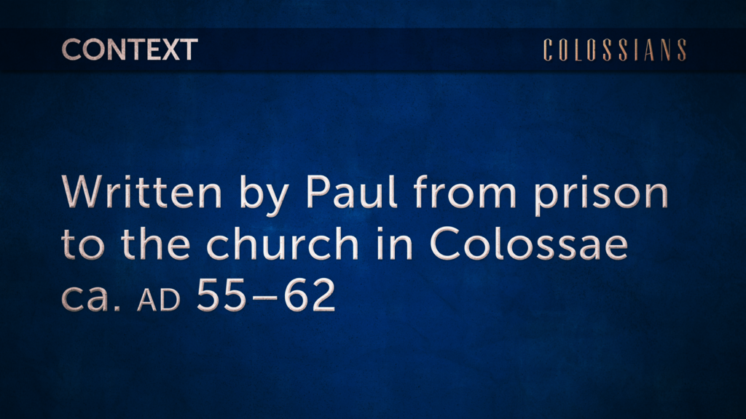

Slide 4
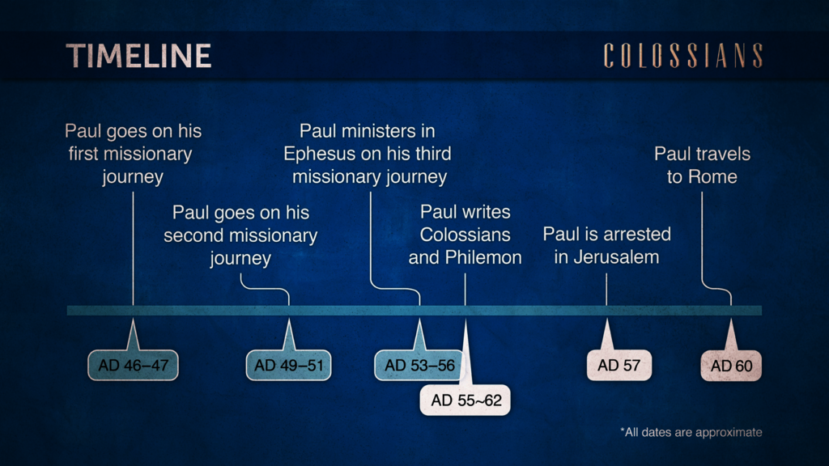

Slide 5
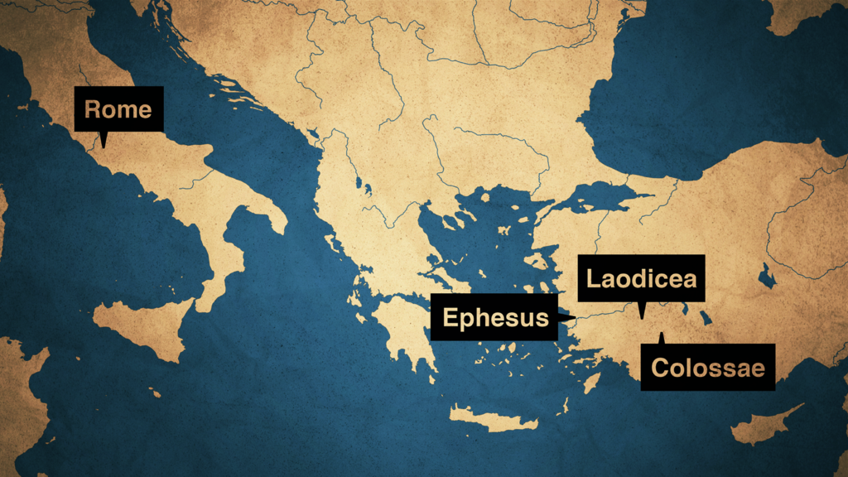

Slide 6
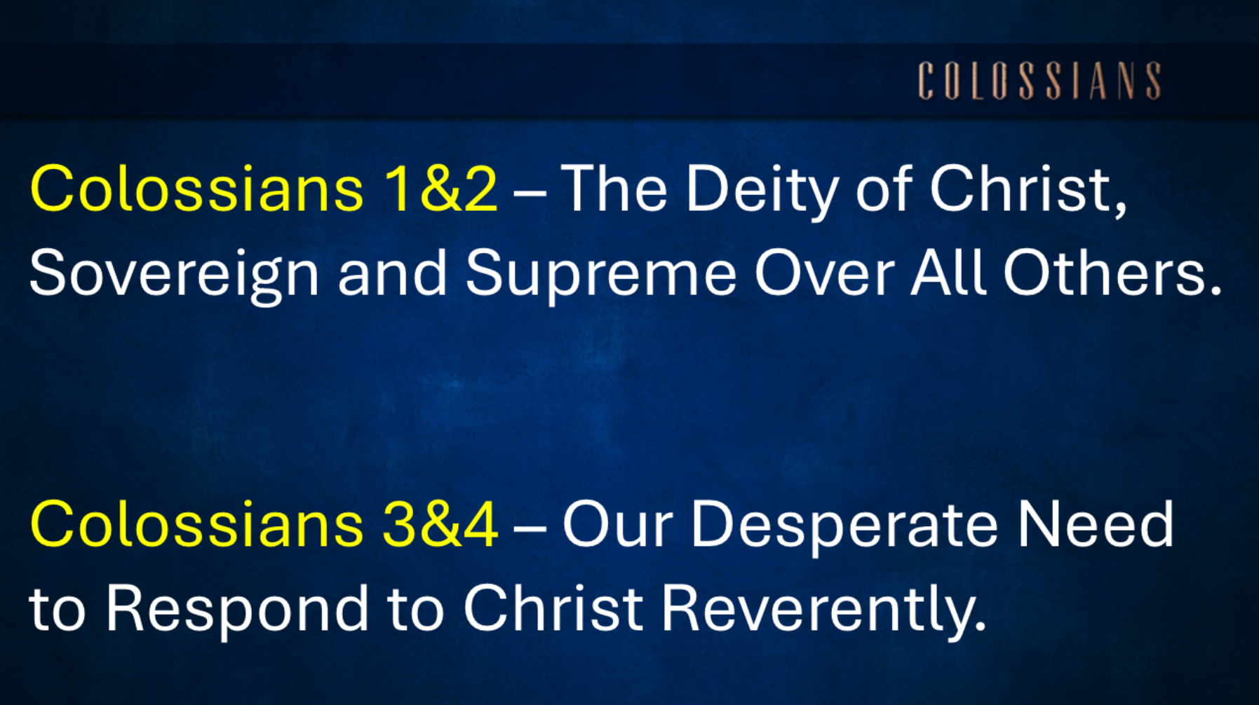


Slide 7
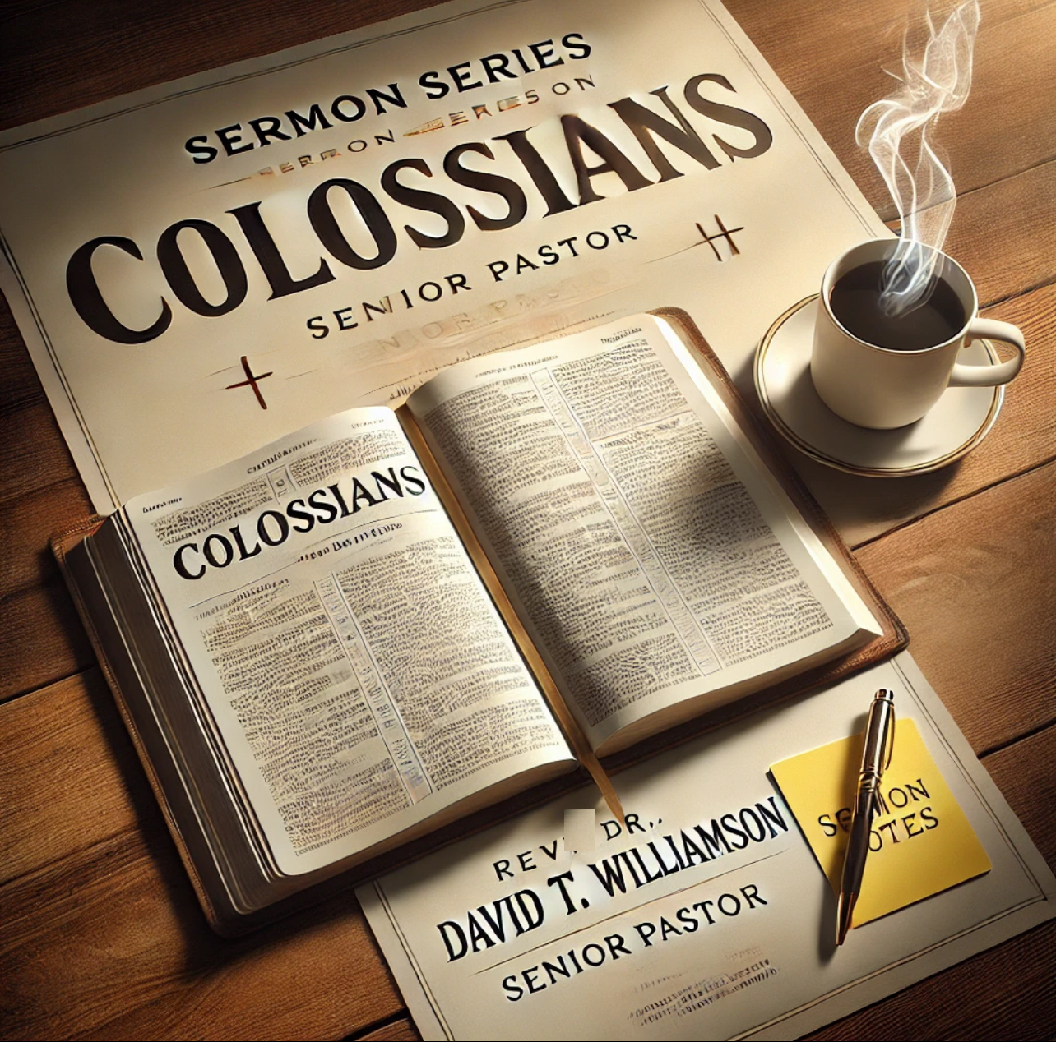
Firmly Rooted
in Christ
Freely Rescued
by Christ
Faithfully Responding to Christ

Slide 8
There are those who believe in Christ Jesus for their salvation, yet at the same time, they have doubts as to its validity.
“Either you believe it, or you don’t.”
If Baal, then Baal. If God, then God… “As for me and my house…” (Josh 24:15)
Psalm 51; 103:12
John 3:16; 14:6
Romans 6:23, 8:1, 10:9-10
1 John 1:9

Slide 9
The main theme of Colossians is the supremacy and sufficiency of Christ in all things, calling believers to:
Live in Him,
Reject false teachings, and
Walk in holiness as those who have been raised …
WITH CHRIST

Slide 10

Firmly Rooted in Christ (vv. 8-10)

Slide 11
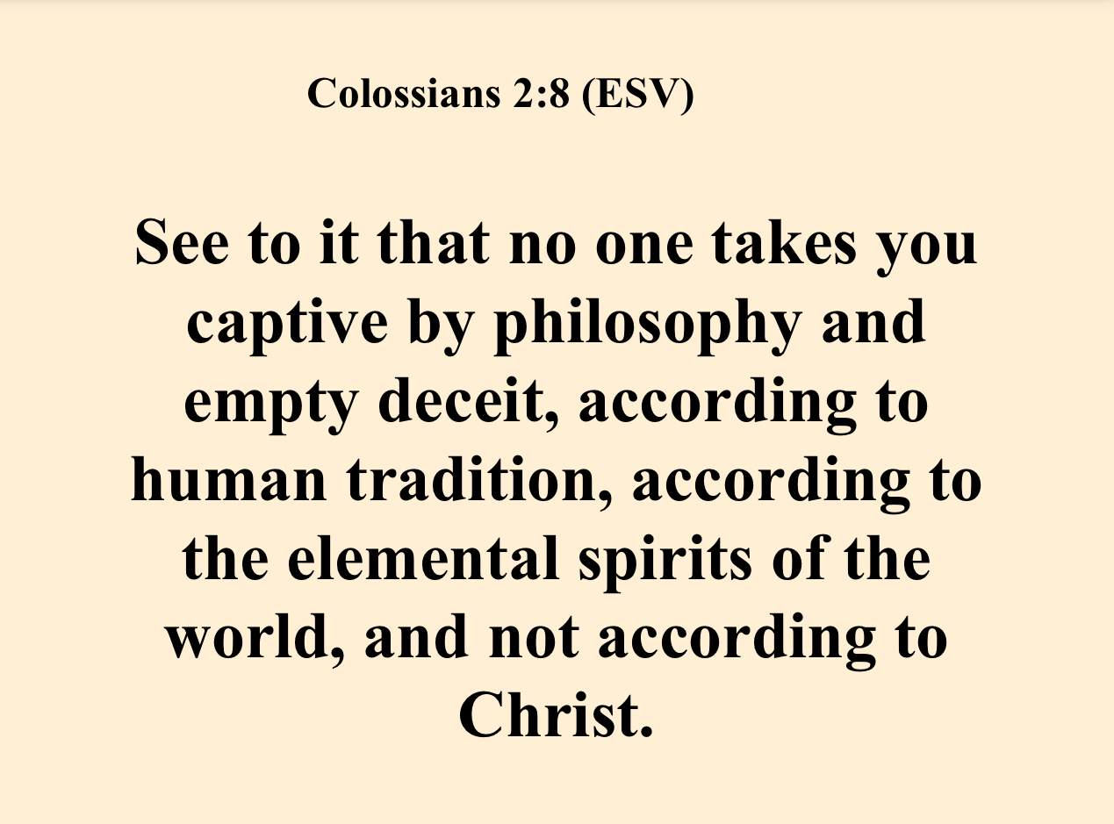

Slide 12
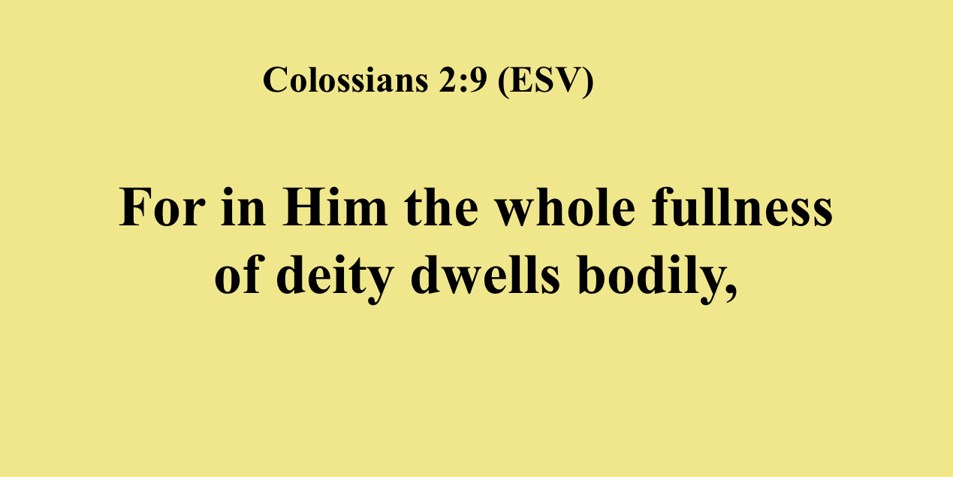


Slide 13
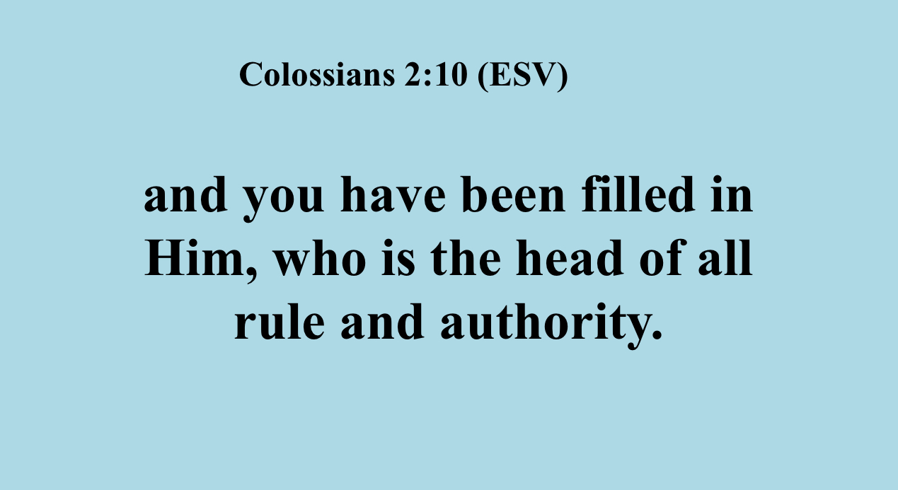

Slide 14

Save me!
2. Freely Rescued by Christ (vv. 11-14)

Slide 15
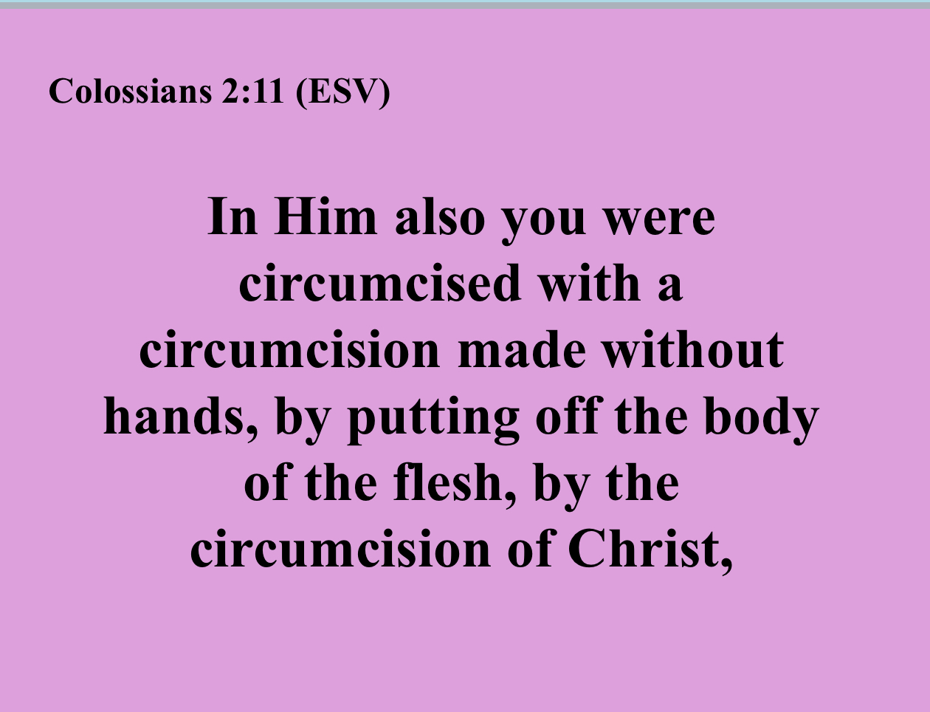

Slide 16
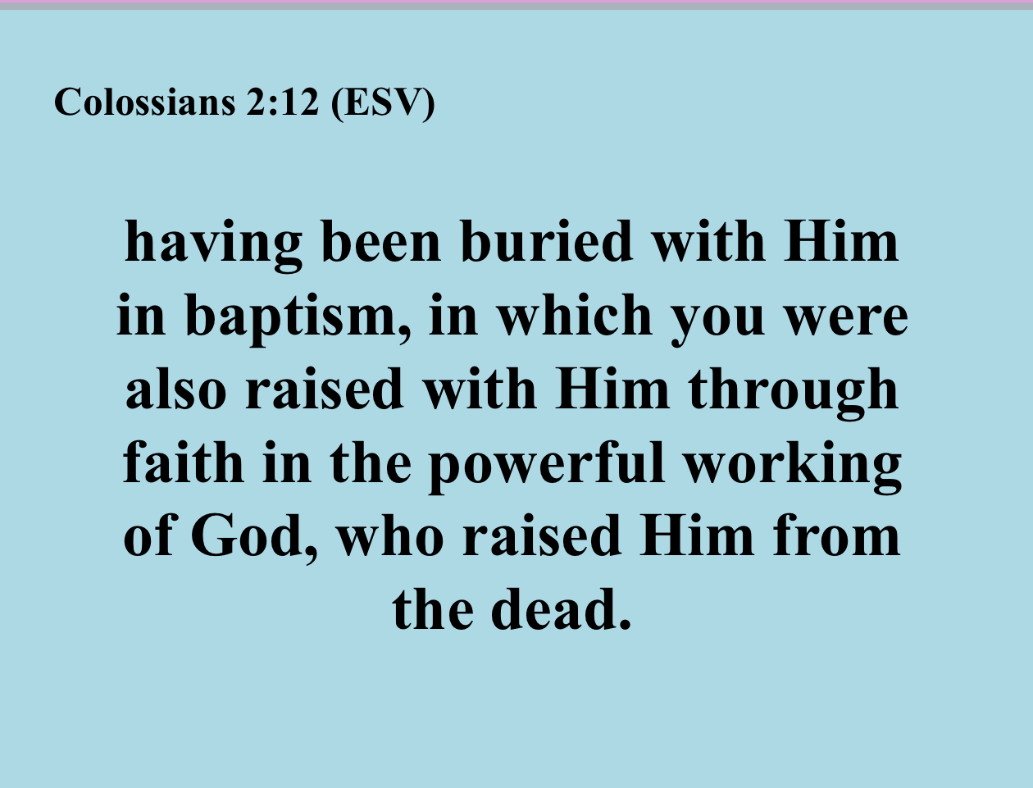

Slide 17
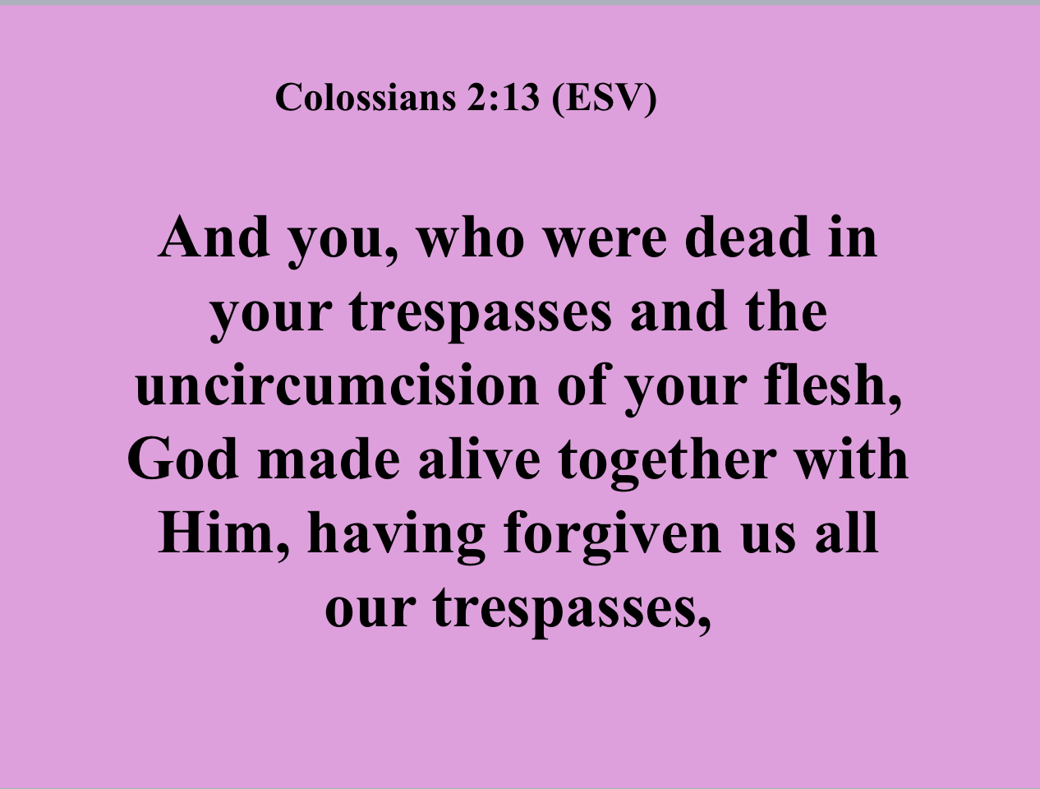

Slide 18
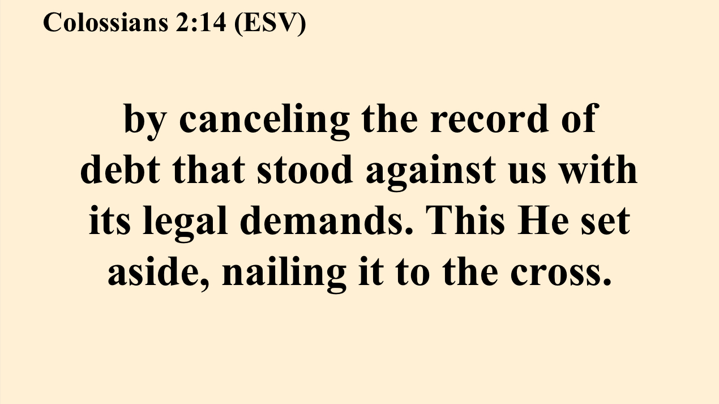

Slide 19
3. Faithfully Responding
to Christ (v. 15)

Slide 20
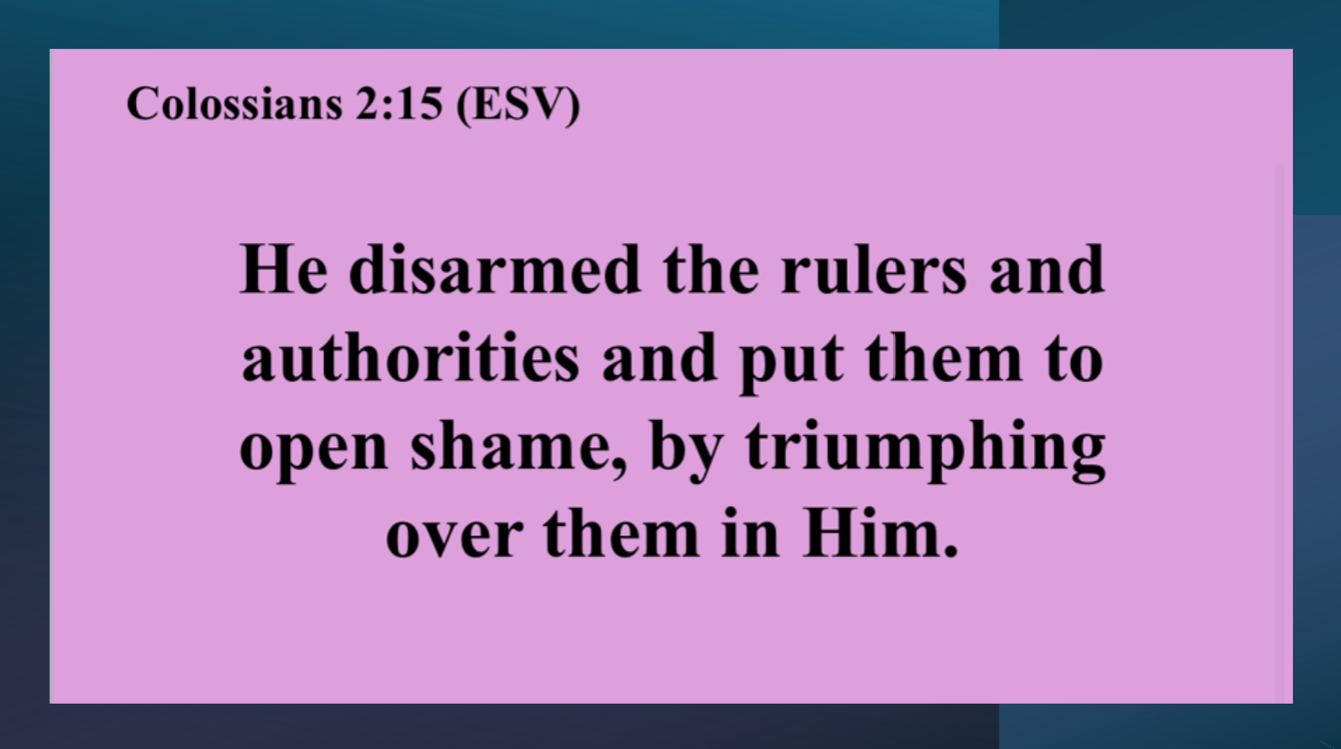

Slide 21
QUESTION:
What are the spiritual truths that you and I can take from today’s text?

Slide 22
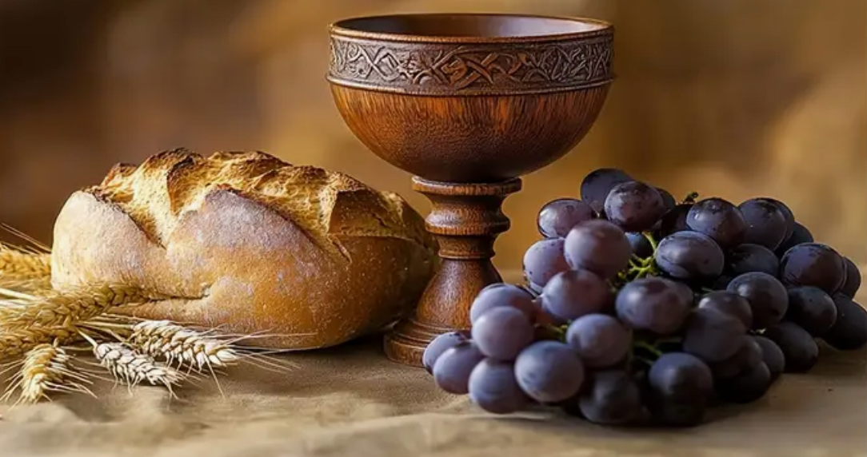
Prepare your heart to receive from the Lord

