Slide 1

Freedom in Christ:
Rejecting Empty Religion
Colossians 2:16-23
Rev. Dr. David T. Williamson
Senior Pastor, FBC Norway, MI

Slide 2
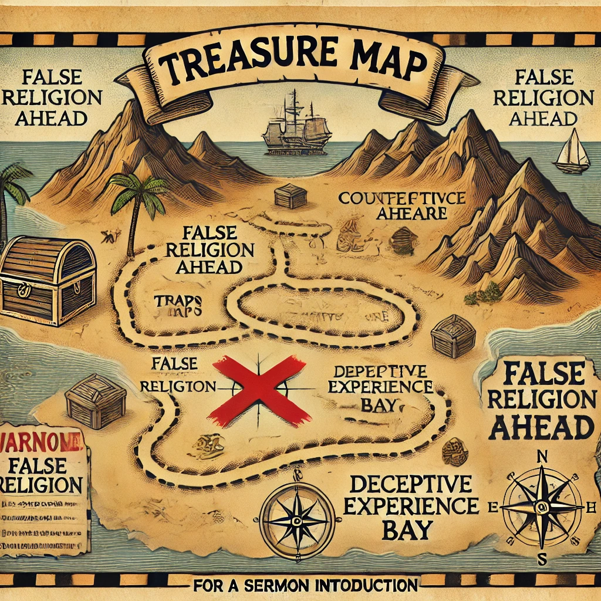
“Where your treasure is, there your heart will be also.”
- Jesus
Matthew 6:21

Slide 3
Historical Context
- Legalism (Jewish rituals)
- Mysticism (visions, angel worship)
- Asceticism (harsh self-denial)
He warns the church not to be
taken captive by empty religion.

Slide 4
1. Reject Religious Regulation (16-17)

Slide 5

(16) Therefore let no one pass judgment on you in questions of food and drink, or with regard to a festival or a new moon or a Sabbath.
(17) These are a shadow of the things to come, but the substance belongs to Christ.
Colossians 2:16-17 (ESV)

Slide 6

2. Resist Mystical Manipulation (18)
Let no one disqualify you, insisting on asceticism and worship of angels, going on in detail about visions, puffed up without reason by his sensuous mind,

Slide 7

3. Remain Rooted in Christ (19)
...and not holding fast to the Head, from whom the whole body, nourished and knit together through its joins and ligaments, grows with a growth that is from God.

Slide 8
4. Rules Ready to be Forsaken (20-22)

Slide 9
20 If with Christ you died to the elemental spirits of the world, why, as if you were still alive in the world, do you submit to regulations—
20
Colossians 2:20 (ESV)

Slide 10
Do not handle,
Do not taste,
Do not touch
21
Colossians 2:21 (ESV)

Slide 11
22 (referring to things that all perish as they are used)—according to human precepts and teachings?
22
Colossians 2:22 (ESV)

Slide 12

5. Restrain from Worldly Ways (23)

Slide 13
These have indeed an appearance of wisdom in promoting self-made religion and asceticism and severity to the body, but they are of no value in stopping the indulgence of the flesh.
Colossians 2:23 (ESV)

Slide 14
Freedom in Christ:
Rejecting Empty Religion
Colossians 2:16-23
Rev. Dr. David T. Williamson
Senior Pastor, FBC Norway, MI

