Slide 1

Your Phone Is Ringing!
Answering the Call to
Serve God to the End
Numbers 8:22-26
Psalm 92:12-15

Slide 2


Slide 3
Numbers 8:22 (ESV)
And after that the Levites went in to do their service in the tent of meeting before Aaron and his sons; as the Lord had commanded Moses concerning the Levites, so they did to them.

Slide 4

Numbers 8:23-24 (ESV)
And the Lord spoke to Moses, saying, “This applies to the Levites: from twenty-five years old and upward they shall come to do duty in the service of the tent of meeting.

Slide 5
Numbers 8:25 (ESV)
And from the age of fifty years they shall withdraw (RETIRE) from the duty of the service and serve no more.

Slide 6
Numbers 8:26 (ESV)
They minister to their brothers in the tent of meeting by keeping guard, but they shall DO NOT SERVICE. Thus you shall do to the Levites in assigning their duties.”

Slide 7
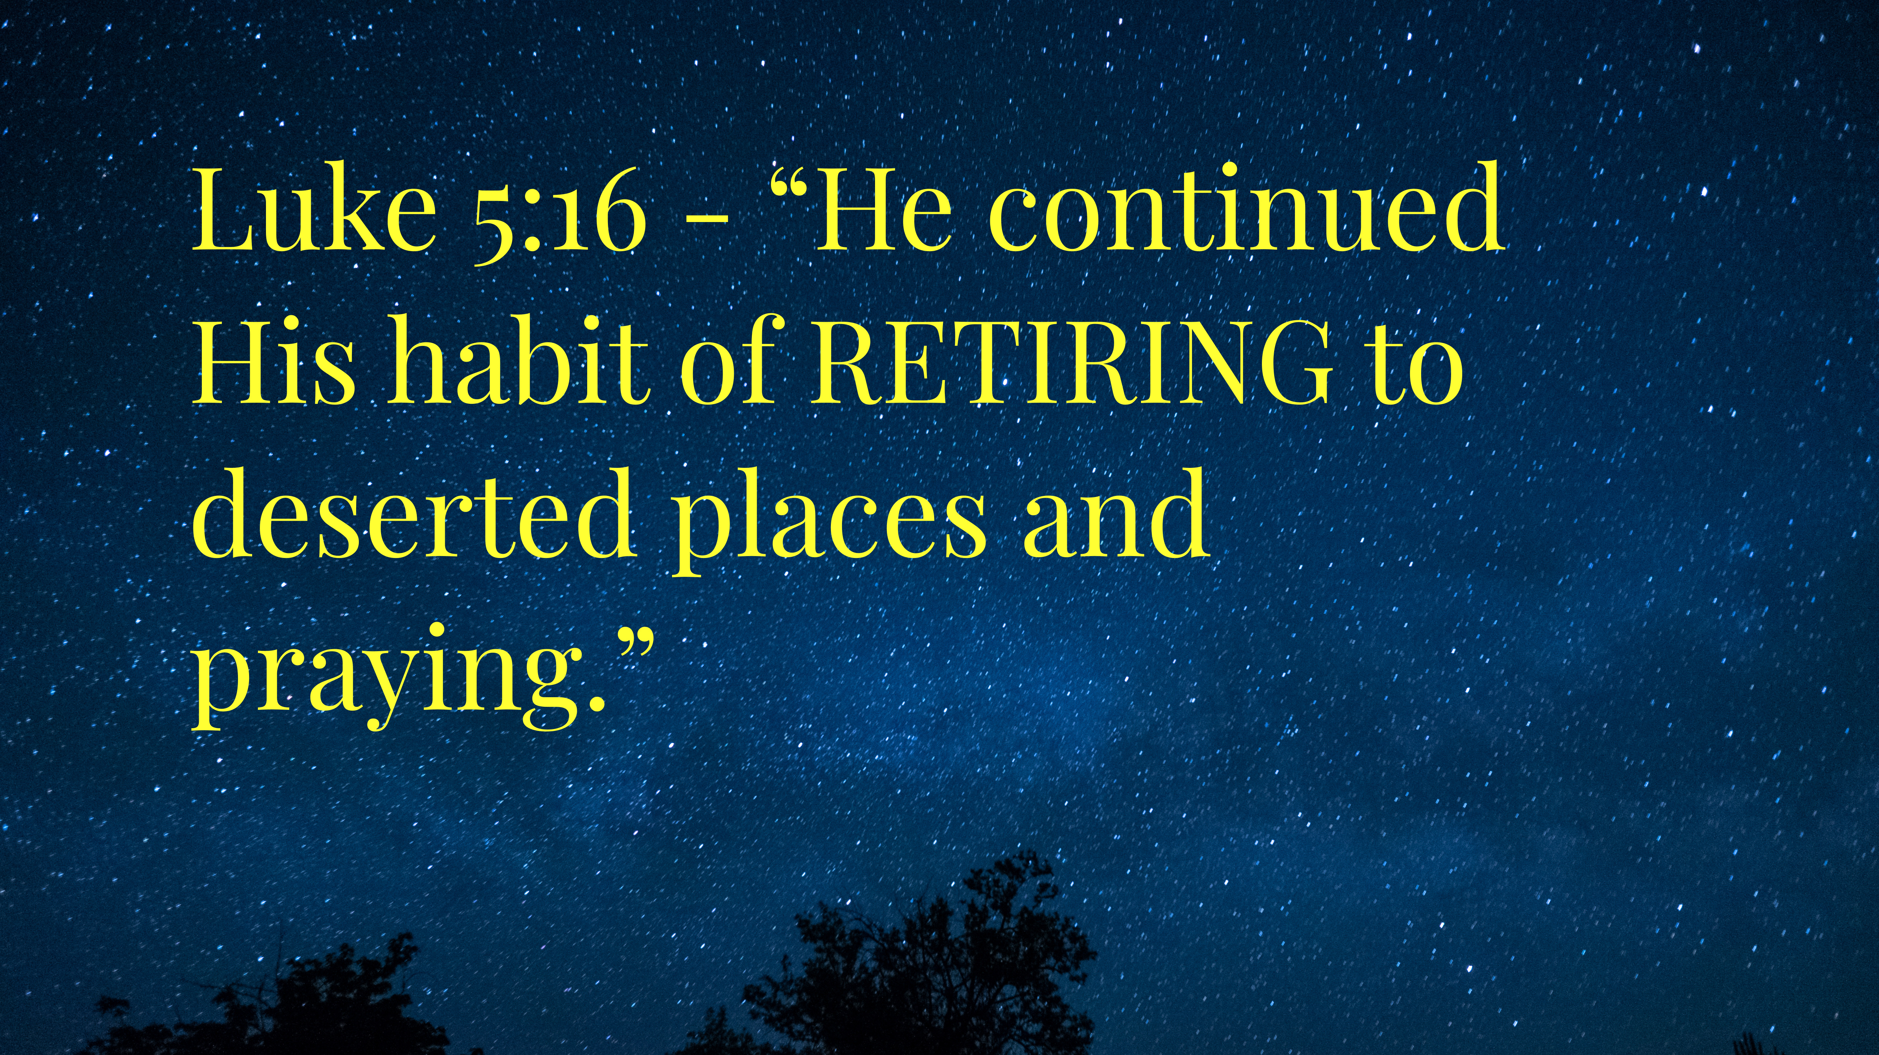

Slide 8
Psalm 95:11
Heb 4:9-11

Slide 9

God Calls
Life’s circumstances
Despite your past
The unlikely and unworthy

Slide 10
God Equips
With His power
With His presence
With His Spirit
Through life’s experiences
Through His Church

Slide 11
God Sends
A.) Mentor and disciple
B.) Prayer and encouragement
C.) Hospitality and invitation

Slide 12
Biblical Examples:
The Apostles
Moses
Caleb
Anna
Simeon

Slide 13
The Apostles Never Retired
Luke
Paul
Andrew/Peter
James/John
Matthew (Levi)

Slide 14
Age Holds No Bounds when it comes to God’s Calling on your life to serve:
Karl Utzat
David Jeremiah
John Hagee
John MacArthur
Jimmy Swaggart
Charles Stanley
Chuck Swindoll
……. Rev. Noah Smith (Minneapolis)

Slide 15

Psalm 92:12 (ESV)
The righteous flourish like the palm tree and grow like a cedar in Lebanon.

Slide 16

Psalm 92:13 (ESV)
They are planted in the house of the Lord; they flourish in the courts of our God.

Slide 17

Psalm 92:14a (ESV)
They still bear fruit in old age;

Slide 18


Psalm 92:14b (ESV)
they are Ever full of sap and green,

Slide 19
Psalm 92:15 (ESV)
to declare that the Lord is upright; He is my rock, and there is no unrighteousness
in Him.

Slide 20
Examples for the Ages:
A.) Moses - Deut 34.7
B.) Caleb - Joshua 14:10-12
C.) Anna - Lk 2:36-38
D.) Paul - 2 Tim 4:7-8
E.) Simeon - Lk 2:25-32
Billy Graham, RC Sproul, Charles Stanley

Slide 21
Call to action:
KEEP
PRAYING
1
KEEP
ENCOURAGING
2
KEEP
SERVING
3
KEEP
SHARING
4

Slide 22
Memory verse: Psalm 71:18
“Even when I am old and gray, oh God, do not forsake me, until I declare your strength to this generation.”

Slide 23
Your Phone Is Ringing!
Answering the Call to
Serve God to the End
Numbers 8:22-26
Psalm 92:12-15

