Slide 1
Colossians 1:21-23 (ESV)
Standing Firm in Hope; Persevering in Faith

Slide 2
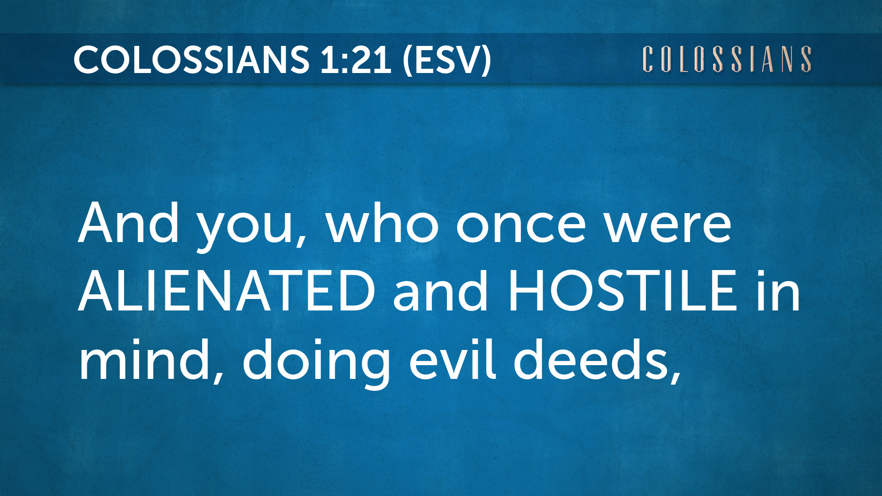

Slide 3
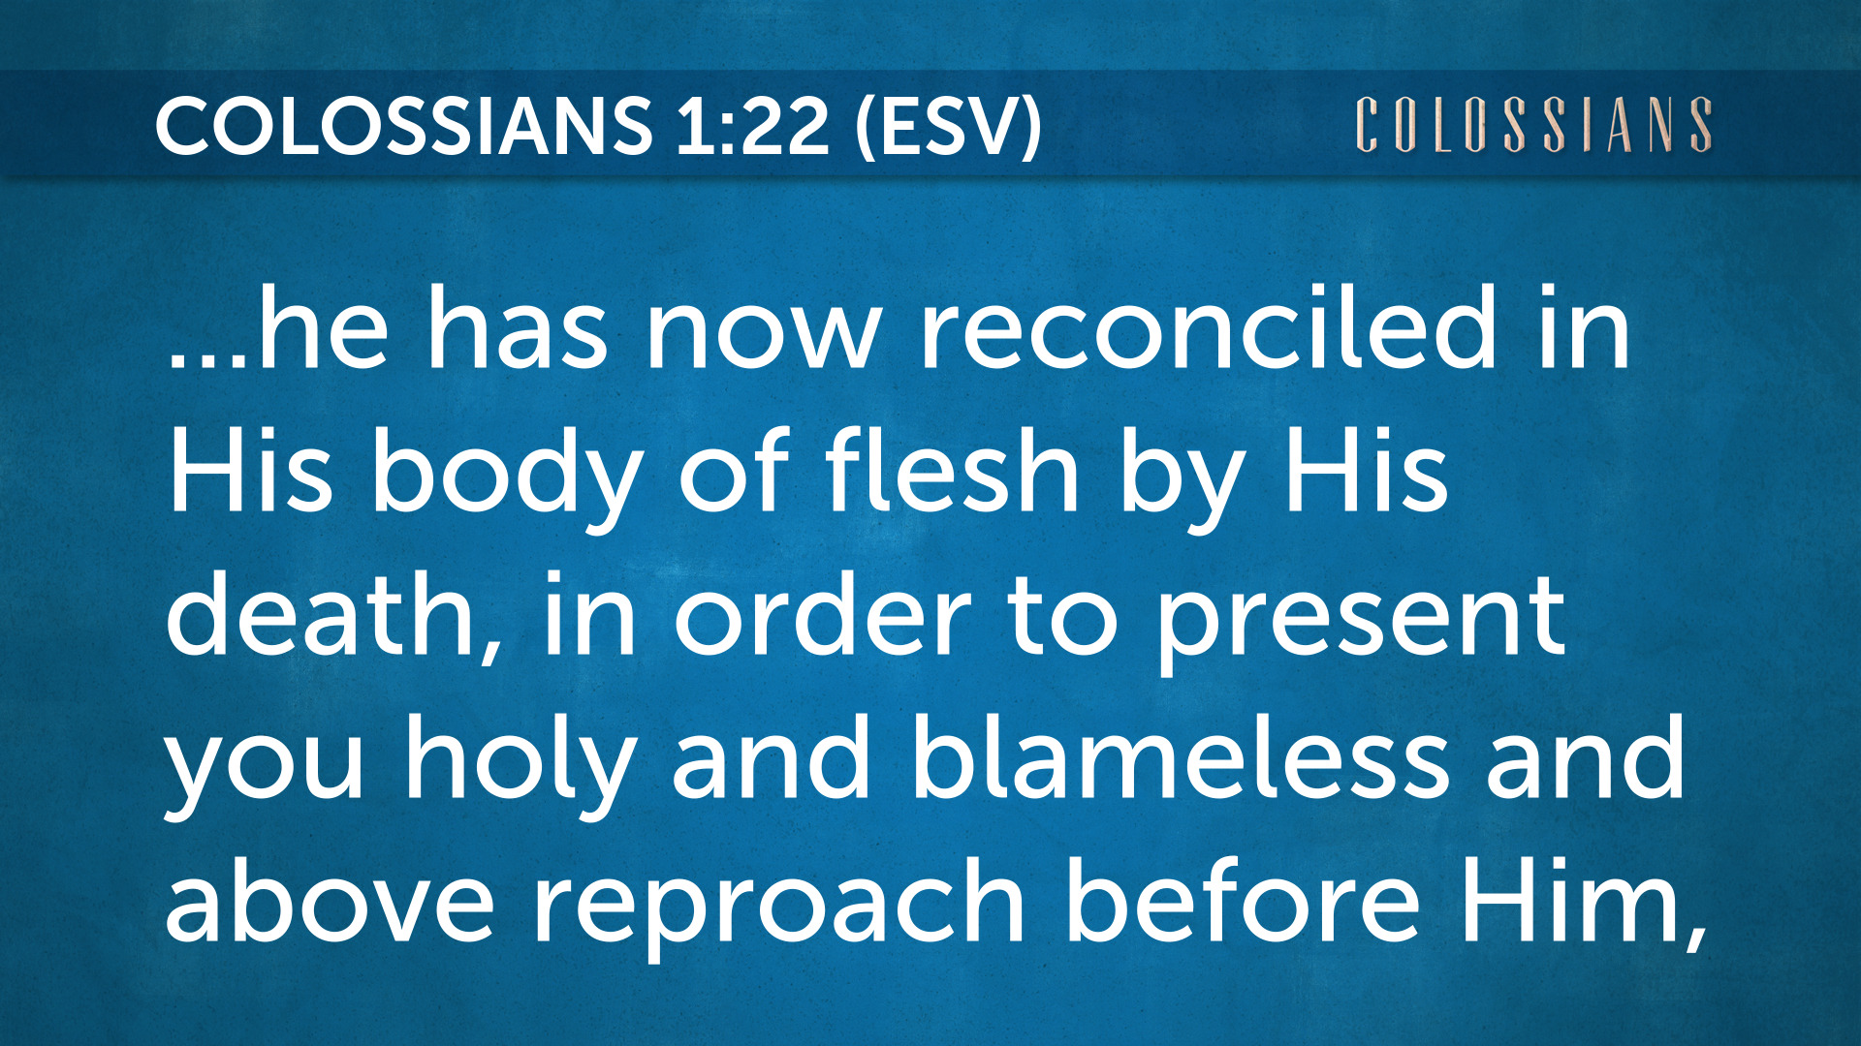

Slide 4
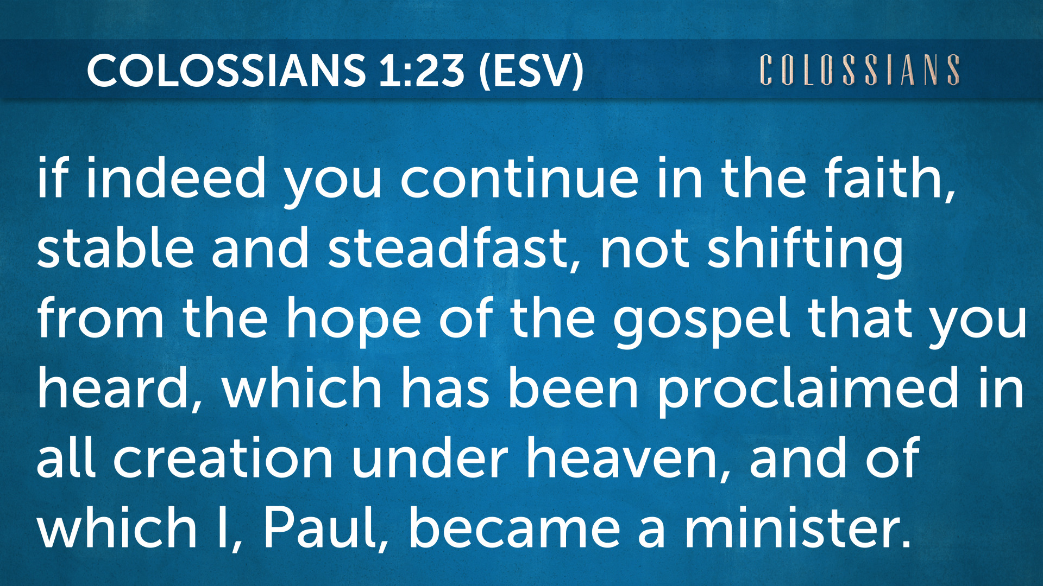

Slide 5
1a.) Steadfast in your faith:
Our past condition -
sin separated us from God.

Slide 6
Colossians 1:21
And you, who once were alienated and hostile in mind, doing evil deeds,

Slide 7
1b.) Steadfast in your faith:
You were alienated from God.

Slide 8
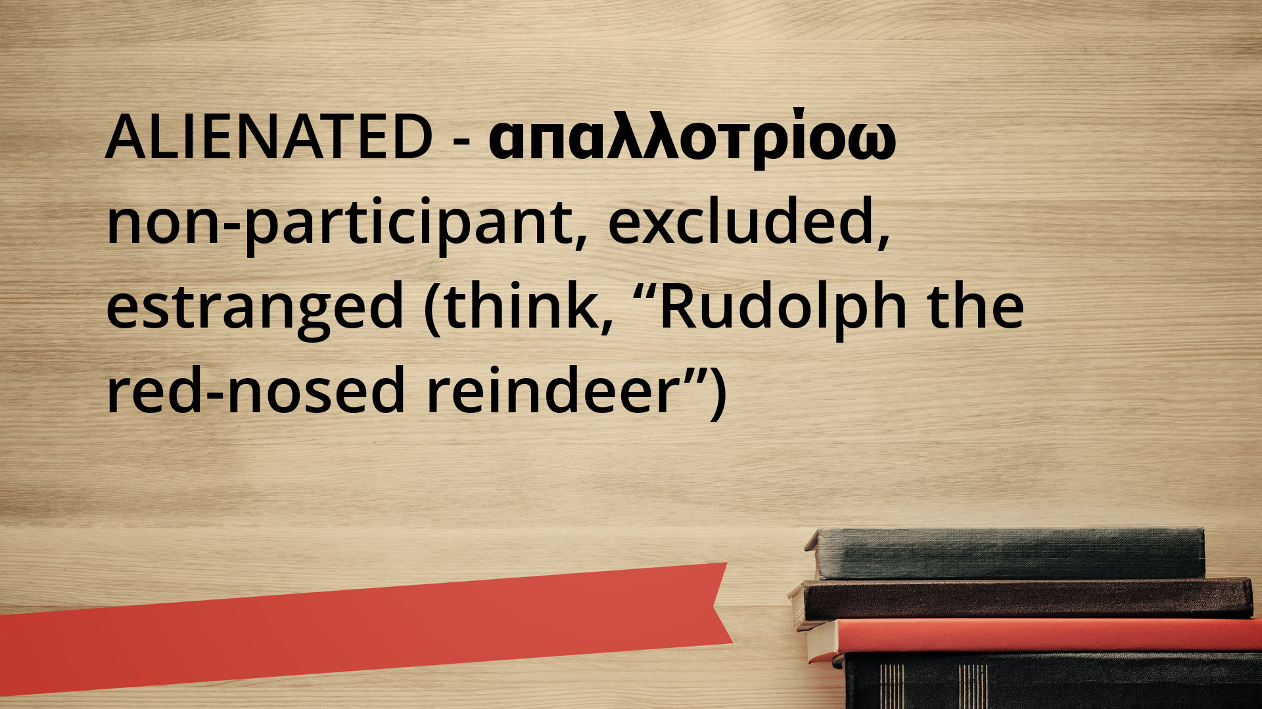

Slide 9
We were hostile in our minds -
and evil in our deeds.
1c.) steadfast in your faith

Slide 10
Colossians 1:21
And you, who once were alienated and hostile in mind, doing evil deeds,

Slide 11
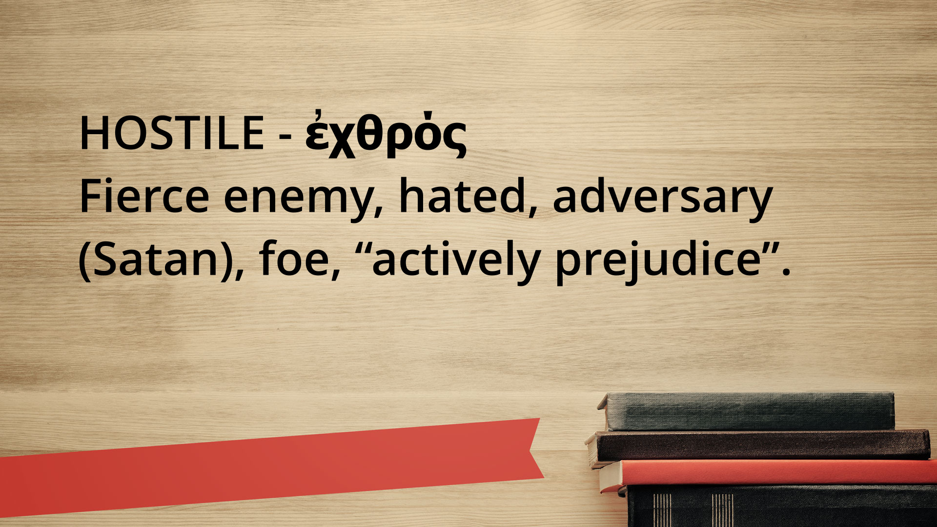

Slide 12
2a.) Firm in our hope:
Our present condition -
Reconciled for a godly purpose

Slide 13
Colossians 1:22
…He has now reconciled in His body of flesh by His death, in order to present you holy and blameless and above reproach before Him,

Slide 14
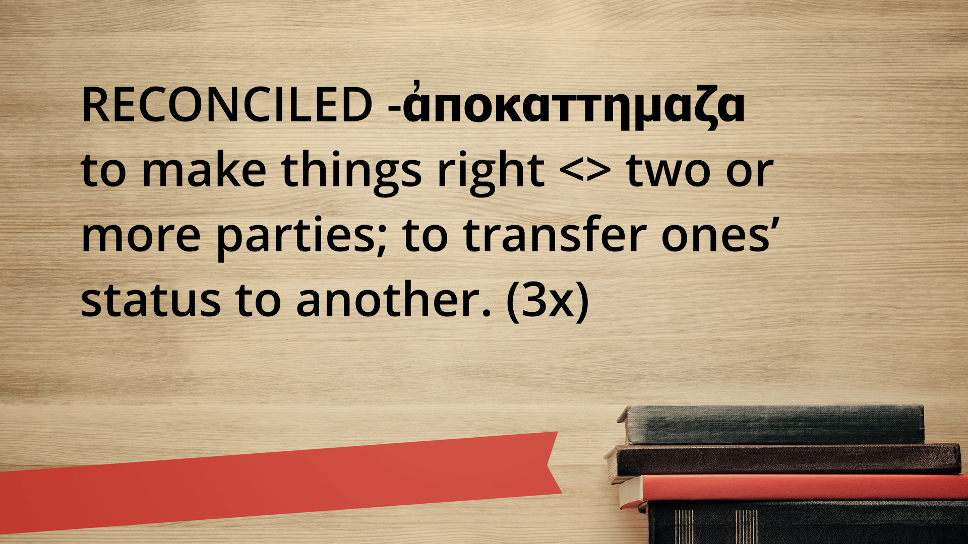

Slide 15
2b.) Firm in our hope:
Reconciled through Christ’s atonement (reconciled)
“in His body of flesh
by His death”

Slide 16
?
Atonement
or
Reconciliation?

Slide 17
OT “atonement” (69x) KJV, (103x) ESV; (et al.) “atoning sacrifice”
Variants - “reconciliation” (KJV), “propitiation” (most English trans.)

Slide 18
Septuagint: Heb trans. into Greek (280 BC). Main language was Koine Greek, not Hebrew.
LXX - “Trans of the 70.”
66 Canon + 4 Apocrypha - (RCC)

Slide 19
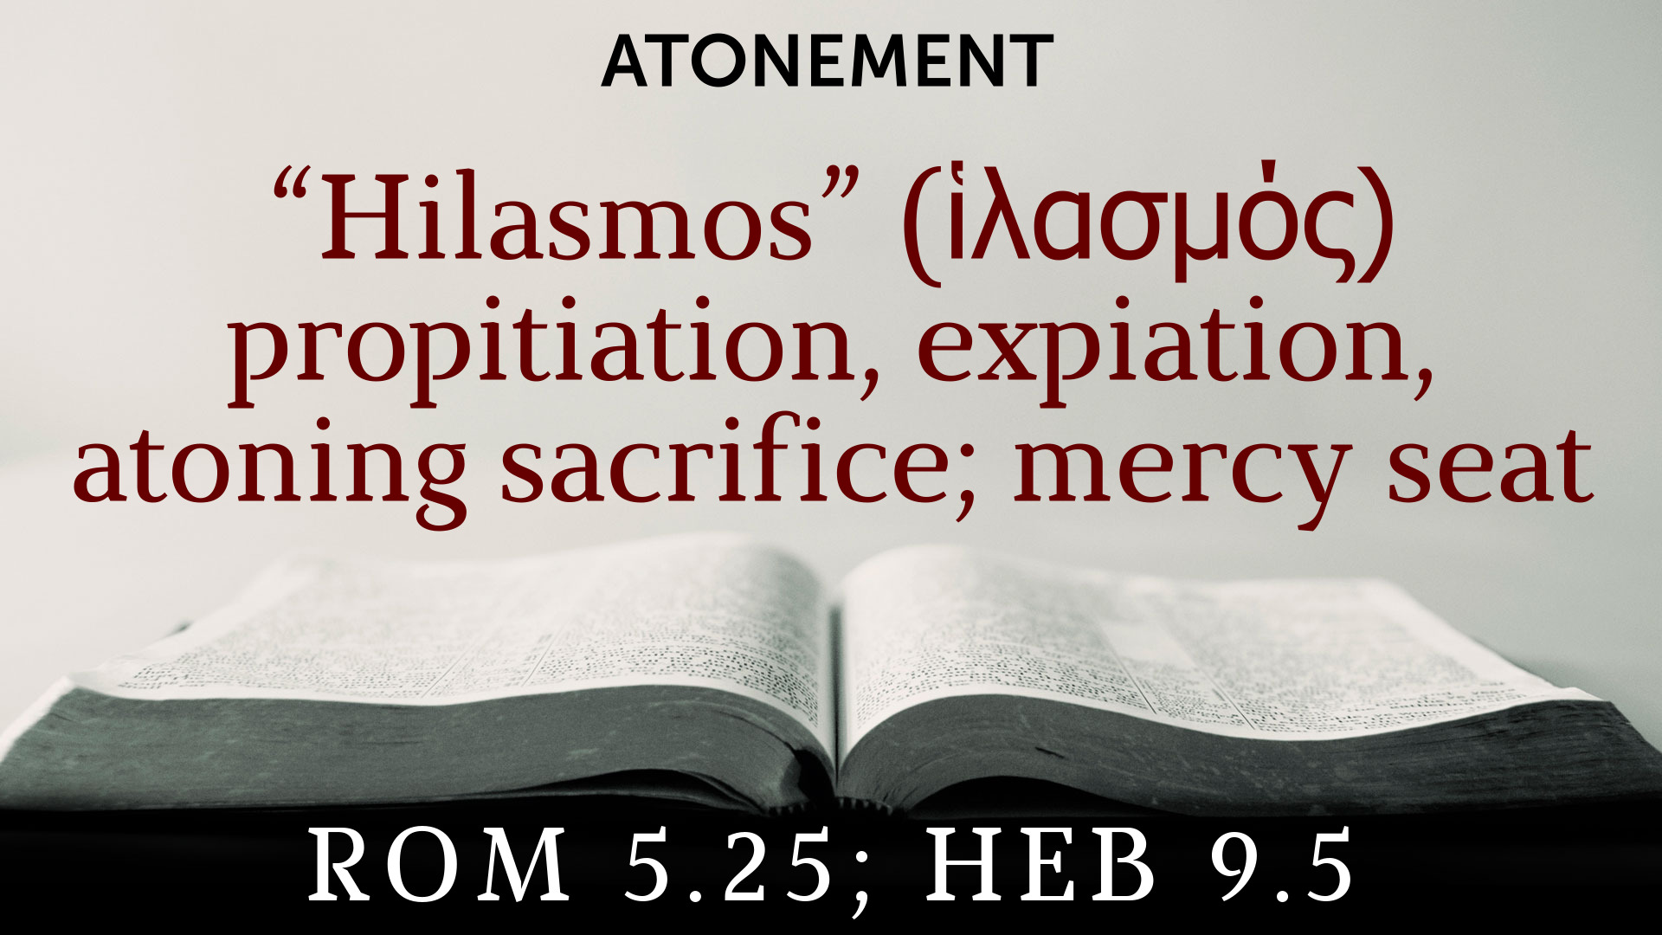

Slide 20
Colossians 1:22
…He has now reconciled in His body of flesh by His death,
in order to present you holy and blameless and above reproach before Him,

Slide 21
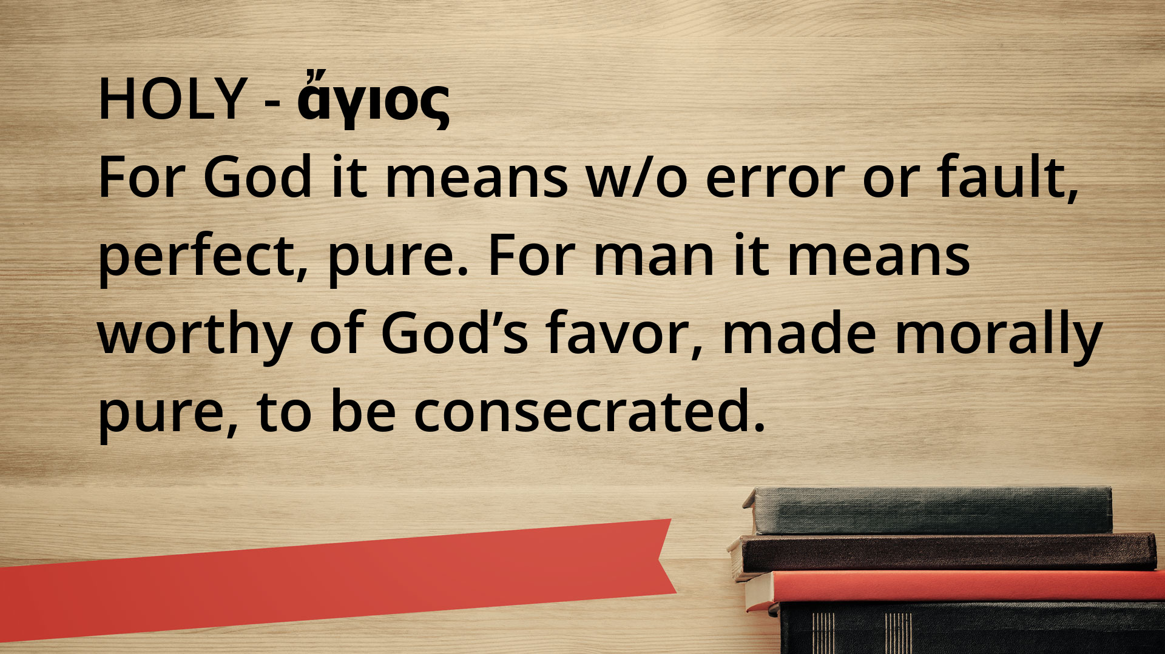

Slide 22
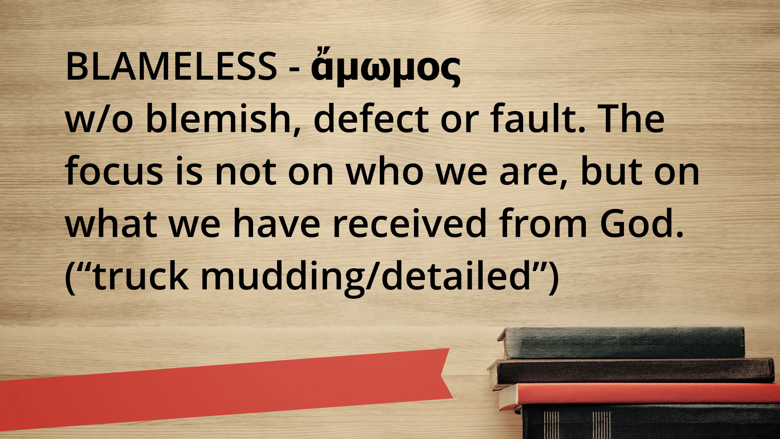

Slide 23
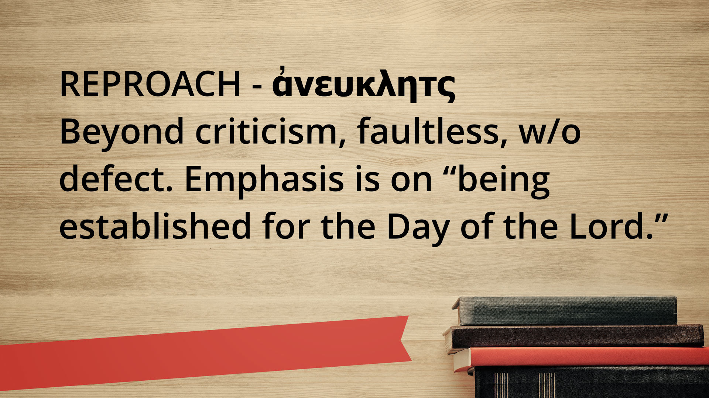

Slide 24
2.) Firm in our Hope: a.) Our past condition (sin) b.) Alienated from God c.) Hostile in mind, evil in deeds

Slide 25
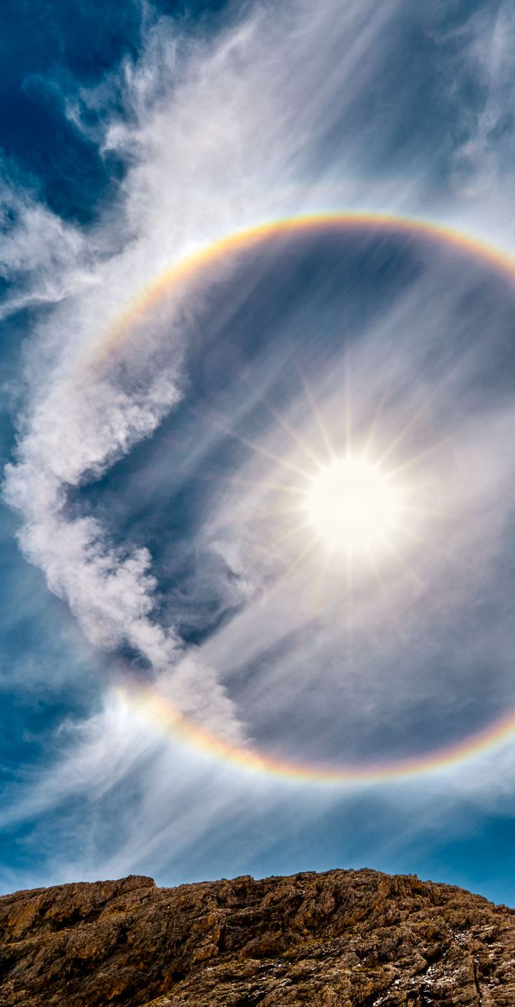
Colossians 1:23
…if indeed you continue in the faith, stable and steadfast, not shifting from the hope of the gospel that you heard, which has been proclaimed in all creation under heaven, and of which I, Paul, became a minister.

Slide 26
3a.) Resolute in our obedience:
Our future condition -
Steadfast in hope

Slide 27
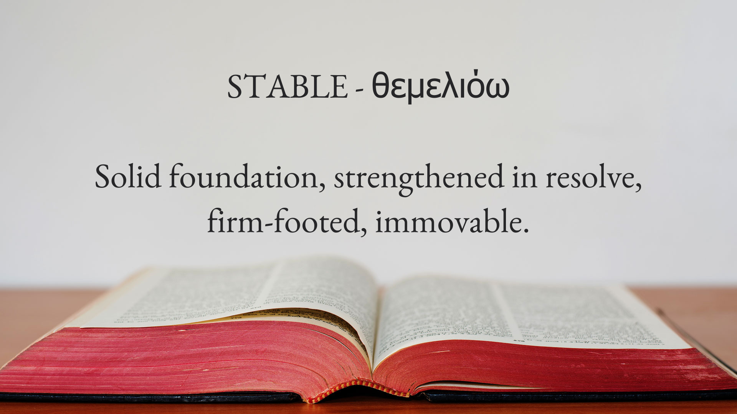

Slide 28
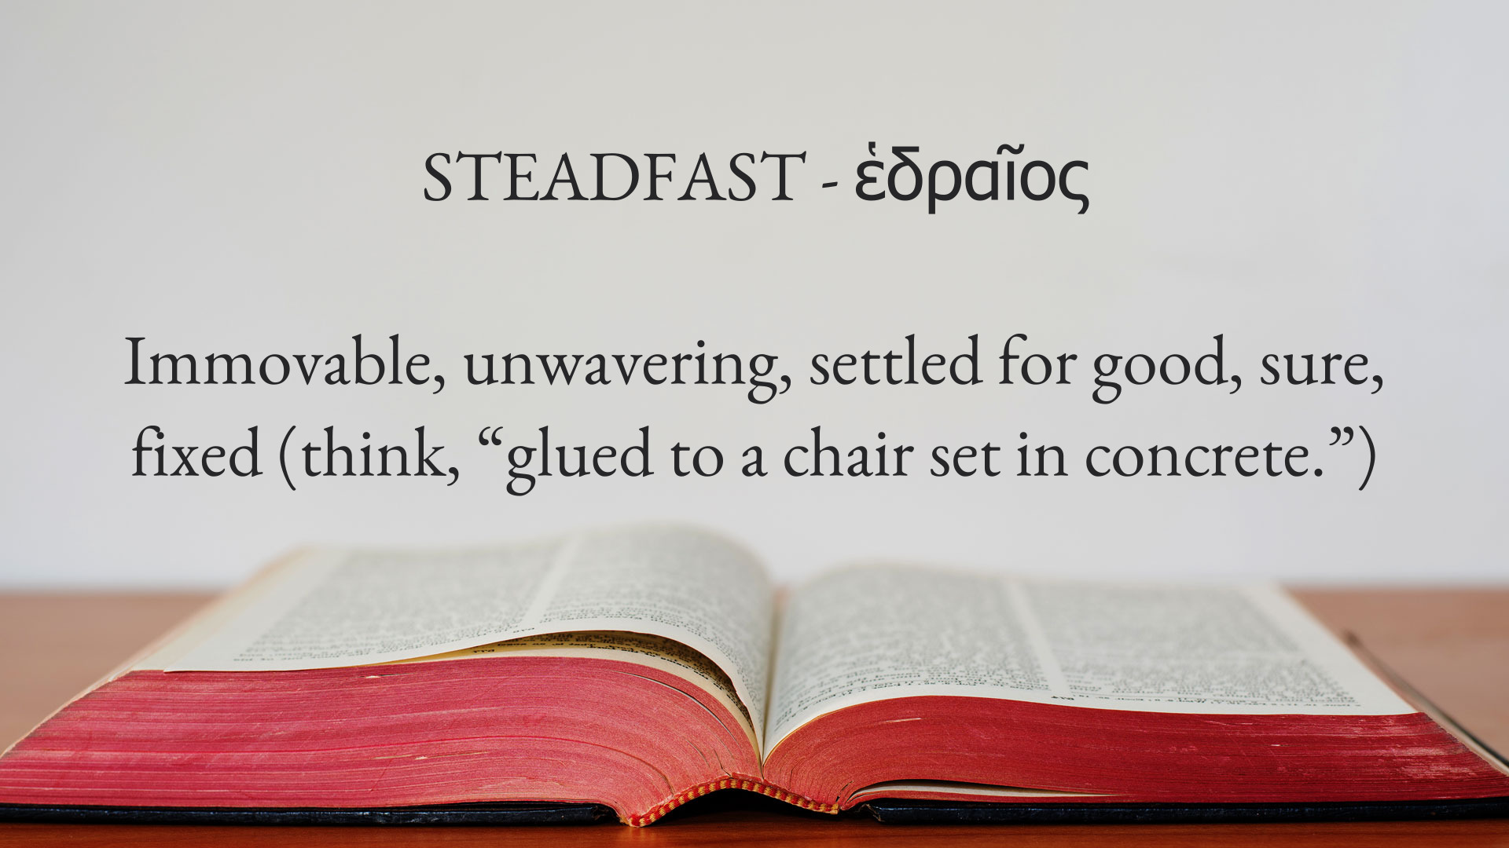

Slide 29
3b.) Resolute in our obedience:
Our hope is rooted in the Word of God.
“not shifting from the hope of the gospel”

Slide 30
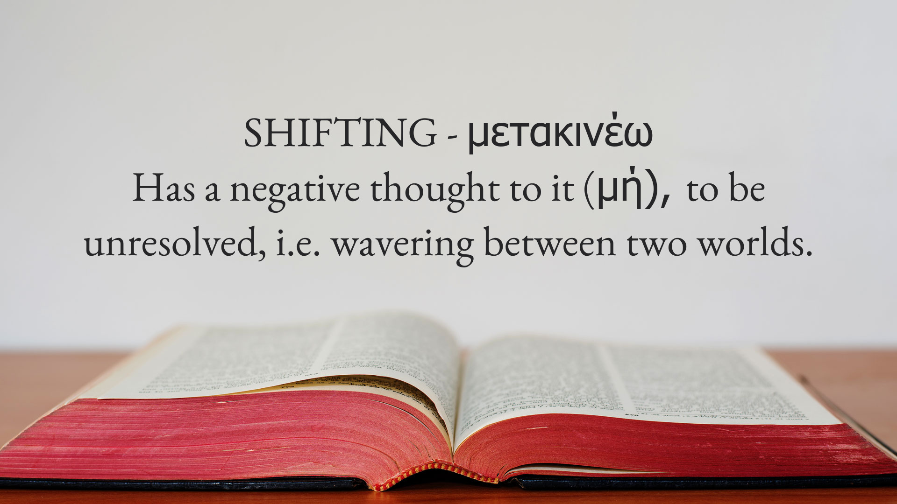

Slide 31
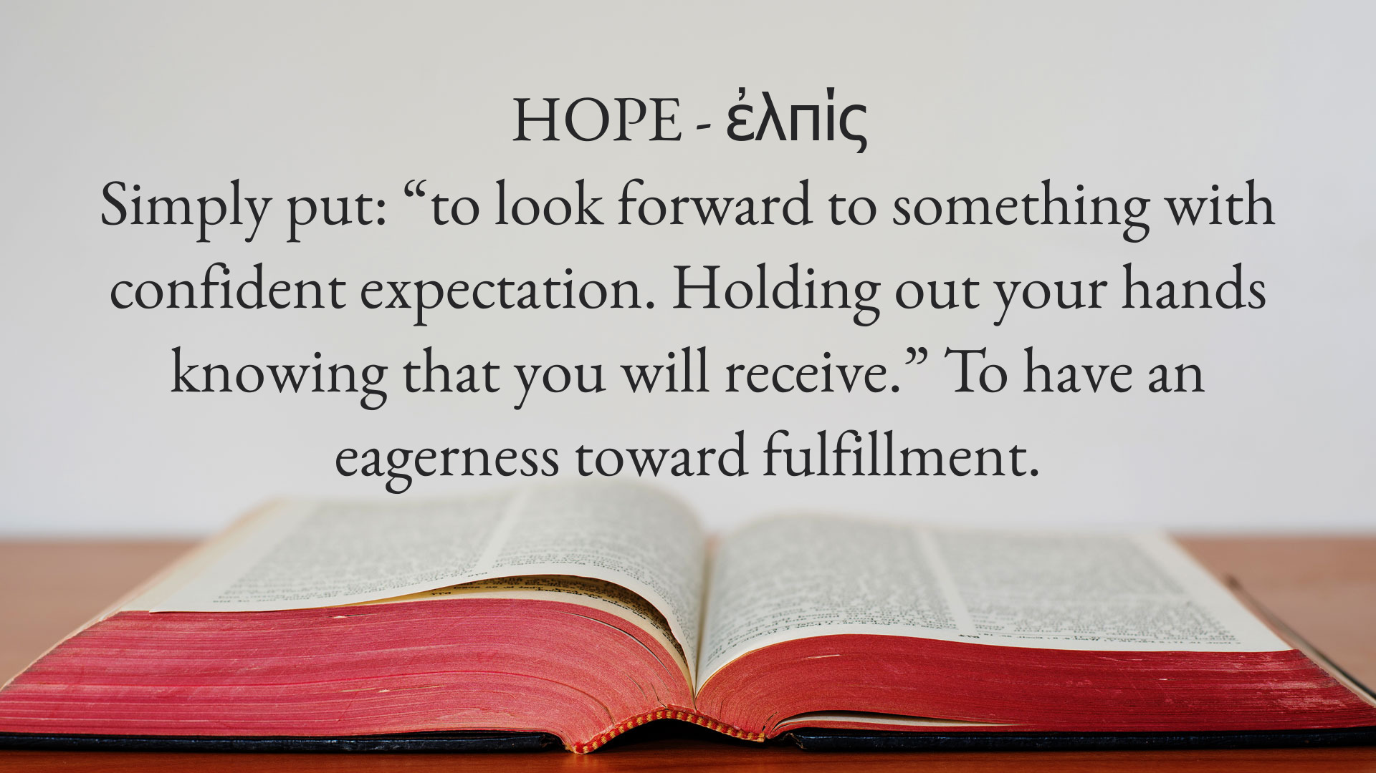

Slide 32
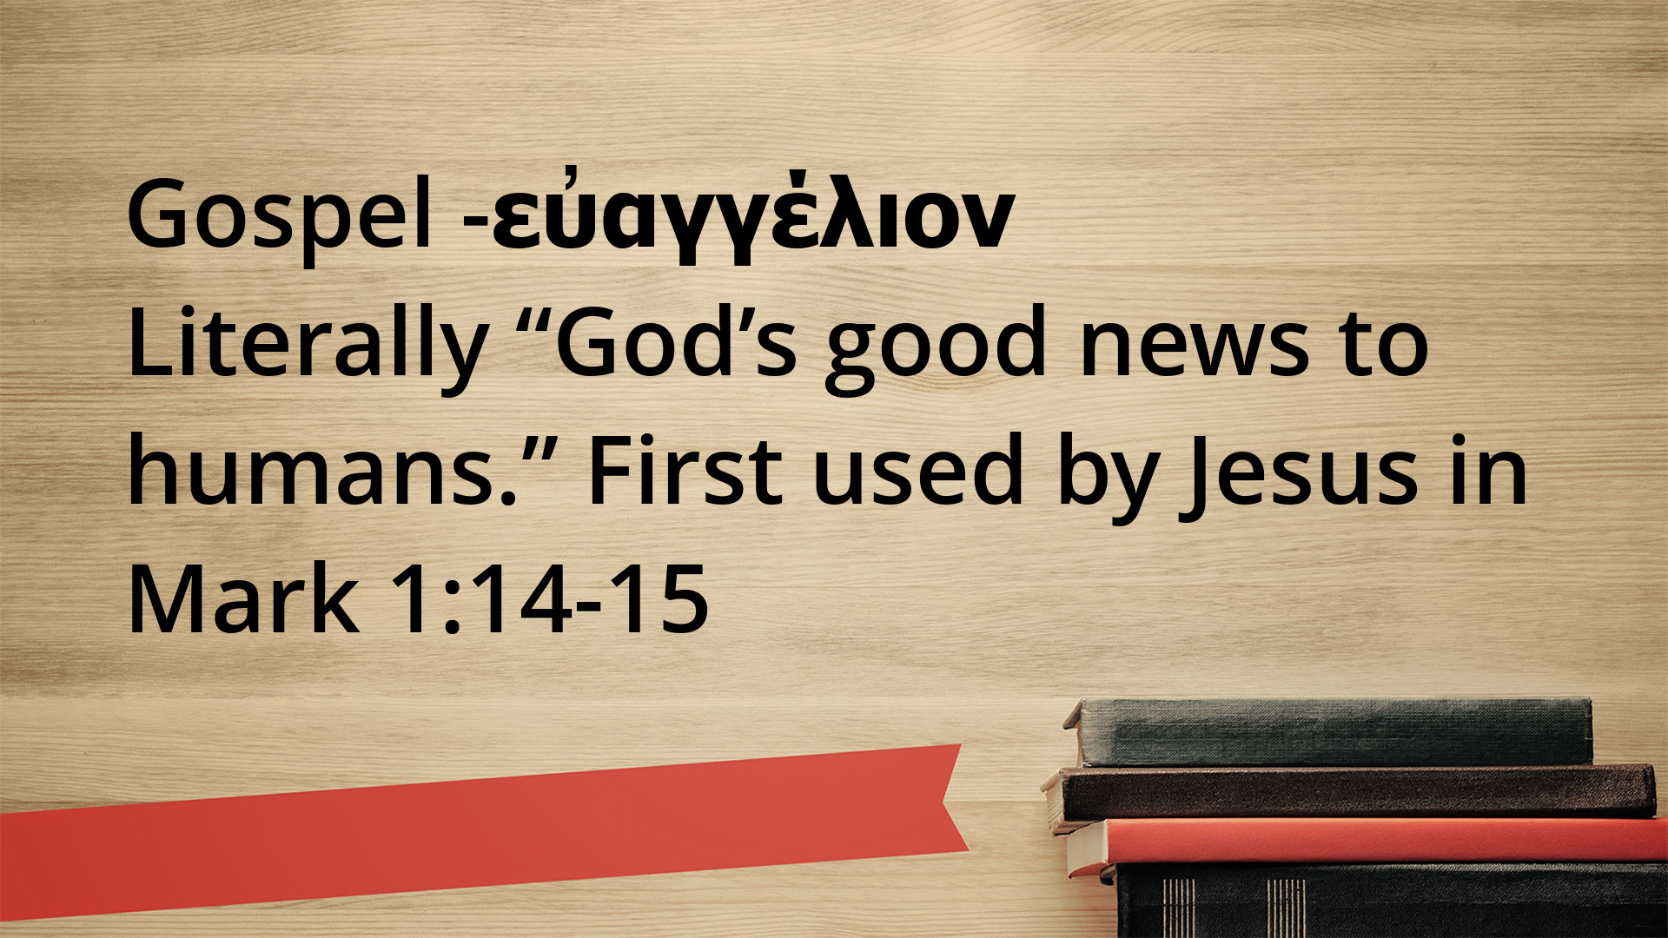

Slide 33
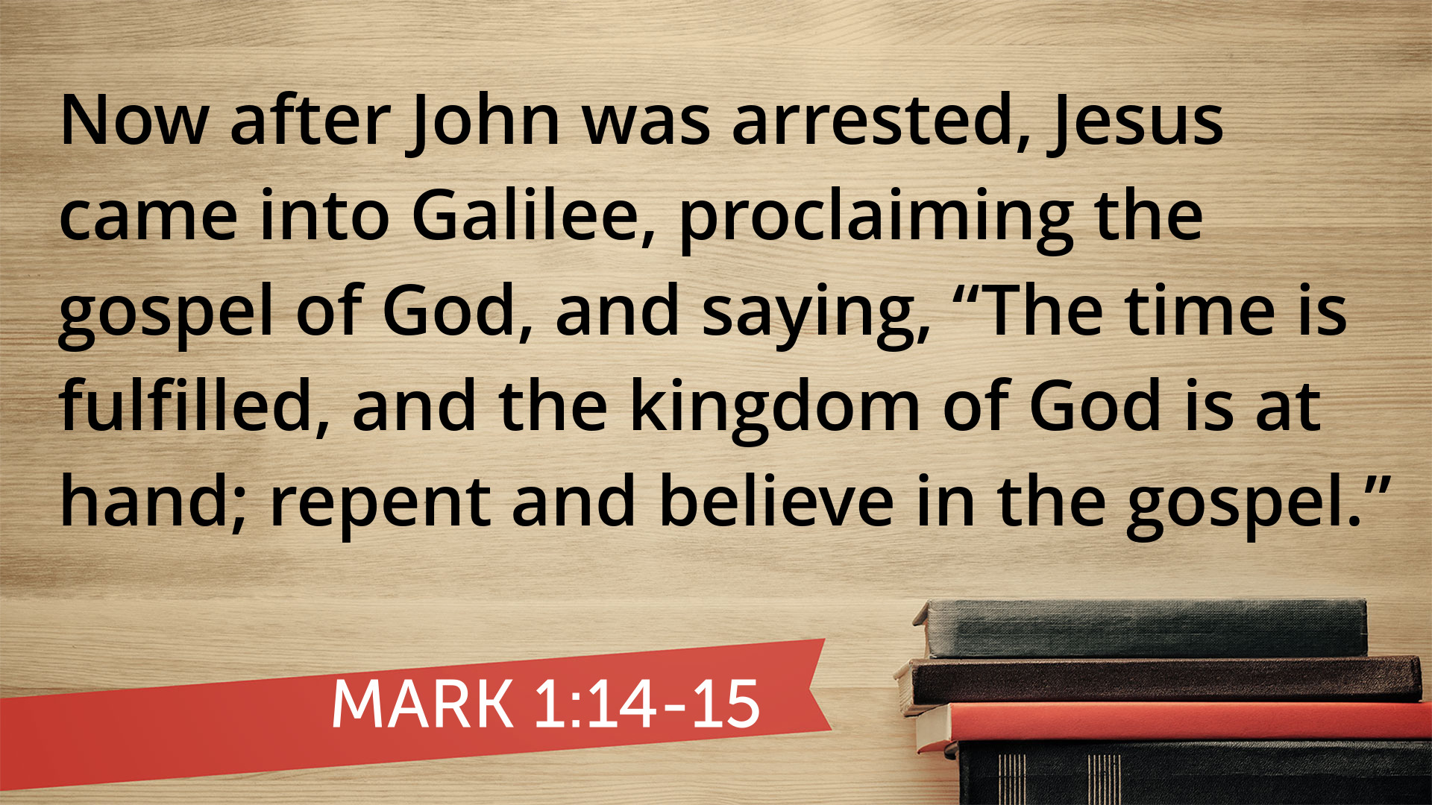

Slide 34
3c.) Resolute in our obedience:
Proclaiming the gospel for OTHERS to hear.

Slide 35
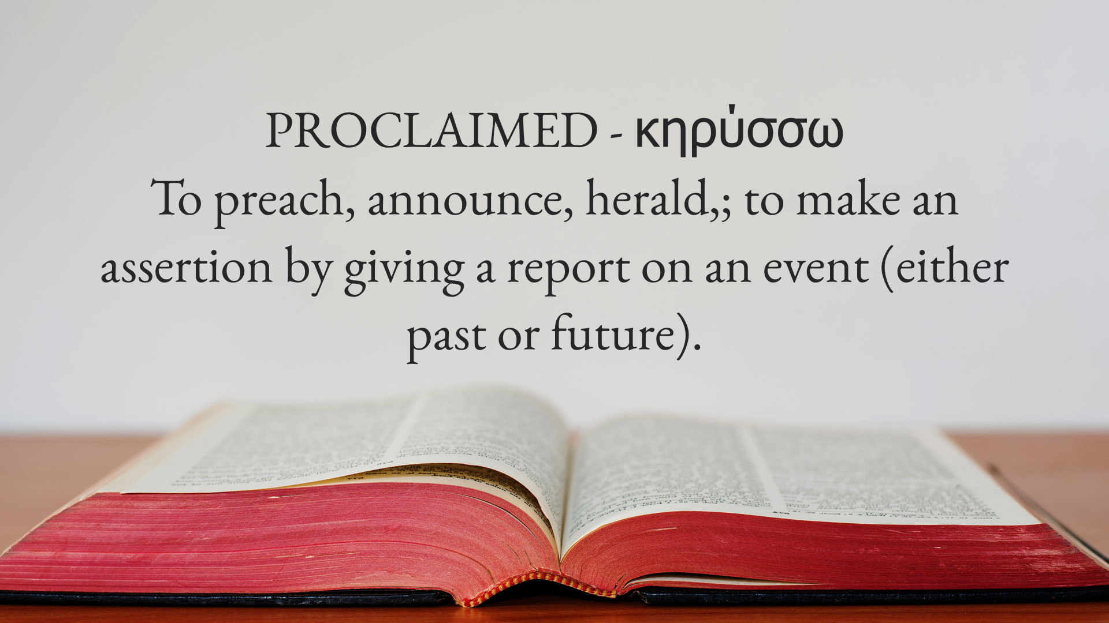

Slide 36
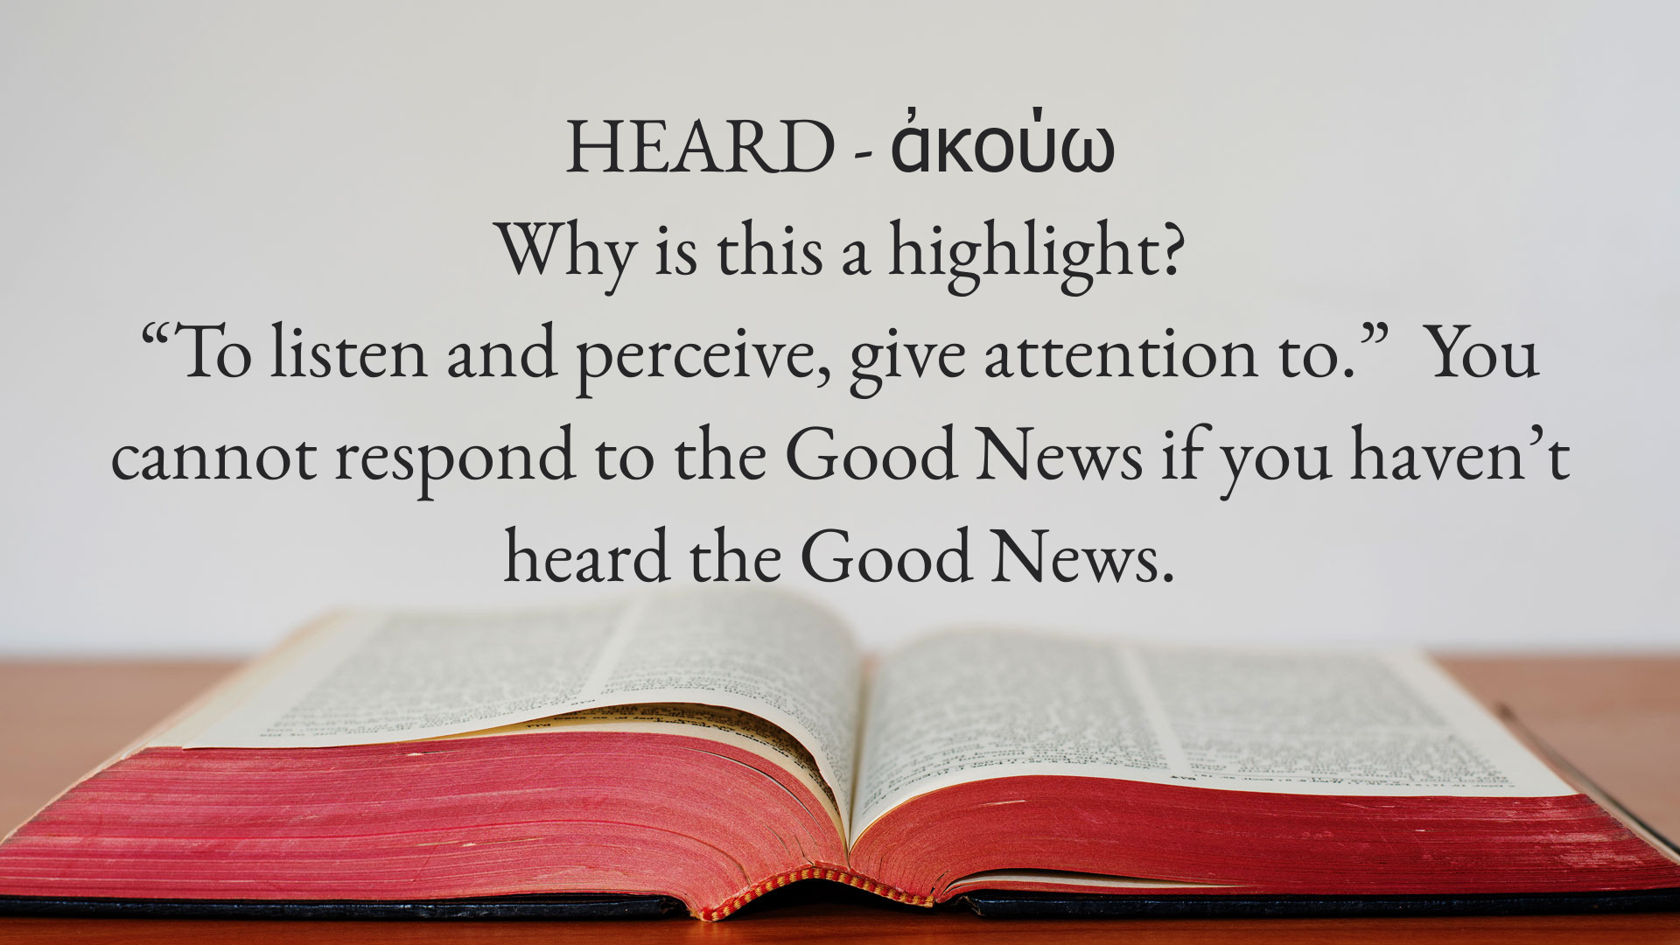

Slide 37
Paul - Apostle, Minister
Author, church planter, missionary
Mentor, teacher, believer, resolute
Friend to many, bold in speech
Champion for Christ!

Slide 38
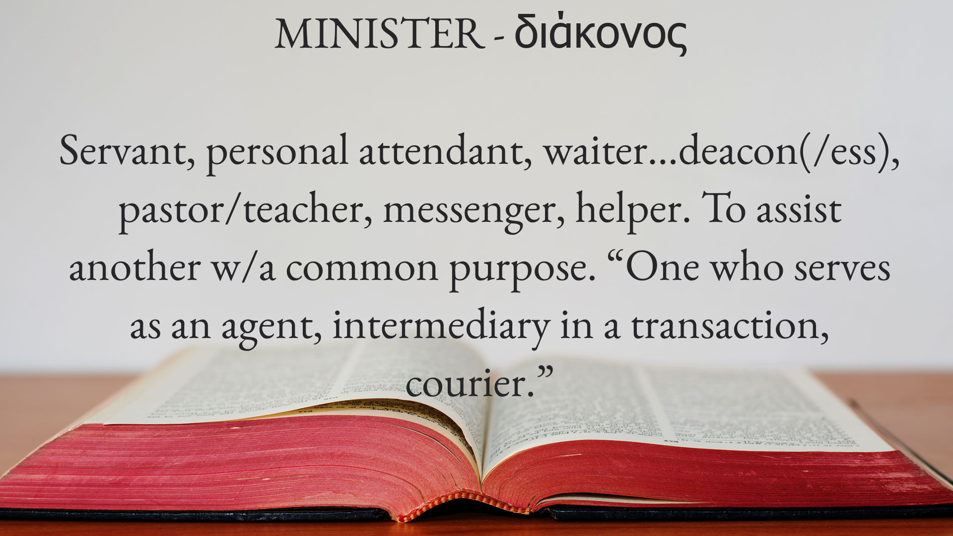

Slide 39

In 1:15-20, Paul declares the preeminence of Christ in his Christological song of praise.
In 1:20-23, Paul declares
the benefits we receive for being …

Slide 40


Slide 41
What - you were separated
from God because of sin.
So What - there is an offer for
forgiveness through Jesus, who
is the propitiation for our sins.

Slide 42
Now What?
There are two decision to make:
  Submit your life to God in Christ.
  Seek after God in all aspects of life.

