Slide 1

Celebrating the Past while
Embracing the Future
Can I get a witness for the Lord?

Slide 2
Why God?
God has (past)
God is (present)
God will (future)
For His Glory … For Our Good

Slide 3
Remembering the past while forgetting what is behind?
This is not a contradiction!

Slide 4


Slide 5
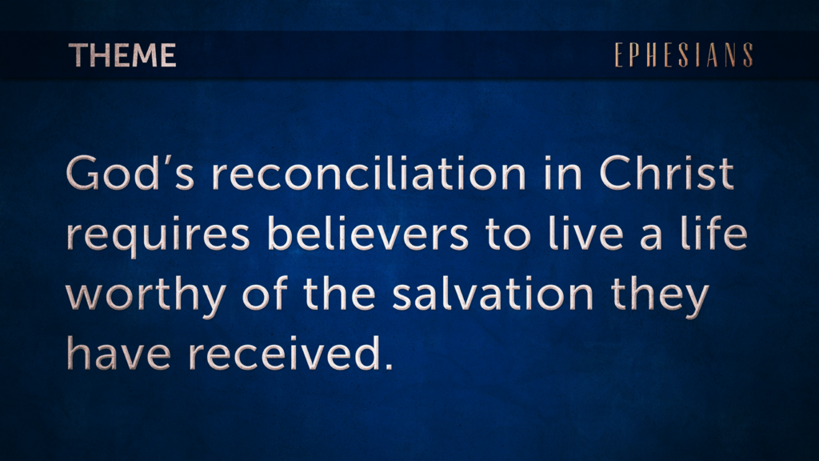

Slide 6

14 For this reason I bow my knees before the Father,
15 from whom every family in heaven and on earth is named,
Eph 3:14-21 (ESV)

Slide 7
16 that according to the riches of His glory He may grant you to be strengthened with power through His Spirit in your inner being,

Slide 8
17 so that Christ may dwell in your hearts through faith - that you, being rooted and grounded in love,

Slide 9
18 may have strength to comprehend with all the saints what is the breadth and length and height and depth,

Slide 10
19 and to know the love of Christ that surpasses knowledge, that you may be filled with all the fullness of God.

Slide 11
20 Now to Him who is able to do far more abundantly than all we ask or think, according to the power within us,

Slide 12
21 to Him be glory in the church and in Christ Jesus throughout all generations, forever and ever. Amen.

Slide 13
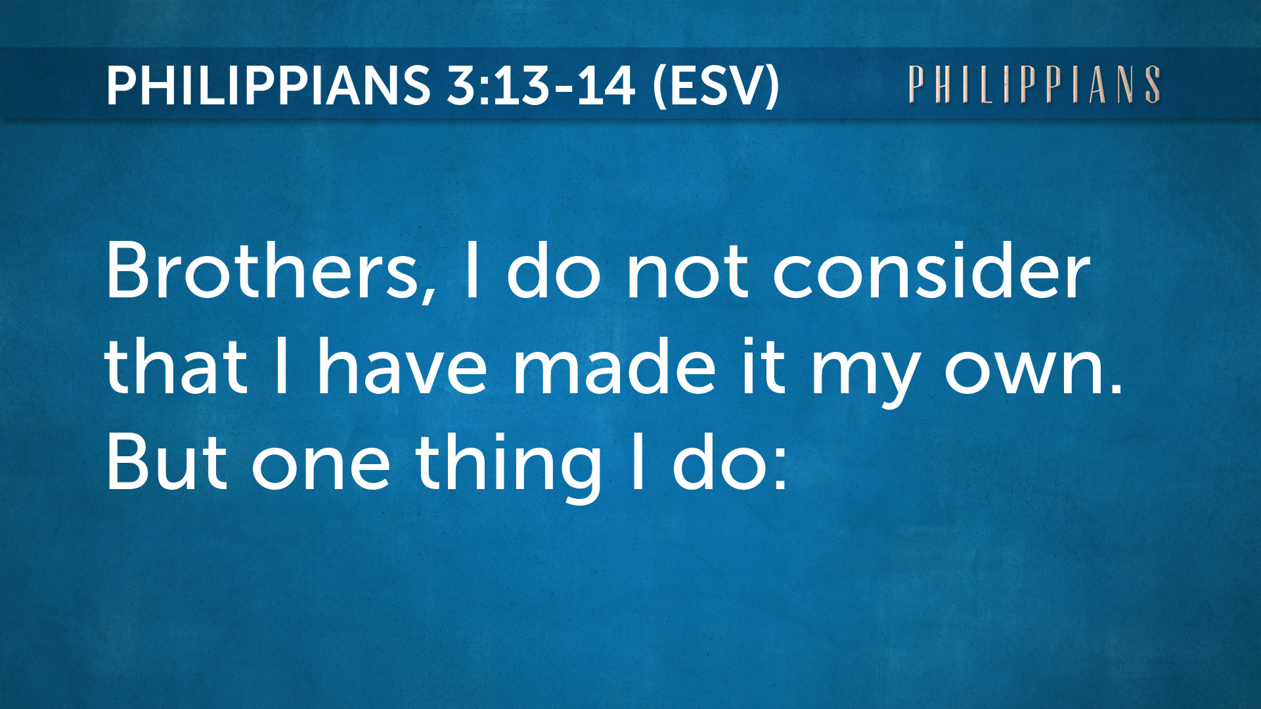

Slide 14
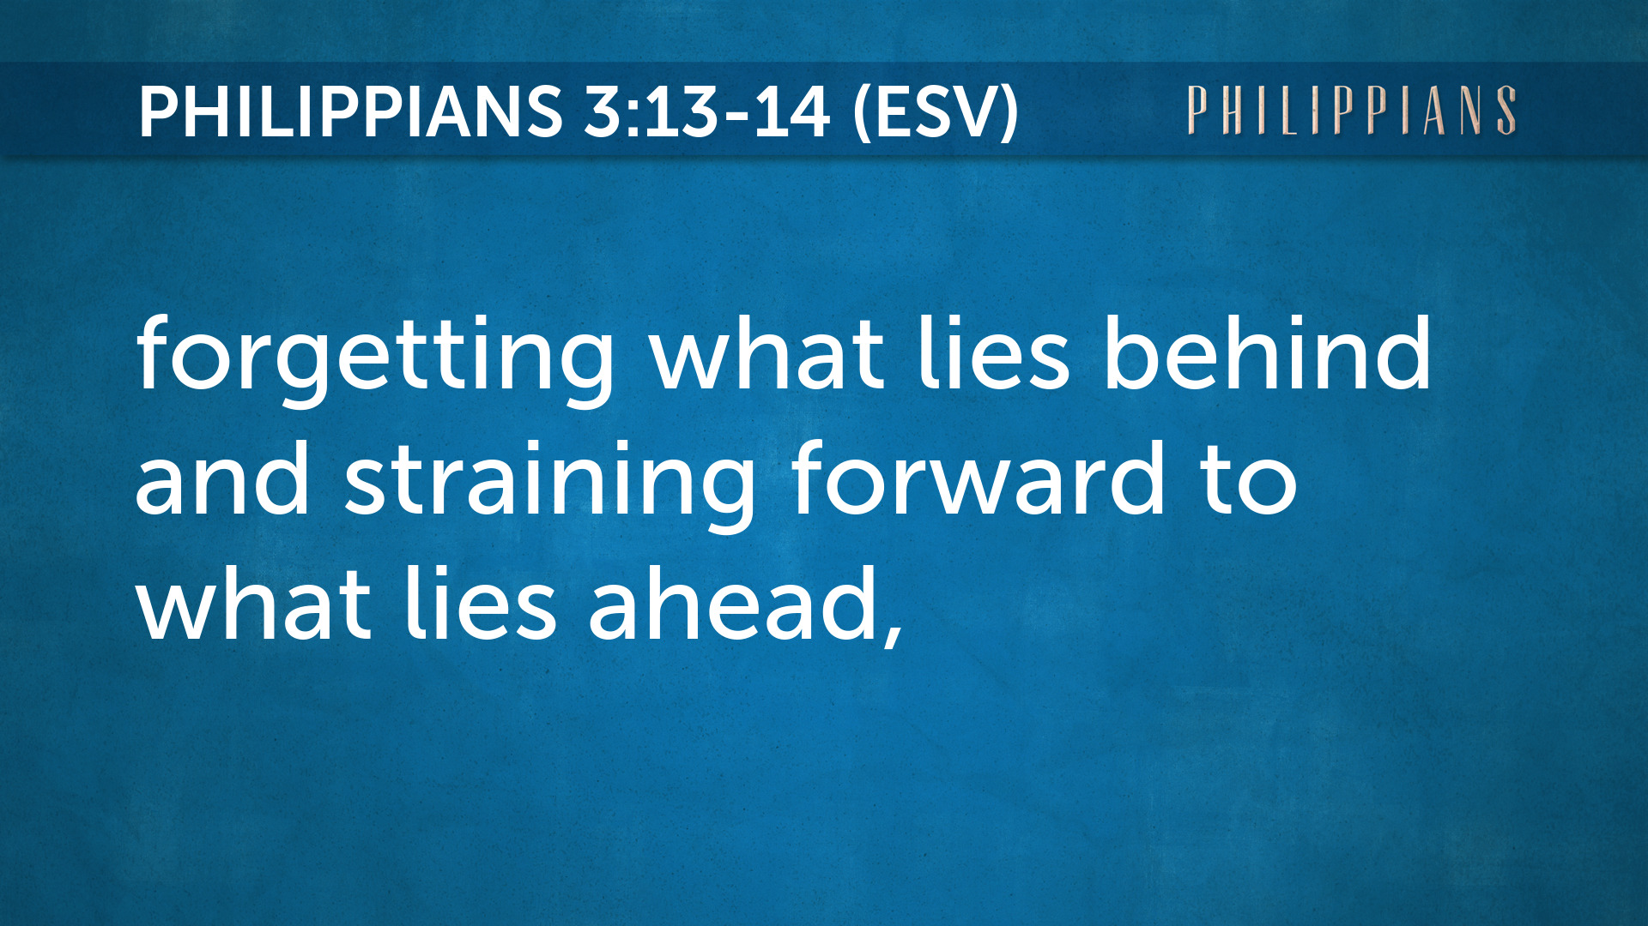

Slide 15
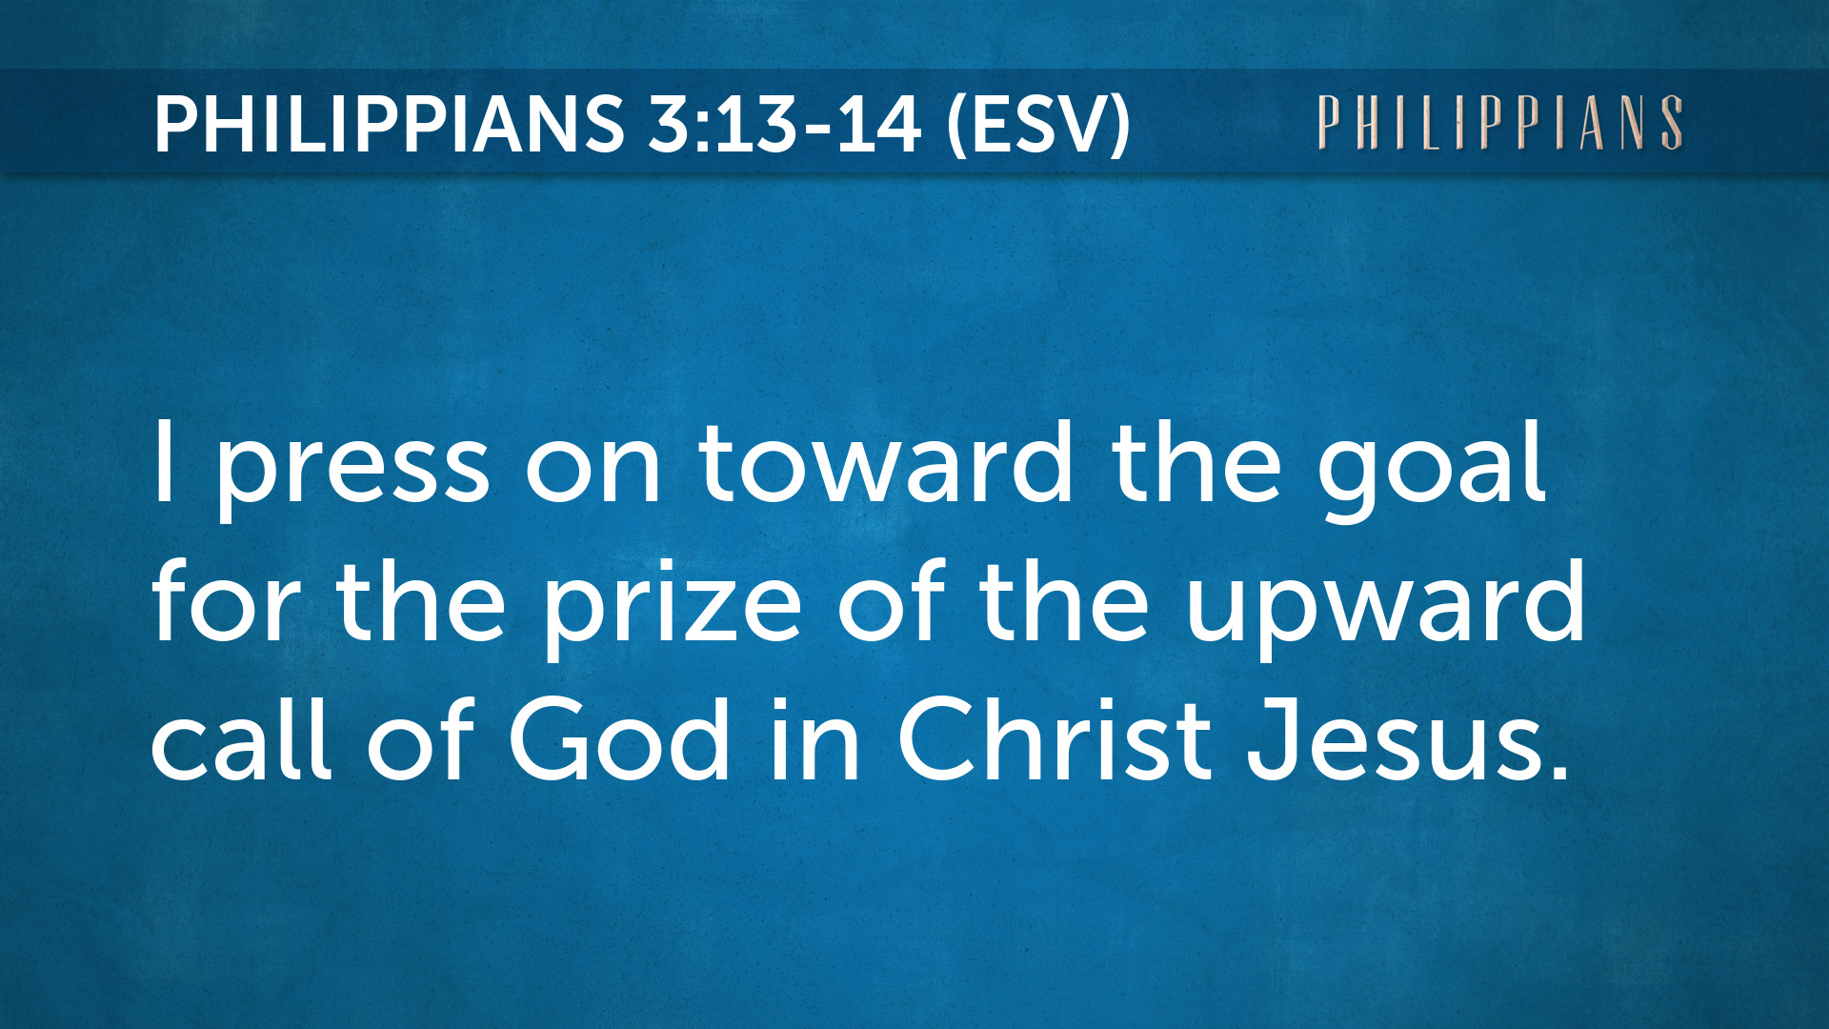

Slide 16

12:1
Therefore, since we are surrounded by so great a cloud of witnesses, let us also lay aside every weight, and sin which clings so closely, and let us run with endurance the race that is set before us,

Slide 17
12:2
looking to Jesus, the founder and perfecter of our faith, who for the joy that was set before him endured the cross, despising the shame, and is seated at the right hand of the throne of God.

Slide 18
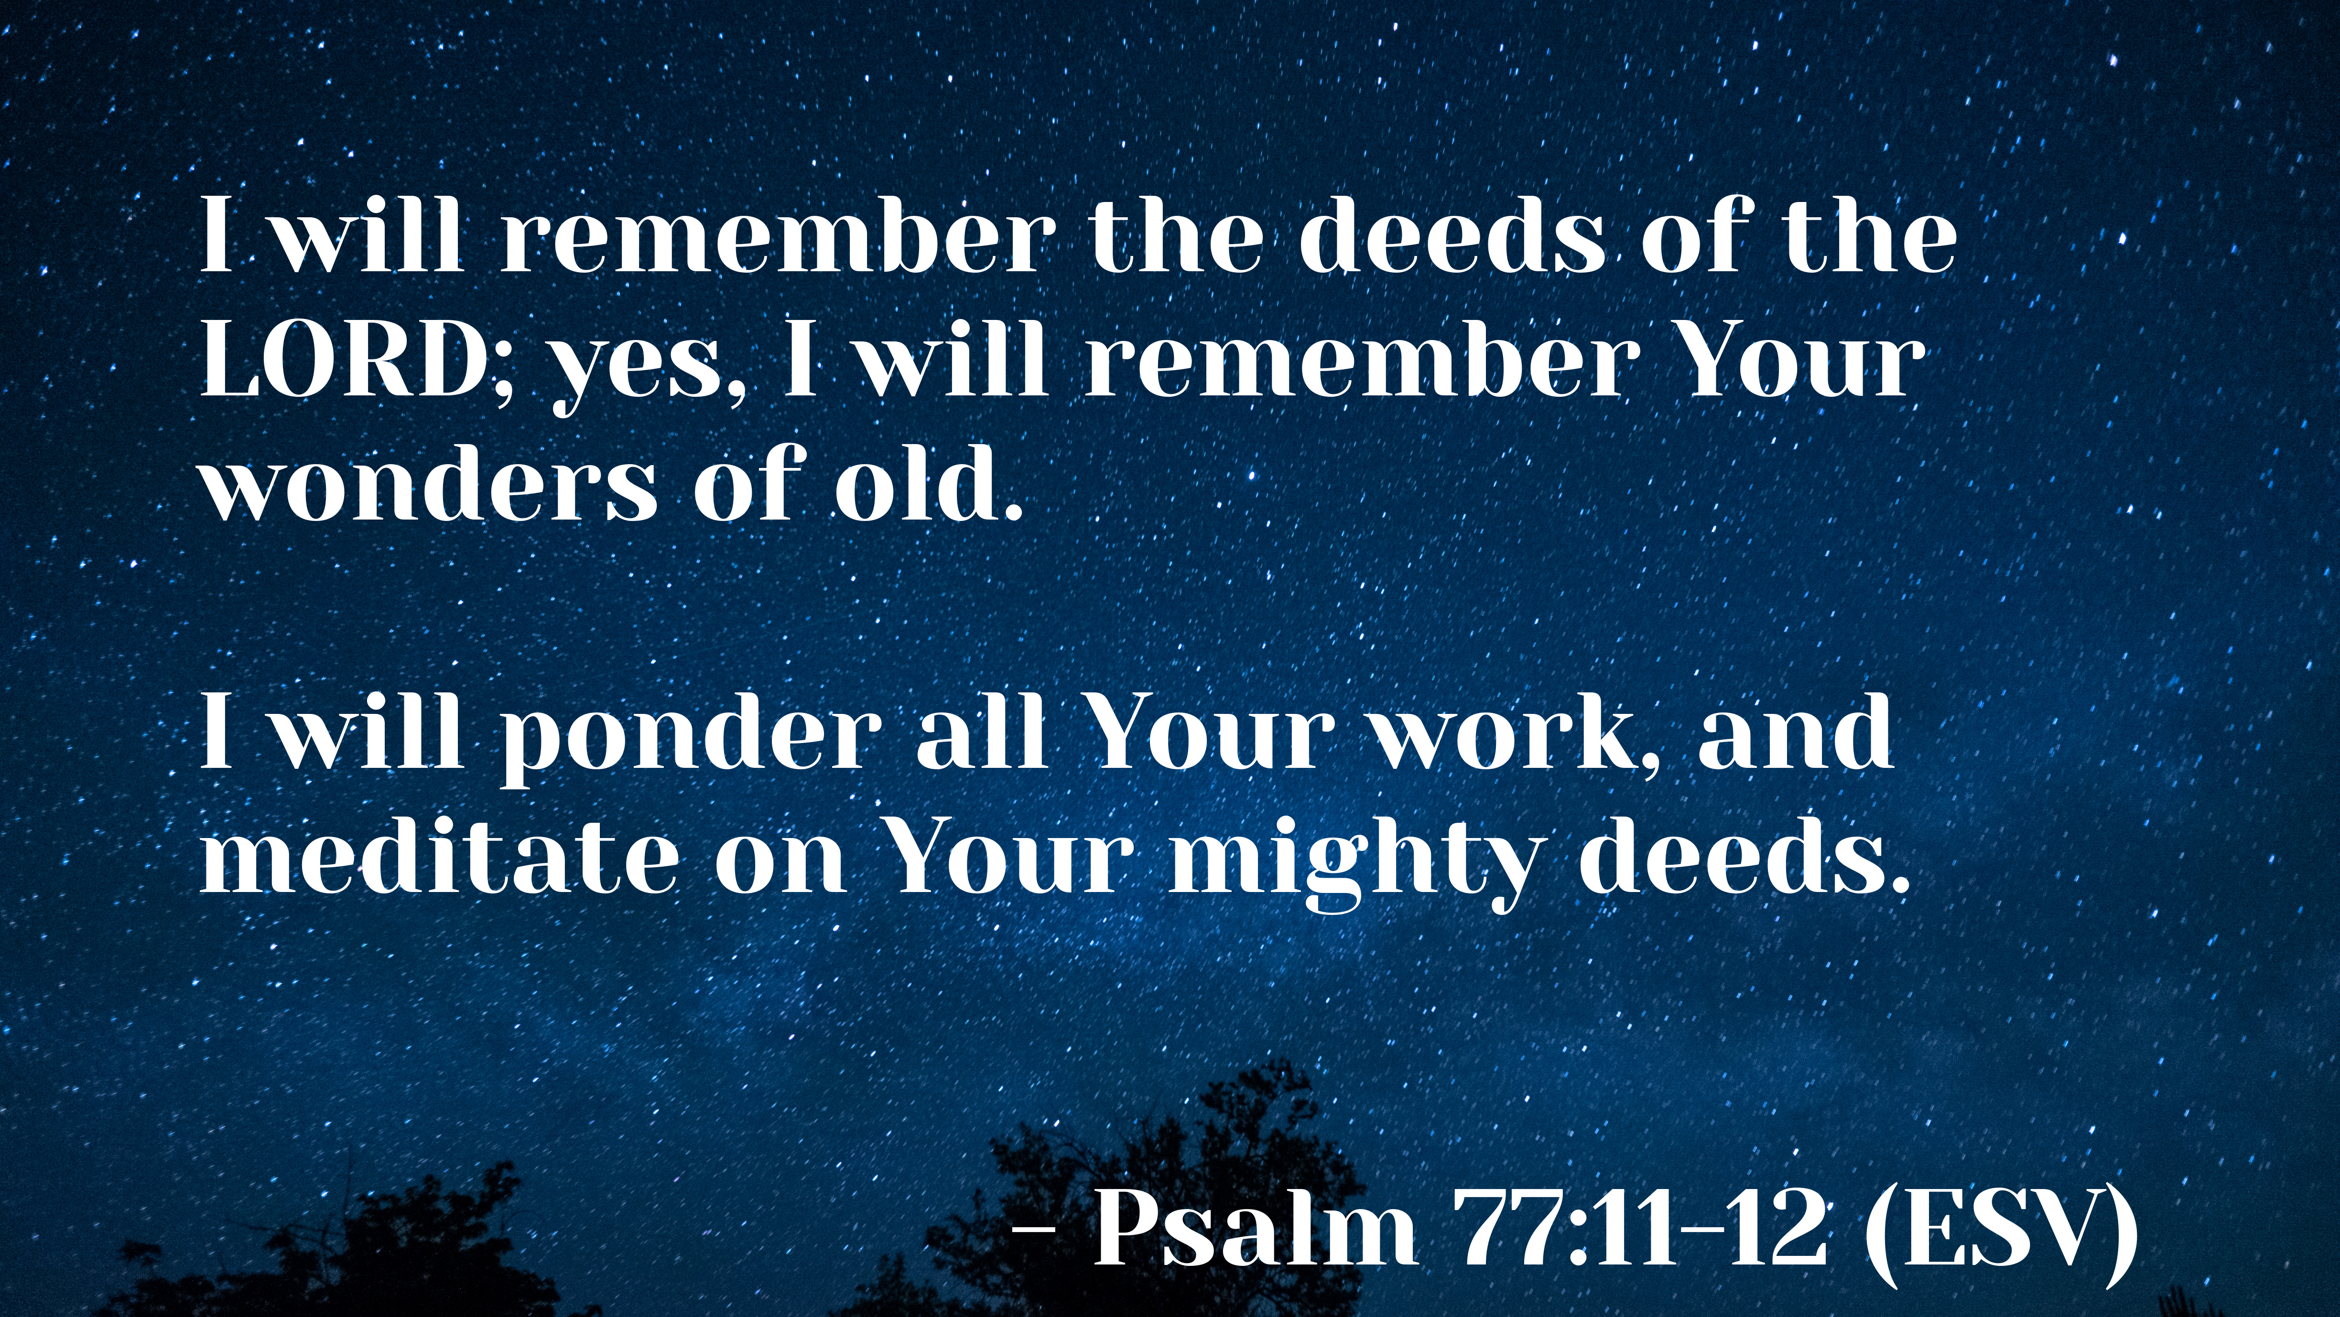

Slide 19
God HAS…
Psalm 77:11-12

Slide 20
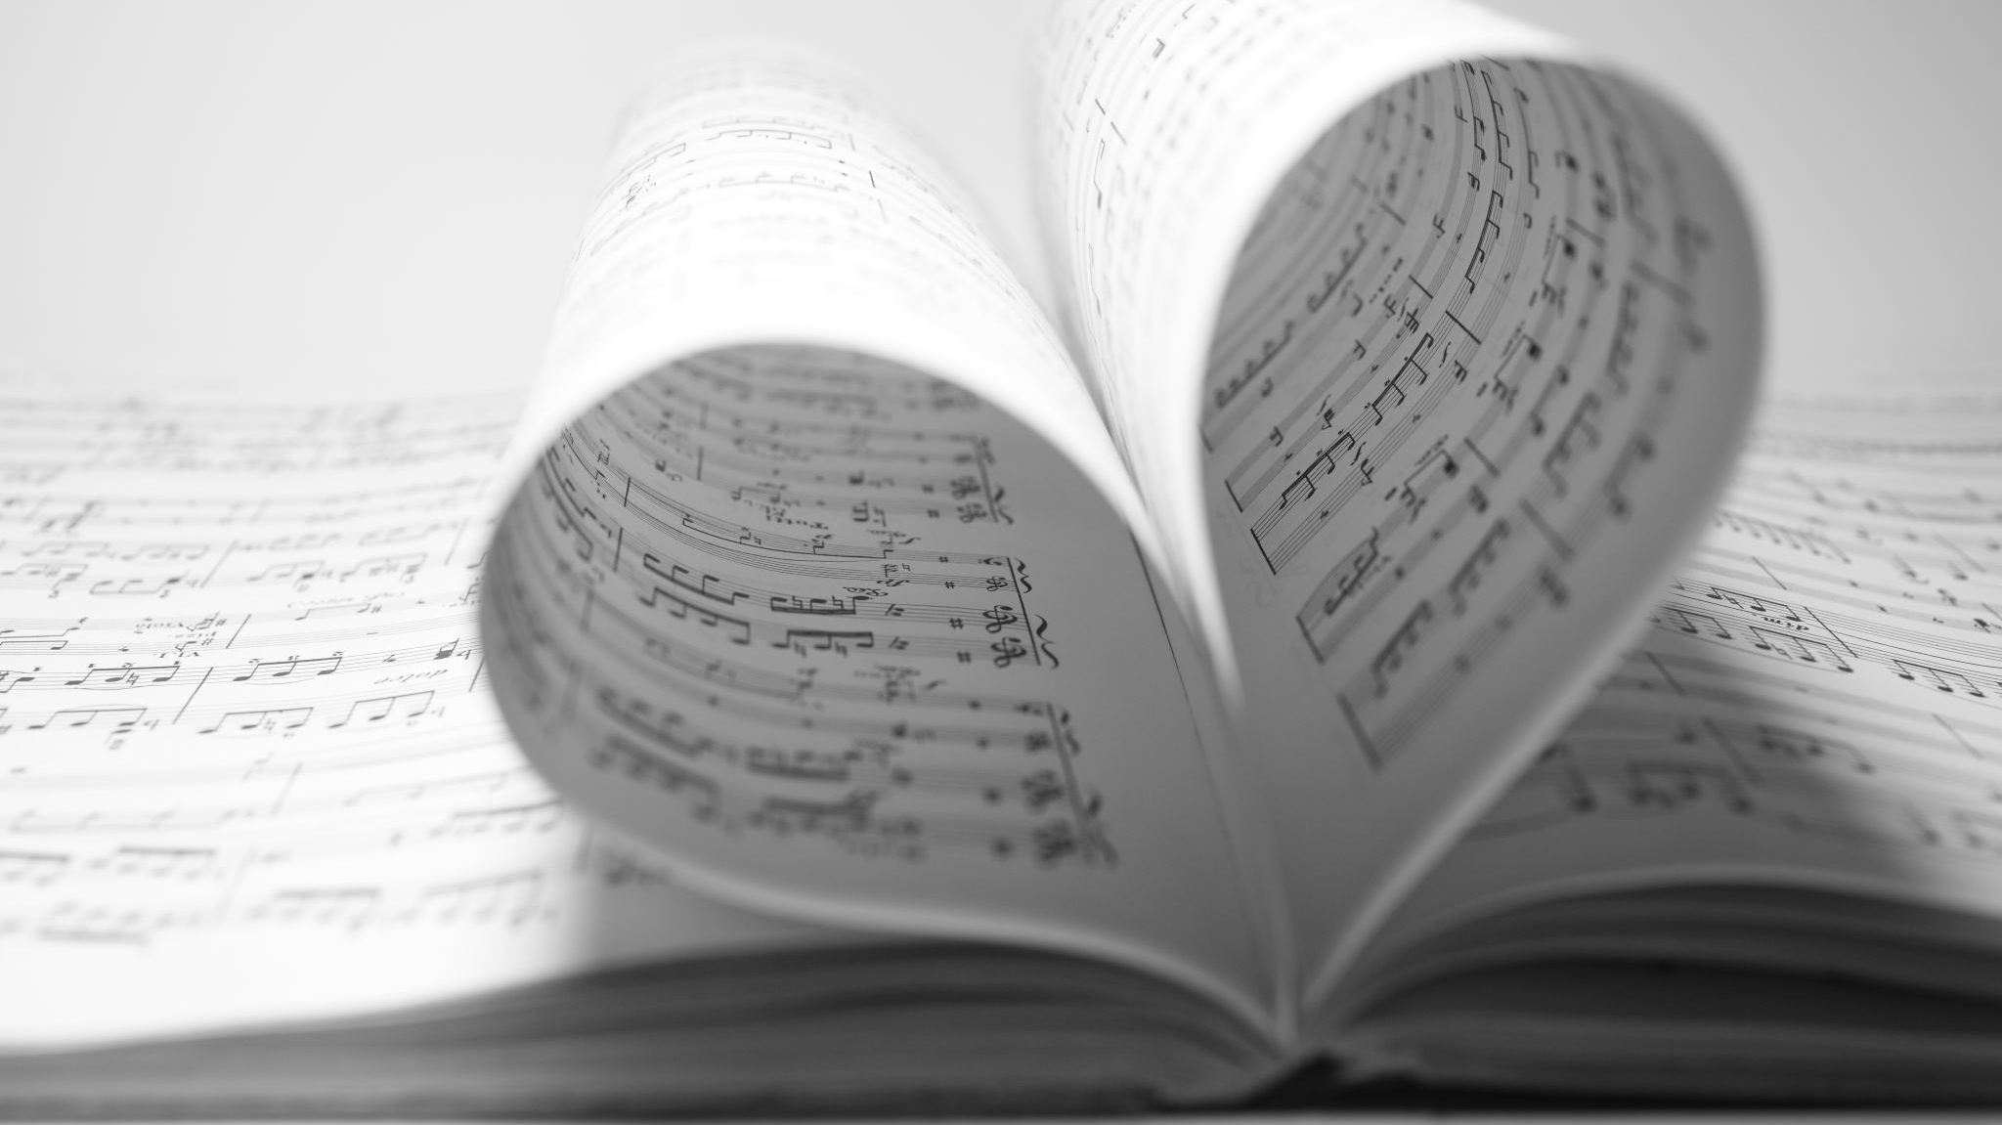
2. God IS….
Ephesians 3:20

Slide 21
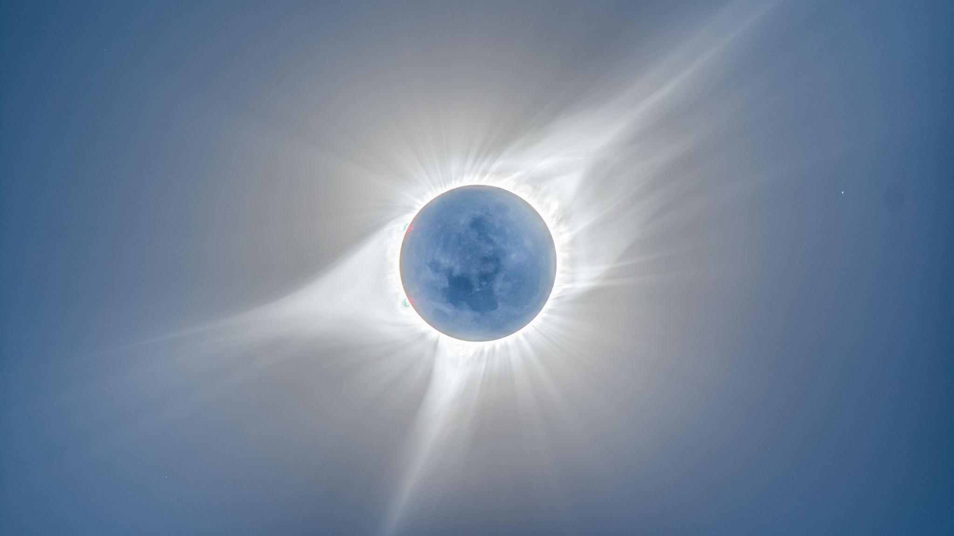
3. God Will …
Phil 3:13-14

Slide 22
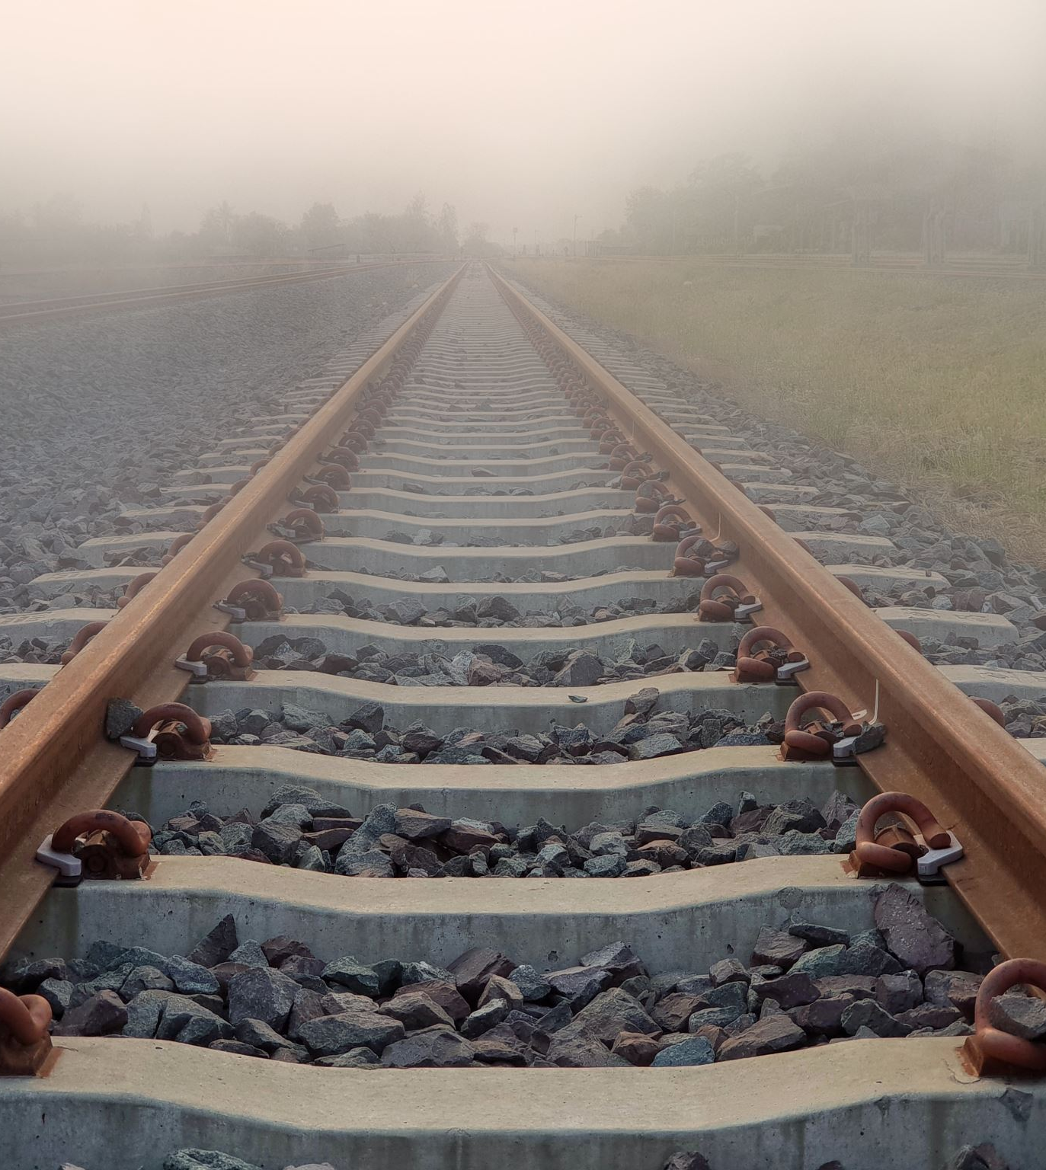
Moving Beyond the Hurt and Pain
Looking forward
Looking back
Let go.
Let God.
Let others.
Let loose.

Slide 23

What are you doing to serve God at FBC?
Worship, fellowship, service -
Warmer, deeper, stronger, larger

