Slide 1
Luke 2 and Matthew 2:1-12
“The Magi,
the Madman, and the Miraculous Mystery”

Slide 2
Who is Jesus to YOU?
What is the
unavoidable question?

Slide 3
Luke 2 (The Setting)

Slide 4
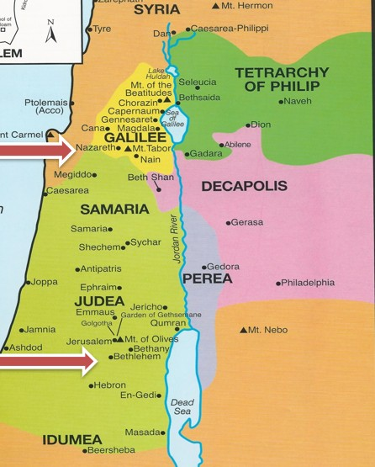

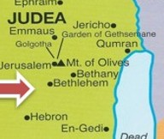
The 90-mile Journey

Slide 5
Matthew 2 (The Story)

Slide 6
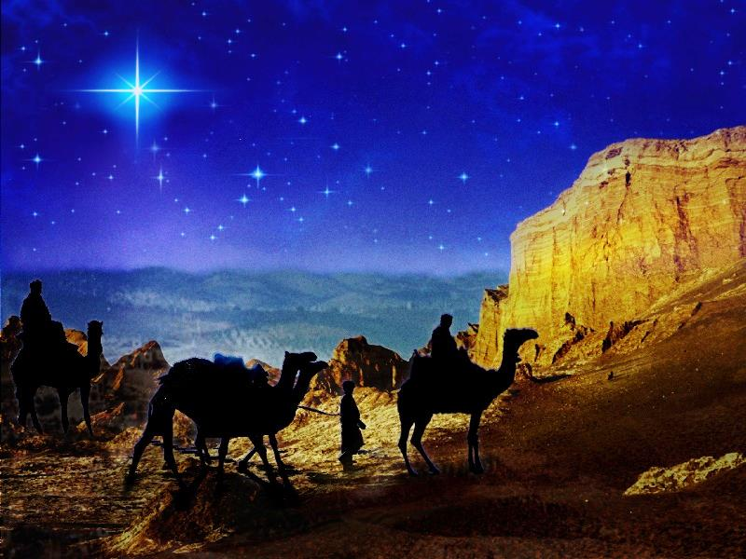
The Star

Slide 7
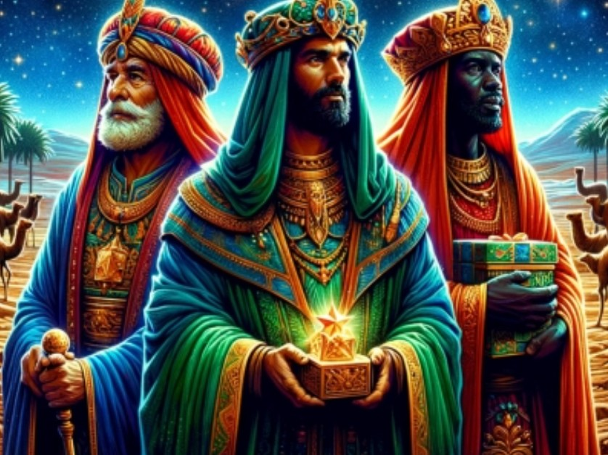
The Magi

Slide 8
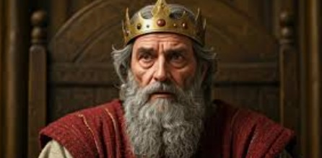
King Herod

Slide 9
King Herod I
37 BC - 4AD
Herod Antipas
4 BC - 39AD
Herod Archelaus
4 BC - 6 AD
Herod Philip 1
4 BC - 34 AD
Herod Philip 2
?
Herod Agrippa I
AD 37-44
Herod Agrippa II
AD 48-93

Slide 10
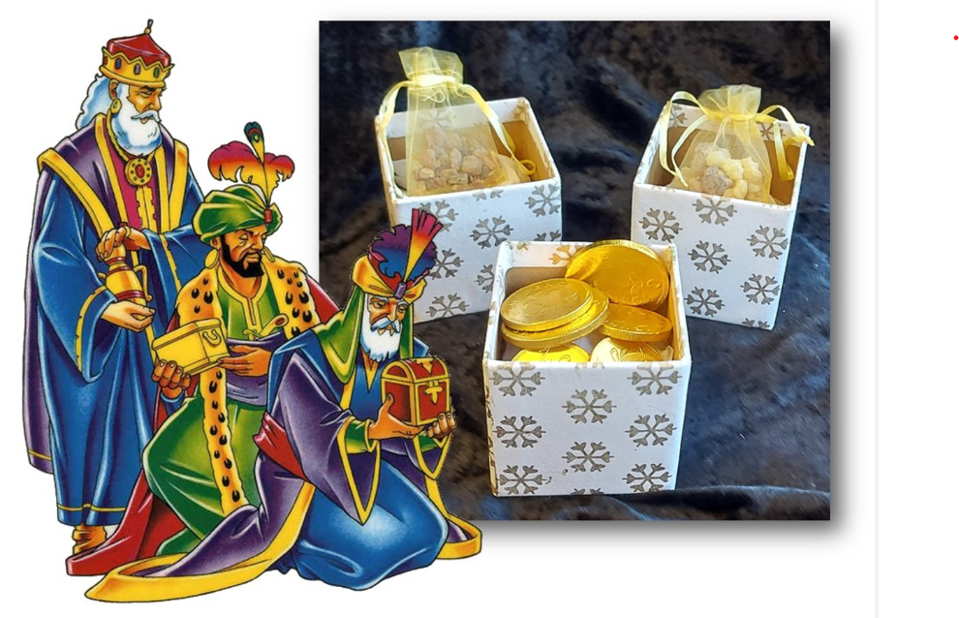
The Gifts

Slide 11

Merry Christmas!

