Slide 1


“Are You Contagious?”
“Are You Contagious?”
Colossians
1:1-8
Notes:
COPY CAT

Slide 2
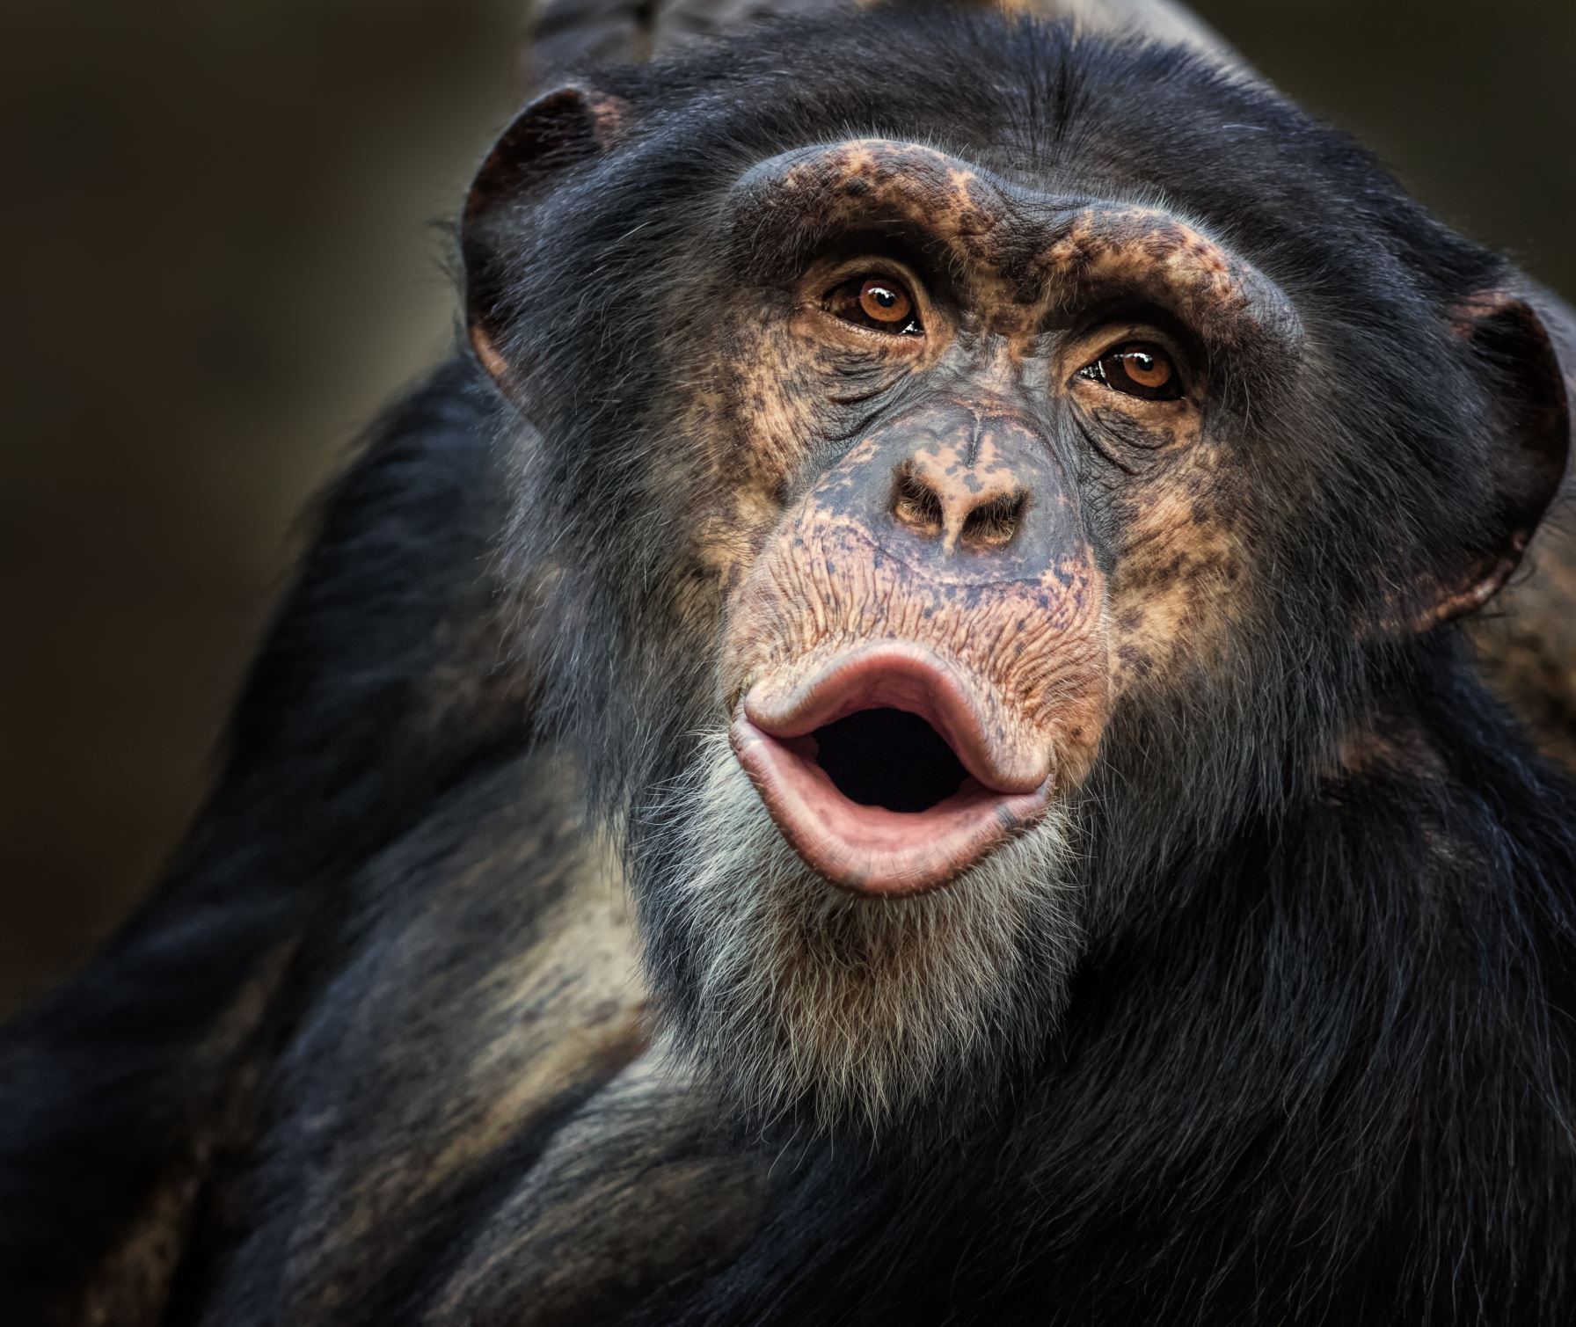
Are your
actions worth
copying?

Slide 3

in the Faith

Slide 4
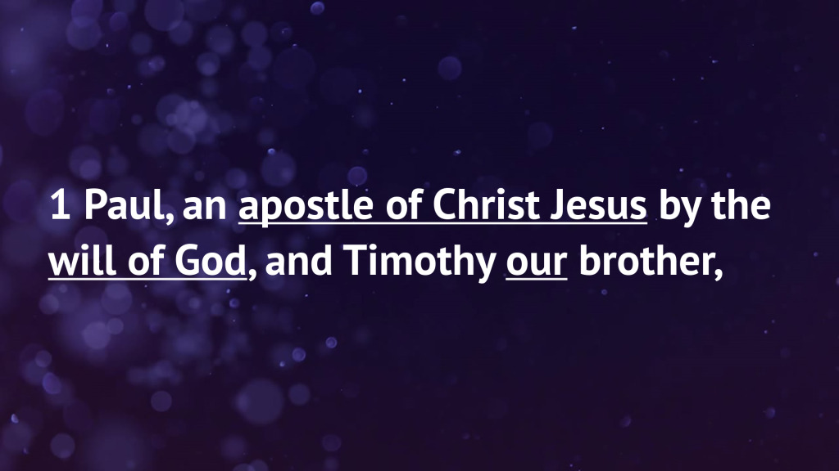

Slide 5
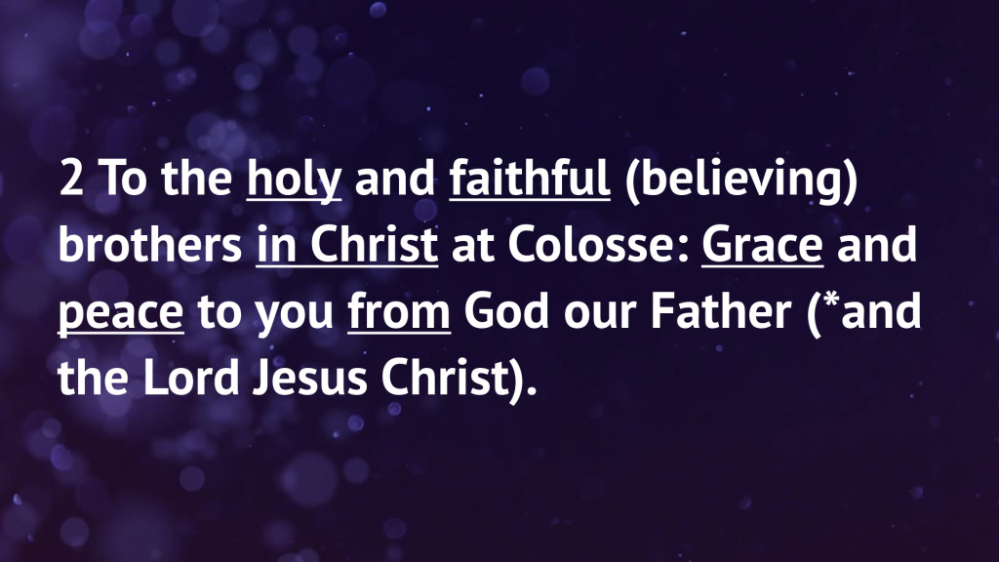

Slide 6

Col 1:2 - “…and the Lord Jesus Christ.”
No - ESV, NIV, NASB, NET, RSV, RSV Catholic, MSG, LEB, NLT, NA/USB Greek Bibles
Yes -KJV, NKJV, 1890 Darby, Young’s Literal Trans, Cambridge Para Bible of the Auth Eng Version, Douay-Rheims, Wycliffe, Eastern/Greek Orthodox

Slide 7
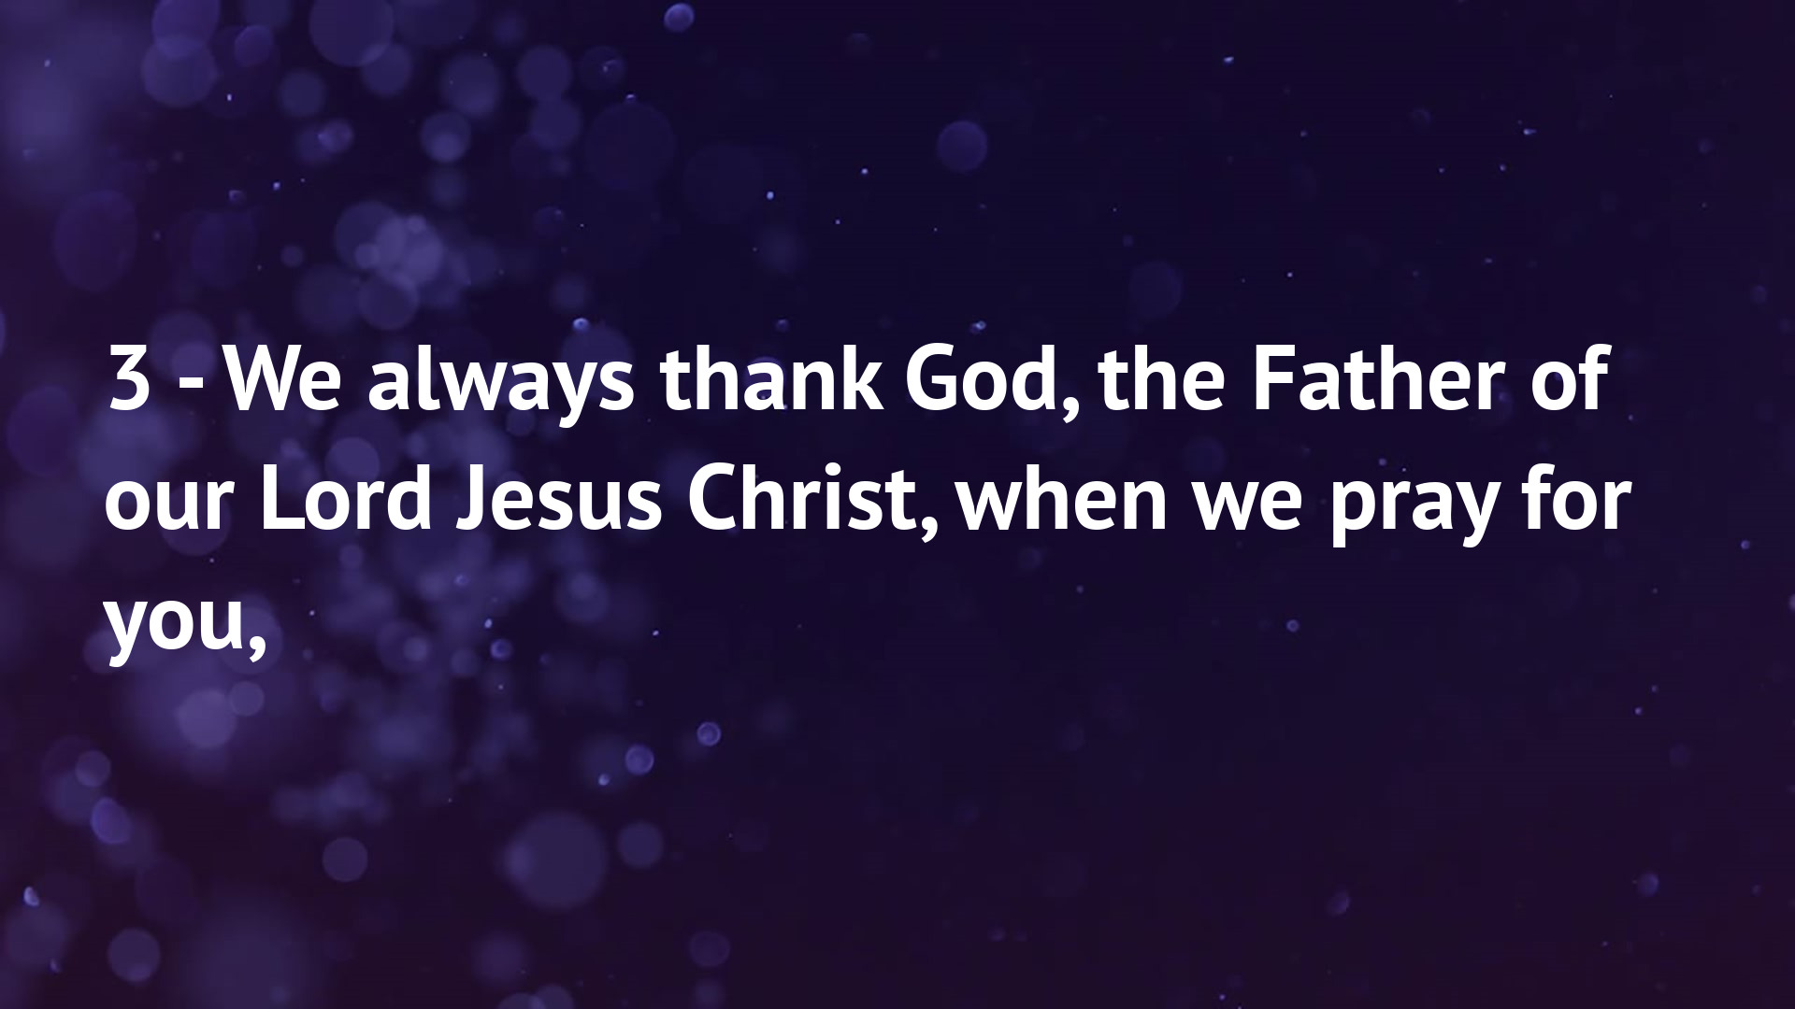

Slide 8
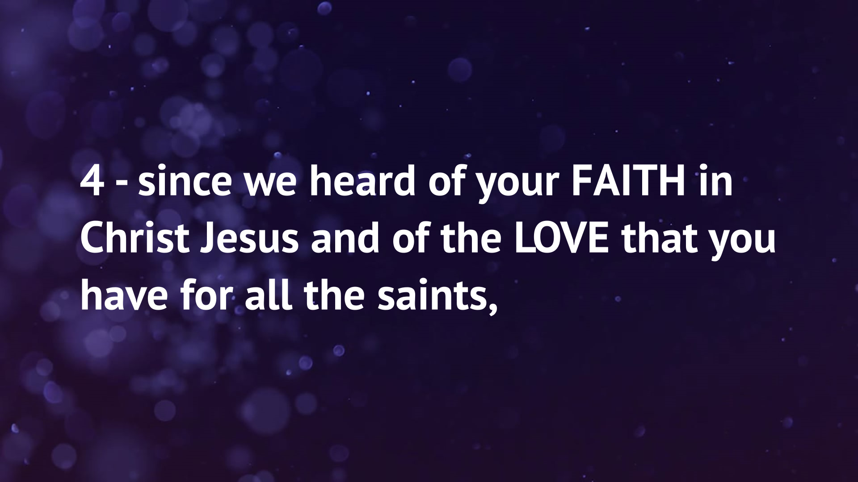

Slide 9
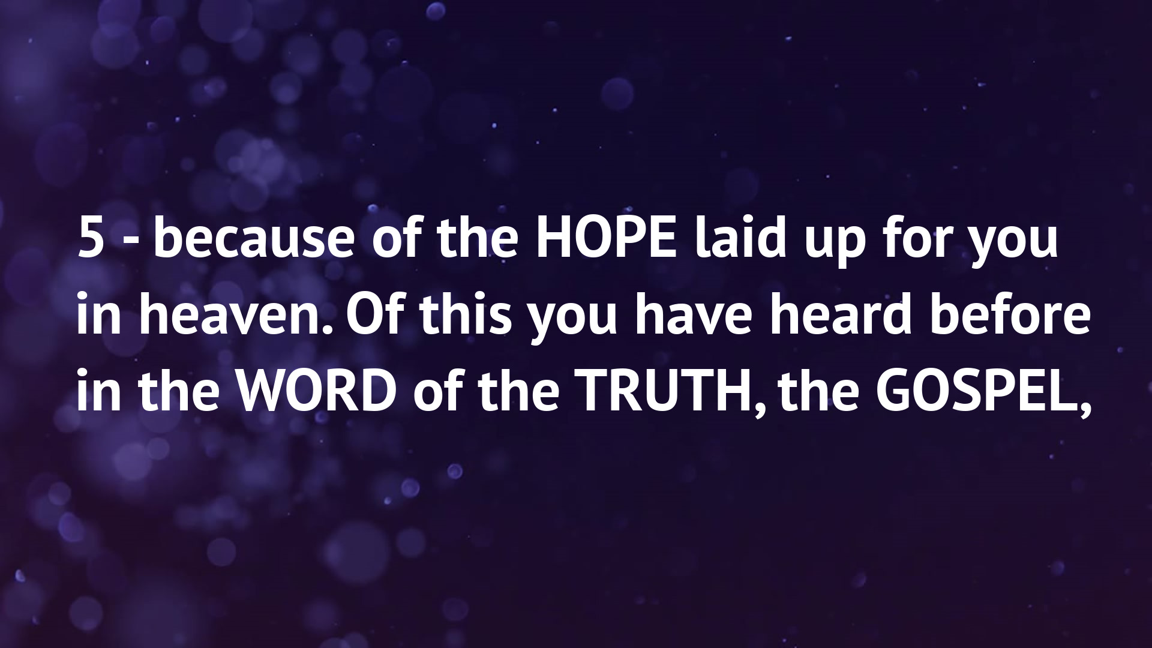

Slide 10
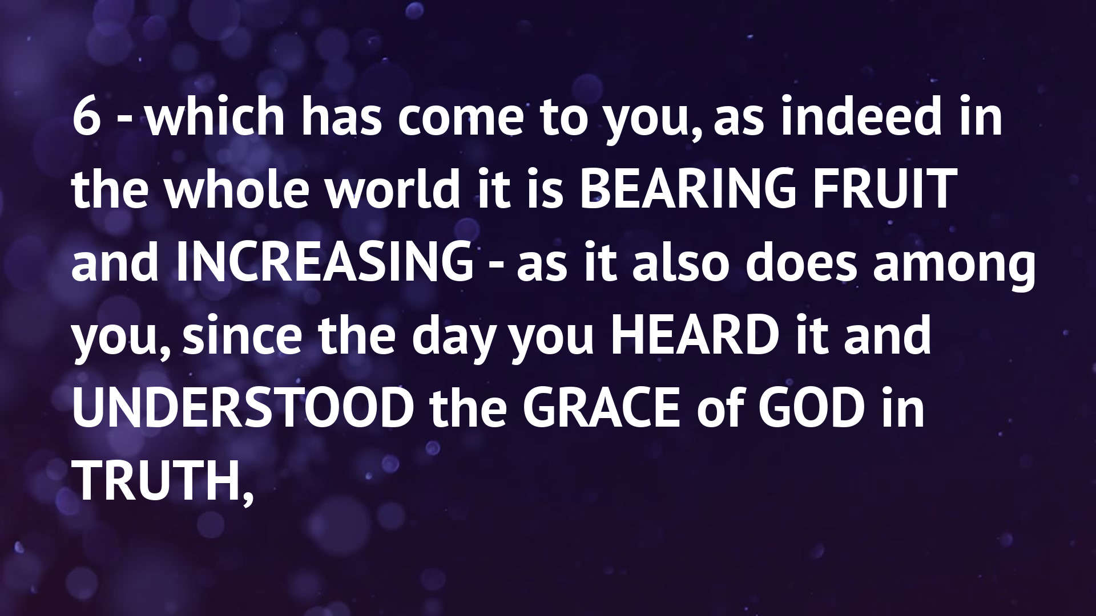

Slide 11
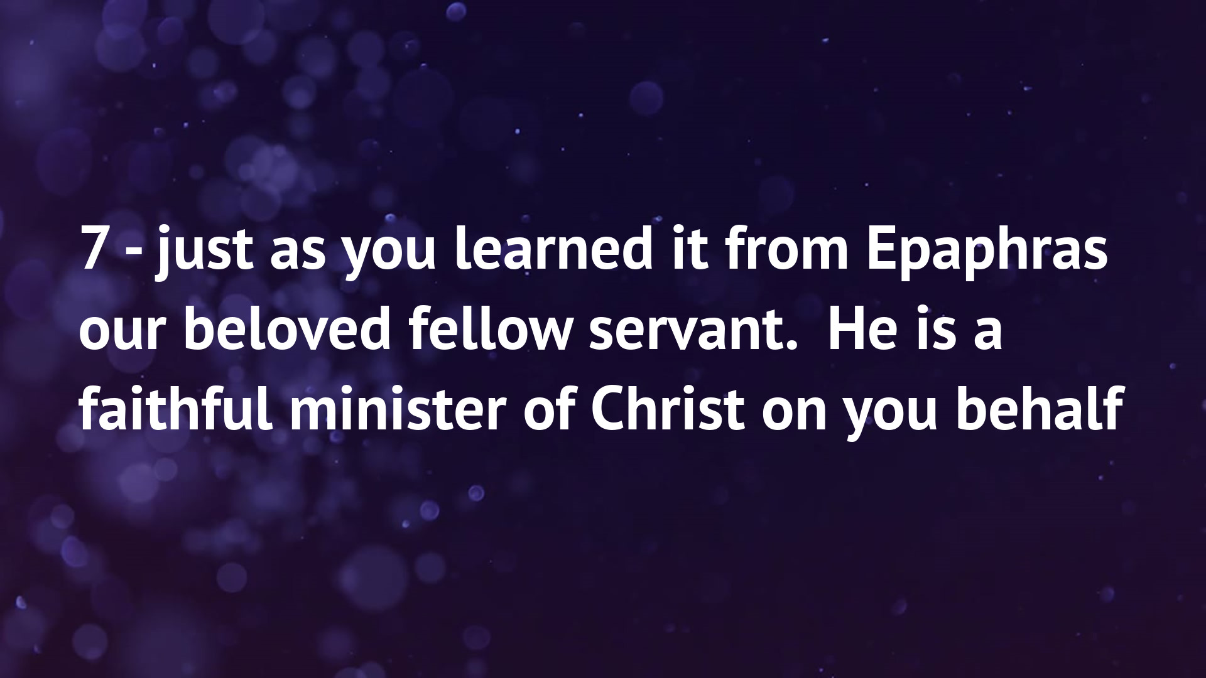

Slide 12
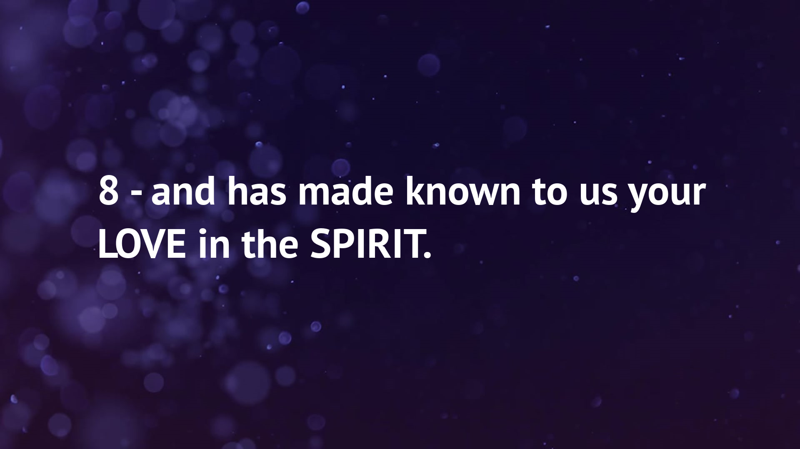

Slide 13
Historical, Geographical, Genre
Social, Economic, Authorial Intent
Grammatical, Key Words, Context x3
Characters, Movement, Speech
Descriptive, Prescriptive, Narrative

Slide 14
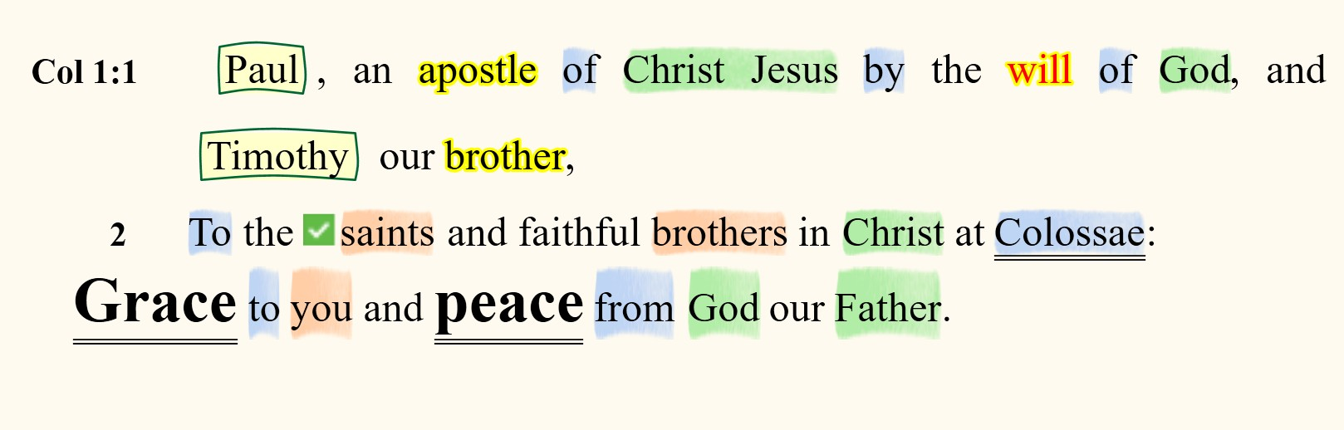
Colossians 1:1-2
Remember, without prepositions,
there would be no theology!

Slide 15
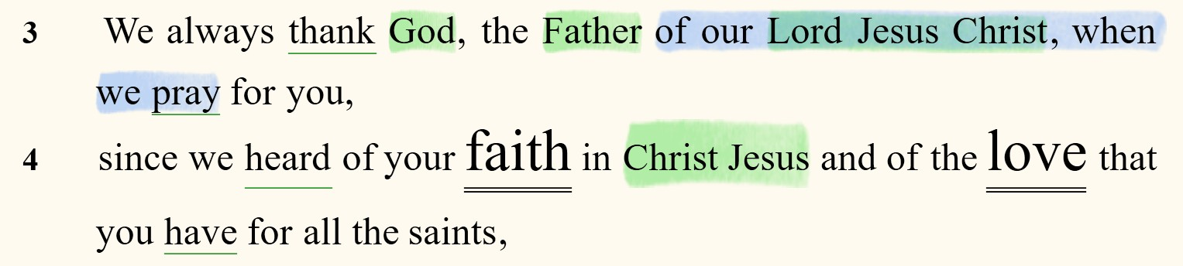
Colossians 1:3-4

Slide 16
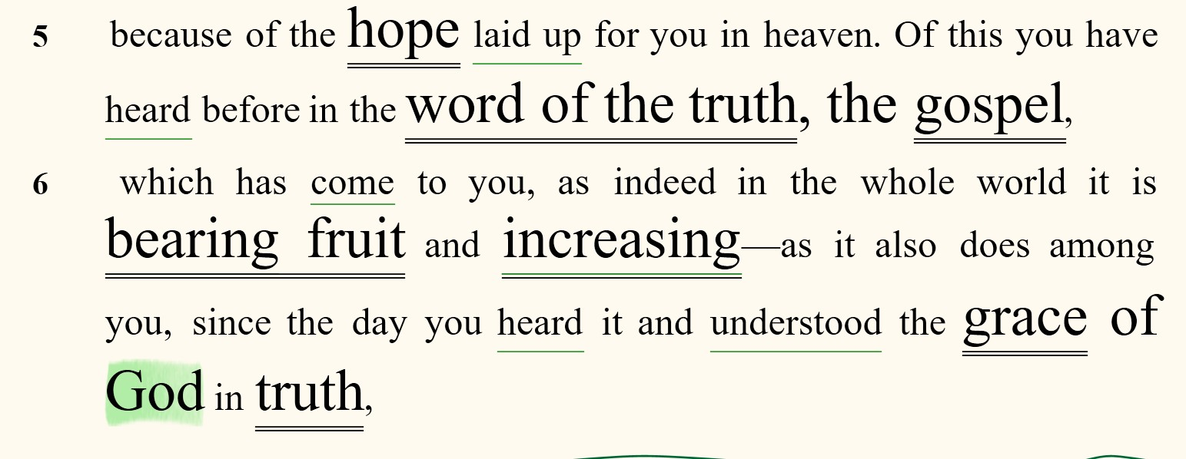
Colossians 1:5-6

Slide 17
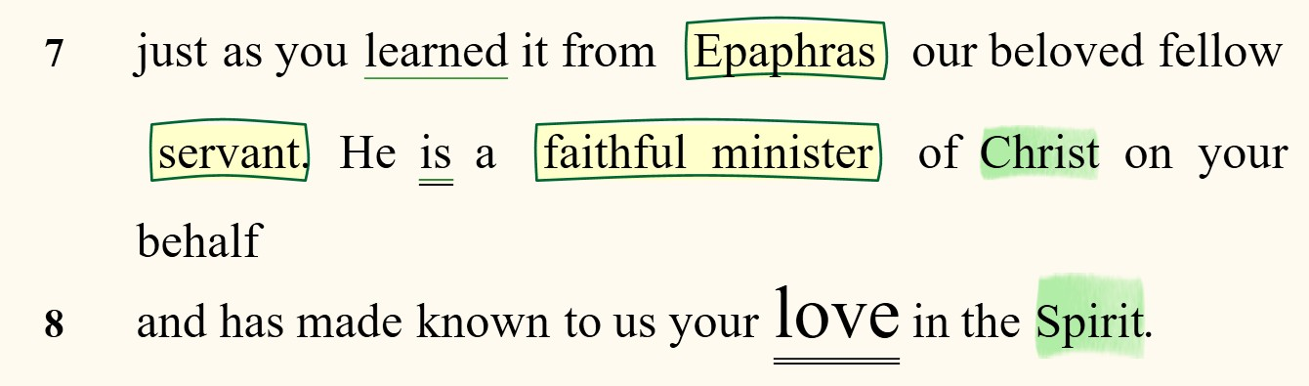
Colossians 1:7-8

Slide 18
What does the text tell us about
Jesus?

Slide 19

“In Christ”
A.) Placing our focus on Jesus Christ, the author and perfector of our faith:
1. Jesus is the Author of our Faith (1-4)
2. Jesus is the Fountain of our Love (4, 8)
3. Jesus is the Foundation of our Hope (5-8)

Slide 20
What does the text tell us about the
Gospel?
Notes:
Gospel - the Good News of Jesus Christ. How does the text fit into the overall message of salvation offered through Jesus?

Slide 21
“The Gospel and God of Truth”
B.) Putting our focus on the truth of the Gospel:
1. The Message of the Gospel (1-5a)
2. The Ministry of the Gospel (5b-7)
3. The Manifestation of the Gospel (8)

Slide 22
How does the text affect
You and Me?
Notes:
Today, middle America, 2025 … as compared to 1st century AD Middle East (or before)

Slide 23
“A Faith that Bears Fruit”
C.) Pursuing our focus upon growing in spiritual maturity:
1. The Faith that Anchors Us (4a)
2. The Love that Unites Us (4b)
3. The Hope that Inspires Us (5-6)

Slide 24
Next Week:
We will finish Paul’s opening prayer of thanksgiving.
(Colossians 1:9-14)

Slide 25
“Are You Contagious?”
“Are You Contagious?”
Colossians
1:1-8
Notes:
COPY CAT

