Slide 1

Jesus is Our Supreme Redeemer
Colossians 1:15-20

Slide 2


Jesus Christ is Supreme Over Creation
1.

Slide 3
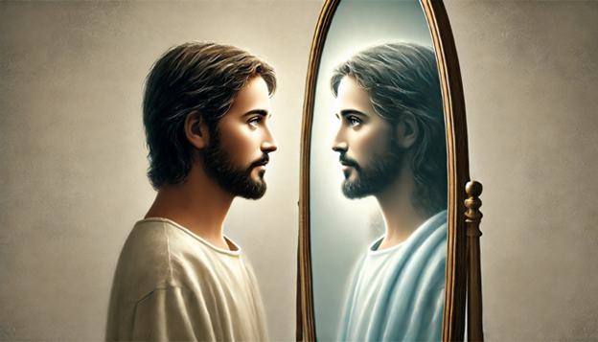
Colossians 1:15a
1a.
He is the image of the invisible God . . .

Slide 4
Colossians 1:15B
1b.
He is the image of the invisible God,
the firstborn
of all creation.
See John 1:1-3

Slide 5
John 1:1-3
1- In the beginning was the Word, and the Word was with God, and the Word was God.
2- He was in the beginning with God.
3- All things were made through Him, and without - Him was not any thing made that was made.

Slide 6
Jesus Christ is Supreme over creation
1.
a.) He is the IMAGE of the INVISIBLE God.
b.) He is the FIRSTBORN of all creation.
c.) He is the SUSTAINER of all things.
See Hebrews 1:1-4

Slide 7
Hebrews 1:1
Long ago, at many times and in many ways, God spoke to our fathers by the prophets,

Slide 8
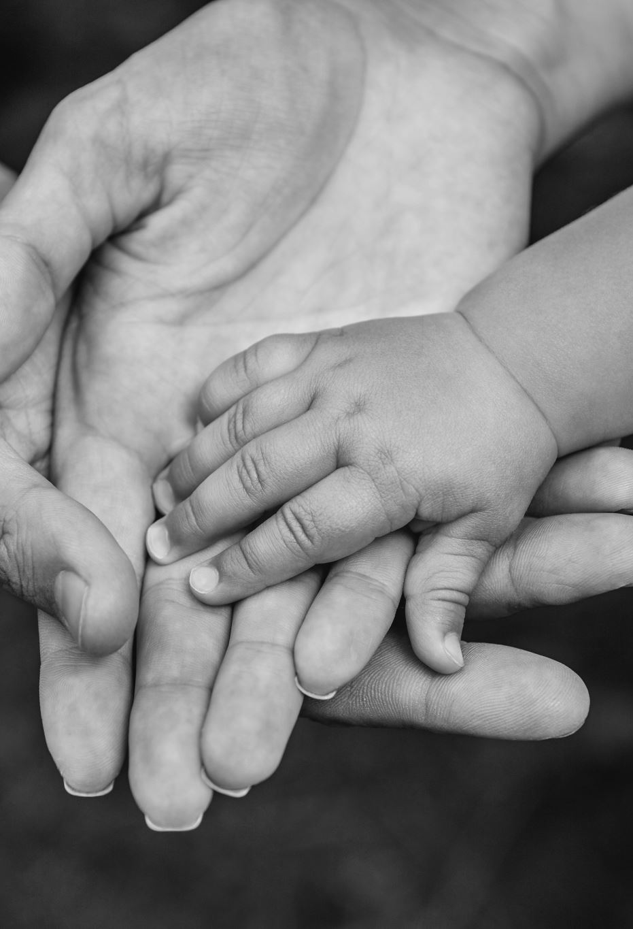
Hebrews 1:2
but in these last days He has spoken to us by His Son, whom He appointed the heir of all things, through whom also He created the world.

Slide 9
Hebrews 1:3
He is the radiance of the glory of God and the exact imprint of His nature, and He upholds the universe by the word of His power. After making purification for sins, He sat down at the right hand of the Majesty on high,

Slide 10

Hebrews 1:4
having become as much superior to angels as the
name He has inherited is more excellent than theirs.

Slide 11
Hebrews 1:3
He is the radiance of the glory of God and the exact imprint of His nature, and
He upholds the universe by the word of His power. After making purification for sins, He sat down at the right hand of the Majesty on high,

Slide 12
Colossians 1:17
And He is before all things, and in Him all things hold together.

Slide 13
Prepositions in Col 1:16
For by Him all things were created, in heaven and on earth, visible and invisible, whether thrones or dominions or rulers or authorities - all things were created through Him and for Him.

Slide 14
Our Union with Christ is defined by prepositions and metaphors Colossians 1:16
Philip Rolsing, DMin Dissertation, Local Church Revitalization Through Christological Discipleship…
There are key theological themes that must be mined from the Scriptures, such as those that uncover our union with Christ:
“Soteriological considerations, justification, adoption, sanctification, Trinitarian Fellowship: The Joy of Our Salvation.”

Slide 15

Philippians 2:5
(5) Have this mind among yourselves, which is yours in Christ Jesus,

Slide 16
Philippians 2:6
(6) who, though He was in the form of God, did not count equality with God a thing to be grasped,

Slide 17
Philippians 2:7
(7) but emptied Himself, by taking the form of a servant, being born in the likeness of men.

Slide 18
Philippians 2:8
(8) And being found in human form, He humbled Himself by becoming obedient to the point of death, even death on a cross.

Slide 19
Philippians 2:9
(9) Therefore God has highly exalted Him and bestowed on Him the name that is above every name

Slide 20
Philippians 2:10
(10) so that at the name of Jesus every knee should bow, in heaven and on earth and under the earth,

Slide 21
Philippians 2:11
(11) and every tongue confess that Jesus Christ is Lord, to the glory of God the Father.

Slide 22
Jesus Christ is Supreme over creation
a.) He is the IMAGE of the INVISIBLE God.
b.) He is the FIRSTBORN of all creation.
c.) He is the SUSTAINER of all things.
RECAP

Slide 23
Jesus Christ is Preeminent Over Redemption
2.

Slide 24
Jesus Christ is preeminent over redemption
2.
Verse 18a
a.) He is the Head of the Body, the CHURCH.

Slide 25
Jesus Christ is preeminent over redemption
2.
Verse 20a
b.) He has forged the path for us to follow.

Slide 26
Jesus Christ is preeminent over redemption
2.
Verse 19
c.) The fullness of God dwells in Him.

Slide 27
Jesus Christ is Preeminent over redemption
a.) Jesus Christ is the Head of the Body, the Church.
b.) Jesus Christ forged the path for us to follow.
c.) The fullness of God dwells in Him.
RECAP

Slide 28
Jesus Christ is Lord Over Reconciliation
3.
Forgiveness, Relationships, Hope

Slide 29
Jesus Christ is Lord over Reconciliation
3.
a.) We are reconciled through His blood.
v. 14, 20b … FORGIVENESS

Slide 30
Jesus Christ is Lord over Reconciliation
3.
b.) He is our peace with God and with others.
v. 20c … RELATIONSHIPS

Slide 31
Jesus Christ is Lord over Reconciliation
3.
c.) In Him we have the assurance of eternal life.
v. 20a … HOPE

Slide 32
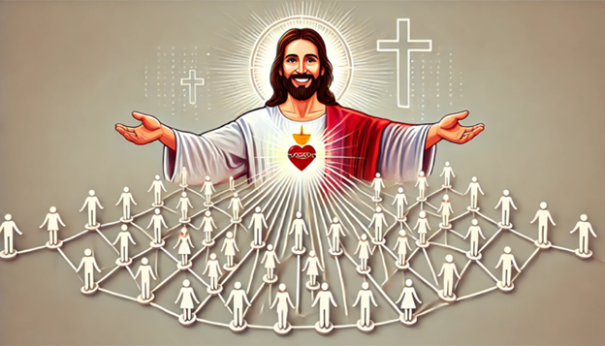
Jesus Christ is: Supreme over creation Preeminent over redemption Lord over reconciliation
Colossians 1:15-20

Slide 33
Colossians: The Supremacy and Sovereignty of Jesus Christ

