Slide 1
“God’s Call to Fear and Draw Near”
Malachi 3:6-12

Slide 2
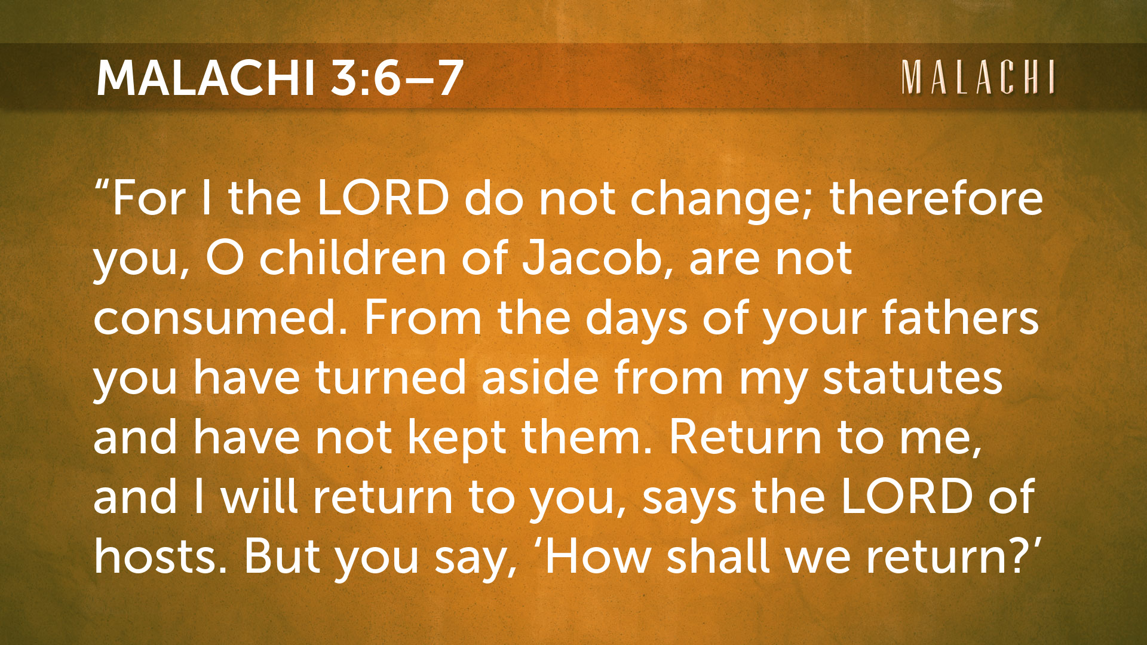

Slide 3

a.) The Consistency of God (6)

Slide 5
a.) The Consistency of God (6)
b.) The Charge of God (7a)

Slide 7
a.) The Consistency of God (6)
b.) The Charge of God (7a)
c.) The Call of God (7b)

Slide 9

1:2 – How have you loved us?
1:6 – How have we shown contempt for Your name?
1:7 – How have we defiled You?
2:17 – How have we wearied God?
3:7 – How are we to return?
3:8 – How are we robbing You?

Slide 10
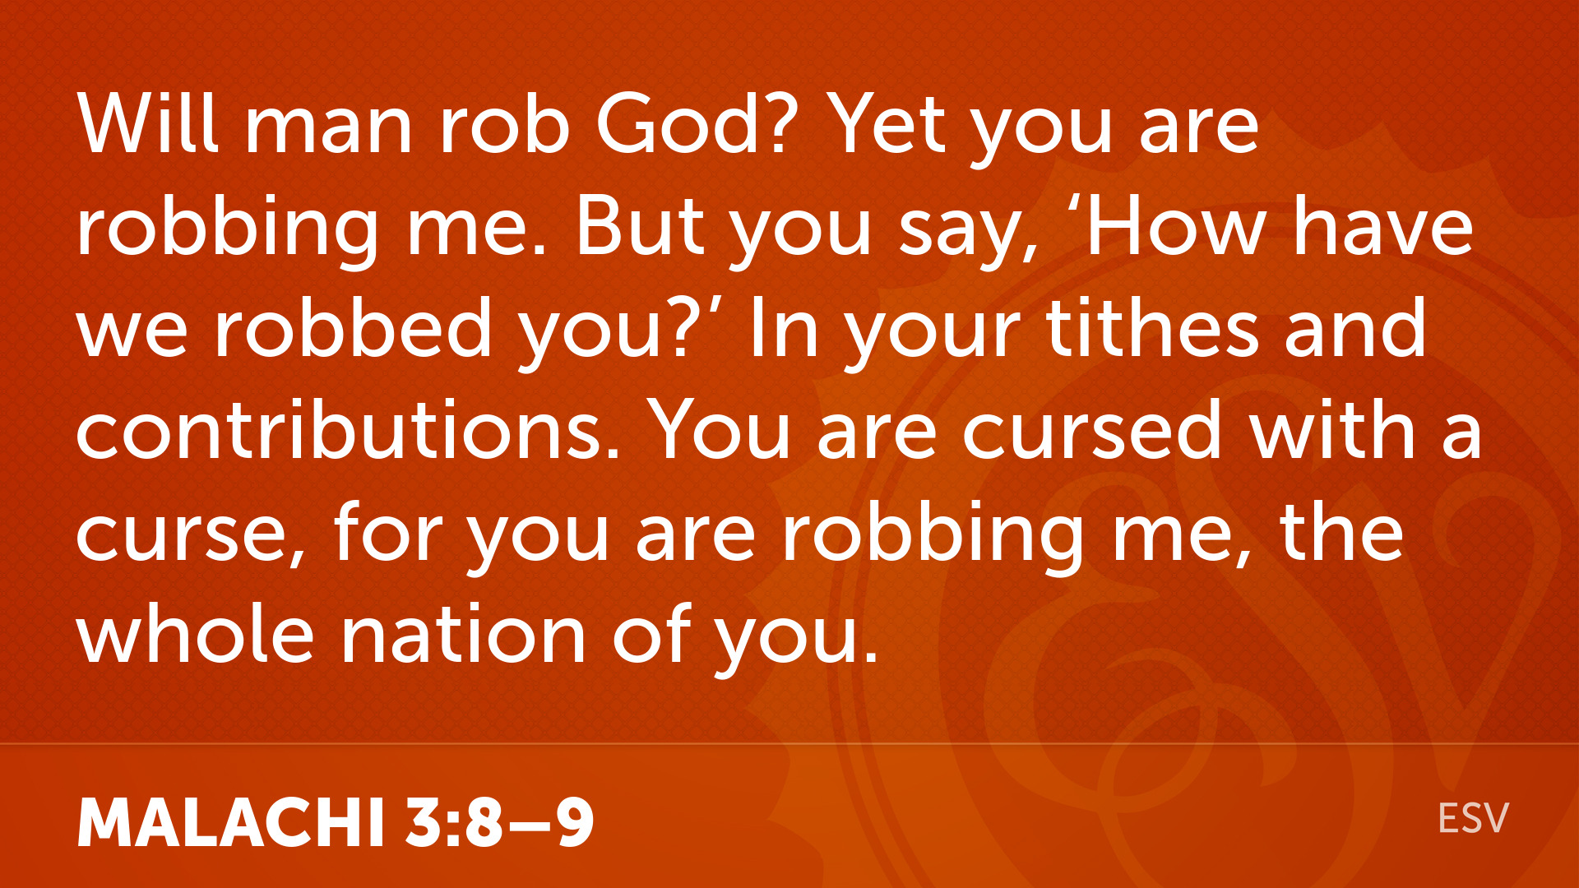

Slide 11
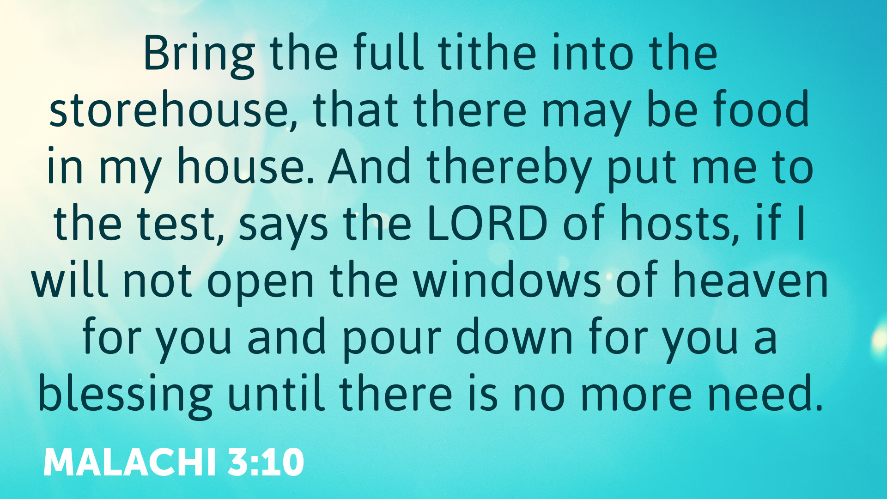

Slide 12

a.) The Command to Trust (10a)

Slide 13


Slide 14
a.) The Command to Trust (10a)
b.) The Challenge to Test (10b)

Slide 16
a.) The Command to Trust (10a)
b.) The Challenge to Test (10b)
c.) The Commitment to Bless (10c)

Slide 18
The PROVIDENCE of God

Slide 19

a.) The Power of God’s Rebuke (11a)

Slide 20
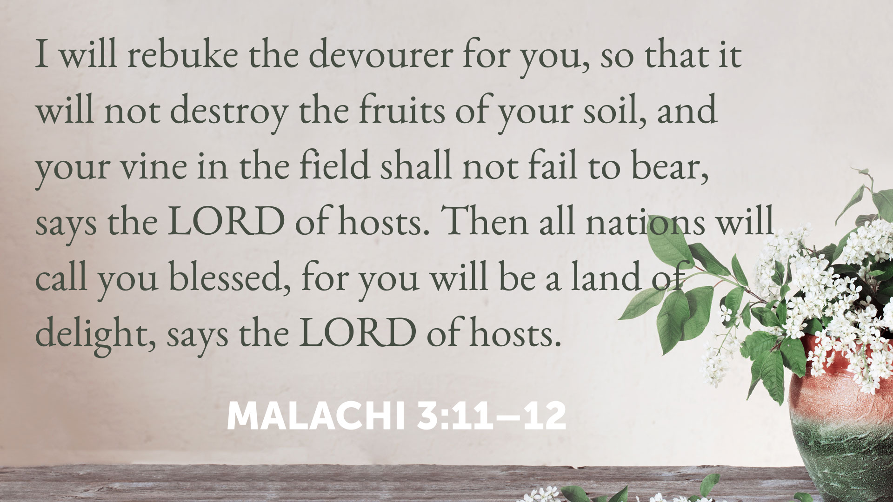

Slide 21
a.) The Power of God’s Rebuke (11a)
b.) The Proof of God’s Protection (11b)

Slide 23
a.) The Power of God’s Rebuke (11a)
b.) The Proof of God’s Protection (11b)
c.) The Promise of God’s Blessings (12)

Slide 25
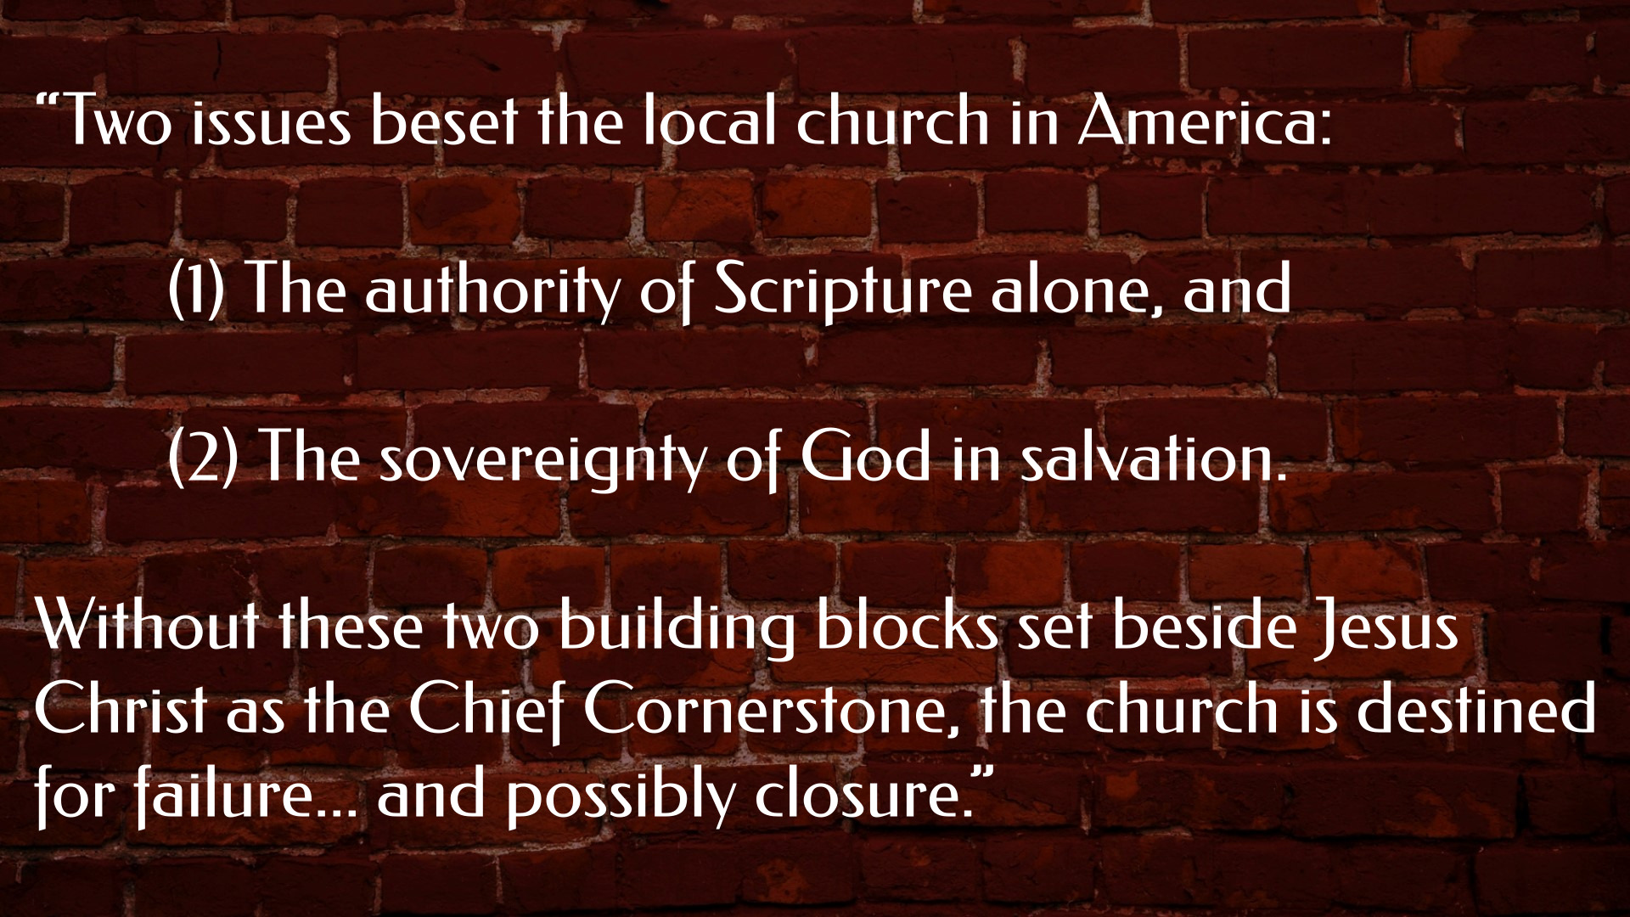

Slide 26
“God’s Call to Fear and Draw Near”
Malachi 3:6-12

Slide 27
Next week:
“Hellbound or Happy Heart?”
Malachi 3:13 - 4:6
- The final of 7 messages in Malachi

Slide 28

A LOOK AT THE LORD’S SUPPER

