Slide 1

“A Future Promise for a Past Reality”
- “In the face of adversity, God is not the adversary!”
- Pastor David
Malachi 2:17 - 3:5

Slide 2
Malachi 2:17
The Problems of a Nation
a.) The problem of wearying God (17a)

Slide 3


Malachi 2:17a (ESV)
You have wearied the Lord with your words. But you say, “How have we wearied Him?”

Slide 4
God’s attributes are on display in Malachi 2:17 -3:15
* He is never physically, emotionally, or mentally fatigued.
* He is Spirit - John 4:23-24
* He is Omnipotent (all powerful), Omniscient (all knowing), and Omnipresent (everywhere and at all times) - Psalm 139 (et al.)

Slide 5
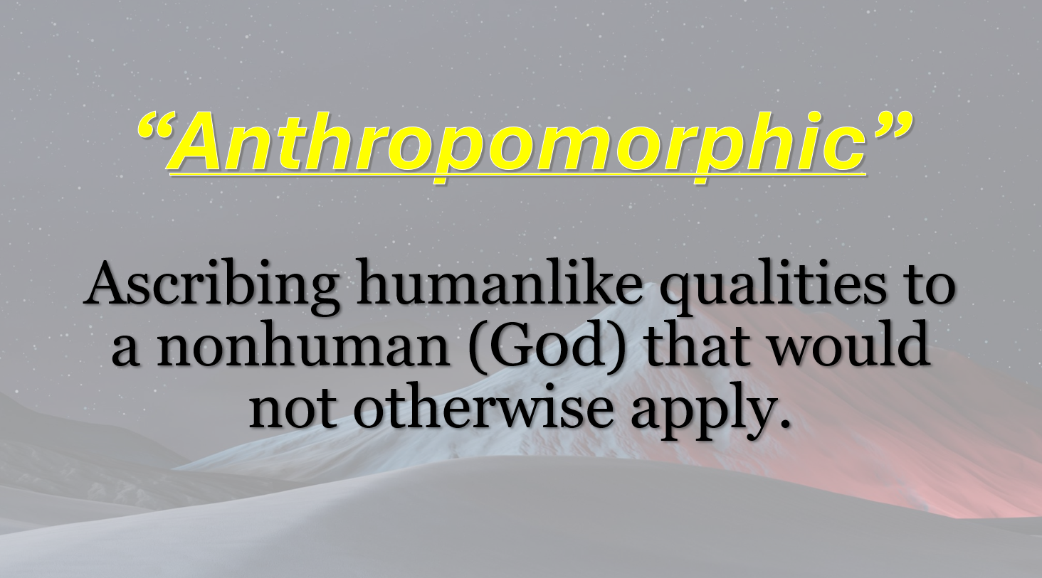

Slide 6
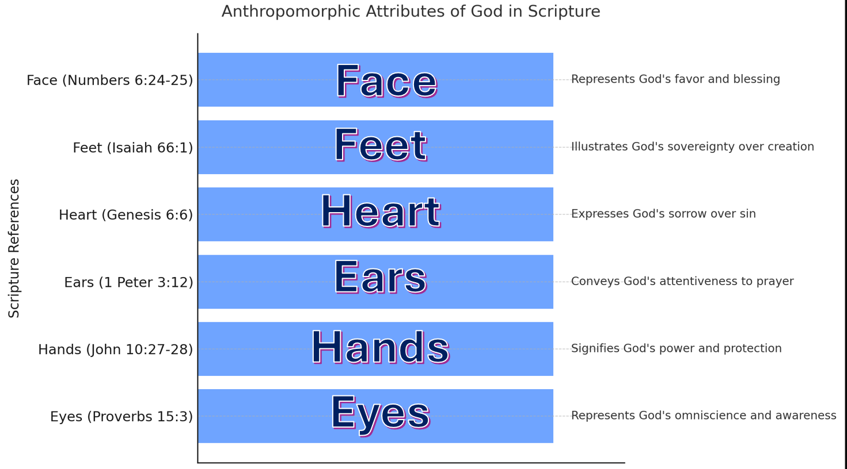

Slide 7
Malachi 2:17
The Problems of a Nation
a.) The problem of wearying God (17a)
b.) The problem of blaming God (17b)

Slide 8
Malachi 2:17b (ESV)
By saying, “Everyone who does evil is good in the sight of the Lord, and He delights in them.”

Slide 9
Malachi 2:17
The Problems of a Nation
a.) The problem of wearying God (17a)
b.) The problem of blaming God (17b)
c.) The problem of questioning God (17c)

Slide 10
Malachi 2:17b (ESV)
Or by asking, “Where is the God of justice?”

Slide 11
The God of Justice
Isaiah 30:18 - For the Lord is a GOD OF JUSTICE …
Deut 32:4 - For all His ways are JUSTICE…
Psalm 89:14 - Righteousness and JUSTICE are the foundation of your throne …
Micah 6:8 - … what does the Lord require of you but to do JUSTLY, to love mercy, and to walk humbly with your God?
Re: Malachi 2:17

Slide 12

Malachi 3:1-2a
2. The Promise of a Future (3:1-2a)
a.) The promise of two messengers (3:1a)

Slide 13
Malachi 3:1-2a
Malachi 3:1a
“Behold, I send My messenger, and he will prepare the way before Me.”
“…and the messenger of the covenant…”

Slide 14
Malachi 3:1-2a
2. The Promise of a Future (3:1-2a)
a.) The promise of two messengers (3:1a)
b.) The promise of a new covenant (3:1b)

Slide 15
Malachi 3:1-2a
Malachi 3:1b
“Even the Messenger of the covenant, in who you delight. Behold, He is coming,” says the Lord of hosts.

Slide 16
Malachi 3:1-2a
2. The Promise of a Future (3:1-2a)
a.) The promise of two messengers (3:1a)
b.) The promise of a new covenant (3:1b)
c.) The promise of a dreadful day (3:2a)

Slide 17
Malachi 3:1-2a
Malachi 3:2a
“But who can endure the day of His coming? And who can stand when He appears?”

Slide 18
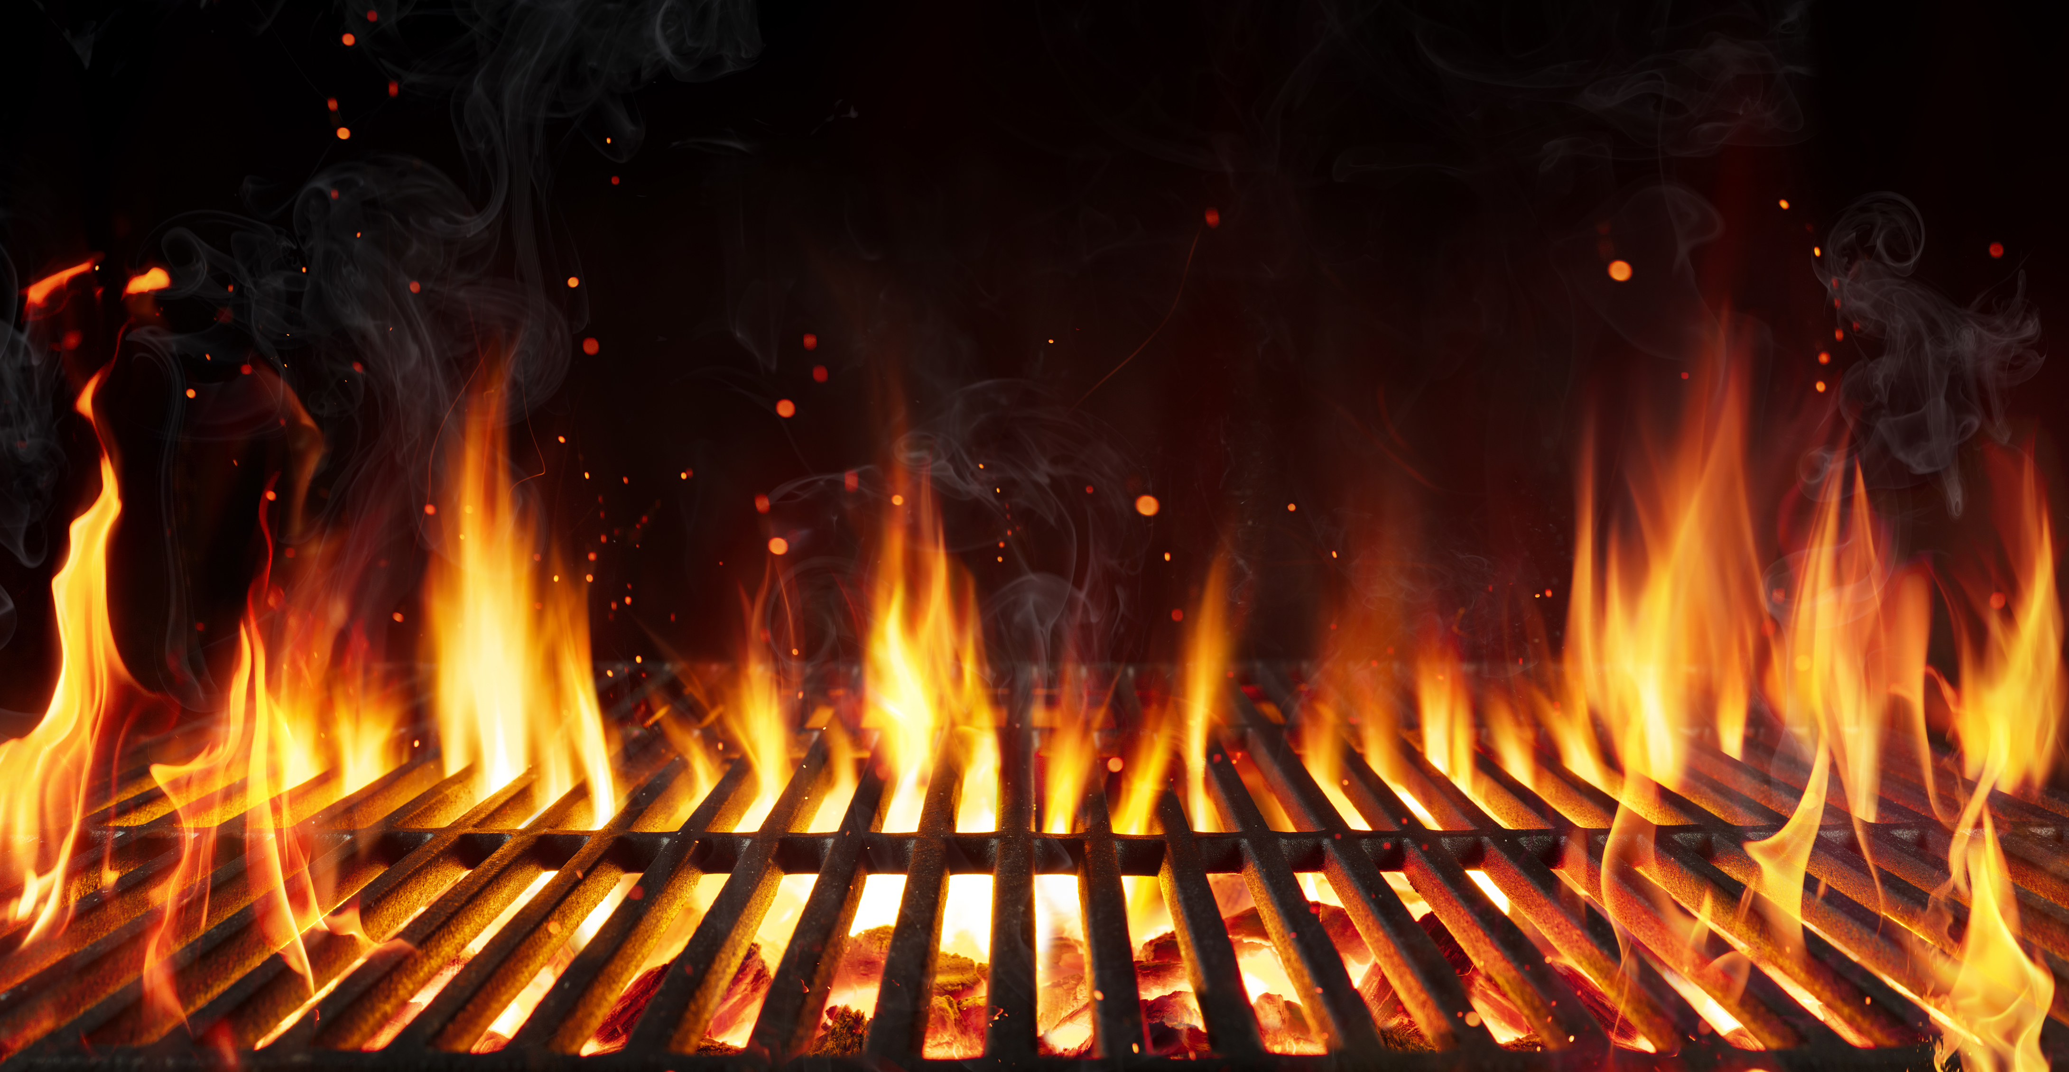
Malachi 3:1-2a
3. The Purity of a People (3:2b-5)

Slide 19
Malachi 3:1-2a
3. The Purity of a People (3:2b-5)
a.) The purifying fire (2b-3a)

Slide 20
Malachi 3:1-2a
Malachi 3:2b-3a
“For He is like a refiner’s fire and like launderers’ soap. He will sit as a refiner and a purifier of silver; He will purify the sons of Levi, and purge them as gold and silver.”

Slide 21
FULLER’s FIELD
This was just outside Jerusalem, near the Upper Pool -or- Gihon Spring.
Archaeological digs have uncovered most of this area.
(No photos available due to copyright restrictions)

Slide 22
Malachi 3:1-2a
3. The Purity of a People (3:2b-5)
a.) The purifying fire (2b-3a)
b.) The perfect offering (3b-4)

Slide 23
Malachi 3:1-2a
Malachi 3:3b-4
“That they may offer to the Lord an offering in righteousness. Then the offering of Judah and Jerusalem will be pleasant to the Lord, as in the days of old, as in former years. ”

Slide 24
Malachi 3:1-2a
3. The Purity of a People (3:2b-5)
a.) The purifying fire (2b-3a)
b.) The perfect offering (3b-4)
c.) The purging of the proud (5)

Slide 25
Malachi 3:1-2a
Malachi 3:5
“And I will come near you for judgment (…) Because they do not fear Me,” says the Lord of hosts.

Slide 26
Malachi 3:1-2a
3. The Purity of a People (3:2b-5)
a.) The purifying fire (2b-3a)
b.) The perfect offering (3b-4)
c.) The purging of the proud (5)

Slide 27
“A Future Promise for a Past Reality”
- “In the face of adversity, God is not the adversary!”
- Pastor David
Malachi 2:17 - 3:5

