Slide 1

“Remaining Faithful
in a Fallen World”
Malachi 2:10-16

Slide 2
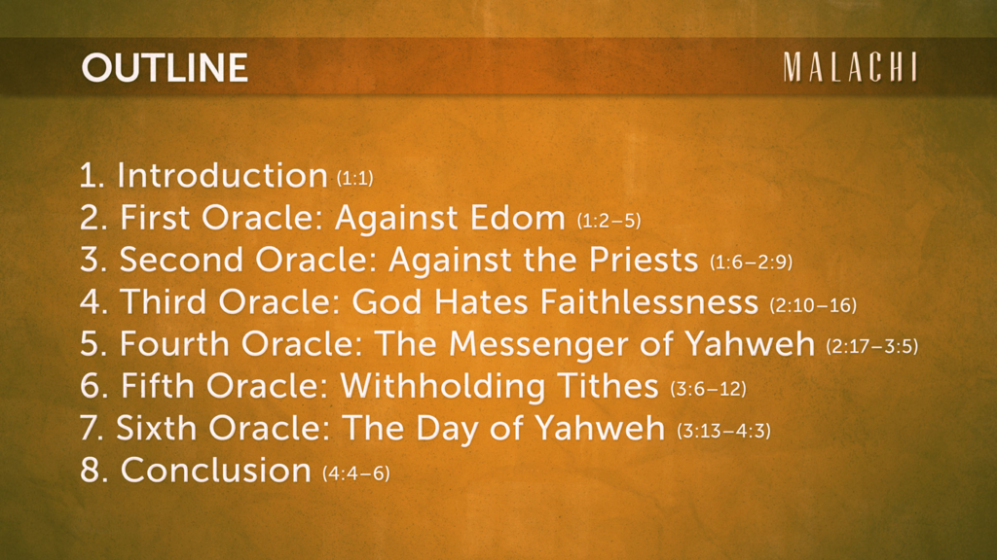

Slide 3

1. The Spirit of Unity - (10)
(Three things we have in common.)
a.) Our Father (10a)

Slide 4
ESV - Malachi 2:10a
“Have we not all
one Father?

Slide 5
1. The Spirit of Unity - (10)
(Three things we have in common.)
a.) Our Father (10a)
b.) Our Creator (10b)

Slide 6
ESV - Malachi 2:10b
“Has not one God created us?”

Slide 7
1. The Spirit of Unity - (10)
(Three things we have in common.)
a.) Our Father (10a)
b.) Our Creator (10b)
c.) Our Covenant (10c)

Slide 8
ESV - Malachi 2:10c
“Why then are we faithless to one another, profaning the covenant of our fathers?”

Slide 9
Two Types of Covenants:
Bilateral (if…then)
Unilateral (held issuing party accountable to the guarantee)

Slide 10
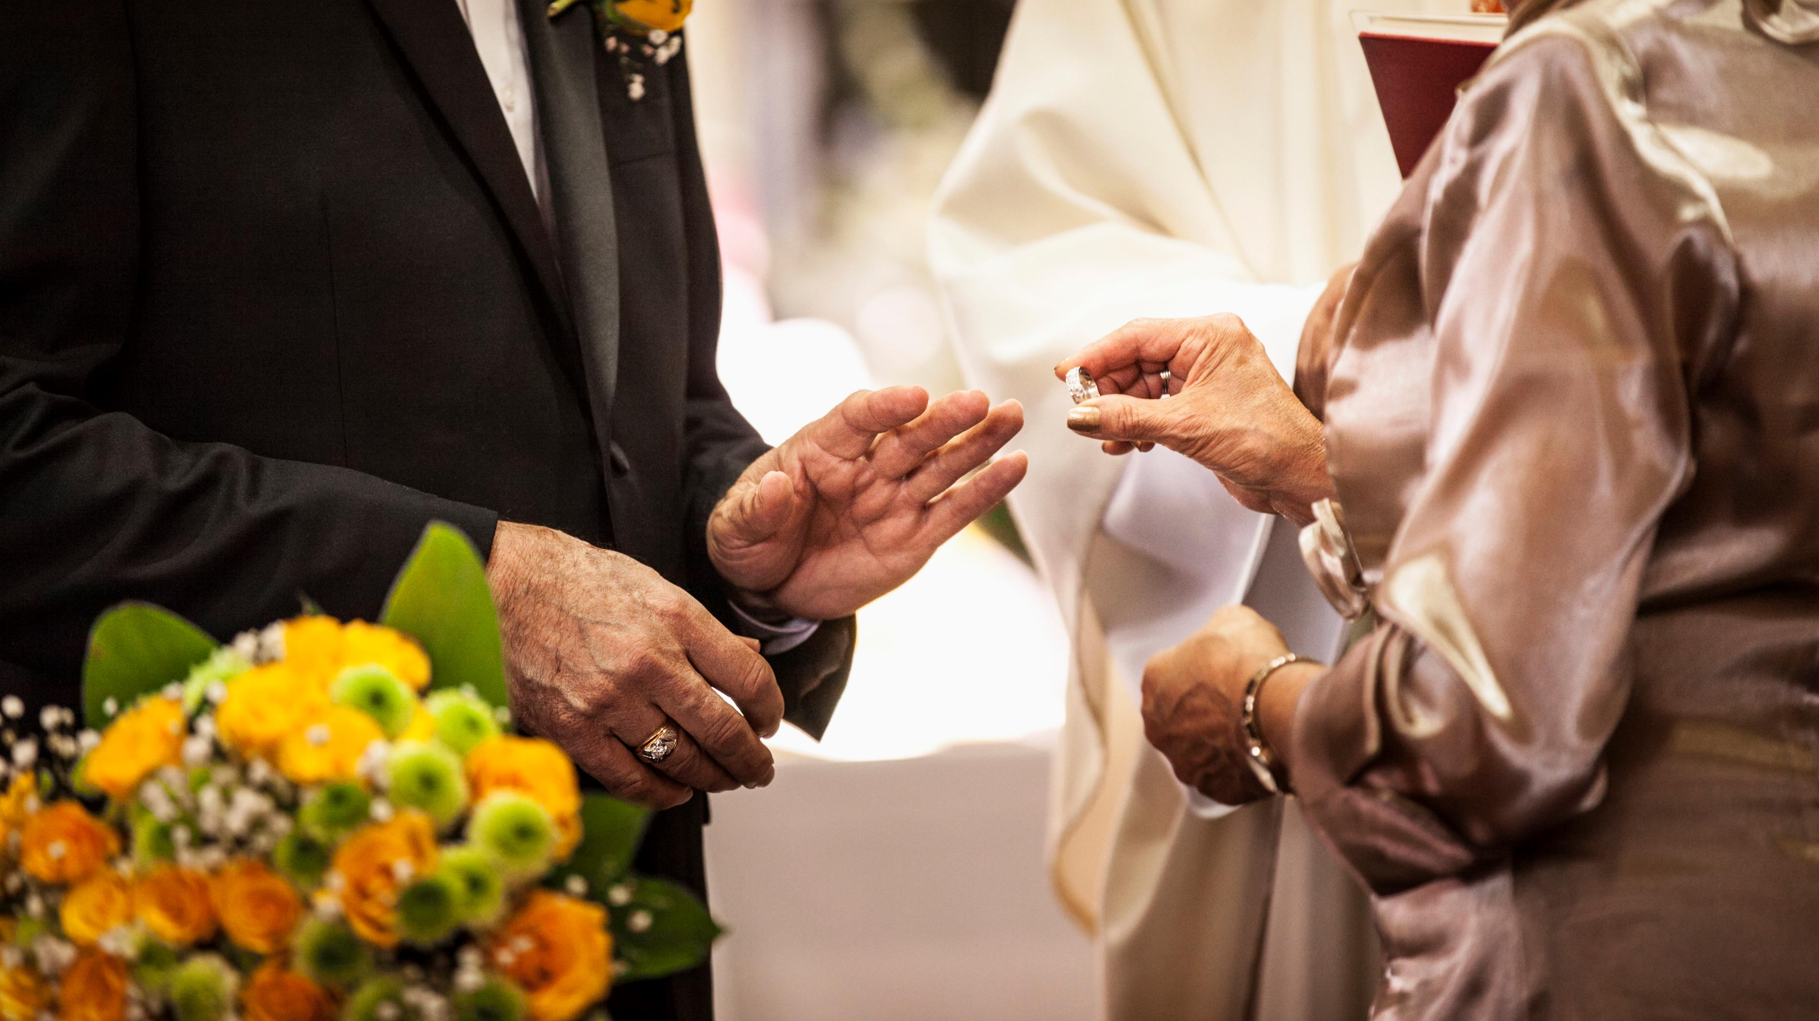
2. The Abandoned Marriage (11-14) (Three sins of a nation.)
a.) The Abomination (11-12)

Slide 11
Malachi 2:11-12 (ESV)
“Judah has been faithless, and ABOMINATION has been committed in Israel and in Jerusalem. For Judah has profaned the sanctuary of the Lord, which He loves, and has married the daughter of a foreign god.”
“May the Lord cut off from the tents of Jacob any descendant of the man who does this, who brings an offering to the Lord of hosts!”

Slide 12
2. The Abandoned Marriage (11-14) (Three sins of a nation.)
a.) The Abomination (11-12)
b.) The Altar (13)

Slide 13
Malachi 2:13 (ESV)
“And this second thing you do. You cover the Lord’s altar with tears, with weeping and groaning because He no longer regards the offering or accepts it with favor from your hand.”

Slide 14
2. The Abandoned Marriage (11-14) (Three sins of a nation.)
a.) The Abomination (11-12)
b.) The Altar (13)
c.) The Affair (14)

Slide 15
Malachi 2:14 (ESV)
But you say, “Why does He not?” Because the Lord was witness between you and the wife of your youth, to whom you have been faithless, though she is your companion and your wife by covenant.

Slide 16

3. The Heart of the Matter (15-16) (Three points to ponder.)
a.) Spiritual Purpose (15a)

Slide 17
Malachi 2:15a
“Did He not make them one, with a portion of the Spirit in their union?”

Slide 18
3. The Heart of the Matter (15-16) (Three points to ponder.)
a.) Spiritual Purpose (15a)
b.) Standing Guard (15b)

Slide 19
Malachi 2:15b
“And what was the one God seeking? Godly offspring. So guard yourselves in your spirit, and let none of you be faithless to the wife of your youth.”

Slide 20
3. The Heart of the Matter (15-16) (Three points to ponder.)
a.) Spiritual Purpose (15a)
b.) Standing Guard (15b)
c.) Sanctity of Marriage (16)

Slide 21
Malachi 2:16
“For the man who does not love his wife but divorces her, says the Lord, the God of Israel, covers his garment with violence, says the Lord of hosts. So guard yourselves in your spirit, and do not be faithless.”

Slide 22
“Remaining Faithful in a Fallen World”
The Spirit of Unity
The Abandoned Marriage
The Heart of the Matter
Malachi 2:10-16

Slide 23

Next week:
“The Messenger of the Lord”
2:17-3:5
Part 5 of 7 in the Sermon Series:
"Return to Me: The Heartbeat of Malachi"

