Slide 1


Malachi 2:1-9
“Truth or Consequences”

Slide 2
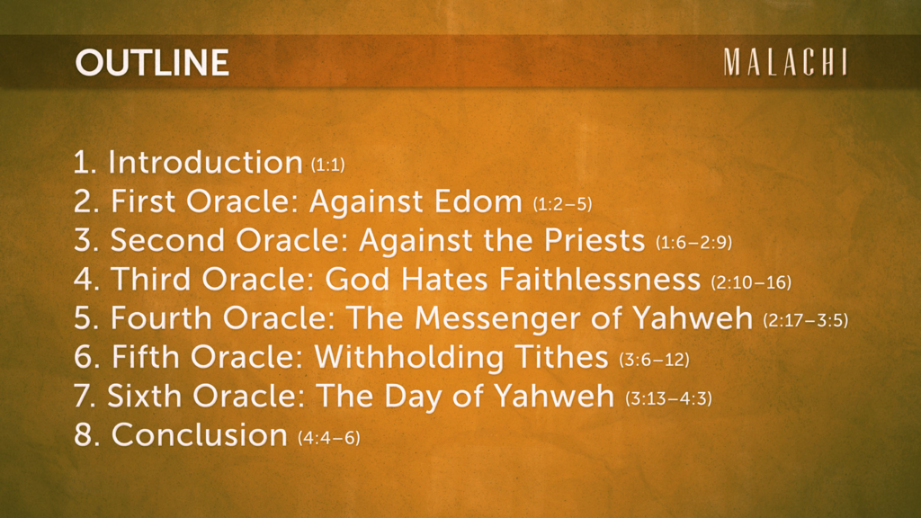

Slide 3

These oracles combat bad theology while revealing God to be:
a Father and Master (1:6),
a great King (1:14) and Creator (2:10, 15);
He loves those who fear Him and serve Him
and He judges the wicked (3:17).

Slide 4
Overview of Malachi:
      I love you (1:2)
      but you do not honor Me (1:6)
      and are not faithful to Me (2:10)
      Therefore, I will show My justice (2:17).
      If you return to Me, I will return to you and bless you (3:7)
      For I will distinguish between the wicked and the righteous who serve Me (3:14, 18).
Source: International Standard Bible Encyclopedia, Bromiley, G. W.

Slide 5

Overview of Malachi
Background &
Historical Narrative

Slide 6
Two common problems faced the community:
Economic depression (3:10f), and
a lack of sound theological teaching (2:6–8).
  Smith, G. V. 19791988. Malachi. In The International Standard Bible Encyclopedia, Revised, edited by Geoffrey W Bromiley, 3:228. Wm. B. Eerdmans.

Slide 7
Bad theology = selfish behavior, evil deeds, and
false assurance.
Is it bad? Blame God.
Is it good? Take all the credit.
Bad theology is “me” focused, while good
theology is THEE (God) focused.

Slide 8
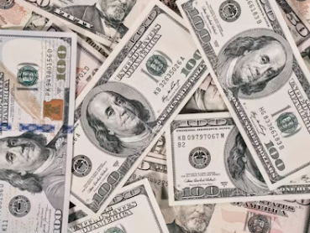
It’s all about me.
Give me coin, not Christ.
We’ll see this attitude confronted in Malachi 3:6-15
Notes:
Photo source: https://unsplash.com/s/photos/100-dollar-bill “Download free images on Unsplash, Free for commercial use. Accessed October 27, 2024.

Slide 9
In Malachi God assured the people of His:
Blessings on those who returned to Him, reminded them of His love, and
promised that the “coming One,”
who would be preceded by Elijah (aka John the Baptist),
would make ready a people chosen by God through judgment (“Repent, for the kingdom of God is at hand.”)
  Smith, G. V. 19791988. Malachi. In The International Standard Bible Encyclopedia, Revised, edited by Geoffrey W Bromiley, 3:228. Wm. B. Eerdmans.

Slide 10
Isaiah 40:3 (ESV)
A voice cries:
“In the wilderness
prepare the way of the Lord;
make straight in the desert
a highway for our God.”

Slide 11
English Standard Version (ESV)
Malachi 2:1-9

Slide 12
The Ultimatum is given (vv. 1-2).
“Take heed to hear in your heart.”
“And now, O priests, this command is for you.
If you will not listen, if you will not take it to heart to give honor to My name, says the Lord of hosts, then I will send the curse upon you and I
will curse your blessings. Indeed, I have already cursed them, because you do not lay it to heart.”

Slide 13
Malachi 2:2
“But if you will not listen to Me and will not do all these commandments,” is a reference to Deut 28:15 –
“But if you will not obey the voice of the Lord your God or be careful to do all His commandments and His statutes that I command you today, then all these curses shall come upon you and overtake you.”
English Standard Version: Cross-References. 2016. Wheaton, IL: Crossway.

Slide 14
2. The Punishment is announced (vv. 3-4a).
“It’s a dung deal.”
“Behold, I will rebuke your offspring, and spread dung on your faces, the dung of your offerings, and you shall be taken away with it.
So shall you know that I have sent this command to you…”

Slide 15
Offal / Dung
Noun – “viscera and trimmings of a butchered animal often considered inedible by humans.” IOW, it is useless and in the way.
Ex 29:14 “But the flesh of the bull and its skin and its dung you shall burn with fire outside the camp; it is a sin offering.”

Slide 16
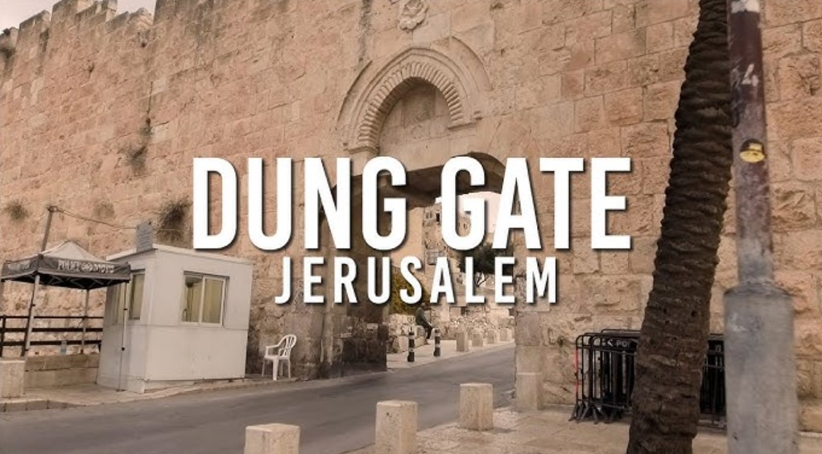
This view is from “new” Jerusalem into the area that is considered Old Jerusalem. Just beyond this gate is the Temple Mount and the Wailing Wall.

Slide 17
Paul used the term “dung” in
Phil 3:7-8 when he compared his past successes to knowing Christ.
IOW…
There is no comparison!

Slide 18
3. The Covenantal Command (vv. 4b-5).
“The example of old.”
“…that my covenant with Levi may stand, says the Lord of hosts. My covenant with him was one of life and peace, and I have them to him. It was a covenant of fear, and he feared Me. He stood in awe of My name.”

Slide 19
4. Your Pastor’s Promise (v. 6).
Thus, pray for your elders.”
“True instruction was in his mouth, and no wrong was found on his lips. He walked with Me in peace and uprightness, and he turned many from iniquity.”

Slide 20
5. The Faithful Following (v. 7).
“Committed to the sacred source.”
“For the lips of a priest should guard knowledge, and people should seek instruction from his mouth, for he is the messenger of the Lord of hosts.”

Slide 21
6. The Care-less Corruption (v. 8).
“In the path of destruction.”
“But you have turned aside from the way You have caused many to stumble by your instruction. You have corrupted the covenant of Levi, says the Lord of hosts.”

Slide 22
Mal 2:7-8 is echoed in Matt 23:3 -
“…so do and observe whatever they tell you, but not the works they do. For they preach, but do not practice.”

Slide 23
7. The Public Punishment (v. 9).
“The pillory of shame.”
“...and so I make you despised and abased before all the people, inasmuch as you do not keep My ways but show partiality in your instruction.”

Slide 24
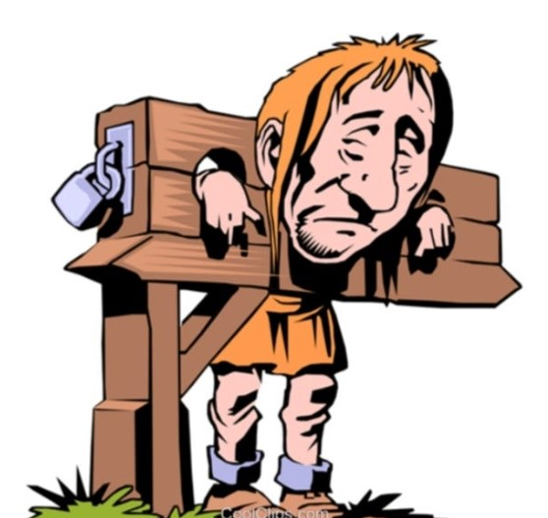

Slide 25
Malachi 2:9 reveals a sin of the priests that goes against Deut. 10:17 (ESV) –
“For the Lord your God is God of gods and Lord of lords, the great, the mighty, and the awesome God, who is not partial and takes no bribe.”

Slide 27
Malachi 2:1-9
“Truth or Consequences”

