Slide 1
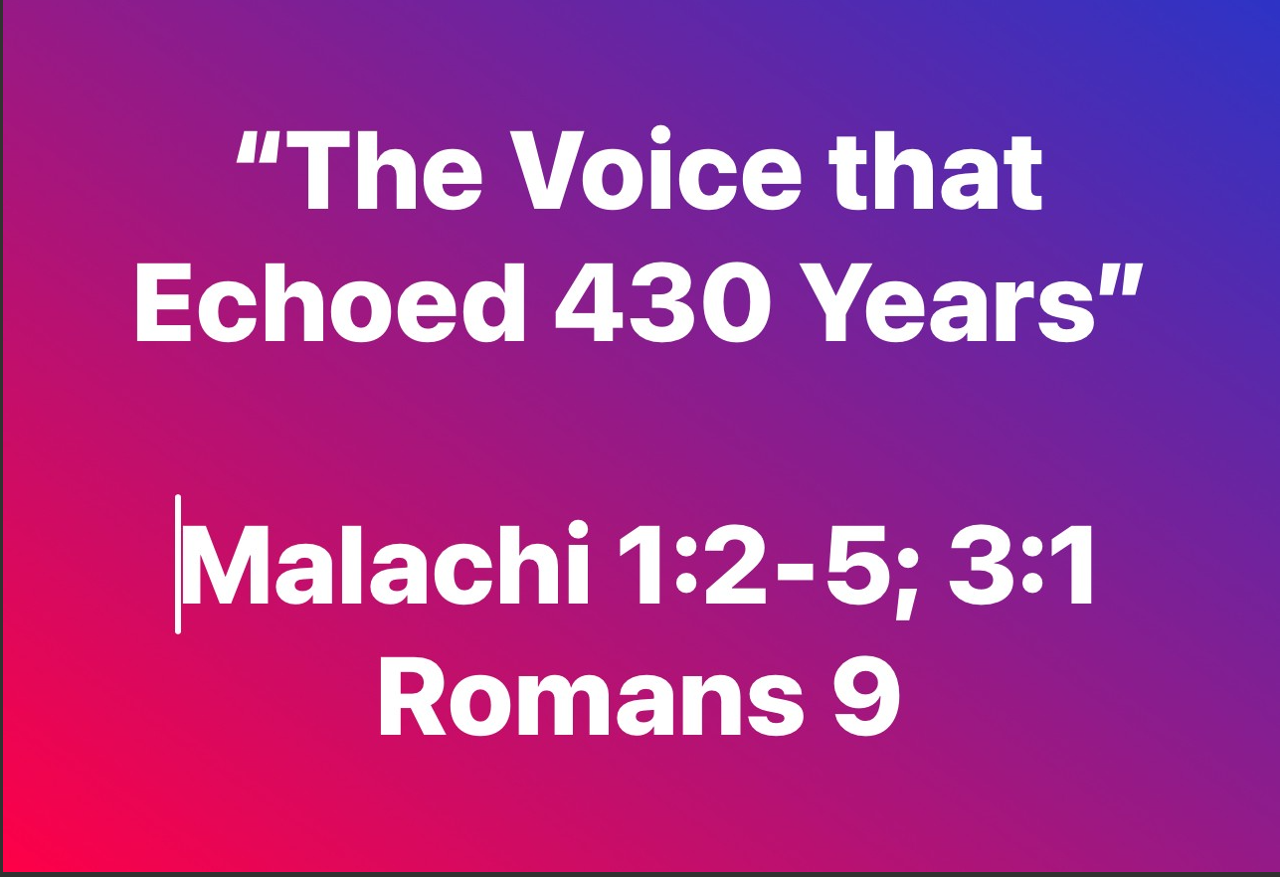

Slide 2


Slide 3


Slide 4

“Malachi”

Slide 5


Slide 6





Slide 8


Slide 9


Slide 10


Slide 11


Slide 12


