Slide 1

“JESUS – The God of Creation”
Week 3 of 4 in a mini-series called, “The Centrality of Christ”
John 1:1-14, 18; 8:58
Amos 8:11-13

Slide 2
In the beginning was the Word (1-5)

Slide 3
In the beginning was the Word (1-5)
2. In Him was life (3-5)

Slide 4
In the beginning was the Word (1-5)
2. In Him was life (3-5)
3. John’s witness to the Word (6-10)

Slide 5
In the beginning was the Word (1-5)
2. In Him was life (3-5)
3. John’s witness to the Word (6-10)
4. Jesus is the True Light (9-11)

Slide 6
In the beginning was the Word (1-5)
2. In Him was life (3-5)
3. John’s witness to the Word (6-10)
4. Jesus is the True Light (9-11)
5. Responses to the Word (11-13)

Slide 7
In the beginning was the Word (1-5)
2. In Him was life (3-5)
3. John’s witness to the Word (6-10)
4. Jesus is the True Light (9-11)
5. Responses to the Word (11-13)
6. The Word became flesh (14-18)

Slide 8
In the beginning was the Word (1-5)
2. In Him was life (3-5)
3. John’s witness to the Word (6-10)
4. Jesus is the True Light (9-11)
5. Responses to the Word (11-13)
6. The Word became flesh (14-18)
7. The divinity, humanity, and work of Jesus Christ (1-14)

Slide 9
Jesus is the Eternal Word of God
(John 1:1-5)

Slide 10
Revelation 19:13
“He is dressed in a robe
dipped in blood,
and His name is
the Word (Logos) of God.”

Slide 11
Logos (word) – but not capitalized:
* Hebrews 4:12
* Colossians 3:16
* James 1:21
* Matthew 12:36
* Acts 4:31
* Romans 10:1
* 1 Peter 1:23

Slide 12
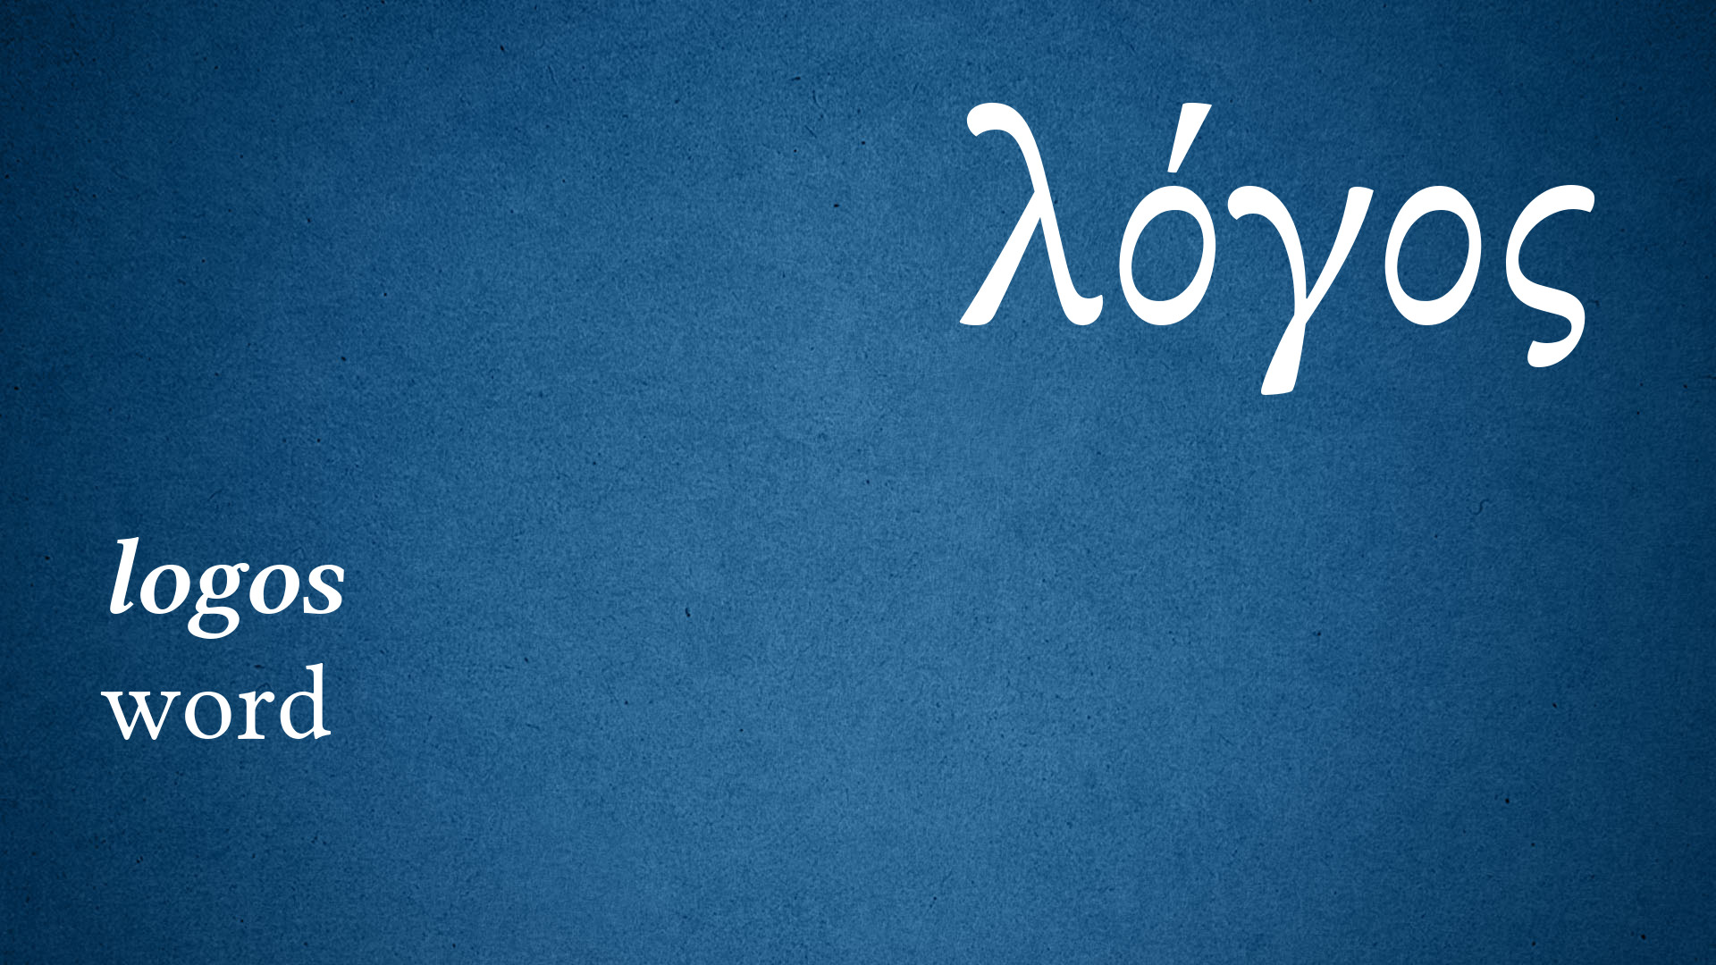
A profound theological statement about Jesus’
nature and role in the
world to offer salvation.
“Dabar” – Hebrew for “word”

Slide 13
Synoptic Gospels:
Matthew – Lion of the Tribe of Judah
Mark – Jesus as the Servant (+)
Luke – Son of Man/Son of God
“Three accounts of one picture.”

Slide 14
The Gospel of John
Depicts Jesus as the One coming down from on high to break the silence of 400 years between the OT and the NT.
Jesus – the Creator, Sustainer, Deliverer

Slide 15

QUESTION:
Have you ever wondered by God was silent during the 400 years between the Old Testament and the New Testament?

Slide 16
Amos 8:11-13
11 “Behold, the days are coming,” declares the Lord God, “when I will send a famine on the land – not a famine of bread, nor a thirst for water, but of hearing the words of the Lord.
12 They shall wander from sea to sea, and from north to east; they shall run to and fro, to seek the word of the Lord, but they shall not find it.
13 “In that day the lovely virgins and the young men shall faint for thirst.”

Slide 17
Illustration –
Words have power.

Slide 18
Application –
Know that Jesus, as Creator, holds authority over all.

Slide 19
Illustration –
The troubled teenager.

Slide 20
2. Jesus as God Revealed
(John 1:14, 18)

Slide 21
Illustration –
The Master Artist.

Slide 22
Spiritual Truth –
Jesus knows!

Slide 23
3. Jesus is the Great “I AM”
(John 8:58)

Slide 24
Illustration –
Jesus is our Spiritual Lighthouse.

Slide 25
Application –
You can always count on Jesus!

Slide 26
- Jesus is the Eternal Word of God
- Jesus revealed the character and nature of God the Father.
- Jesus is the great “I AM”.

Slide 27
Questions –
What exactly does it mean that Jesus is the God of creation?
Why is that significant for us today?

Slide 28
“JESUS – The God of Creation”
Week 3 of 4 in a mini-series called, “The Centrality of Christ”
John 1:1-14, 18; 8:58
Amos 8:11-13

