Slide 1
Children Matter to God
- “Will You Go?”
Luke 9:23-26, 10:2, 14:23; Matthew 28:18-20

Slide 2
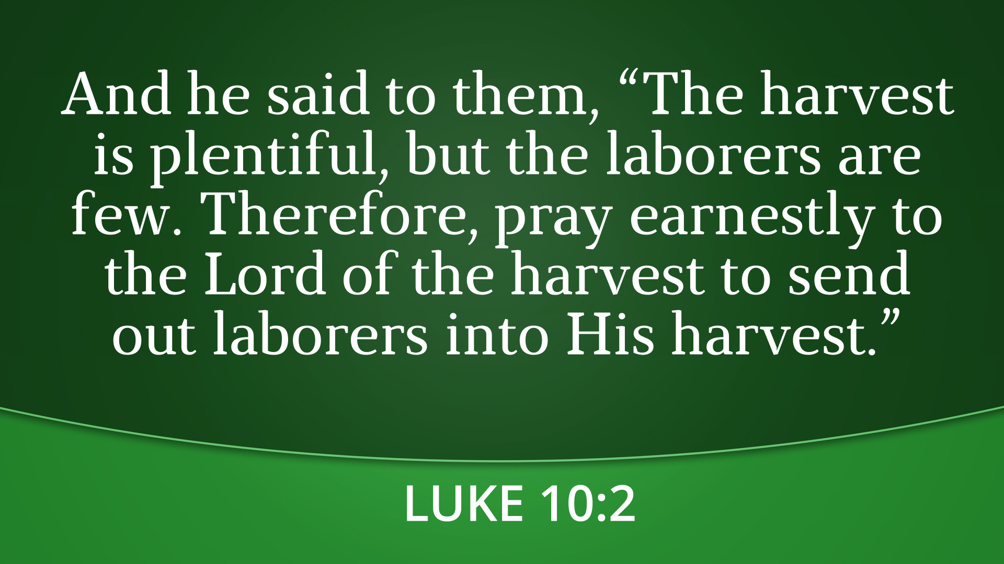

Slide 3
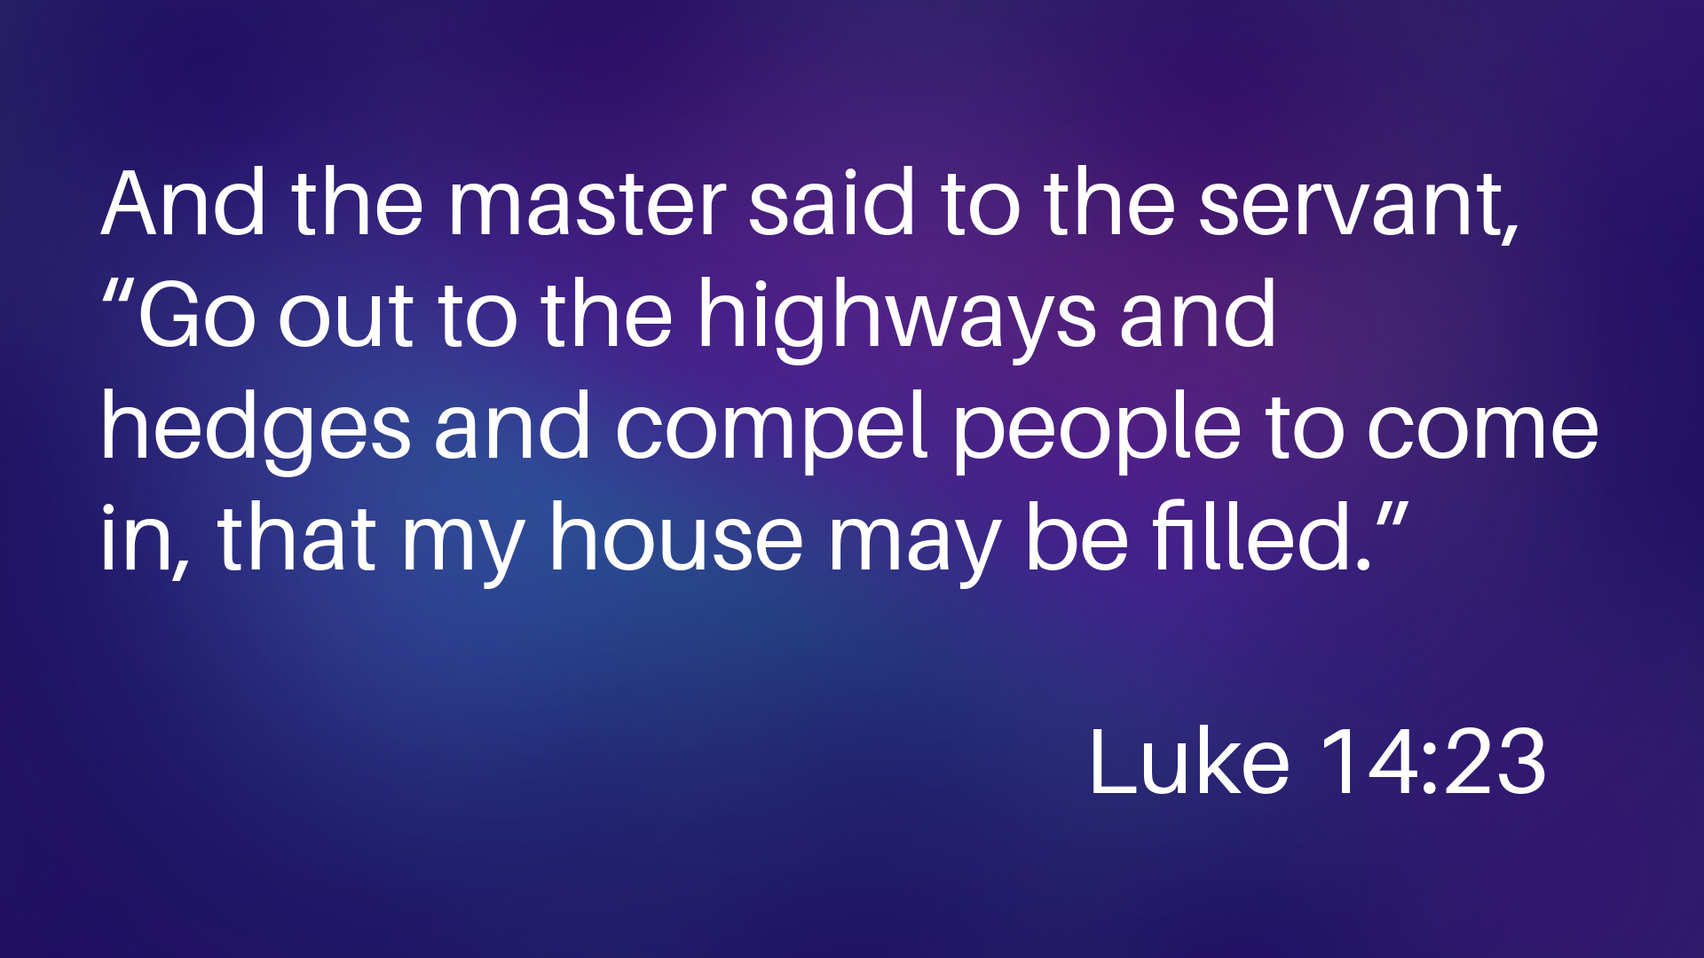

Slide 4
The Call to Follow Christ
Luke 9:23-24
01

Slide 5
DENY
Repudiate, disown, forsake
(Verb, aorist, imperative)

Slide 6
The Call to Fulfill the Great Comm Commission
Luke 9:26; Matt 28:18-20
02
The Call to Follow Christ
Luke 9:23-24
01

Slide 7
And Jesus came and said to them, “All authority in heaven and on earth has been given to me. Go therefore and make disciples of all nations, baptizing them in the name of the Father and of the Son and of the Holy Spirit, teaching them to observe all that I have commanded you. And behold, I am with you always, to the end of the age.”
Matthew 28:18-20

Slide 8
For whoever is ashamed of Me and My words, of him will the Son of Man be ashamed when He comes into His glory and the glory of the Father and of the holy angels.
Luke 9:26

Slide 9
DISCIPLE
Student, follower, disciple
(Verb, aorist, active, imperative)

Slide 10
The Call to Follow Christ
Luke 9:23-24
01
The Call to Fulfill the Great Comm Commission
Luke 9:26; Matt 28:18-20
02
The Call to Impact Eternity -
Luke 9:25, 10:2
03

Slide 11
Children Matter to God
- “Will You Go?”
Luke 9:23-26, 10:2, 14:23; Matthew 28:18-20

