Slide 1
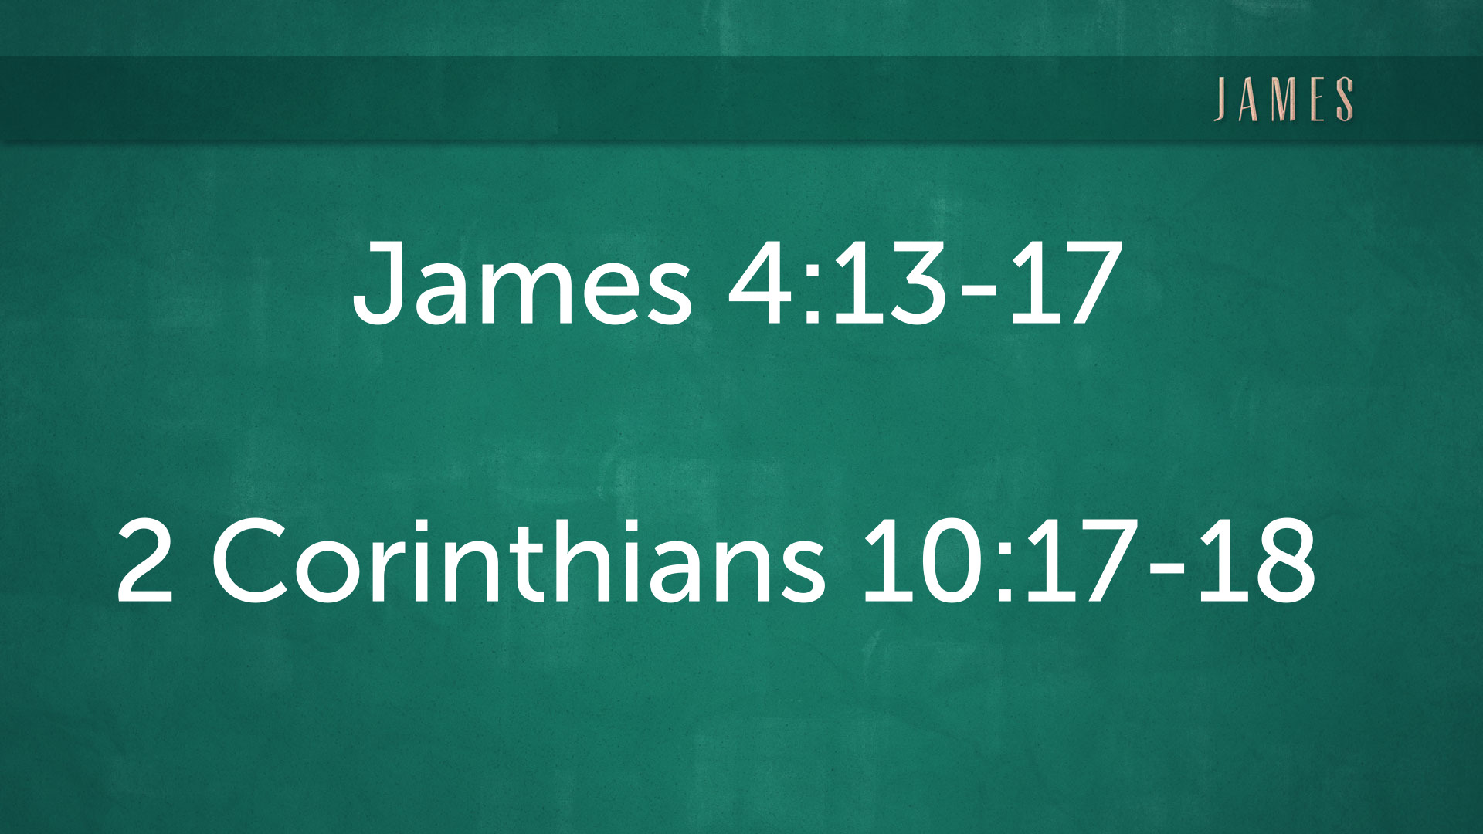
Today’s Main Texts -

Slide 2

“Living Life in the Will of the Father”
James 4:13-17
Prov 16:9; 2 Cor 10:17-18; Rom 12:1-2

Slide 3

Who is James?
(A Recap)

Slide 4
Four Parallels
to Ecclesiastes

Slide 5

1. Surrender
Your life to God the Father
James 4:13-14

Slide 6
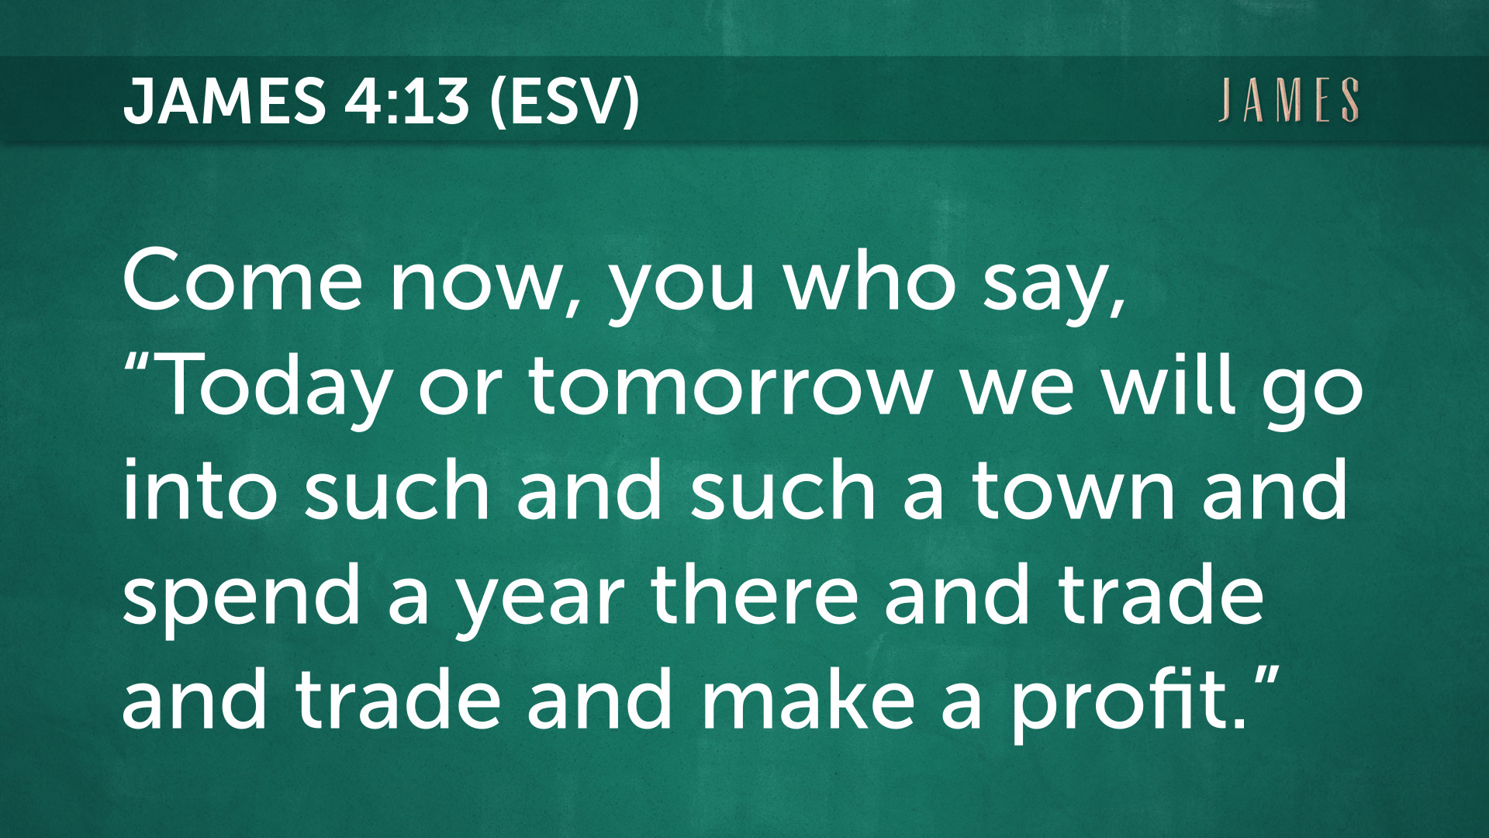

Slide 7


Slide 8
Examples of
self-confidence
(Misplaced)

Slide 9
2. Submit
Your will to the Lord Jesus Christ
James 4:15; Proverbs 16:9

Slide 10


Slide 11
QUESTION:
How do you determine what God’s will is for your life?

Slide 12
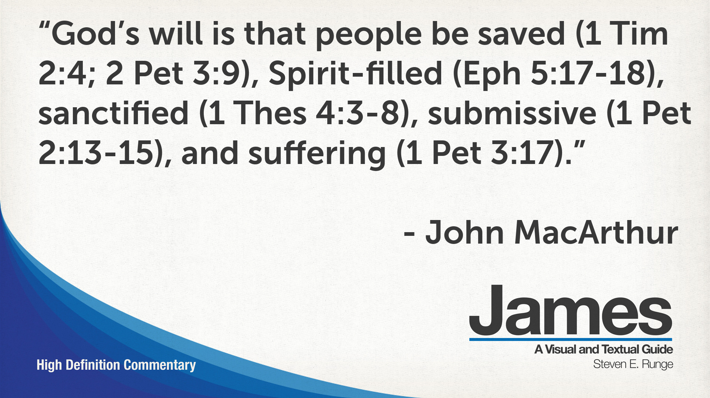

Slide 13
3. Seek
To live with humility
James 4:16; 2 Cor 10:17

Slide 14
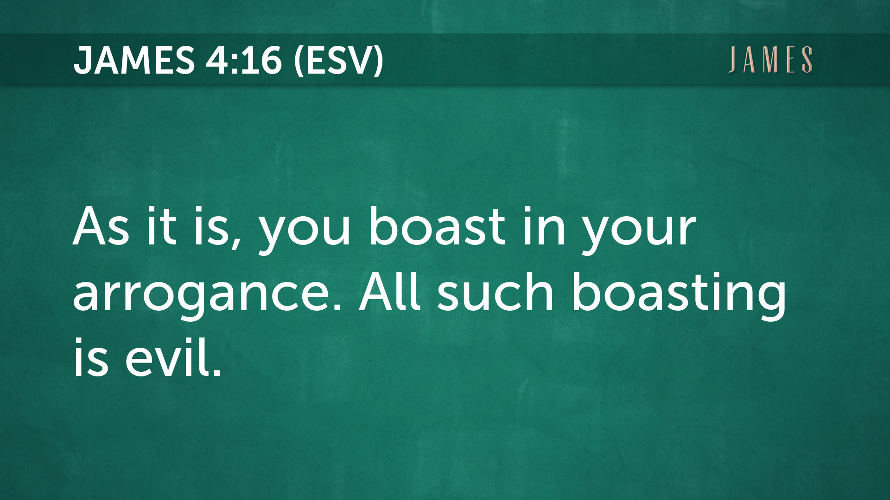

Slide 15
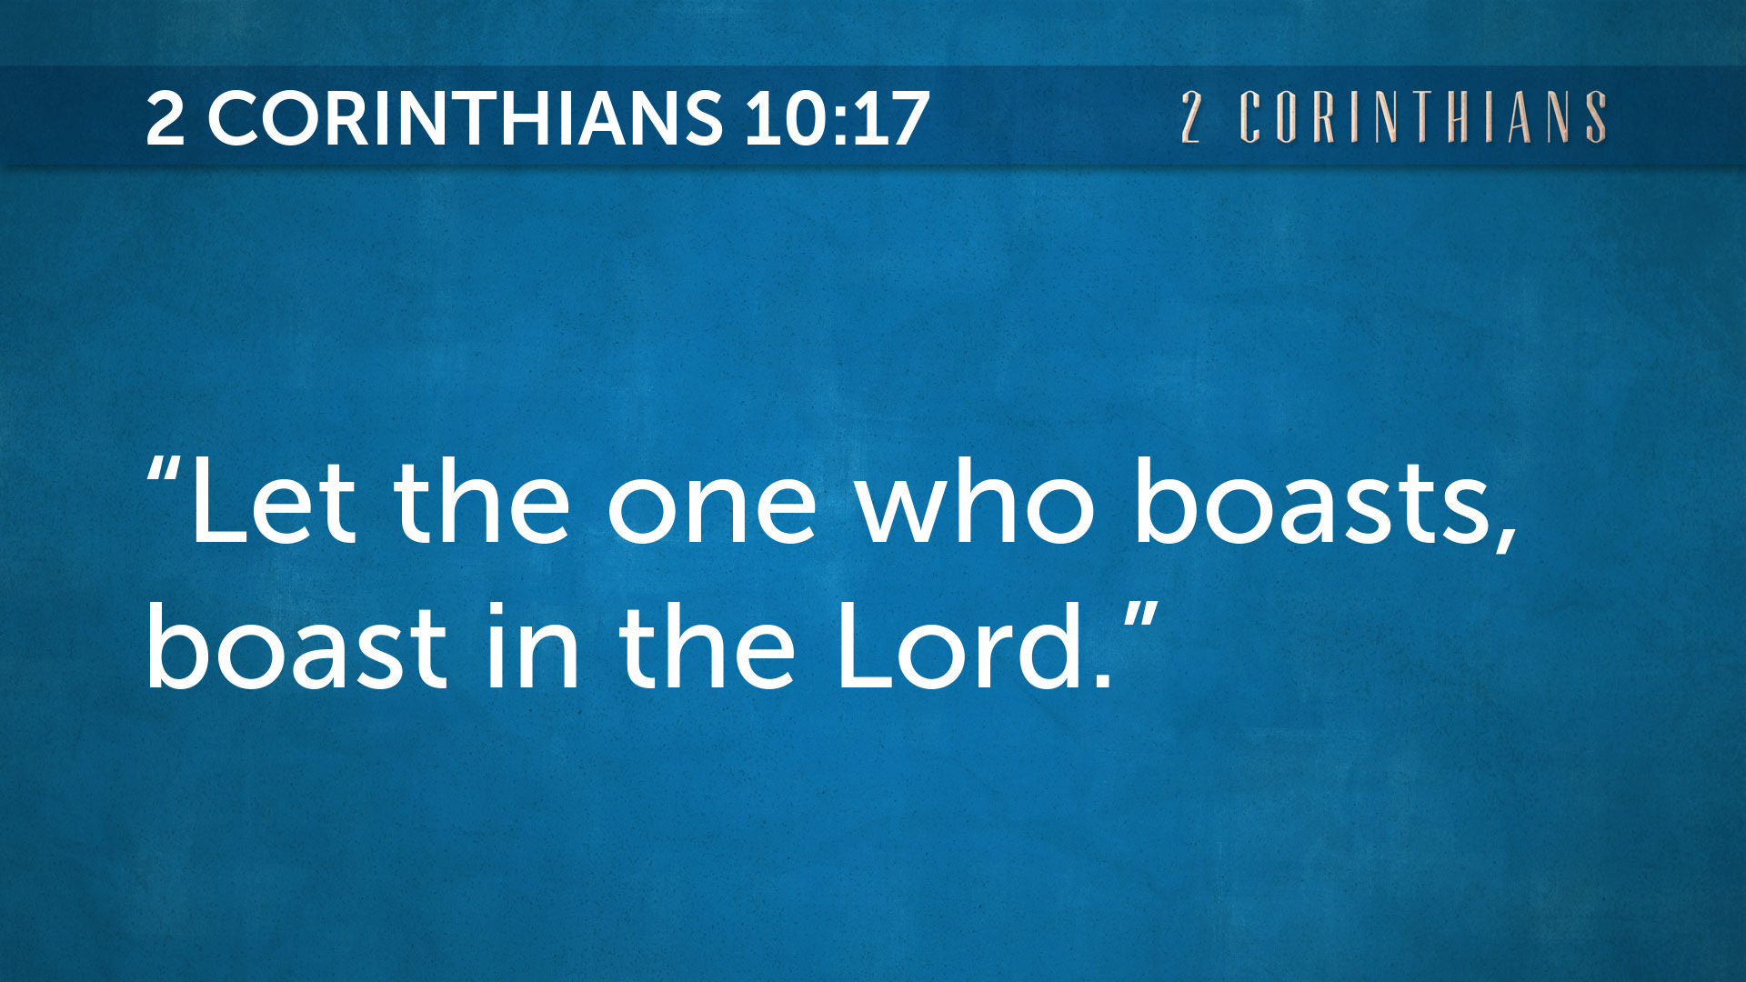

Slide 16
4. Strive
For the Savior’s approval
James 4:17; 2 Cor 10:18; Rom 12:1-2

Slide 17


Slide 18


Slide 19
“Living Life in the Will of the Father”
James 4:13-17
Prov 16:9; 2 Cor 10:17-18; Rom 12:1-2

Slide 20
Prepare your hearts
before observing the Lord’s Supper

