Slide 1

“Two Kinds of Wisdom”
James 3:13-18
(NKJV)

Slide 2

Earthly Wisdom vs Godly Wisdom

Slide 3
Who is wise and understanding among you? Let him show by good conduct that his works are done in the meekness of wisdom.
Verse 13 bookends verse 18

Slide 4
Let’s set things up:
1. Proof of godly wisdom (13) 2. Characteristics of earthly wisdom (14-16) 3. Characteristics of godly wisdom (17) 4. Fruits of godly wisdom (18)

Slide 5
What exactly is “WISDOM”?
σοφία…wisdom, insight, understanding, skillful living, discernment.

Slide 6
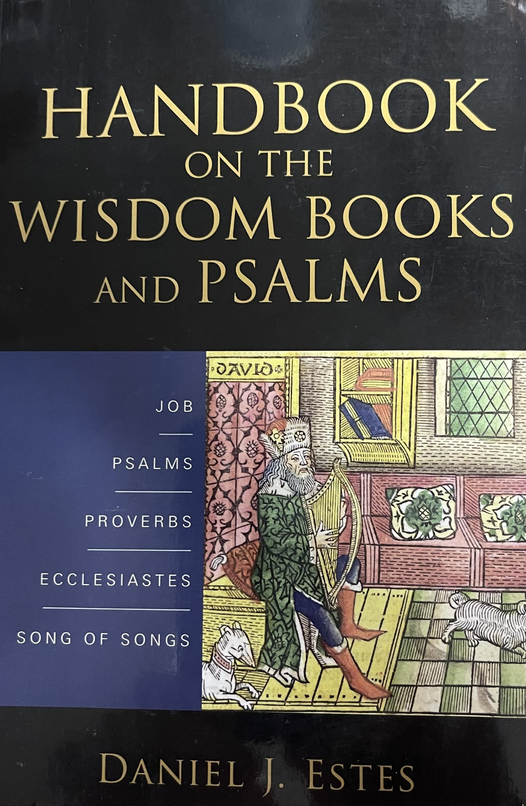
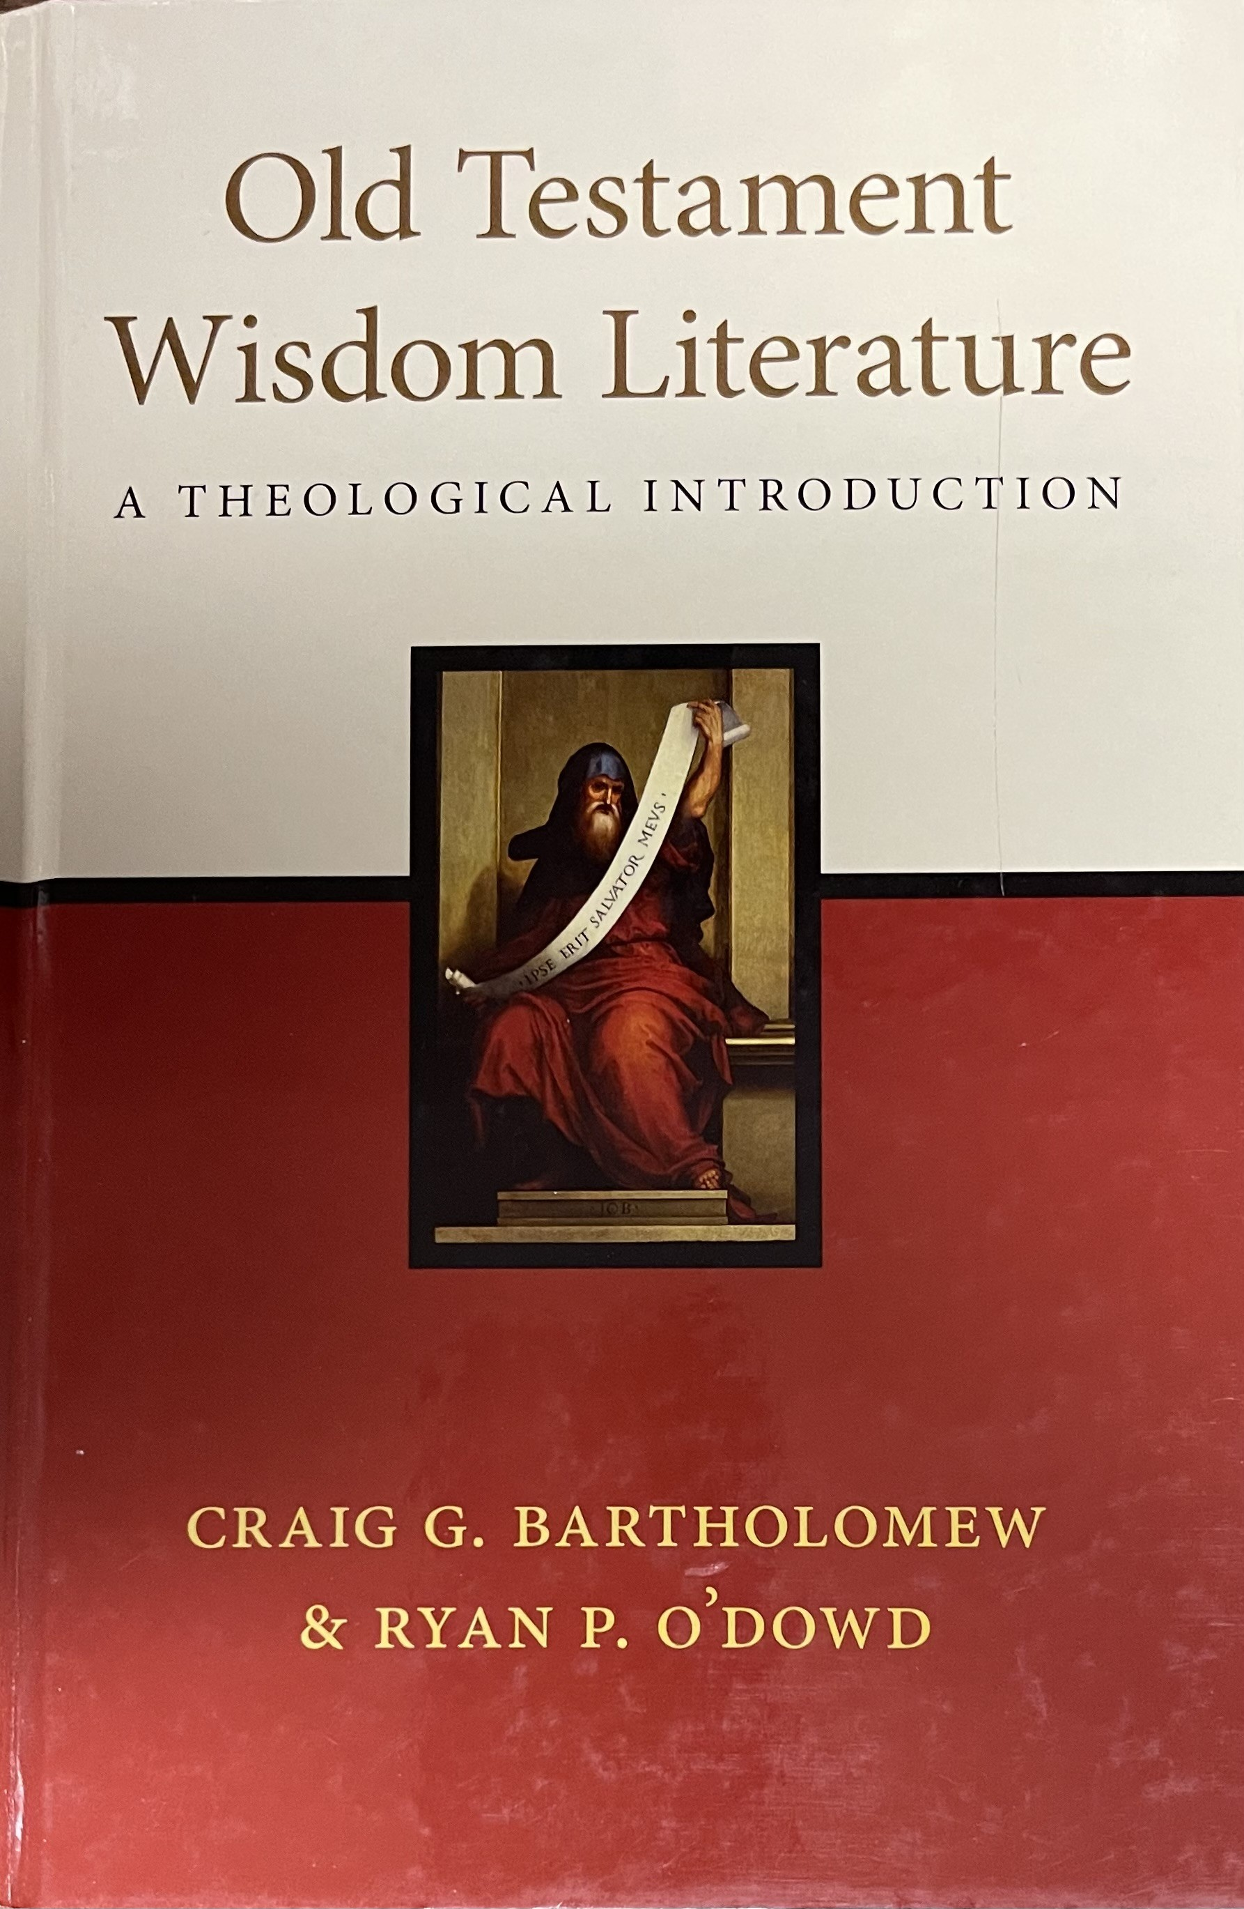

Slide 7
Earthly Wisdom

Slide 8
But if you have bitter envy and self-seeking in your hearts, do not boast and lie against the truth.
Verse 14

Slide 9
This wisdom does not descend from above, but is earthly, sensual, demonic.
Verse 15

Slide 10
For where envy and self-seeking exist, confusion and every evil thing are there.
Verse 16

Slide 11
Godly Wisdom

Slide 12
But the wisdom that is from above is first pure, then peaceable, gentle, willing to yield, full of mercy and good fruits, without partiality and without hypocrisy.
Verse 17

Slide 13
Now the fruit of righteousness is sown in peace by those who make peace.
Shalom!
Verse 18

Slide 14

Godly Wisdom –
Making a Difference
pure –
peaceable –
willing to yield –
full of mercy –
full of good fruits –
without partiality –
without hypocrisy -

Slide 15
1. Different Characteristics
vv. 14-16
vv. 17-18
A.) Earthly Wisdom | B.) Godly Wisdom
1) Selfish Ambition | 1) Pure
2) Bitter Envy | 2) Peace-loving
3) Boasting | 3) Considerate

Slide 16
2. Different Sources
A.) Earthly Wisdom | B.) Godly Wisdom
Rooted in Human Understanding | 1) Comes from God
2) Influenced by Worldly Desires | 2) Guided by the Holy Spirit

Slide 17
3. Different Outcomes
A.) Earthly Wisdom | B.) Godly Wisdom
Leads to Disorder and Evil Deeds | Yields Righteousness and Peace
2) Produces Discord and Confusion | 2) Fosters Harmony and Unity
Notes:
Outline provided by SermonCentral AI, March 7, 2024.

Slide 18
“Two Kinds of Wisdom”
James 3:13-18
(NKJV)

