Slide 1
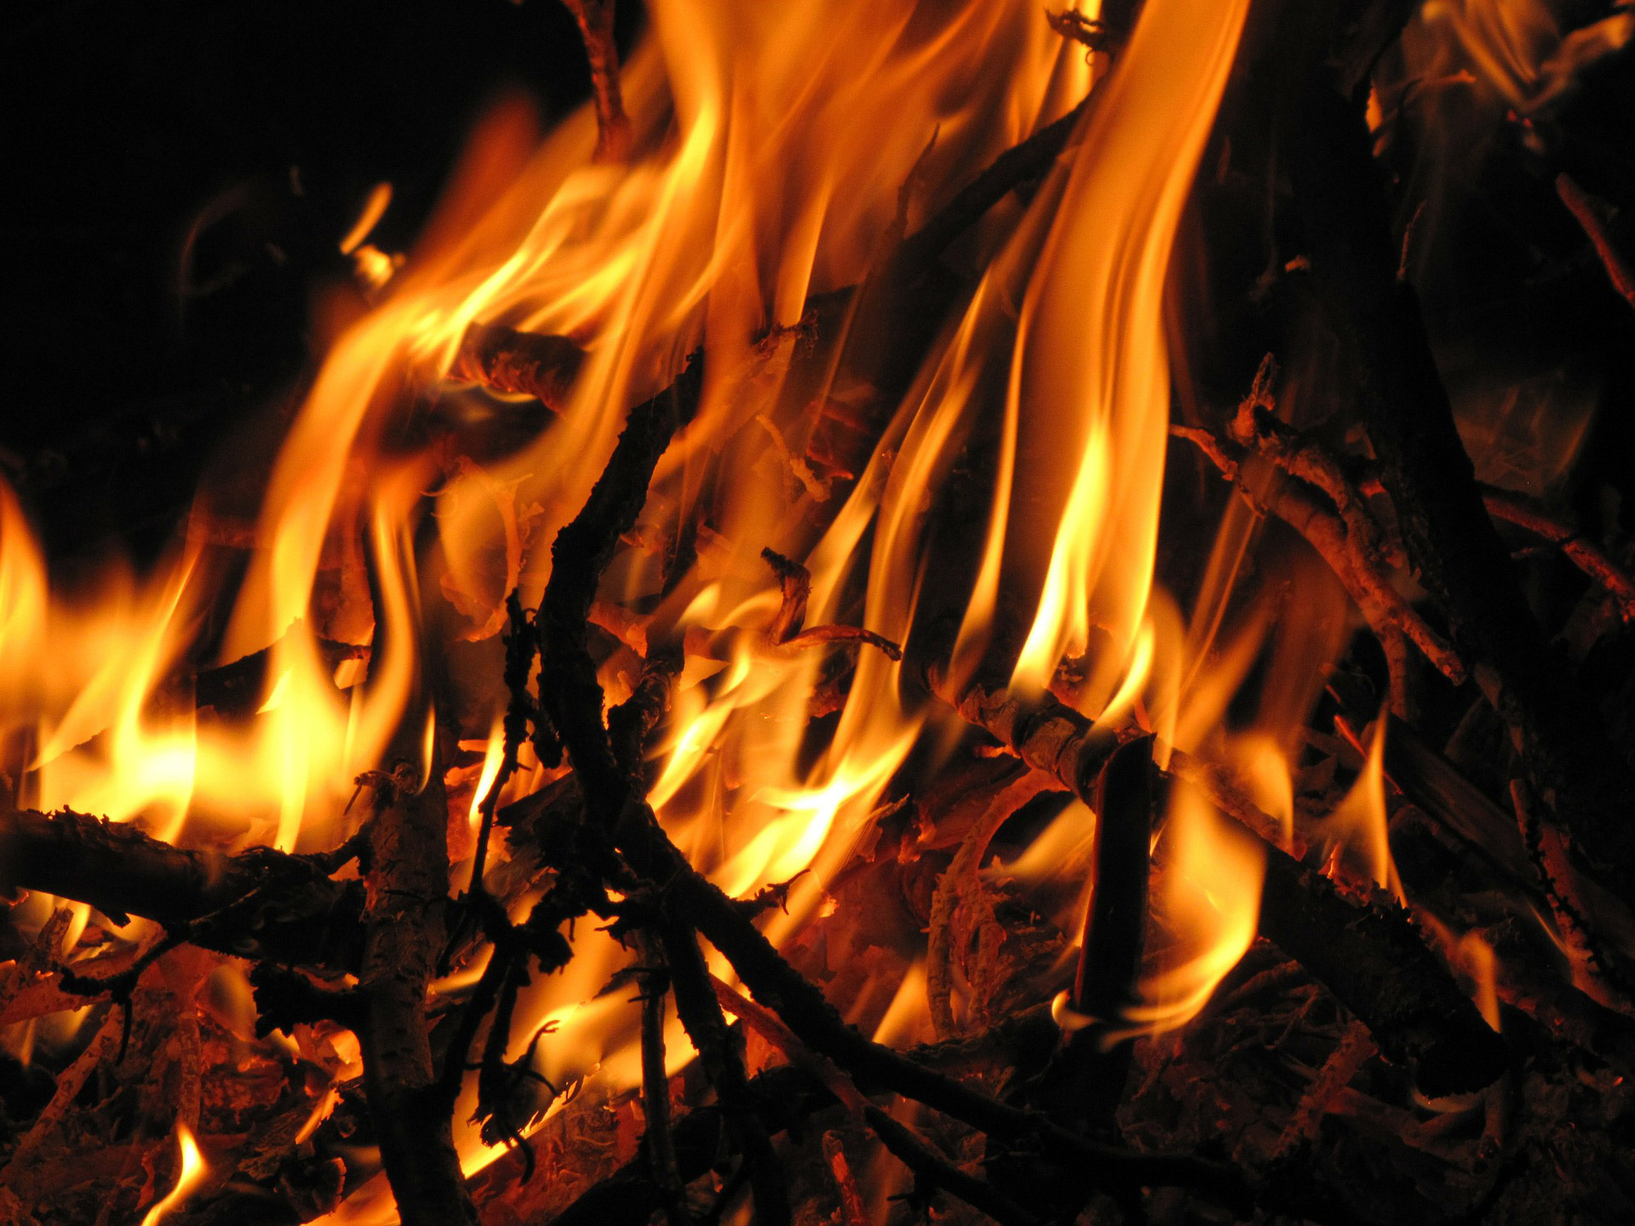
Hell, Fire, and the Tameless Tongue
James 3:6-12

Slide 2

(context) James 3:1-12
Please stand
for the reading
of God’s Word.

Slide 3
Words have POWER to:
- Corrupt (v. 6)
- Condemn (v.8)

Slide 4
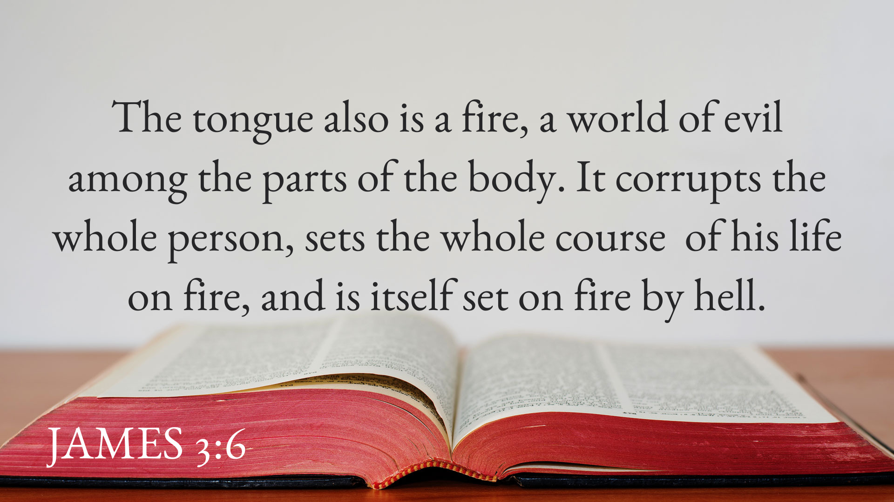

Slide 5
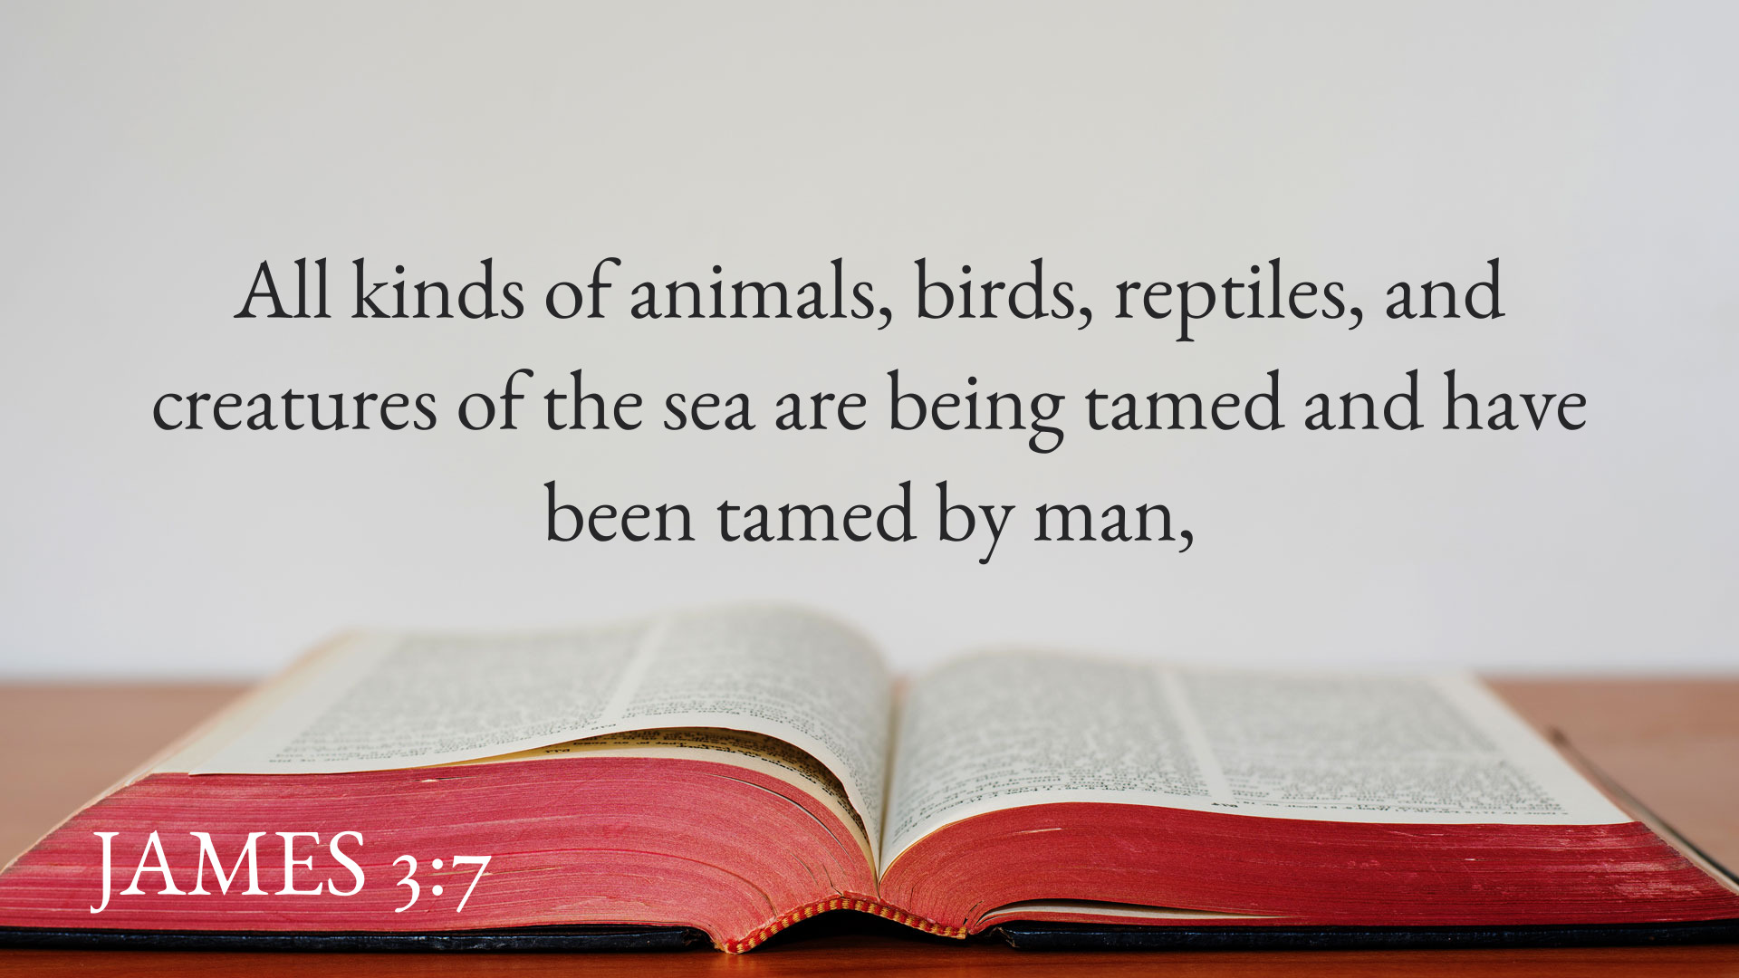

Slide 6
Dualism –
poetry on display

Slide 7
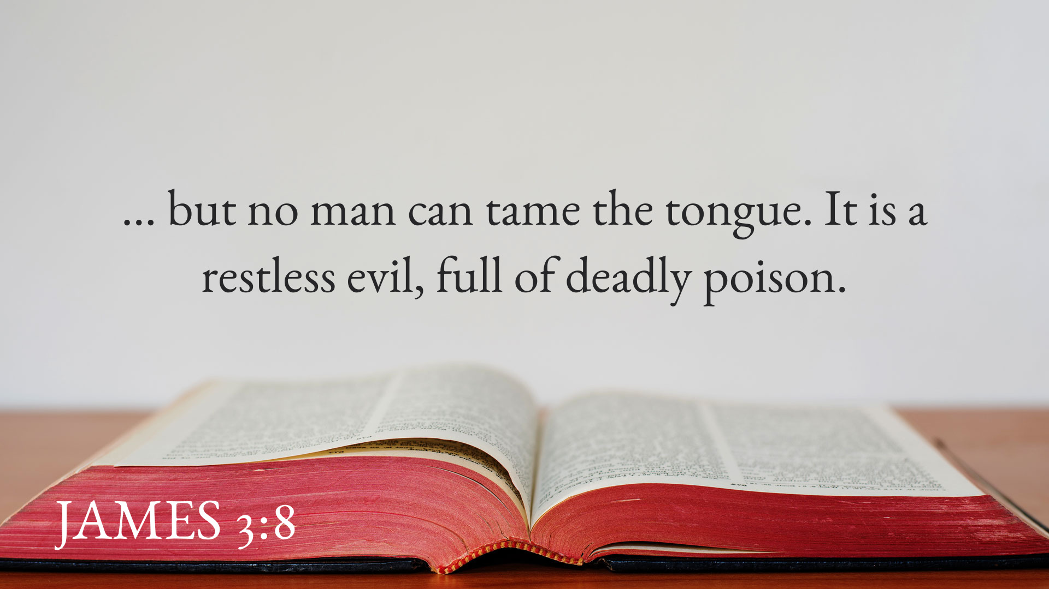

Slide 8

Words have PURPOSE to:
- Praise (v. 9a)
- Curse (v.9b)

Slide 9
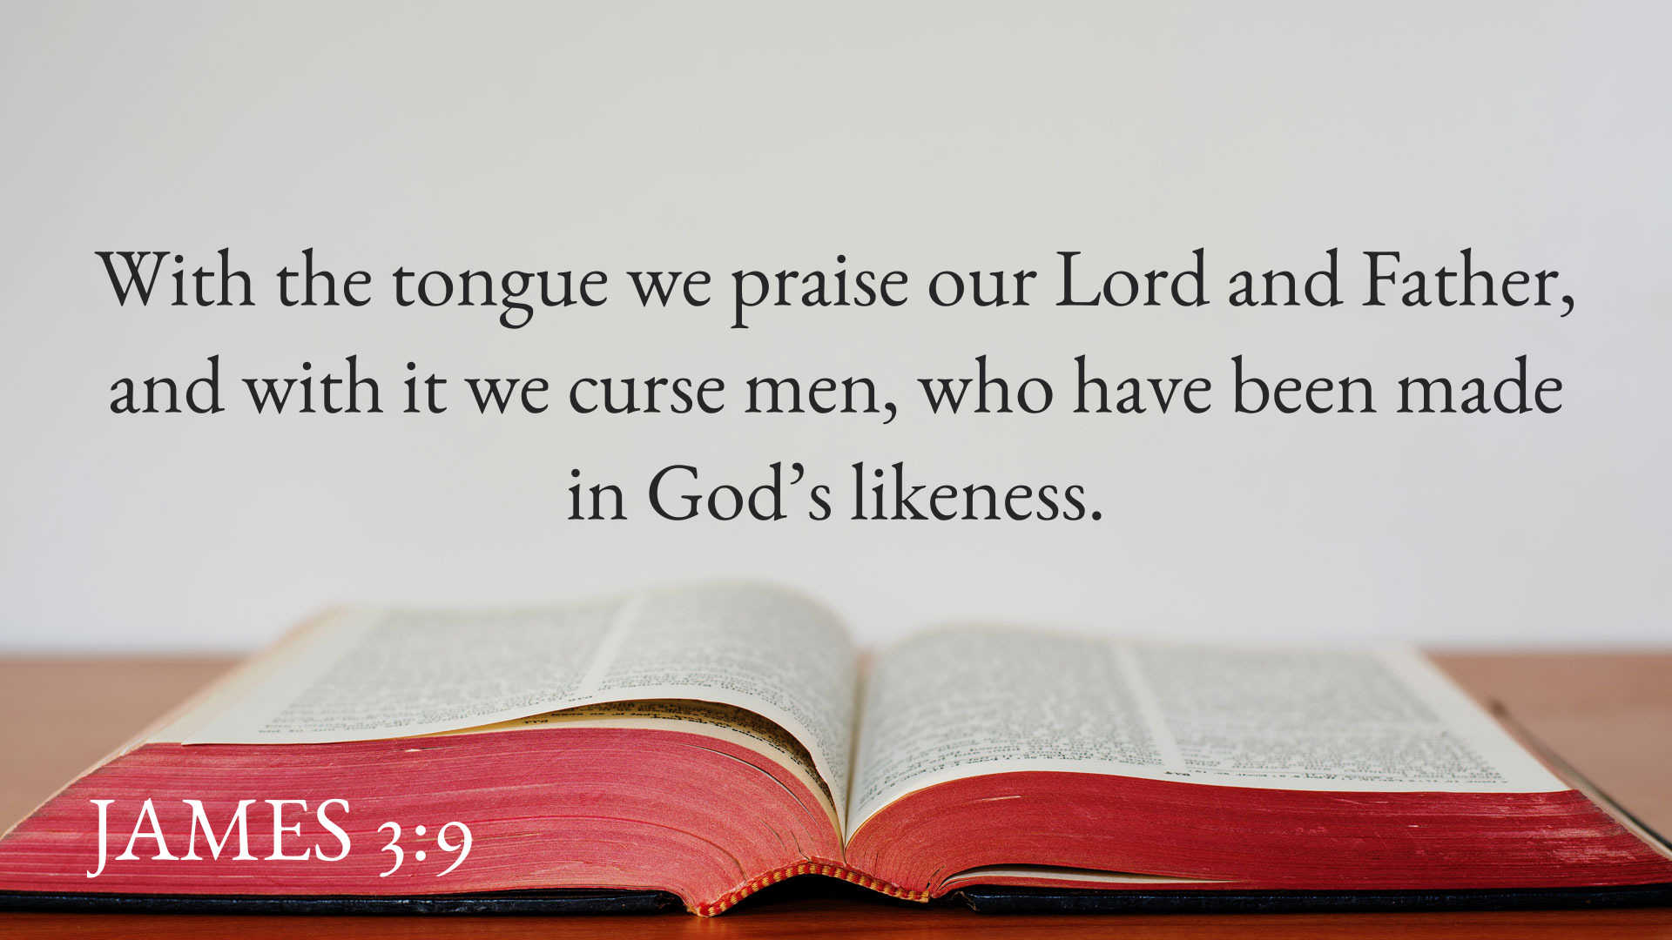

Slide 10
Forked Tongue
Snakes, reptiles …
and cats?
Satan, the serpent

Slide 11
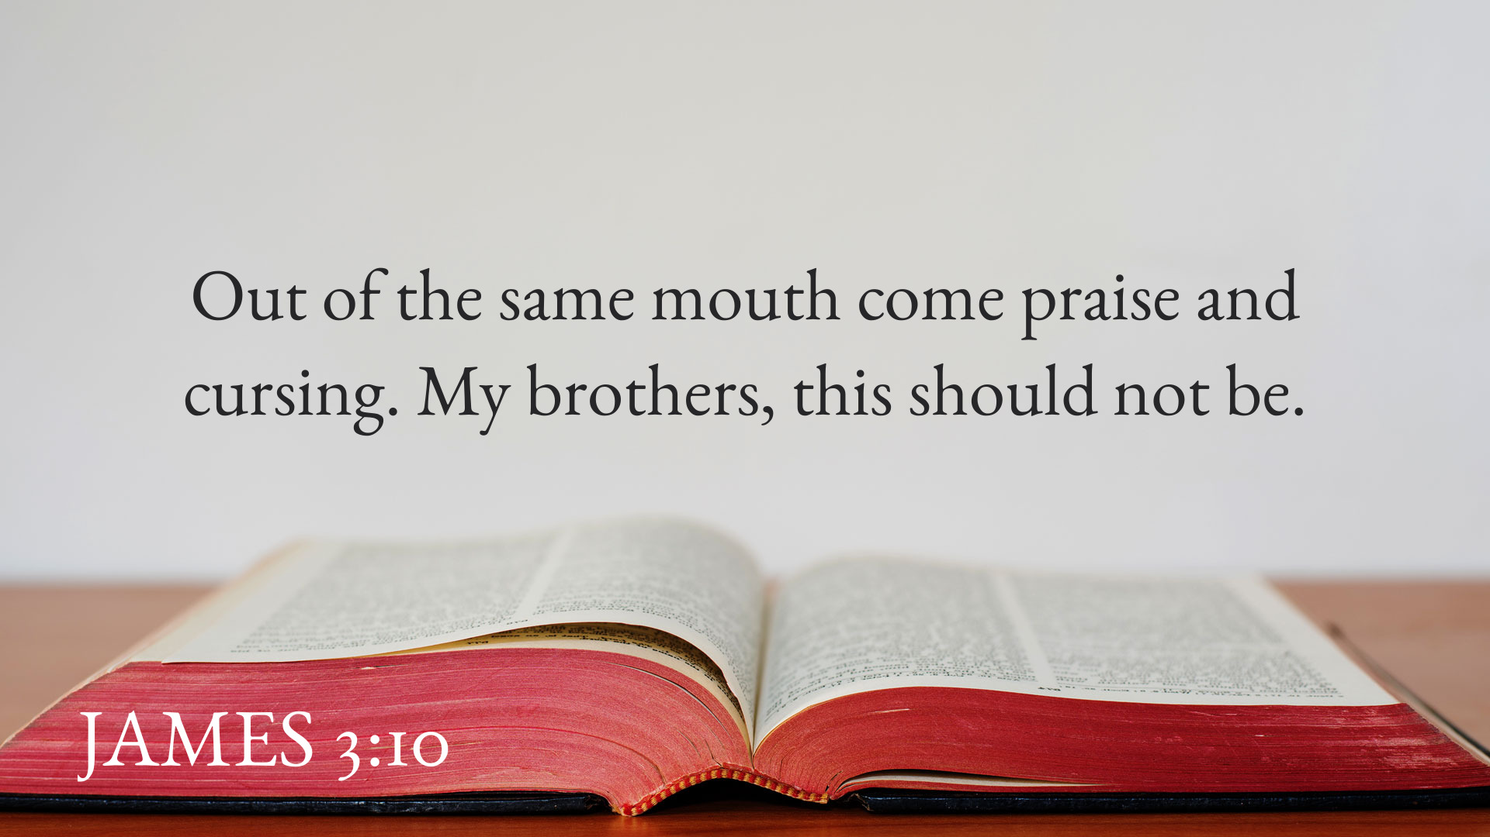

Slide 12
Blessing (praise)
Εὐλογία (You-loge-e-ah)
The act of speaking favorably, generous gift, bestowing praise upon another.

Slide 13
Curse
κατάρα (cot-tar-ah)
An appeal to some supernatural power to inflict injury or destruction on someone or some group.

Slide 14


Slide 15
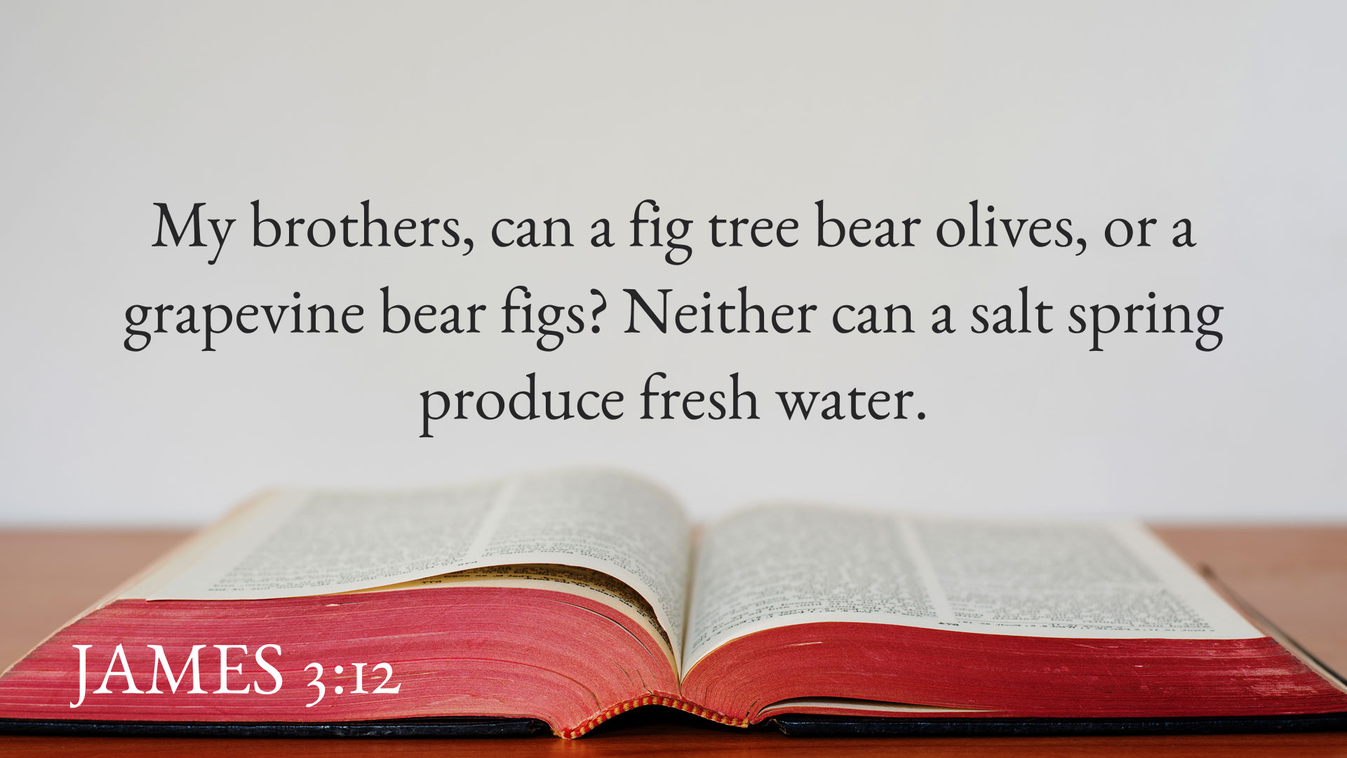

Slide 16
Hell, Fire, and the Tameless Tongue
James 3:6-12

