Slide 1
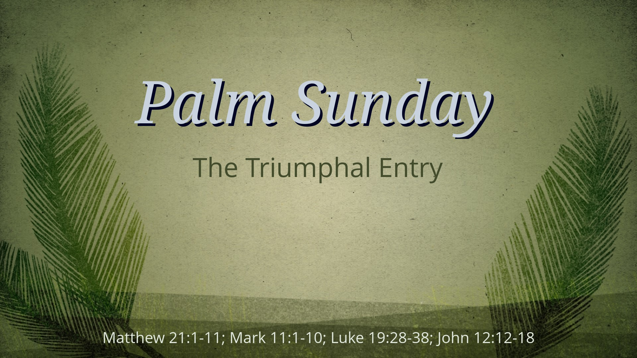

Slide 2

“The Reaction to the
Red-Carpet Ride”
Matthew 21:1-11, 15 (ESV)

Slide 3
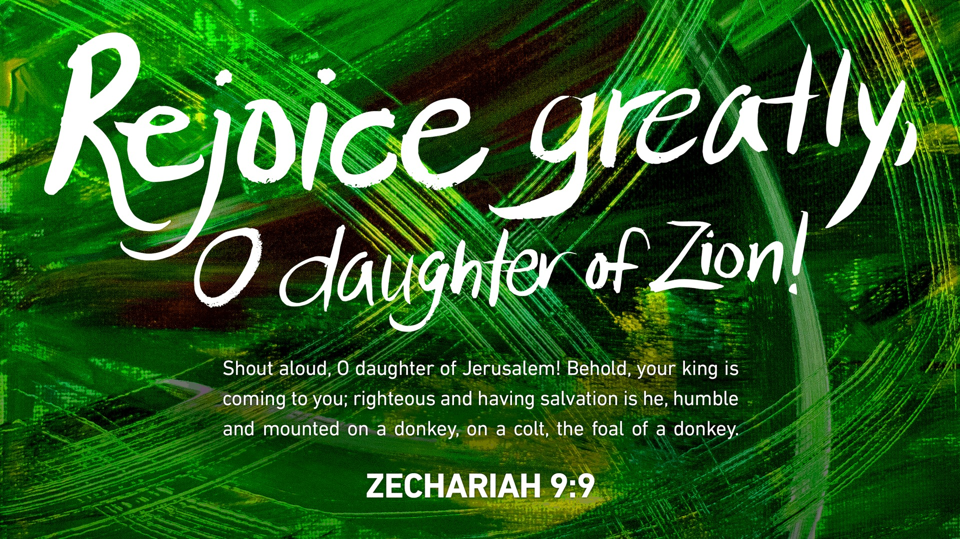

Slide 4

The King Came in Peace
The Significance of the Colt
The Sacredness of the Christ
The Similarities of the Calling

Slide 5

The King Came in PEACE
Verses 1-5

Slide 6

a.) The Significance of the Colt
1 Now when they drew near to Jerusalem and came to Bethpage, to the Mount of Olives, then Jesus sent two disciples,
2 saying to them, “Go into the village in front of you, and immediately you will find a donkey tied, and a colt with her. Untie them and bring them to Me.

Slide 7
b.) The Sacredness of the Christ
3 If anyone asks anything to you, you shall say, ‘The Lord needs them,’ and he will send them at once.”
4 This took place to fulfill what was spoken by the prophet, saying,

Slide 8
c.) The Similarities of the Calling
5 “Say to the daughter of Zion, ‘Behold, your king is coming to you, humble, and mounted on a donkey, on a colt, the foal of a beast of burden.’”

Slide 9
II. The King was Confirmed by People
The Righteous few.
The Religious flock.
The Rebellious fraud.

Slide 10
II. The King was Confirmed by PEOPLE
Verses 6-8, 15

Slide 11

a.) The RIGHTEOUS few
6 The disciples went and did as Jesus had directed them.
7 They brought the donkey and the colt and put on them their cloaks, and He sat on them.

Slide 12
b.) The RELIGIOUS flock
8 Most of the crowd spread their cloaks on the road, and others cut branches from the trees and spread them on the road.

Slide 13
c.) The REBELLIOUS fraud
15 But when the chief priests and the scribes saw the wonderful things that He did, and the children crying out in the temple, “Hosanna to the Son of David!” they were indignant.

Slide 14
III. The King was Crowned with Praise
The Shouts of the Convinced
The Stirring of the City
The Snubbing of the Crowds

Slide 15
III. The King was Crowned with PRAISE
Verses 9-11

Slide 16

a.) The Shouts of the Convinced
9 And the crowds that went before Him and that followed Him were shouting, “Hosanna to the Son of David! Blessed is he who comes in the name of the Lord! Hosanna in the highest!”

Slide 17
b.) The Stirring of the City
10 And when He entered Jerusalem, the whole city was stirred up, saying, “Who is this?”

Slide 18
c.) The Snubbing of the Crowds
11 And the crowds said,
“This is the prophet Jesus,
from Nazareth of Galilee.”

Slide 20
