Slide 1
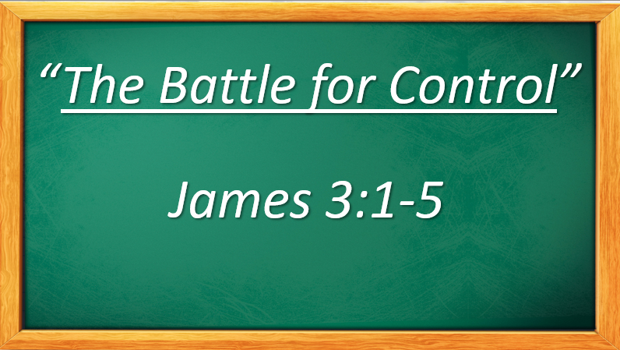

Slide 2
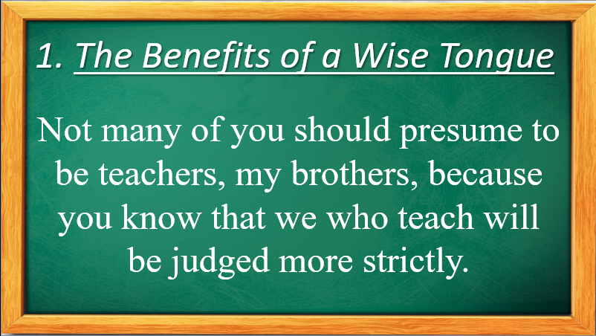

Slide 3


Slide 4
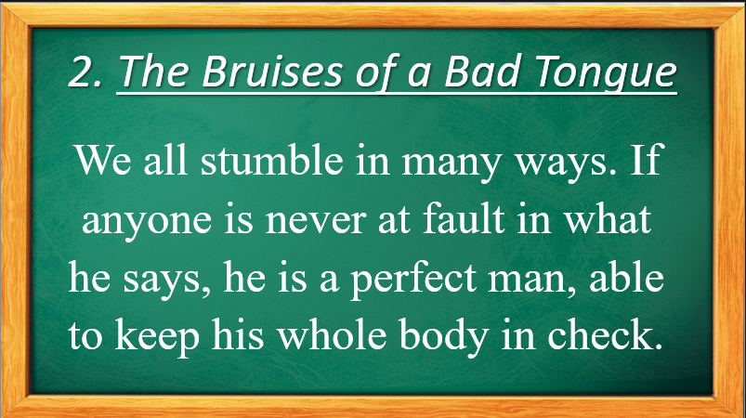

Slide 5
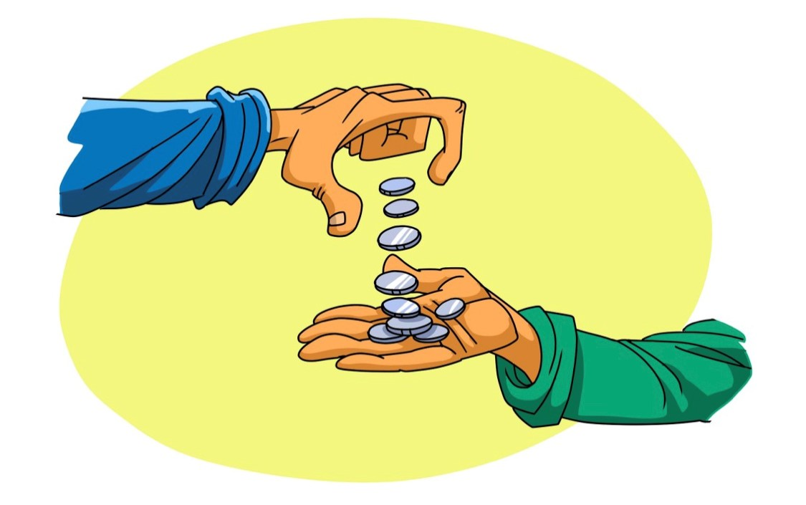
It’s the little things in life that make a big difference.

Slide 6
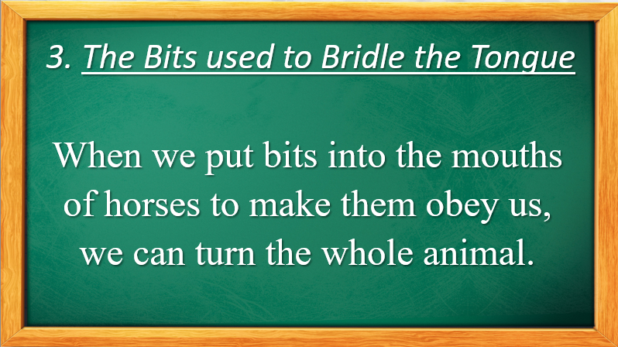

Slide 7
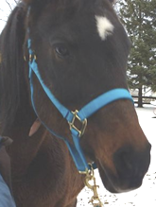
Neigh, you should think before you speak.

Slide 8
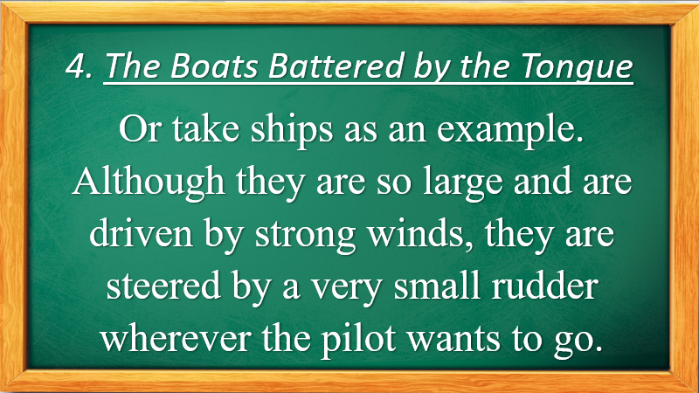

Slide 9
The Barrage of Bullying
Like the many gallons of water in the sea, words piled on can have a negative or a positive impact.

Slide 10
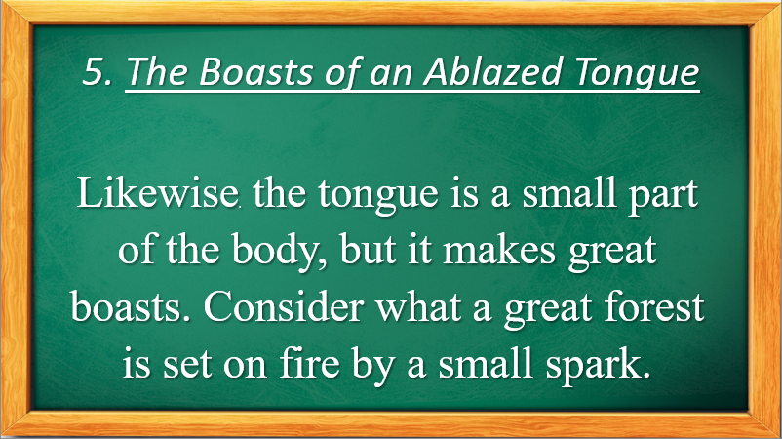

Slide 11


Slide 12
