Slide 1
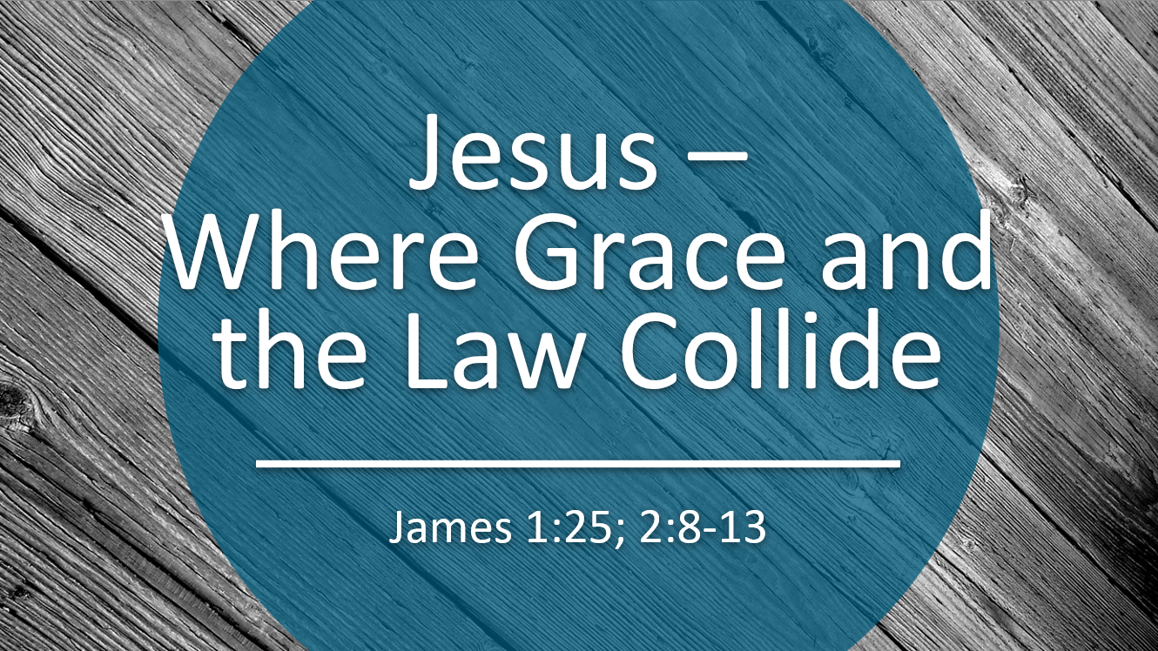

Slide 2
OT Law and NT Grace
Compare
Coincide
Collide
Compliment
Contradict
?
James uses the singular for “law” (νομος), either to summarize the one law given by Jesus or the one group of laws found in the Torah.

Slide 3

James 1:25 and 2:12

Slide 4
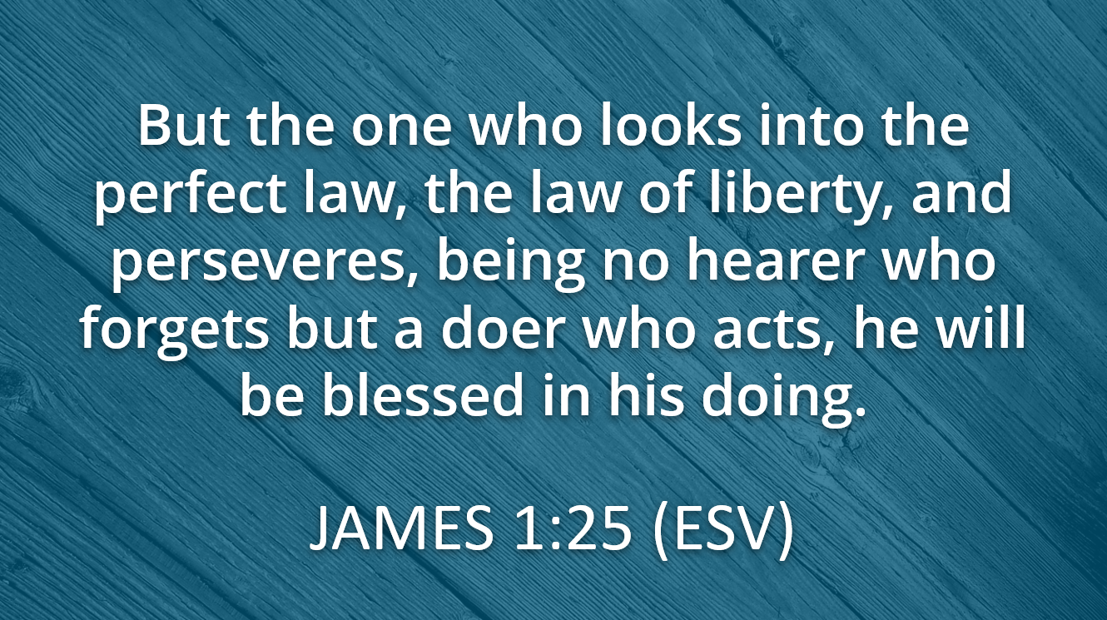

Slide 5
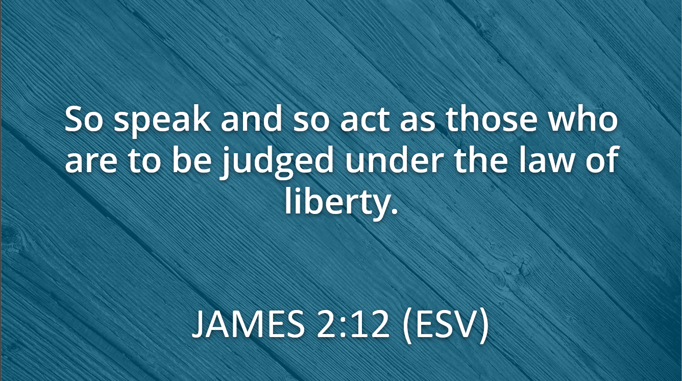

Slide 6
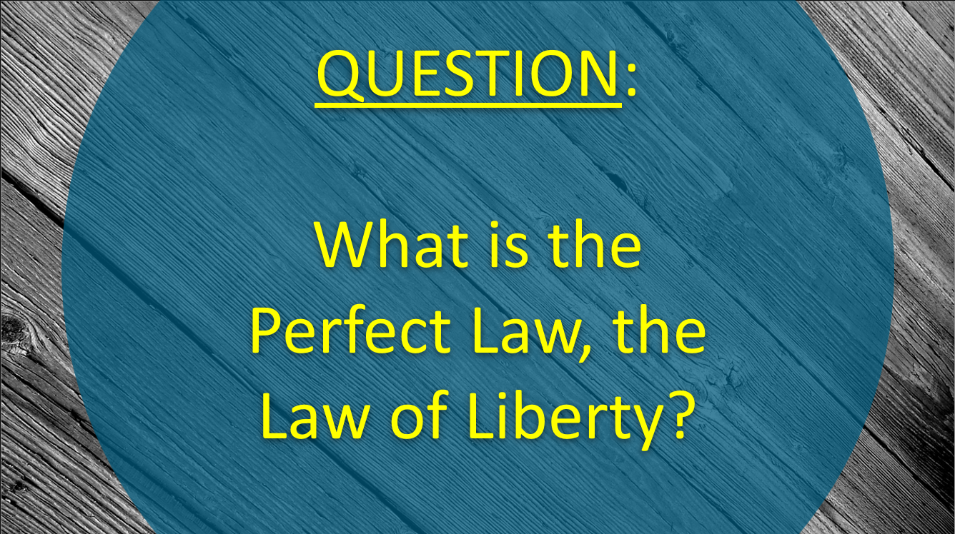

Slide 7
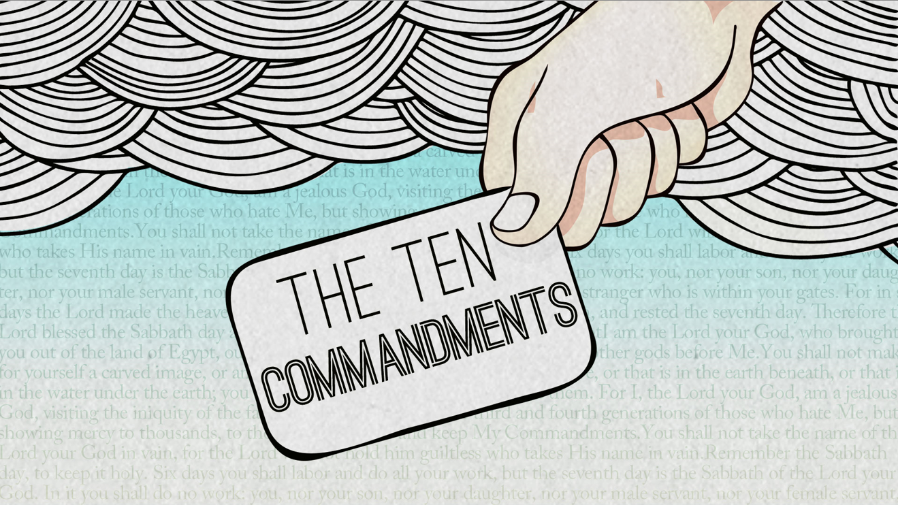
Torah – Pentateuch Levitical Laws
Ceremonial Laws Civic Laws
Pharisitical Mandates Dietary Restrictions
Circumcision Requirements Sacrificial System

Slide 8
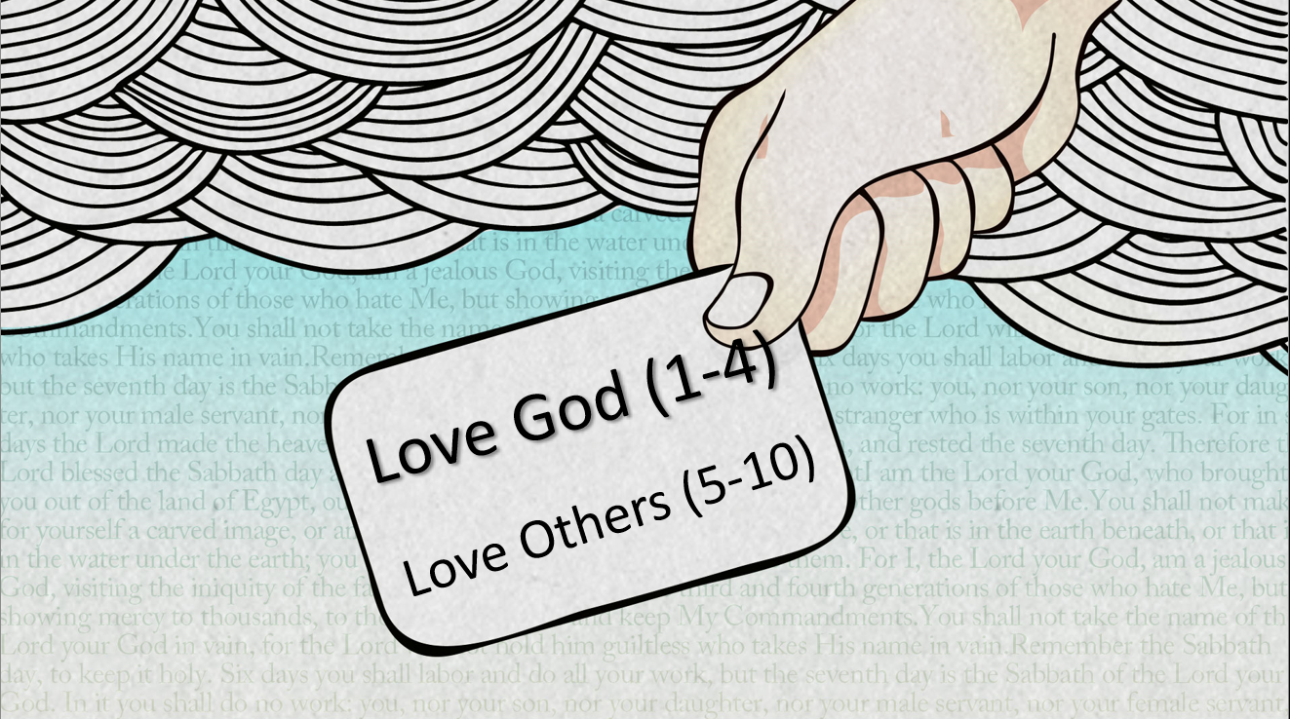
James in context…
Favoritism – Partiality
Matt. 22:34-40

Slide 9
Not only does

Slide 10

James 2:8, 13

Slide 11
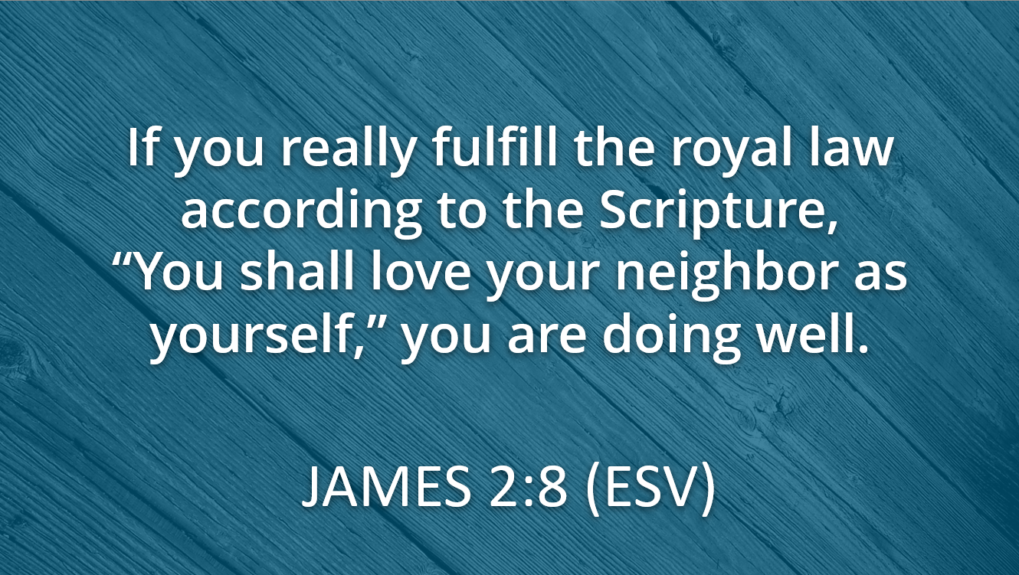

Slide 12
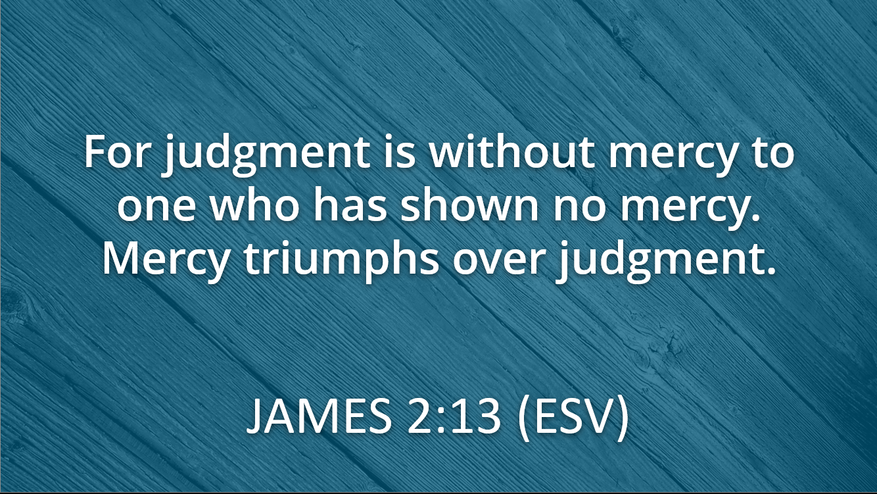

Slide 13
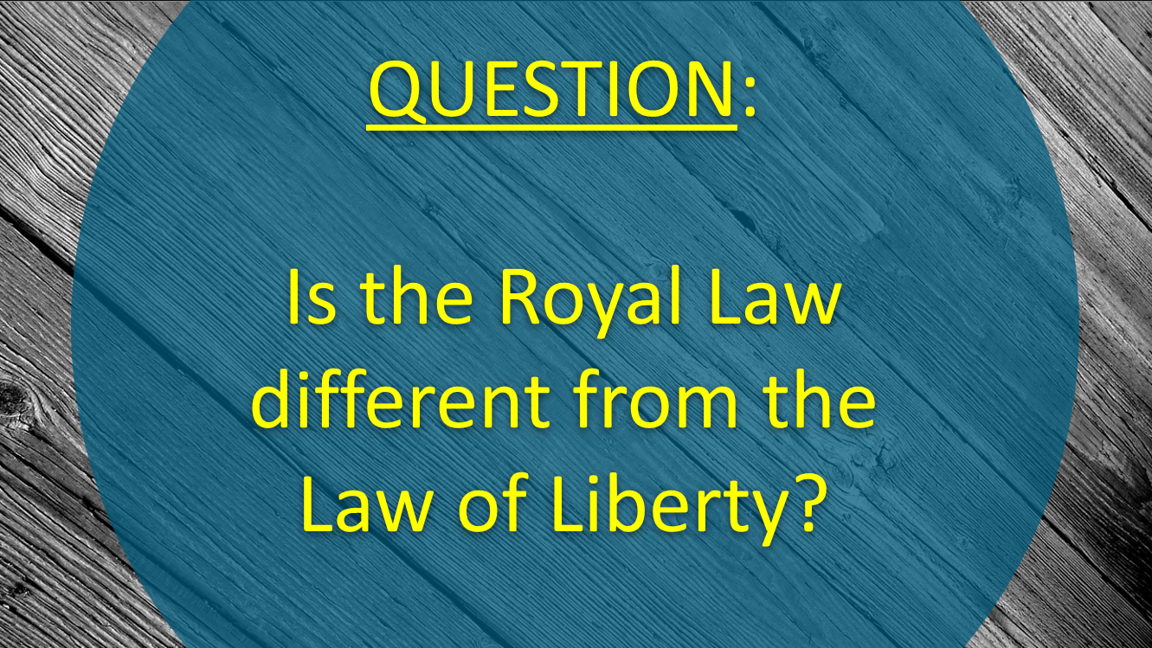

Slide 14
Not only does

Slide 15
and

Slide 16
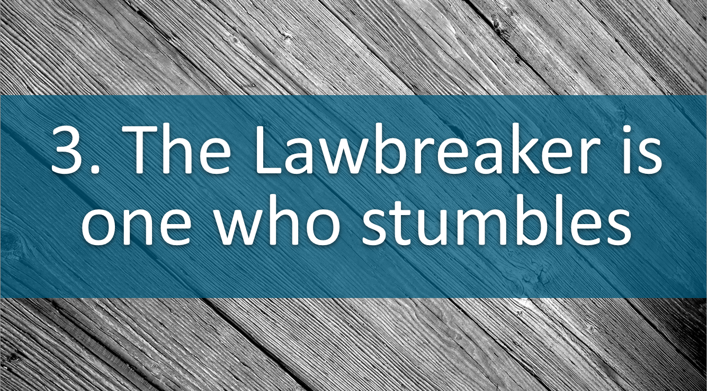
James 2:9-11

Slide 17
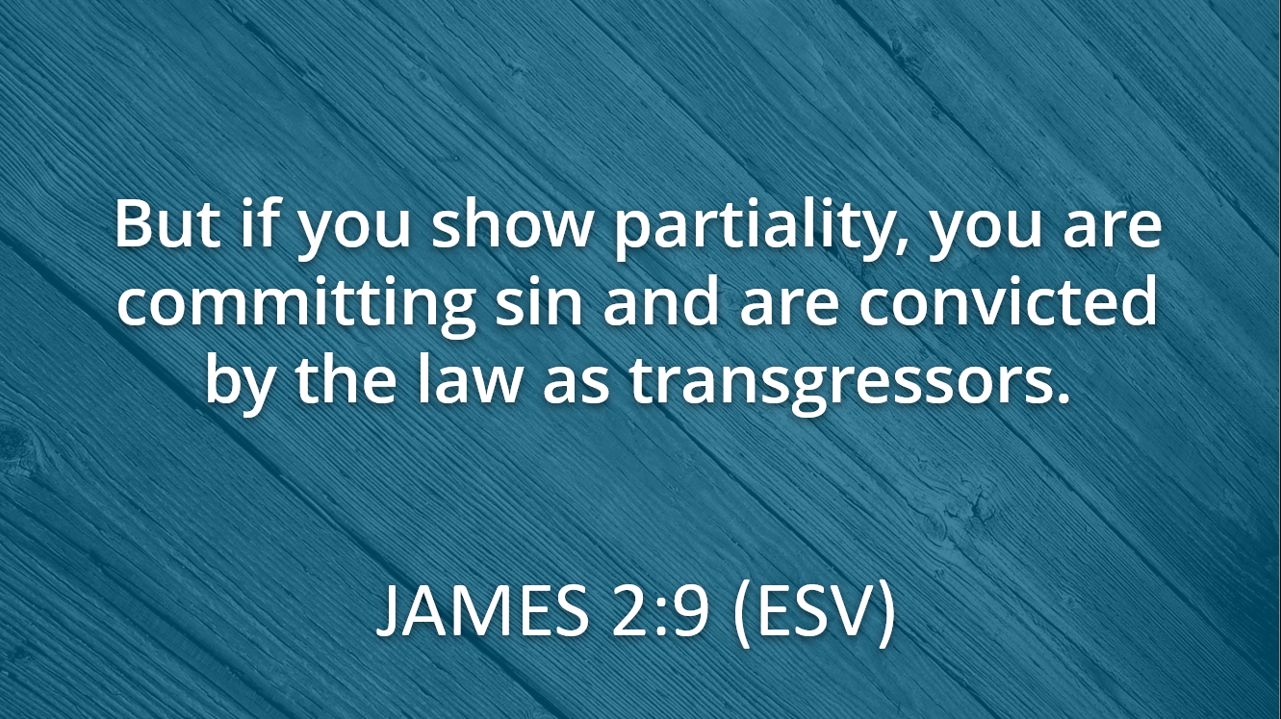

Slide 18
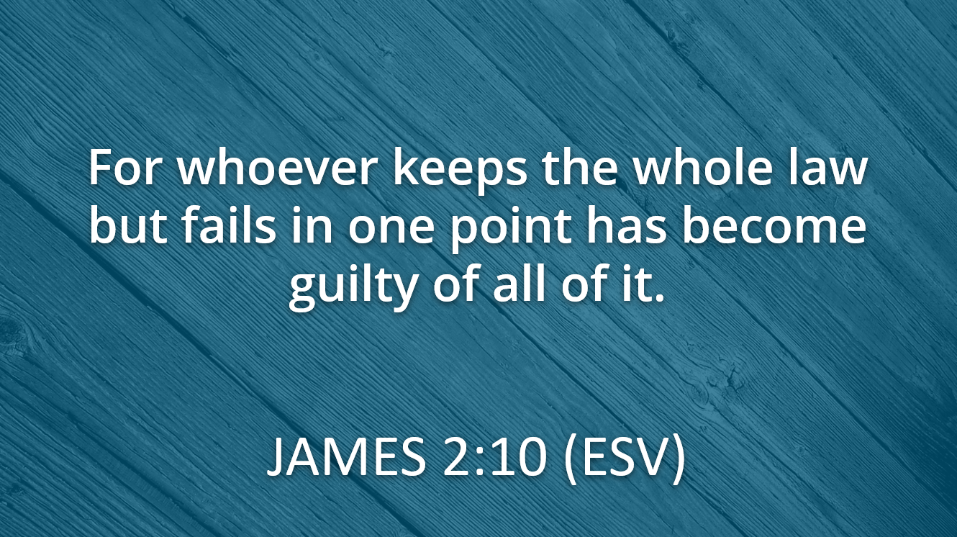

Slide 19
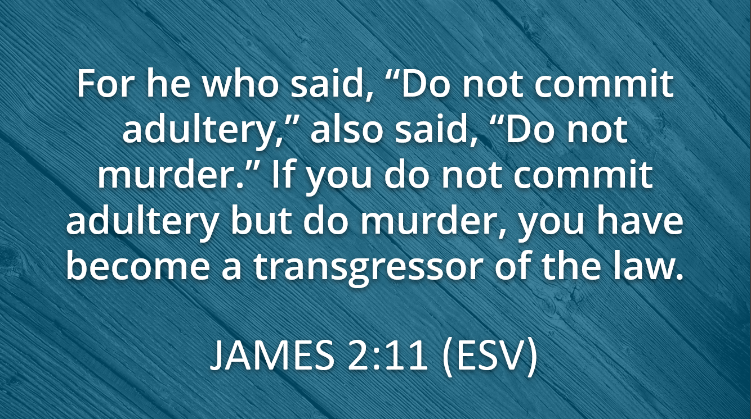

Slide 20
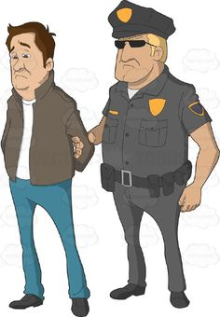
3. The Lawbreaker is One Who Stumbles
Why?
Because he is working toward his/her own righteousness.

Slide 21
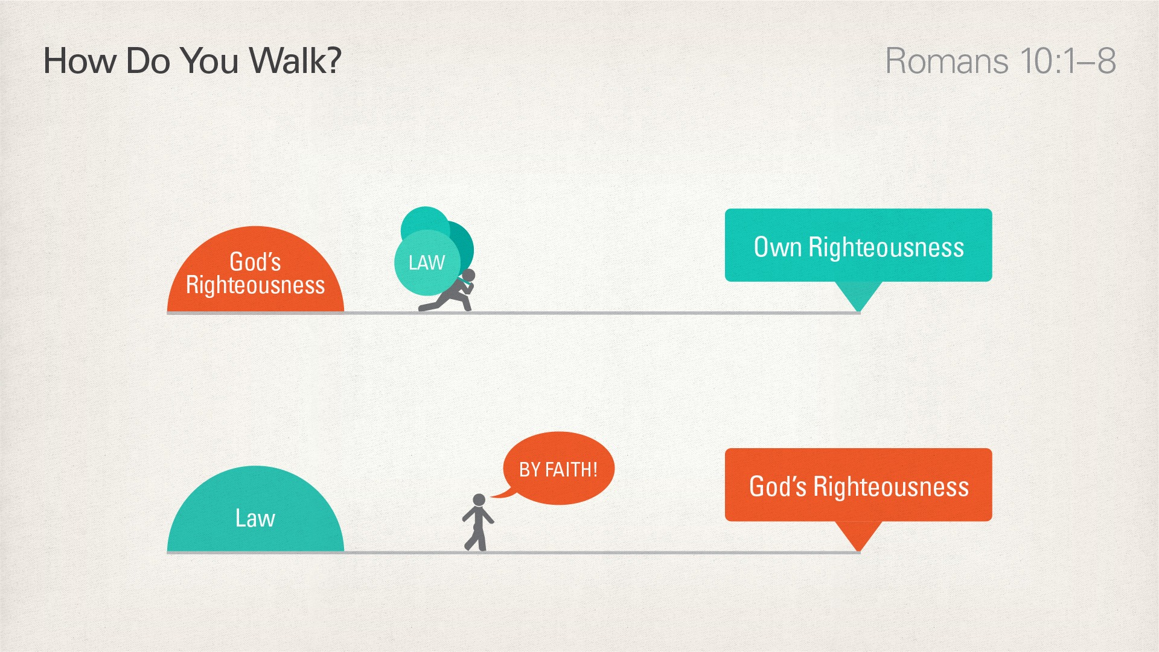

Slide 22


Slide 25
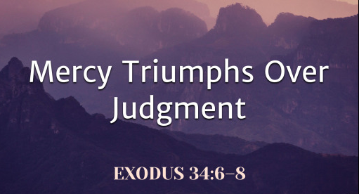

Slide 26
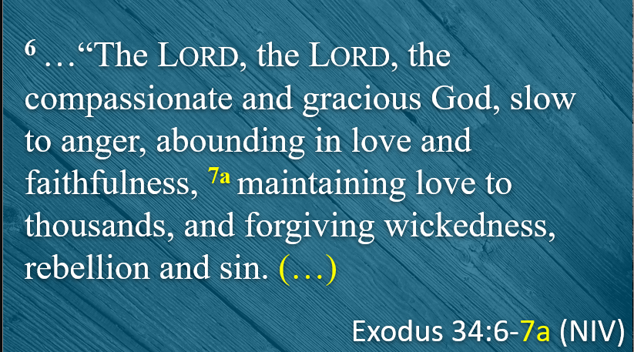

Slide 27

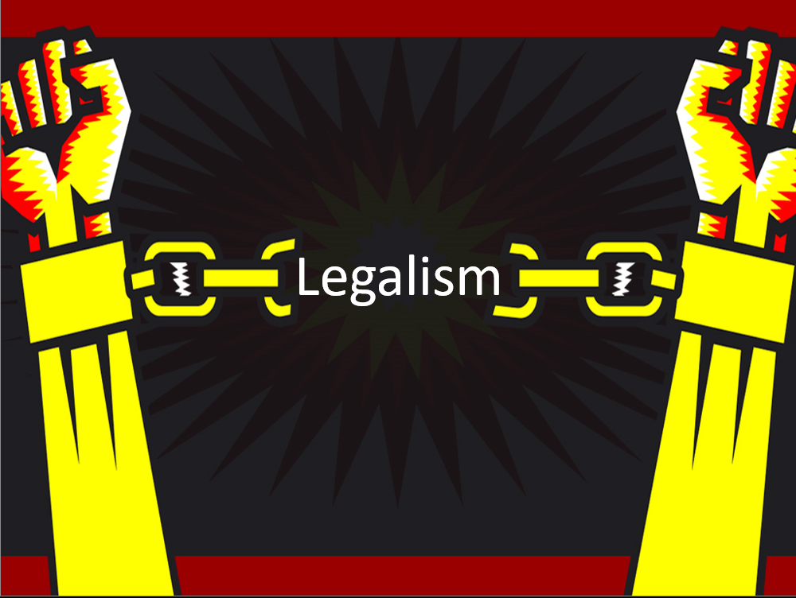
Breaking the Bondage of Legalism

