Slide 1


Slide 2

- James 2:14-26

Slide 3
1. Faith Defined
a.) Saving faith (Eph 2:8-9)

Slide 4
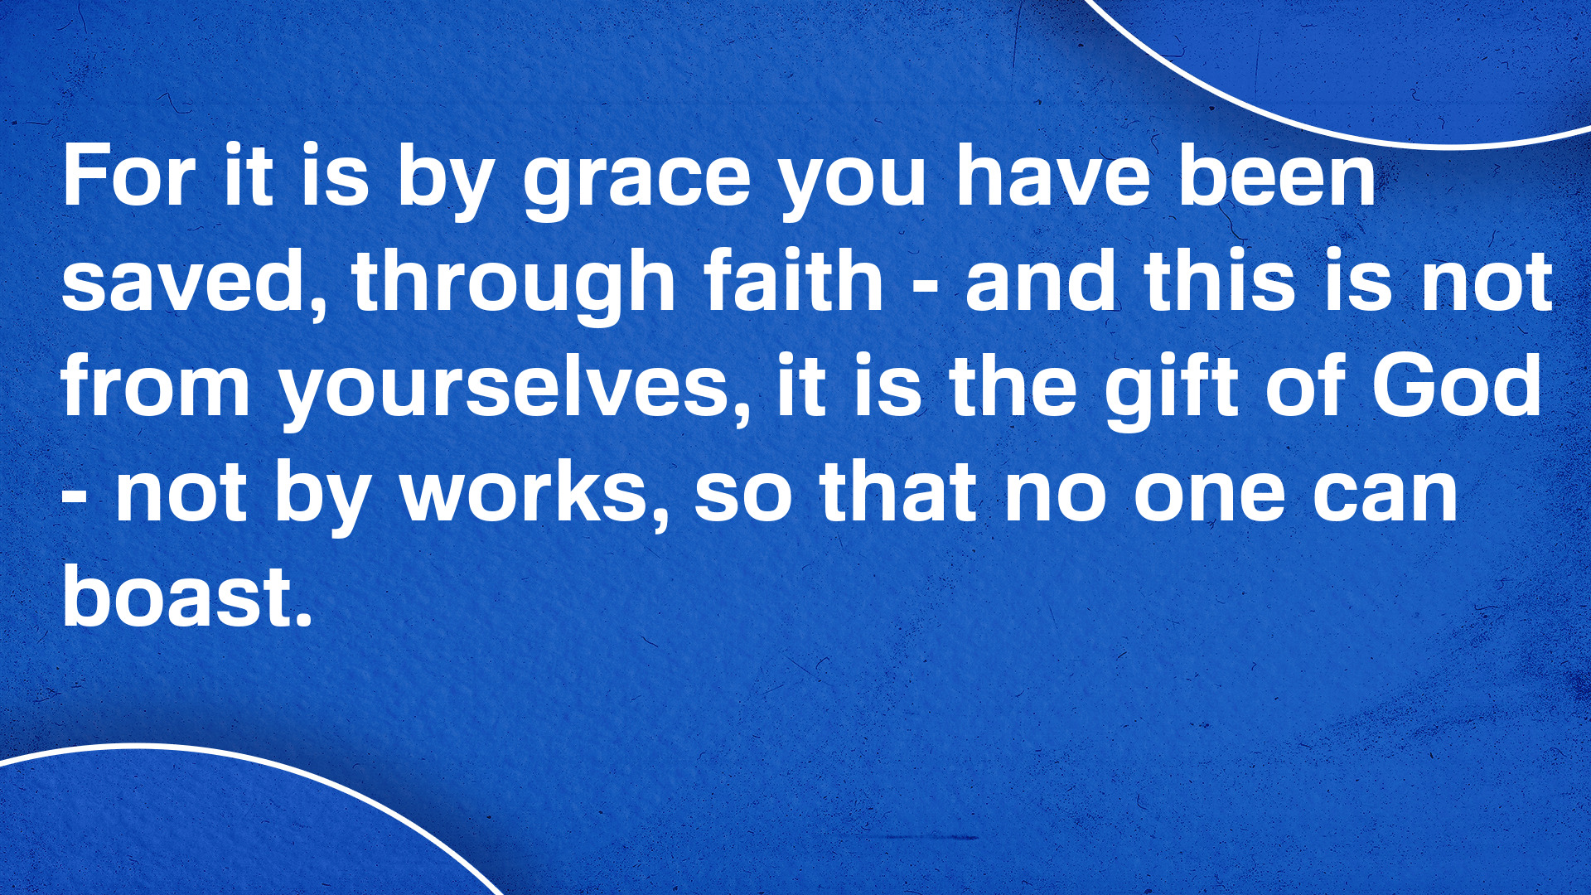
- Eph 2:8-9 (NIV)

Slide 5
1. Faith Defined
b.) Living faith (2 Cor 5:7)

Slide 6

- 2 Cor 5:7 (NIV)

Slide 7
1. Faith Defined
c.) Pleasing faith (Heb 11:6)

Slide 8
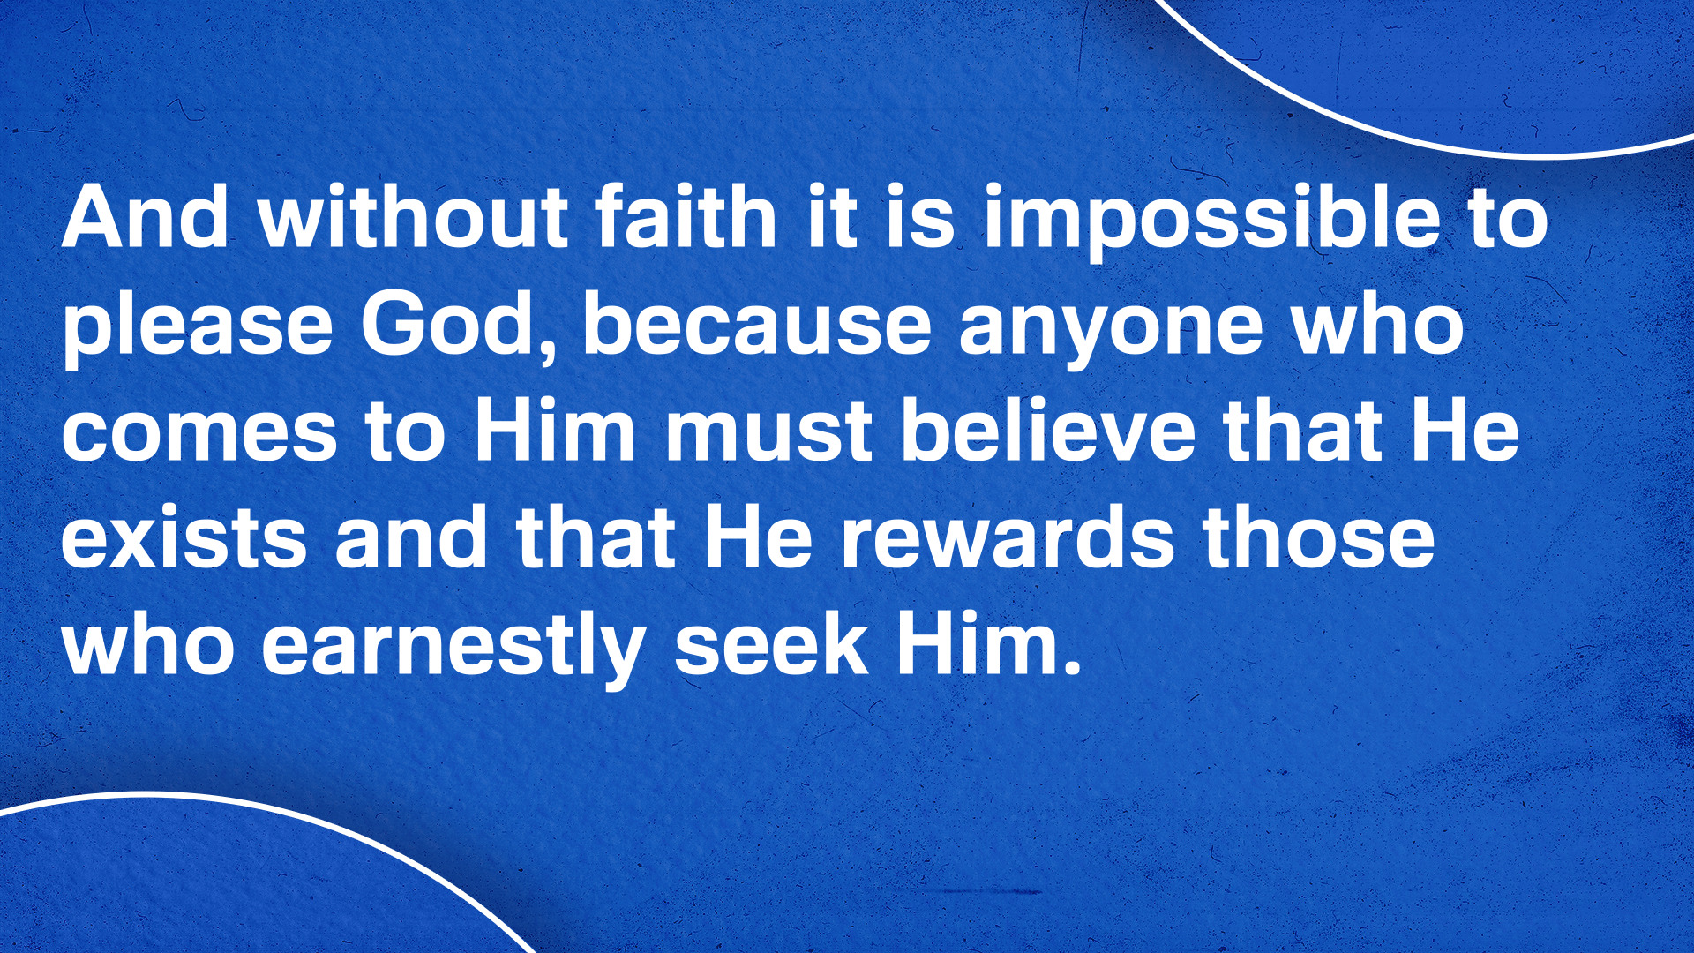
- Heb 11:6 (NIV)

Slide 9
1. Faith Defined
d.) Sinless faith (Rom 14:23b)

Slide 10
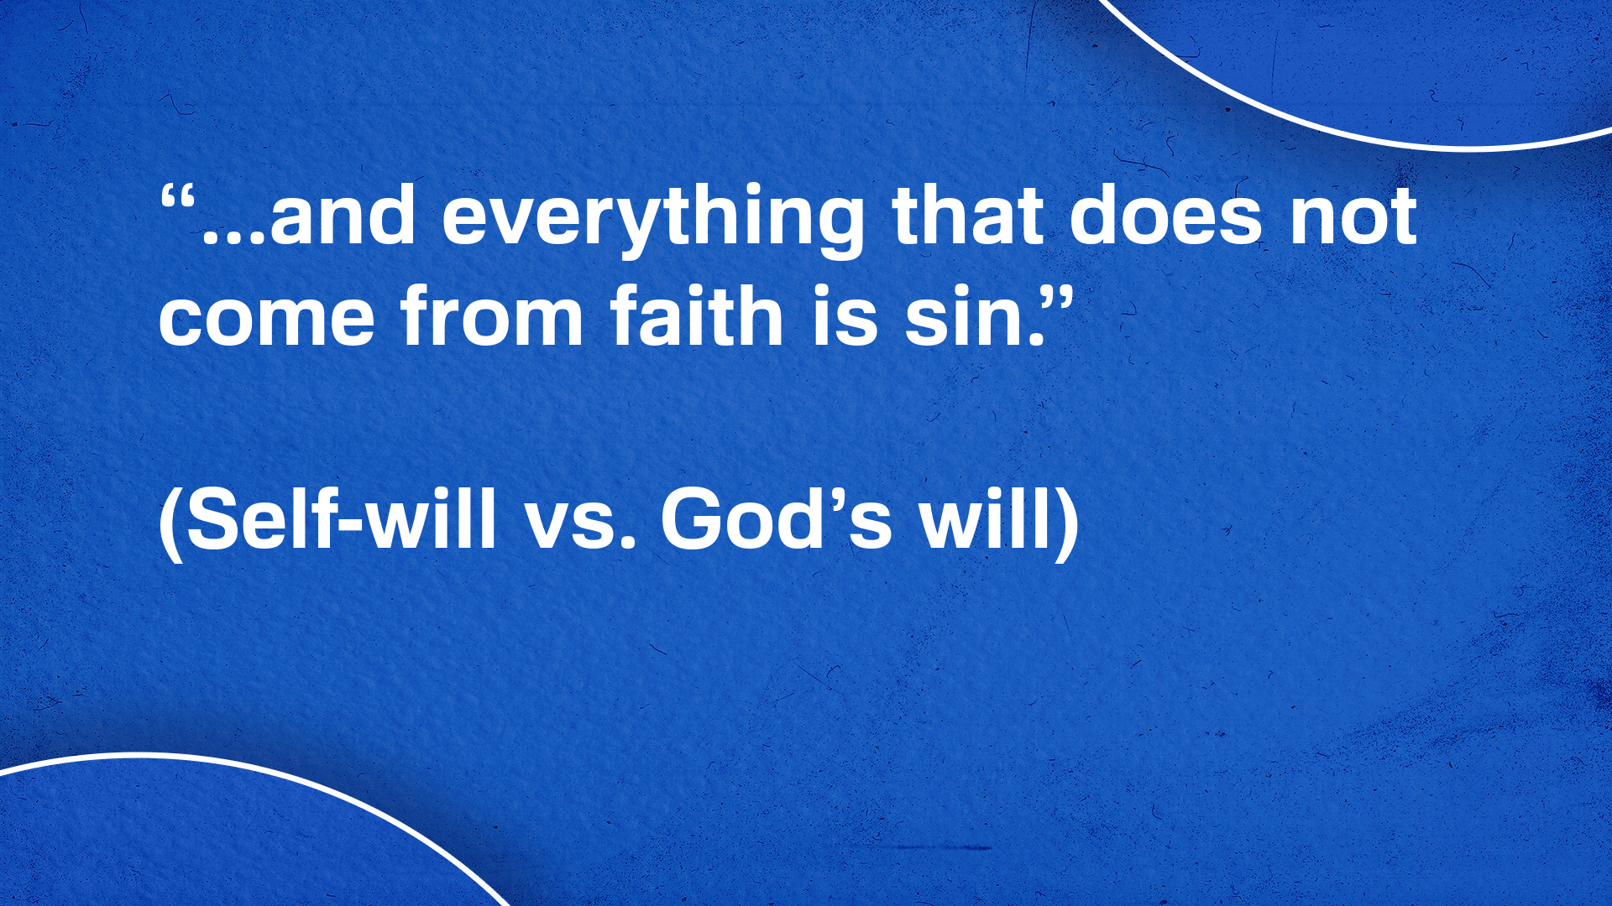
- Rom 14:23b (NIV)

Slide 11

A True, Biblical Faith…
…is saving, living, pleasing, and sinless.

Slide 12


Slide 13
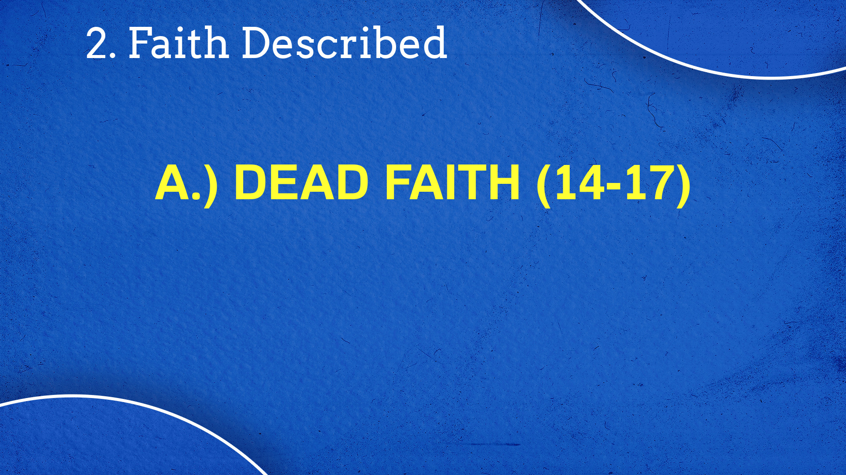

Slide 14
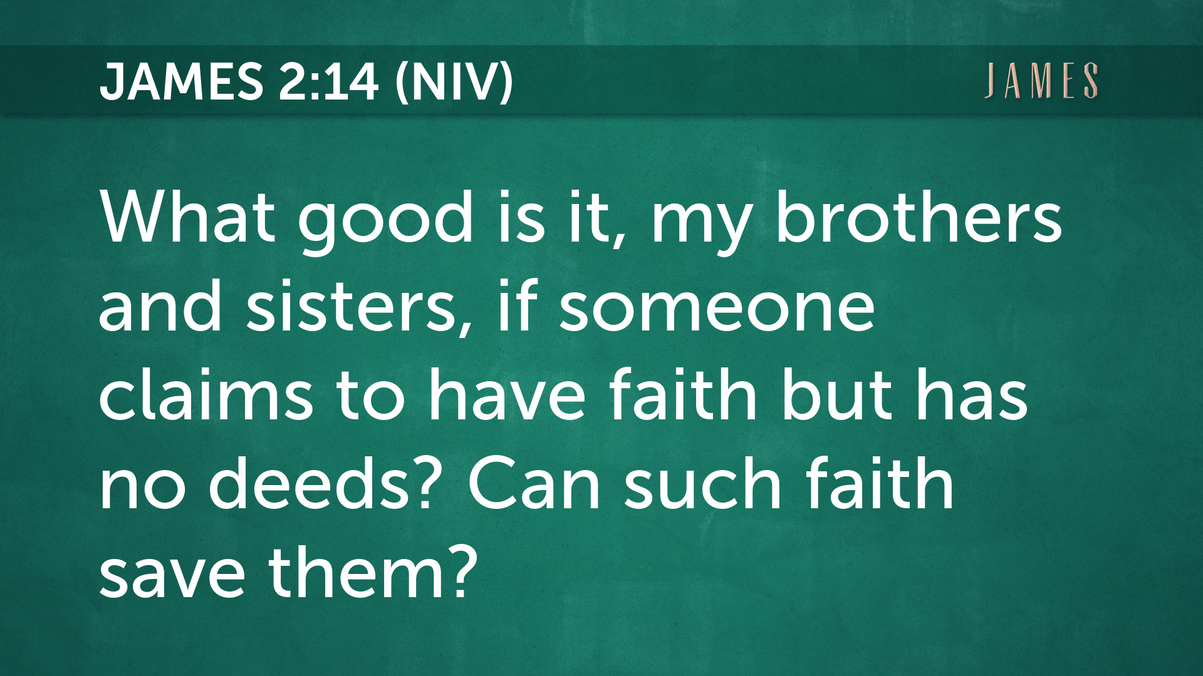

Slide 15
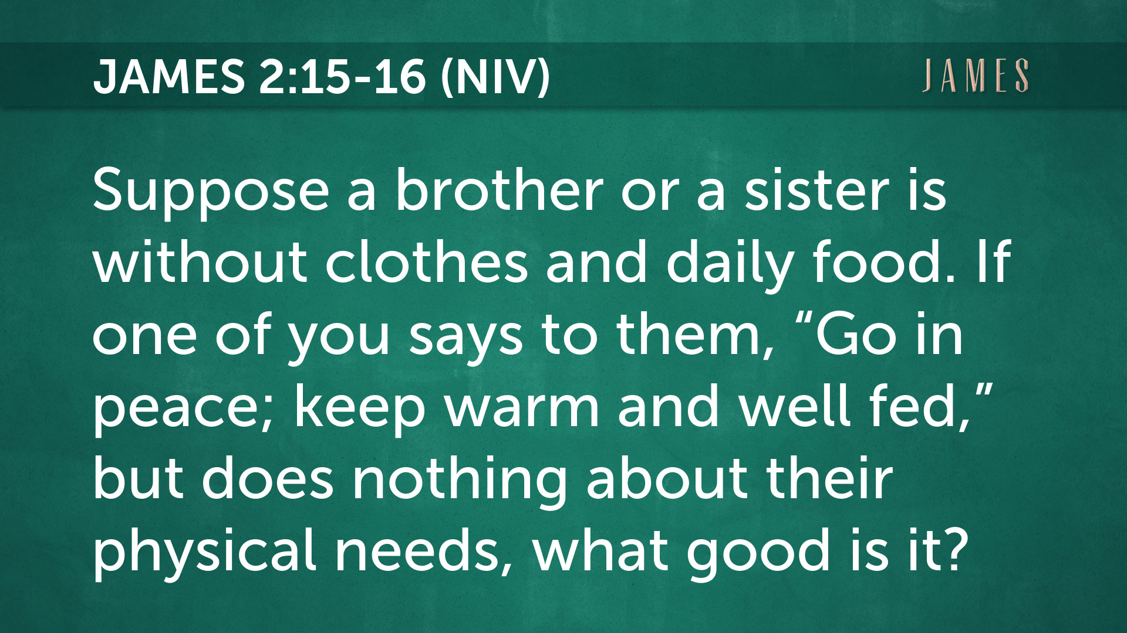

Slide 16
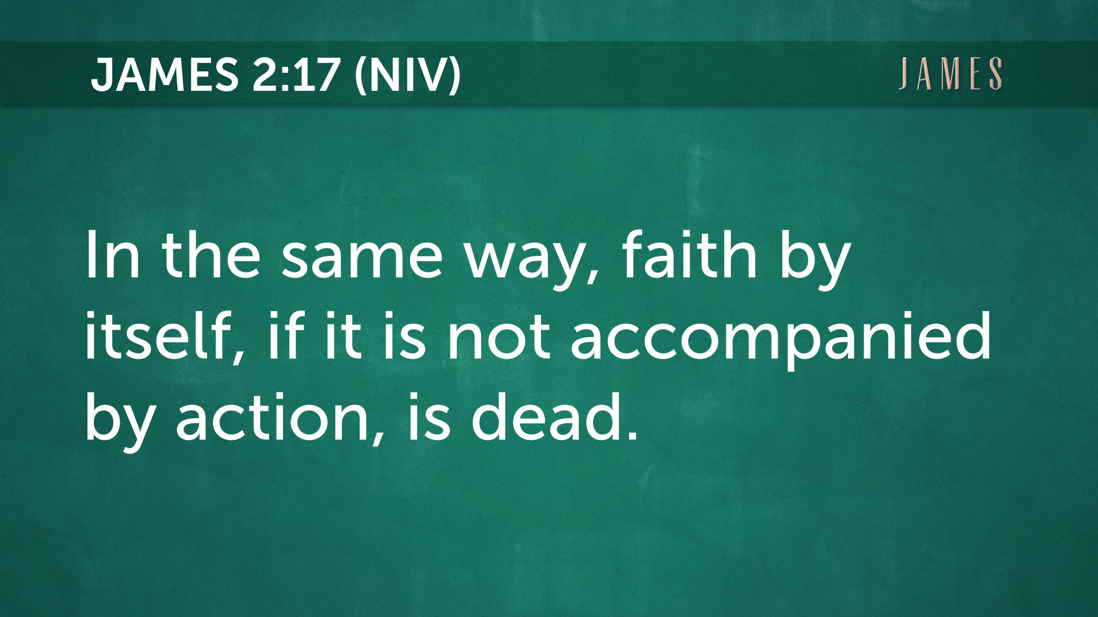

Slide 17

Romans 3:28
Romans 4:5
Galatians 3:9-11
1 John 3:17-18
No Contradictions!

Slide 18
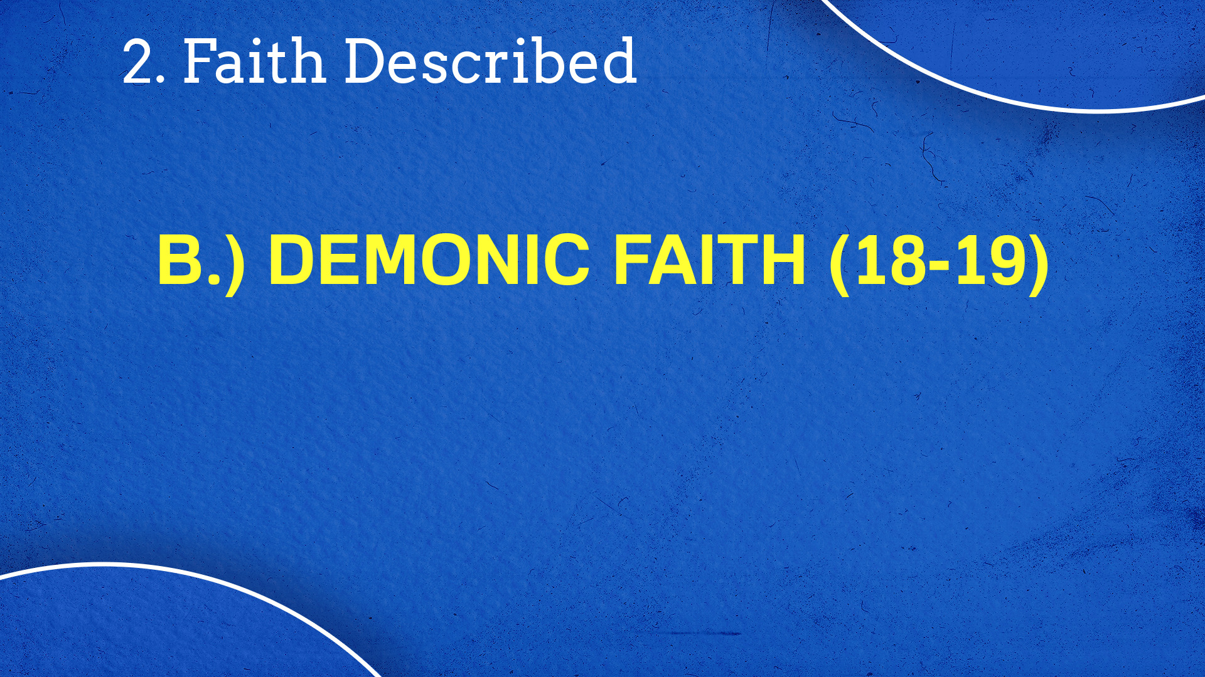

Slide 19
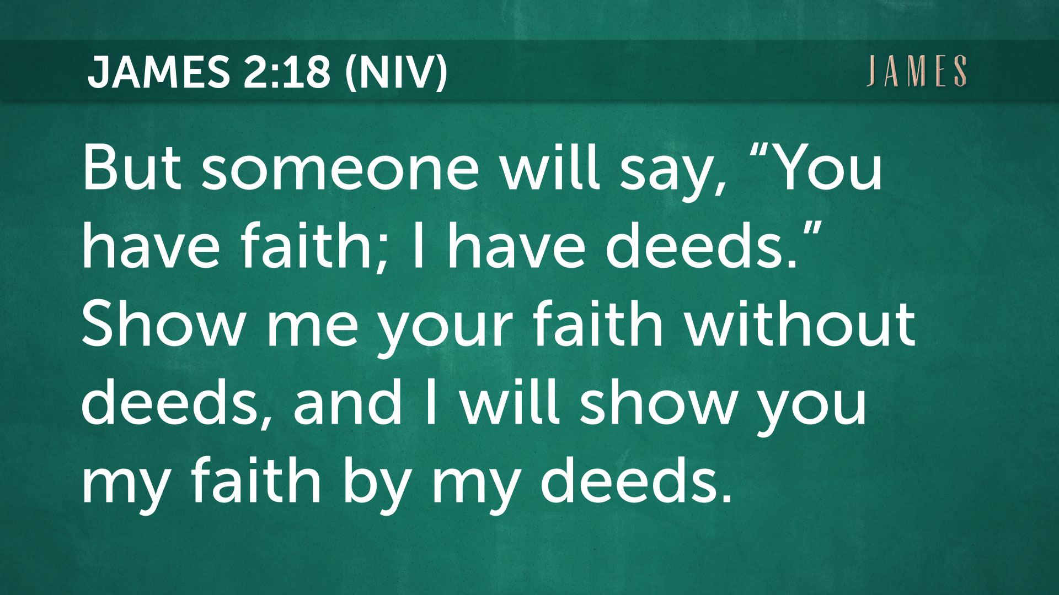

Slide 20


Slide 21
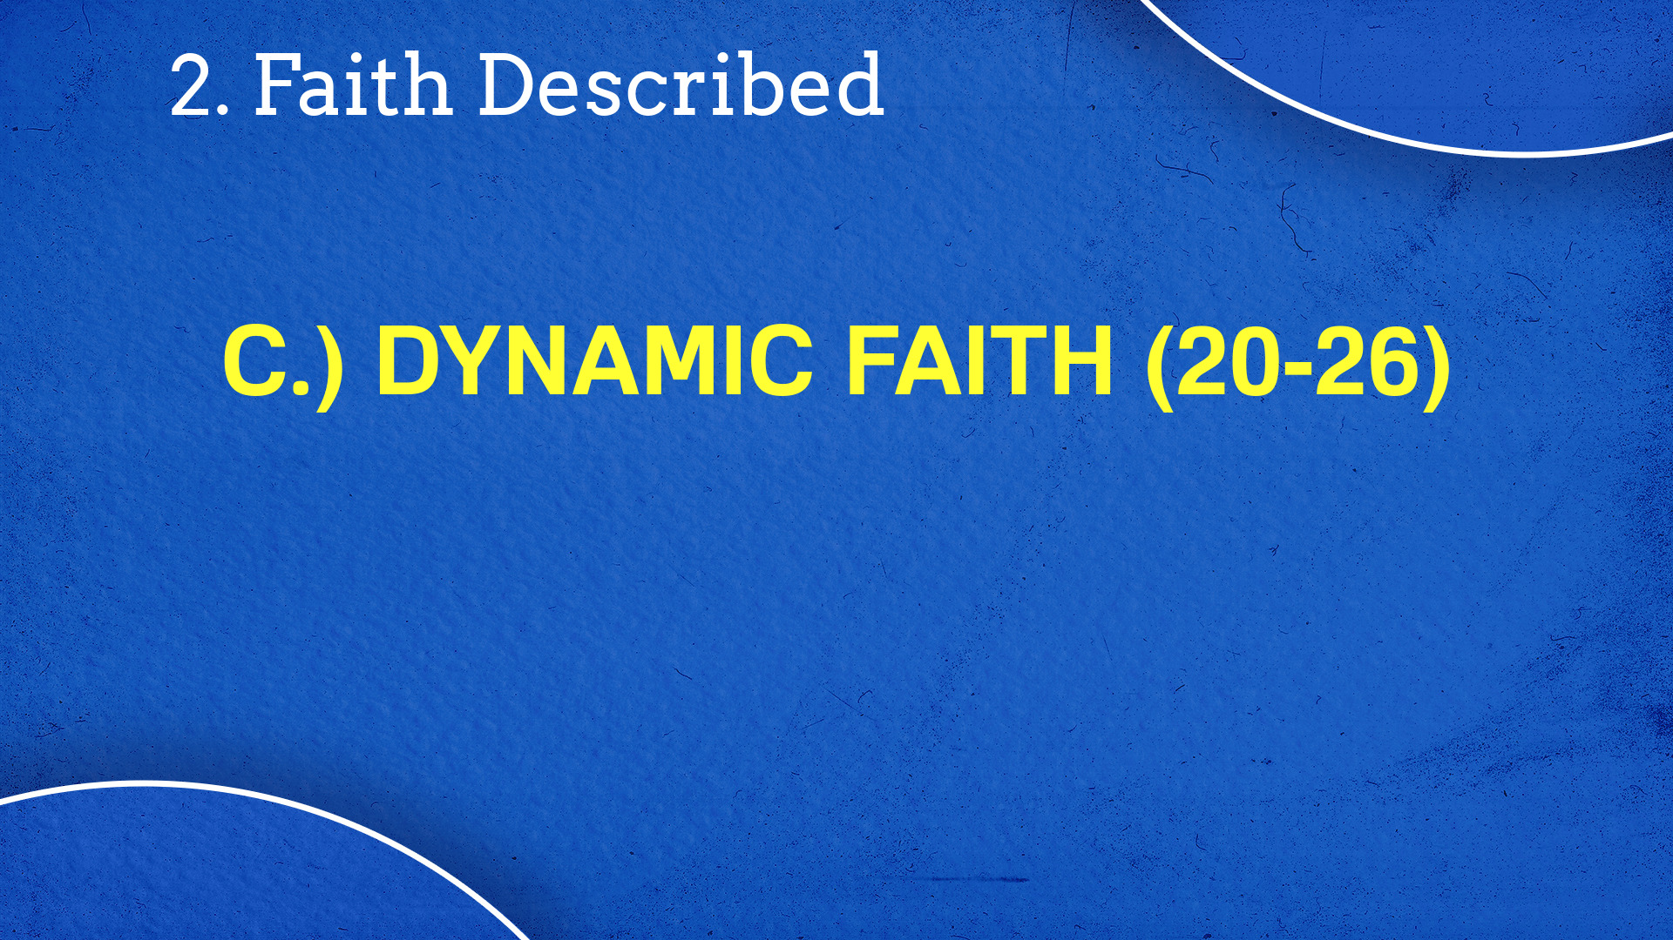

Slide 22


Slide 23
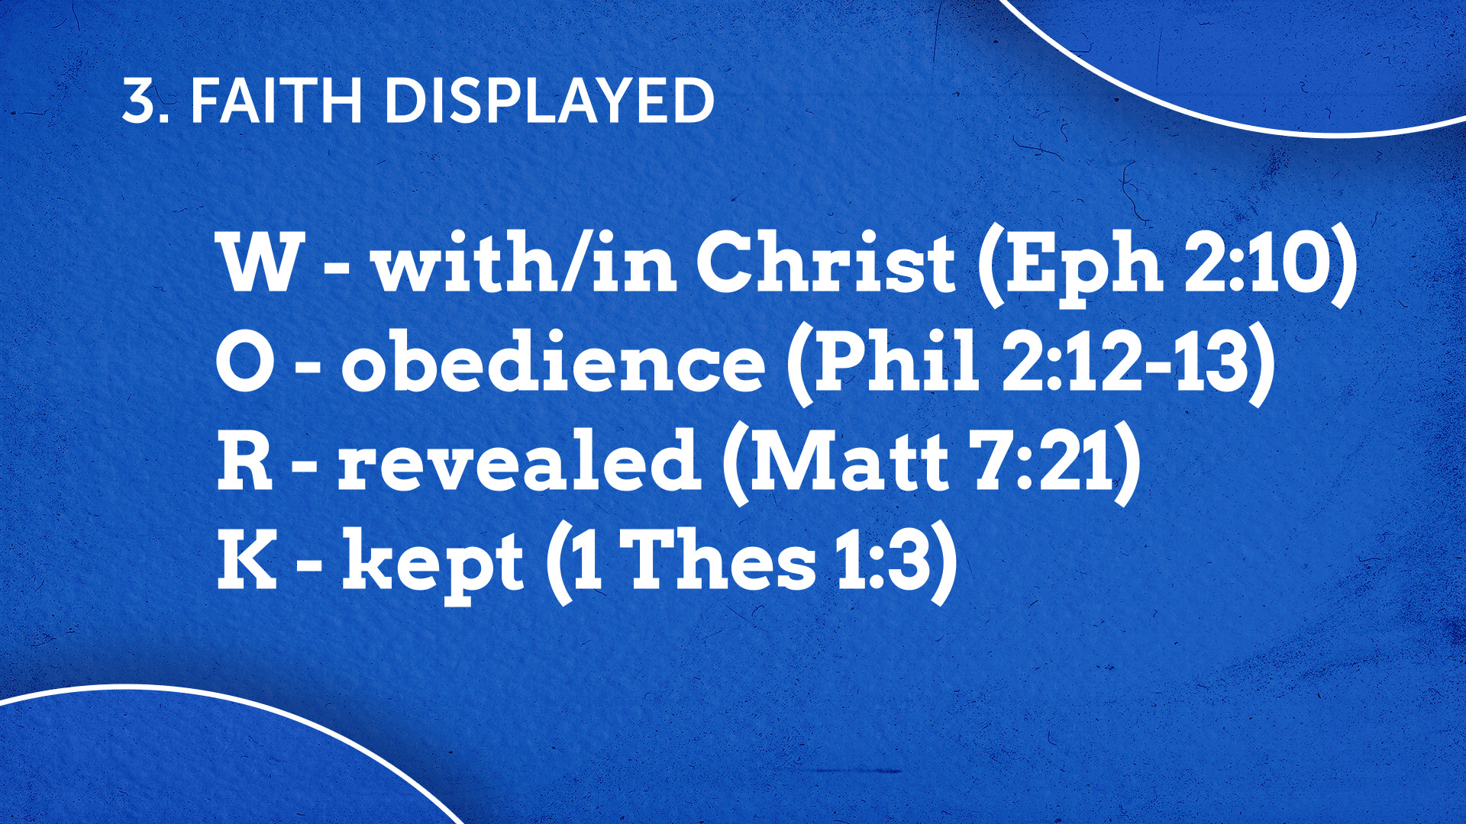

Slide 24
If faith without works is dead, what
works are we supposed to be doing?
Faith Defined
Faith Described
Faith Displayed

