Slide 1


Slide 2

The “ABCs”
of
Easter
Their Faith was Tested,
and they were
Transformed by
the Truth!

Slide 3

What do The Boston Tea Party and Uruguay have to do with Easter?

Slide 4
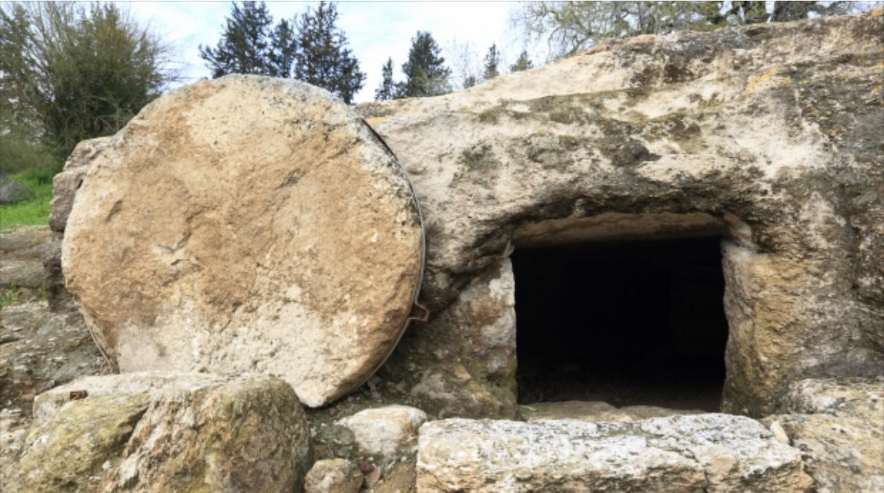
The Easter Narrative is a Descriptive Text
T – Tell the story
E – Explain the meaning
A – Apply the truth

Slide 5
Jesus was: Accused Beaten Crucified
The ABCs of Easter

Slide 6
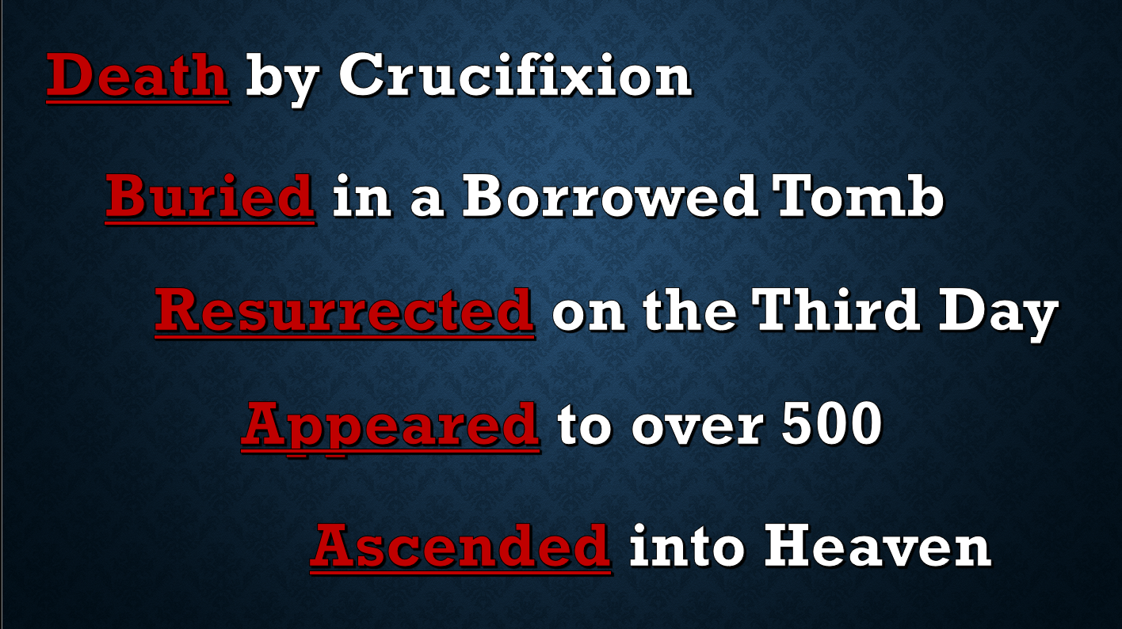

Slide 7
Death and Burial
Matthew 27:45-56
Mark 15:21-32
Luke 23:44-49
John 19:28-37
Matthew 27:57-65
Mark 15:33-47
Luke 23:50-56
John 19:38-42
D
B

Slide 8
Death by Crucifixion –Medically Speaking
Dr. C. Truman Davis, University of Tennessee College of Medicine, Physician, Pastor, and Author of a book about medicine in the Bible.
“The Crucifixion of Jesus Christ”, March 1965.

Slide 9
Resurrection and Appearances
Matthew 28:1-18
Mark 16:1-8
Luke 24:1-12
John 20:1-9
Matthew 28:9-10, 16-20
Mark 16:9-18*
Luke 24:13-49
John 20:10-25
R
A
Jesus’ appearances are also covered by Paul in 1 Corinthians 15:3-8.

Slide 10
Ascension into Heaven
Matthew
- Not Covered
Mark 16:19-20
- Disputed
Luke 24:50-53
Acts 1:1-11
John
- Not Covered

Slide 11
Q: Who Goes to Heaven? All “good” people Born Again Believers Church Attenders
The ABCs of Easter

Slide 12

“Jesus
and the
Two Thieves”
Luke 23:32-43

Slide 13

… and the offer is FREE!

