Slide 1

Welcome Everyone Equally
JAMES 2:1-7
Today’s outline is adapted from Chris A. Vlachos, Exegetical Guide to the Greek New Testament, James (Nashville, TN: B&H Academic, 2013), 76.

Slide 2
Jesus meets people where they are and calls sinners to repentance.
Jesus welcomes folks equally and does not judge based on outward appearance.

Slide 3
BE LIKE JESUS
… and walk across the room.

Slide 4
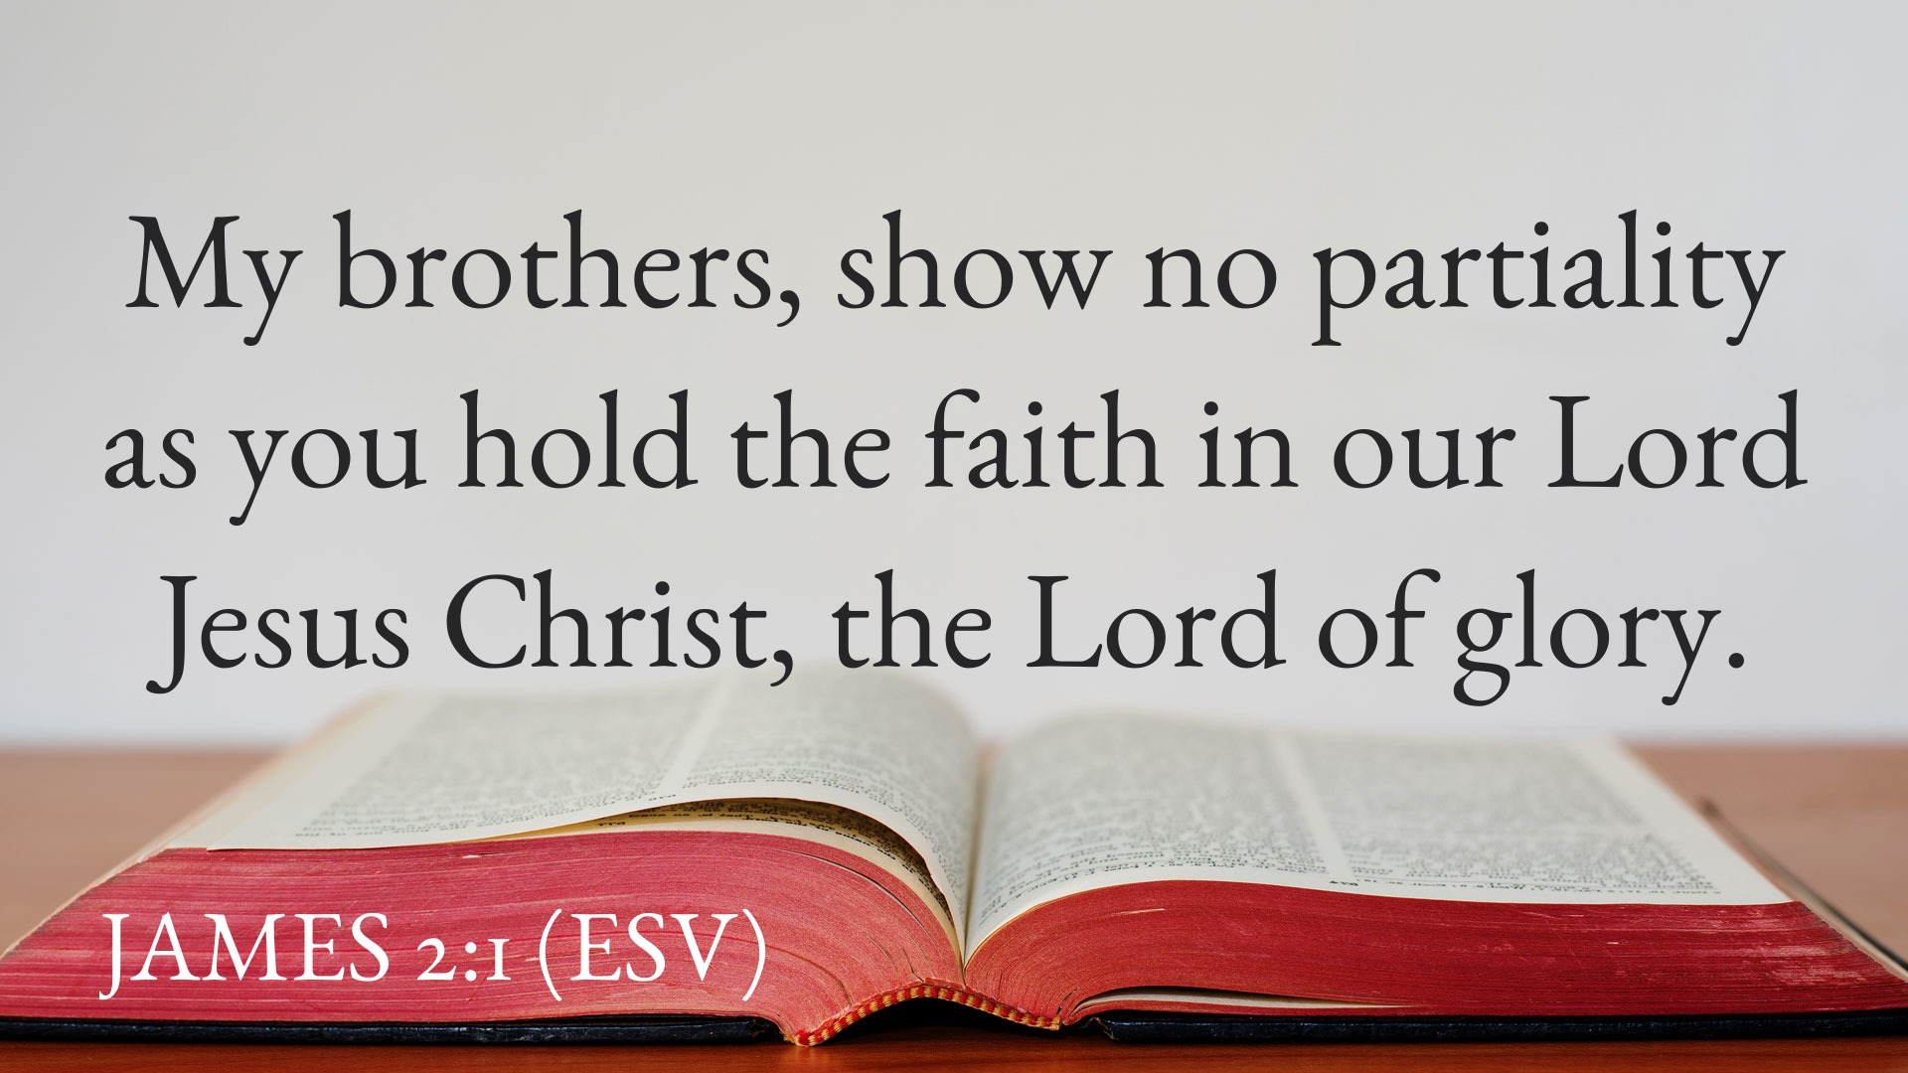

Slide 5
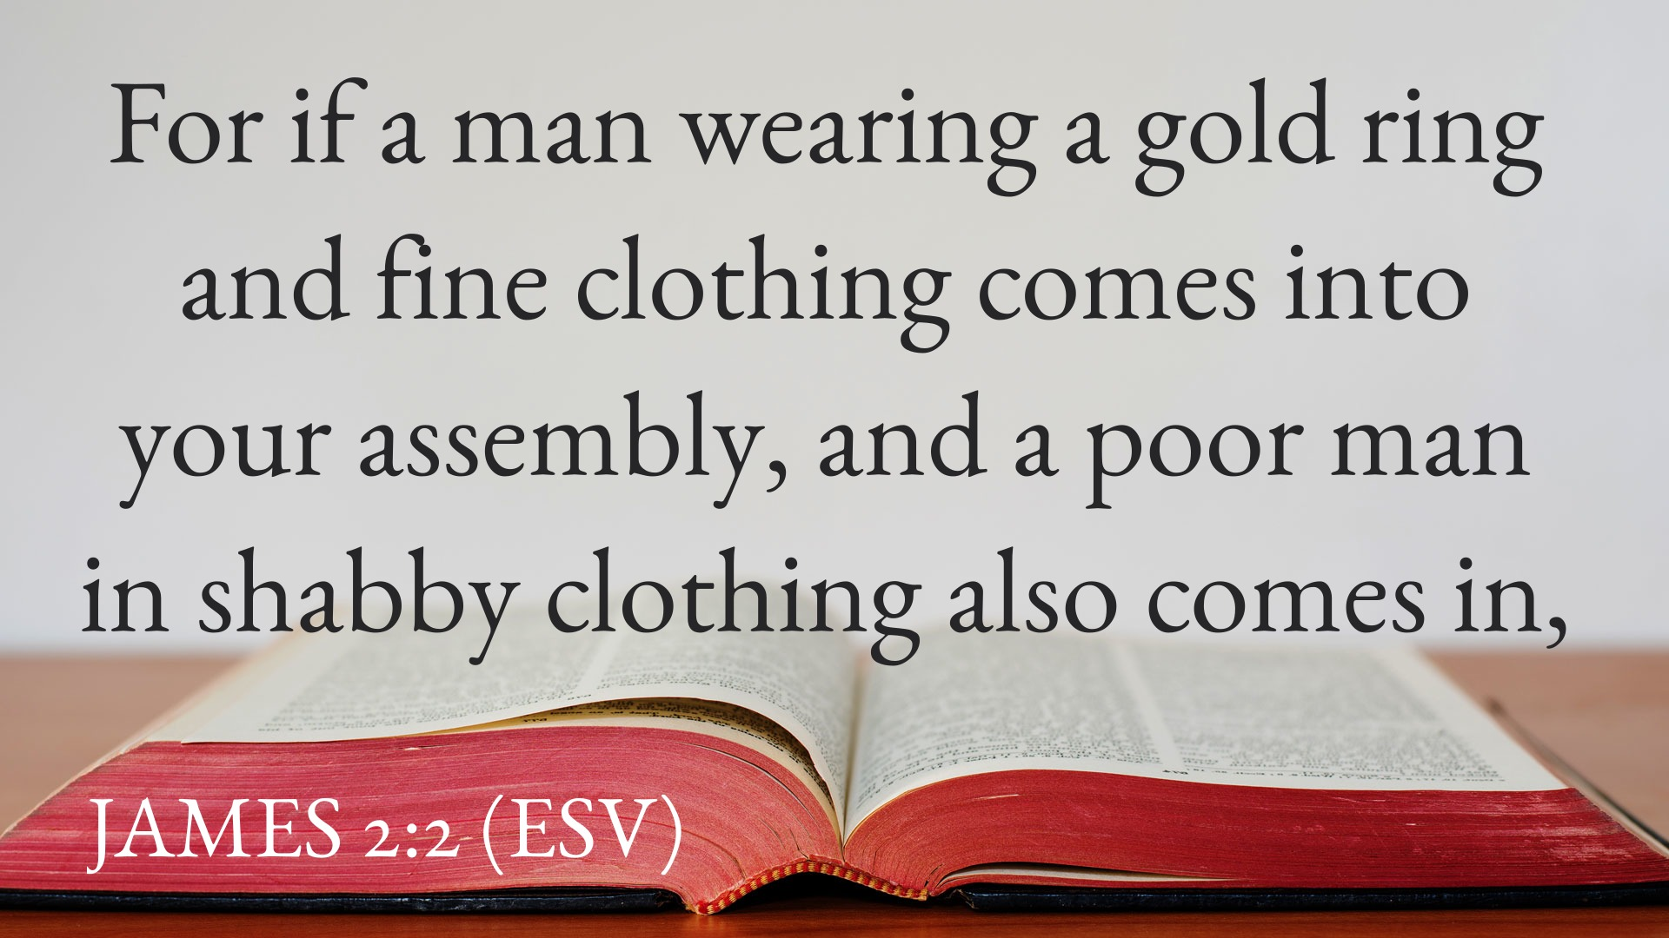

Slide 6
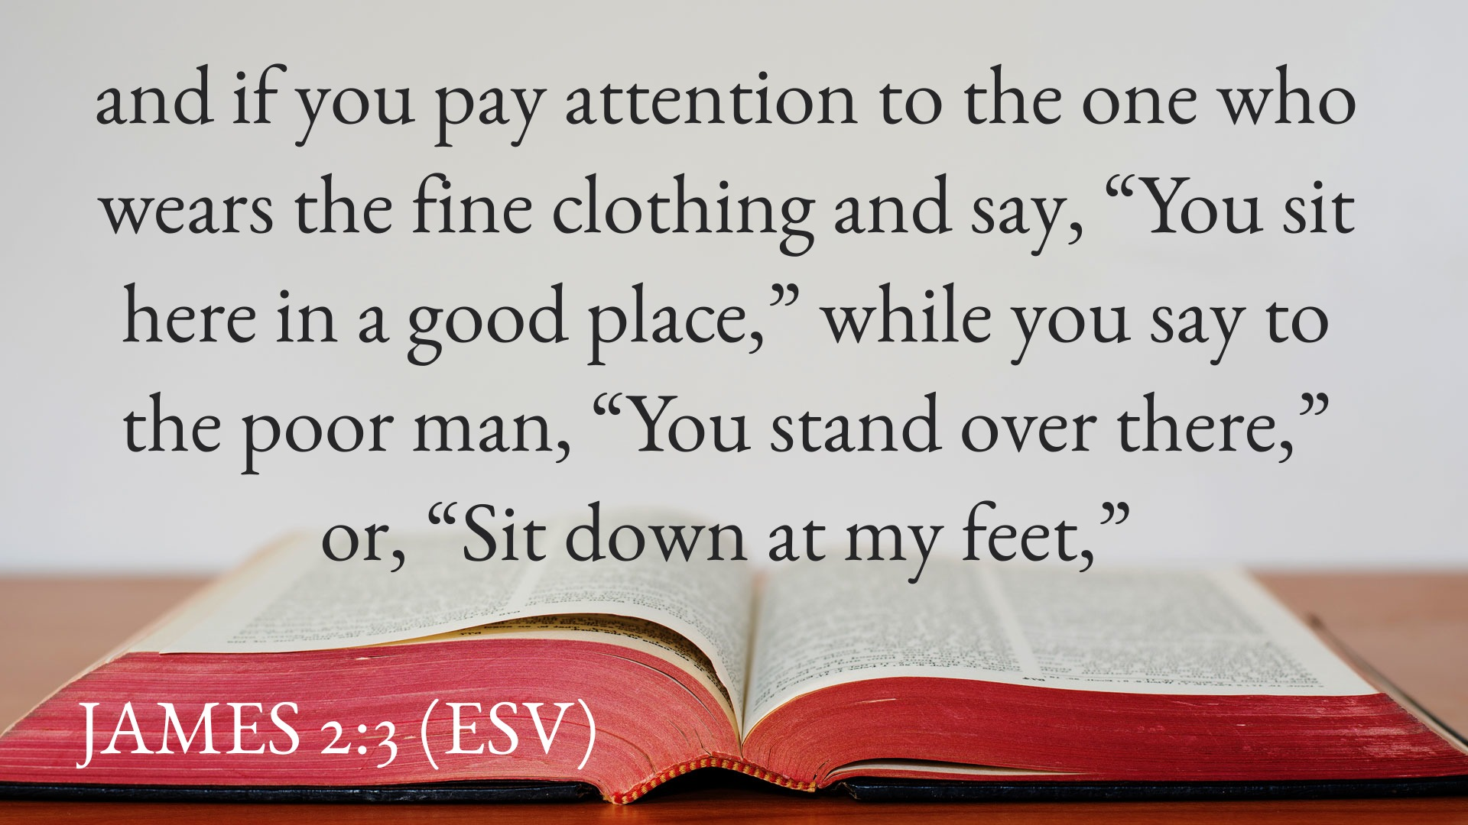

Slide 7
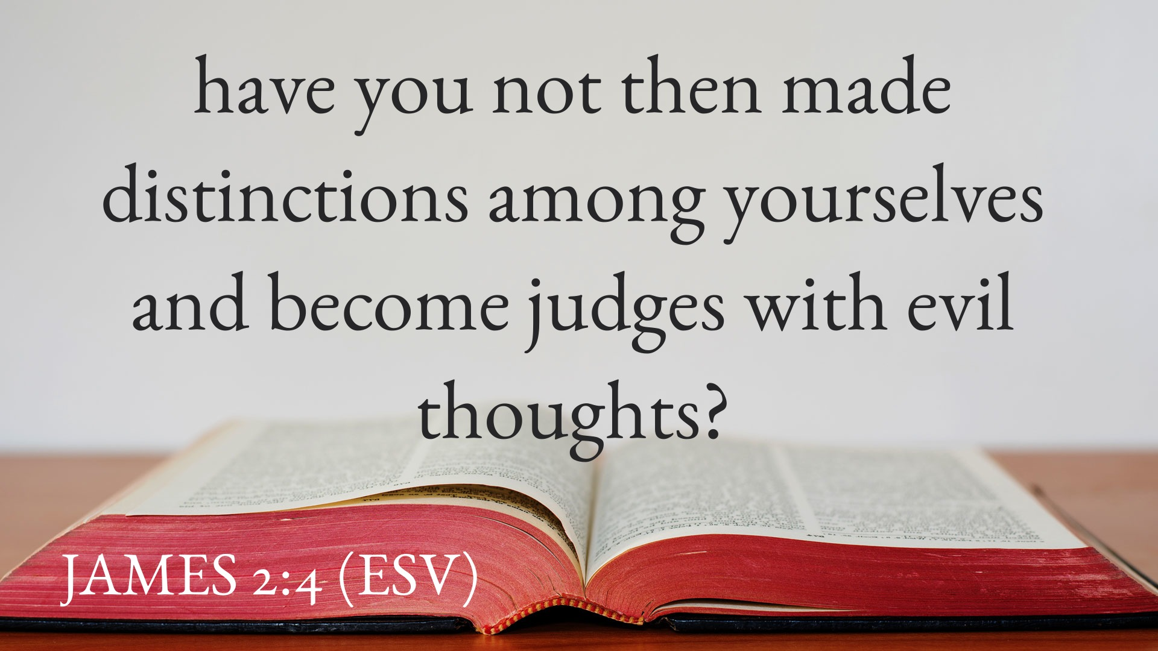

Slide 8
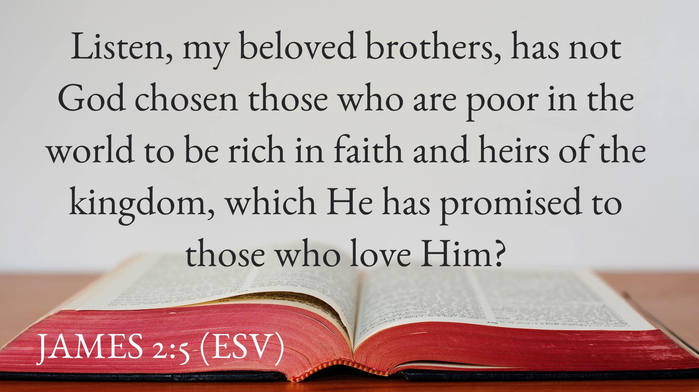

Slide 9
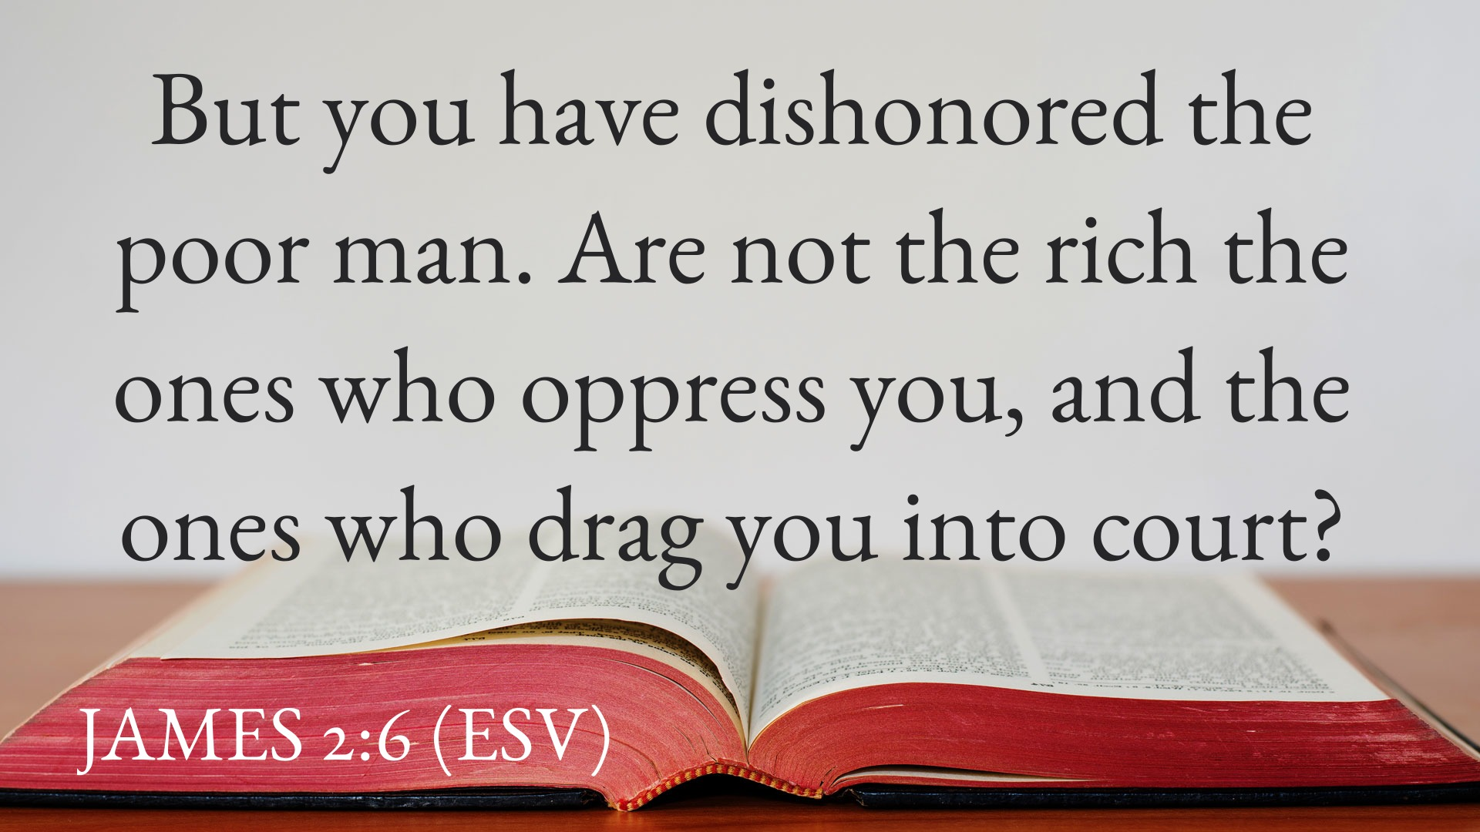

Slide 10
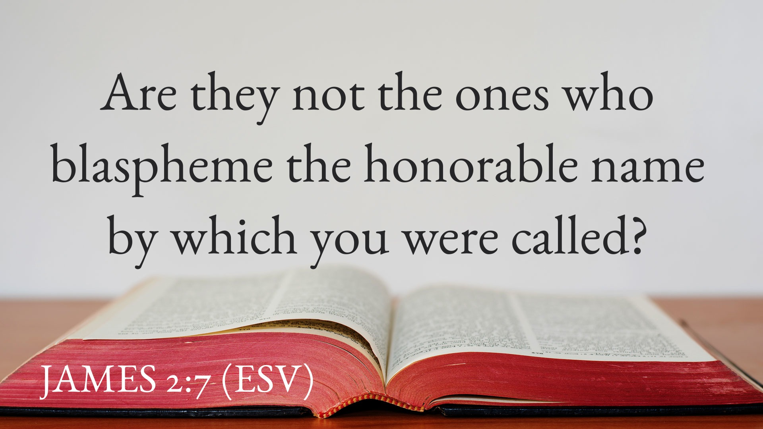

Slide 11
Attitudes Blasphemy Poverty Choices Judging Status
Disrespect Equality Ethics Favoritism Hospitality Humiliation Impartiality Prejudice Respect
Fallenness Earthly Riches Evangelism
Seekers Dress Code Hygiene
Sensitivity Materialism Division
Lawsuits Ministries Involvement
Outreach Selfishness Fellowship
Topical Sermon Ideas: Descriptive/Prescriptive

Slide 12
The Central Idea of the Text (CIT) is “Welcome Everyone Equally.”
The Main Application for FBC is
“Will You Join the Warm Welcome Team?”

Slide 13
1. Two Commands (v. 1) a. Show no partiality. b. Hold the faith.

Slide 14
2:1 My brothers, show no partiality as you hold the faith in our Lord Jesus Christ, the Lord of glory.

Slide 15
2. Two Visitors (v. 2) a. Richly Adorned b. Poorly Attired

Slide 16
2:2 For if a man wearing a gold ring and fine clothing comes into your assembly, and a poor man in shabby clothing also comes in,

Slide 17
3. Two Responses (v. 3) a. Gladly Welcomed b. Barely Tolerated

Slide 18
2:3 and if you pay attention to the one who wears the fine clothing and say, “You sit here in a good place,” while you say to the poor man, “You stand over there,” or, “Sit down at my feet,”

Slide 19
4. Two Sins (v. 4) a. Unity Avoided b. Judgment Pursued

Slide 20
2:4 have you not then made distinctions among yourselves and become judges with evil thoughts?

Slide 21
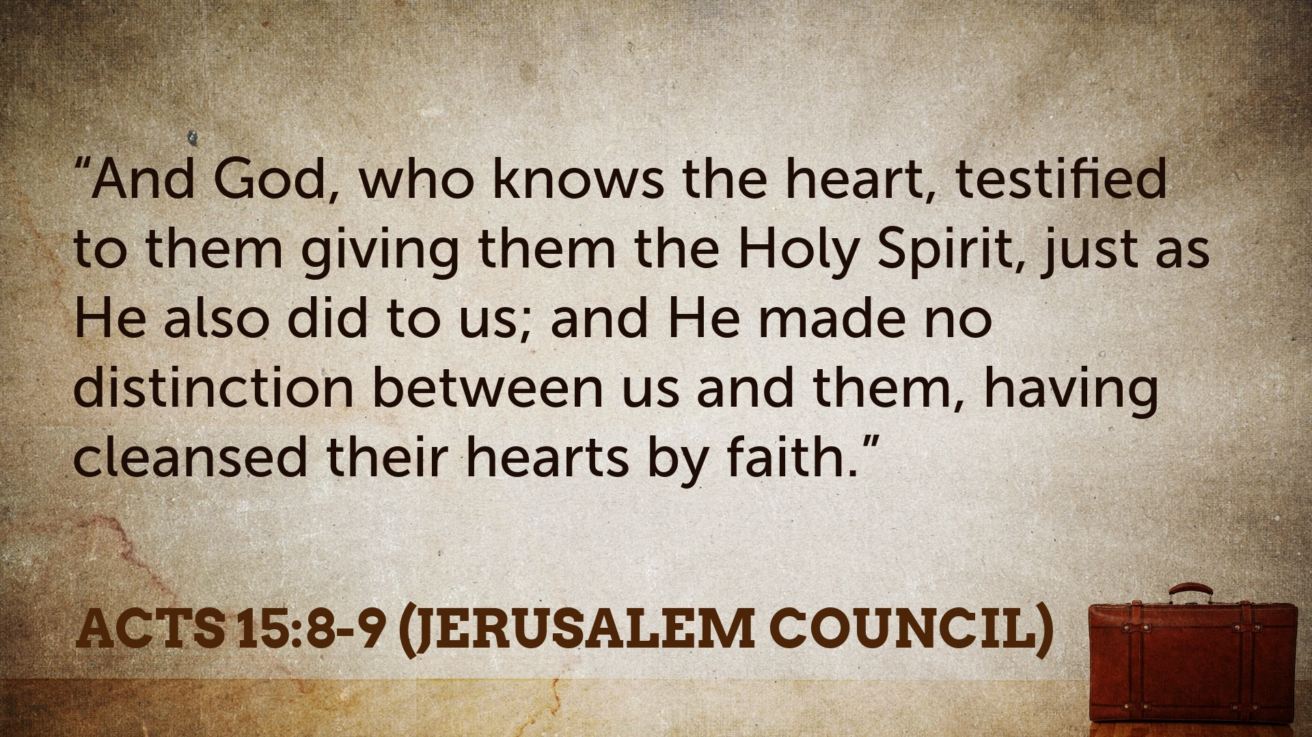

Slide 22
5. Two Comparisons (5-6) a. Rich in faith; heirs (5) b. Oppressive; litigious (6)

Slide 23
2:5 Listen, my beloved brothers, has not God chosen those who are poor in the world to be rich in faith and heirs of the kingdom, which He has promised to those who love Him?

Slide 24
2:6 But you have dishonored the poor man. Are not the rich the ones who oppress you, and the ones who drag) you into court?

Slide 25
6. Two Conclusions (v. 7) a. Bow to the world? (no) b. Bow to the Lord? (yes)

Slide 26
2:7 Are they not the ones who blaspheme the honorable name
by which you were called?

Slide 27
The Central Idea of the Text (CIT) is “Welcome everyone equally and introduce them to the Lord!”
The Main Application for FBC is
“Will You Join the Warm Welcome Team?”

Slide 28
Will You Join the Warm Welcome Team?
JAMES 2:1-7

